Slide 1
Everything is better on WiFi
The WiFi enabled Table Top Lamp

Slide 2
WHY?
Different light levels.
Fun.
Remote control.
Notification patterns.
More.

Slide 3
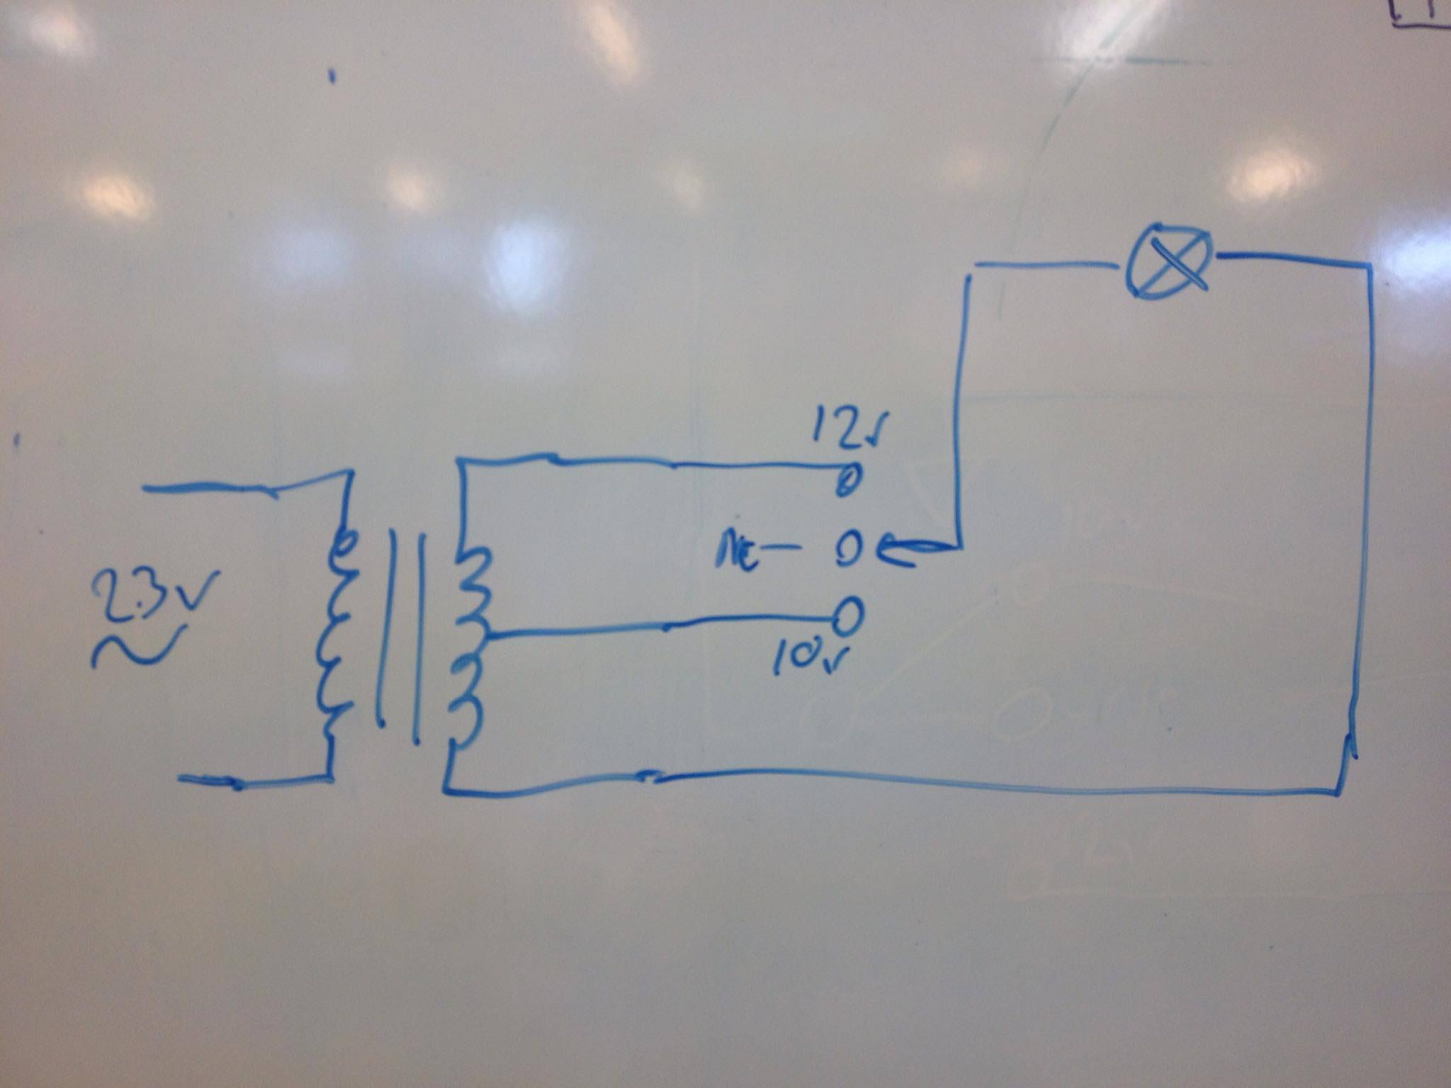
ORIGINAL DESIGN

Slide 4
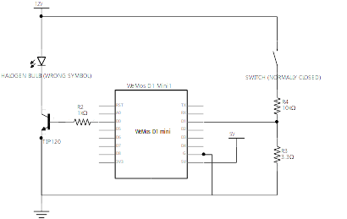
HACKED DESIGN

Slide 5
DID WE HAVE PROBLEMS?
Not enough current was supplied from the powersupply.
Jitters in when using the button.

Slide 6
SOFTWARE
ESP8266WebServer library
Converting the website files into binary, to store in flash
Serving the flash files
Accepting requests from the html buttons
Dual AP configuration

Slide 7
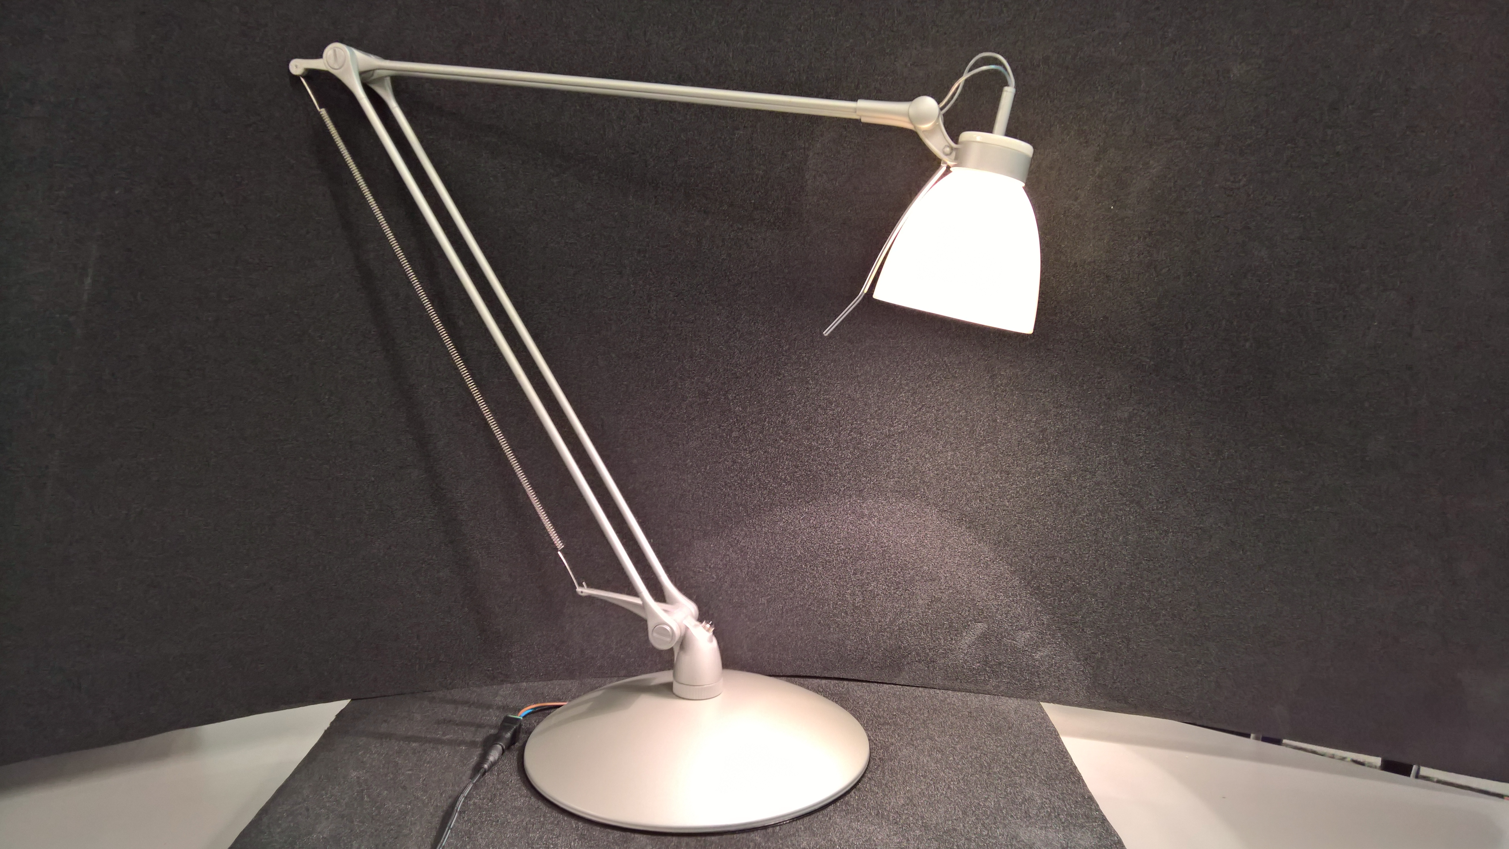
DEMO !!! BE EXCITED

Slide 8
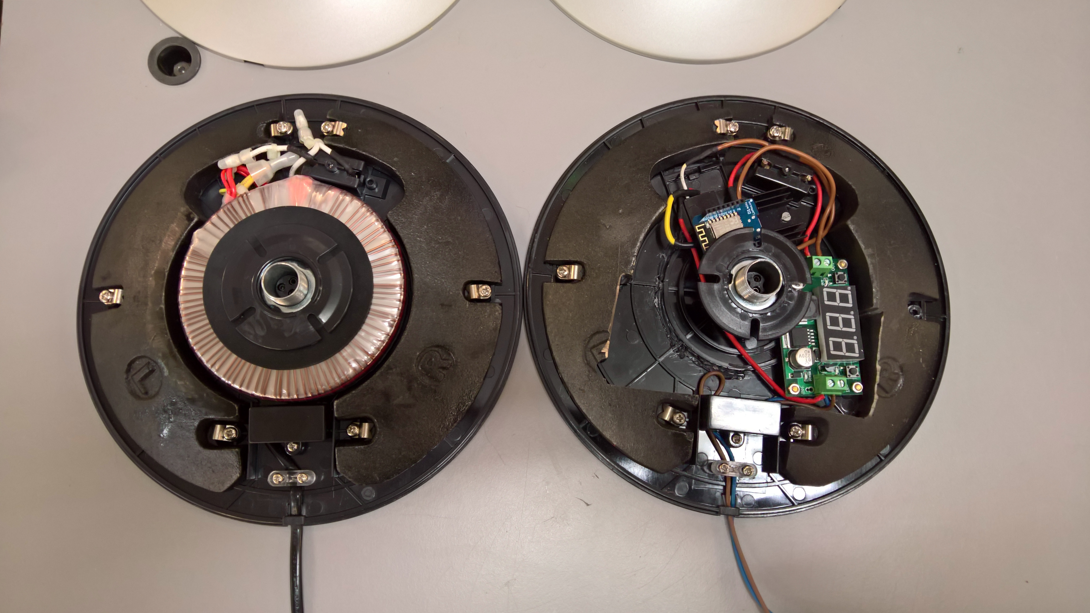
QUESTIONS?

