Slide 1
Sentiment Analysis
90 min Workshop

Slide 2






Cognitive Engineer,
IBM Watson and Cloud Platform
Computational Linguistics,
Master of Science (ongoing)
Robin Rojowiec
#nlp #ml #cognitive #Watson #linguistics #java
#climbing #drums #moredrums #coding #travel
https://www.linkedin.com/in/rojowiec/
robin.rojowiec@de.ibm.com
https://twitter.com/Robin_it_is
https://www.instagram.com/robinlphood/
Notes:
https://www.kdnuggets.com/2018/03/5-things-sentiment-analysis-classification.html

Slide 3
Agenda
Introduction 10 min
Excercise 70 min
Task
Implementation
Testing and Improvements
Wrap up & Outlook 10 min

Slide 4
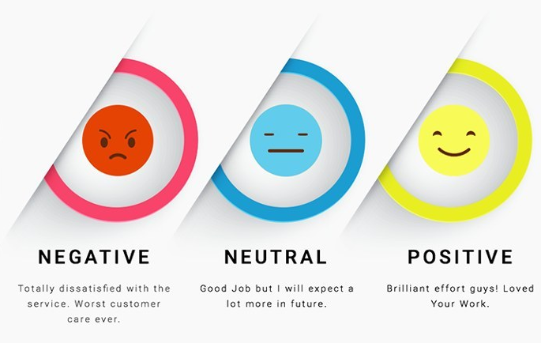
Quelle: https://www.kdnuggets.com/2018/03/5-things-sentiment-analysis-classification.html
Notes:
https://www.kdnuggets.com/2018/03/5-things-sentiment-analysis-classification.html

Slide 5
Sentiment based on Words
Document Level = Neutral
I watched a bad movie last night. Luckily, the next movie was much better.
Sentence 1 = Negative
Sentence 2 = Negative
Notes:
https://www.kdnuggets.com/2018/03/5-things-sentiment-analysis-classification.html

Slide 6
Sentiment based on Words (ASPECTS)
I watched a bad movie last night. Luckily, the next movie was much better.
Movie: Negative
Movie: Positive
Notes:
https://www.kdnuggets.com/2018/03/5-things-sentiment-analysis-classification.html

Slide 7
Exercise
Task

Slide 8
Word Based binary Sentiment Classifiction
Predict sentiment class of movie reviews
25 000 reviews for training, equal split positive/negative
Calculate class probability, feature probability and the probability of each word belonging to each class
Sentiment Class Probability will be:
class_probability * feature_probabilities = class_prediction_probability
Normalize by all probabilites: P_pos = P_pos / (P_pos + P_neg)
Use logarithmus naturalis (ln) to avoid underflow and discard unknown tokens!

Slide 9
Word Based binary Sentiment Classifiction STEPS
Load text files
Tokenize and remove stopwords
Calculate for each token:
Number of occurences in the documents
Number of occurences per class (positive/negative)
Sum up counts and calculate probabilites
Write prediction function which normalizes the probabilites
Run test script and modify your code to improve results
(You should end up with around 70% accuracy)

Slide 10
Word Based binary Sentiment Classifiction BONUS
Bouns 1)
Calculate integrate the TF/IDF value (document frequency ratio to word frequency) to improve accuracy
Bonus 2)
Change granularity to sentence level or aspect-level (rule-based)
Bonus 3)
Try to improve performance with word bi- and trigrams as well as character bi- and trigrams

Slide 11
Exercise
Implementation

Slide 13
Wrap up & Questions

Slide 14



Wrap up
~ 70 % Accuracy => 7/10 Classifications are correct
Simple Algorithm which uses Probabilistic Properties
Nice Excercise, in practice you would use on of these:
And many more!

Slide 15
Further QUESTIONS ?

Slide 16
BACKUP

Slide 17
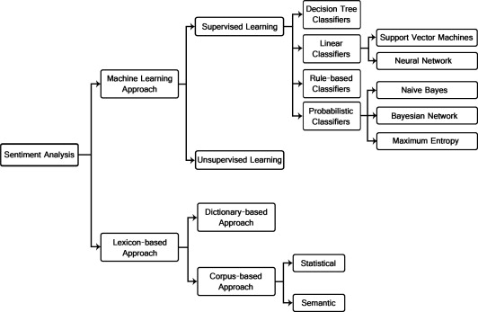

Slide 18
Probaibilistic Sentiment Classification
Word-based (Unigram, 1 Word = 1 Feature)
Probability -> Frequency for xi / Frequency x
Granularity:
Word-Level (Aspects)
Sentence-Level
Document-Level
Unseen words:
Backoff / Laplace Smoothing
Discard words

