Slide 1
Sentiment Analysis
90 min Workshop

Slide 2






Cognitive Engineer,
IBM Watson and Cloud Platform
Computational Linguistics,
Master of Science (ongoing)
Robin Rojowiec
#nlp #ml #cognitive #Watson #linguistics #java
#climbing #drums #moredrums #coding #travel
https://www.linkedin.com/in/rojowiec/
robin.rojowiec@de.ibm.com
https://twitter.com/Robin_it_is
https://www.instagram.com/robinlphood/
Notes:
https://www.kdnuggets.com/2018/03/5-things-sentiment-analysis-classification.html

Slide 3
Agenda
Introduction 10 min
Excercise 70 min
Task
Implementation
Testing and Improvements
Conclusion 10 min

Slide 4
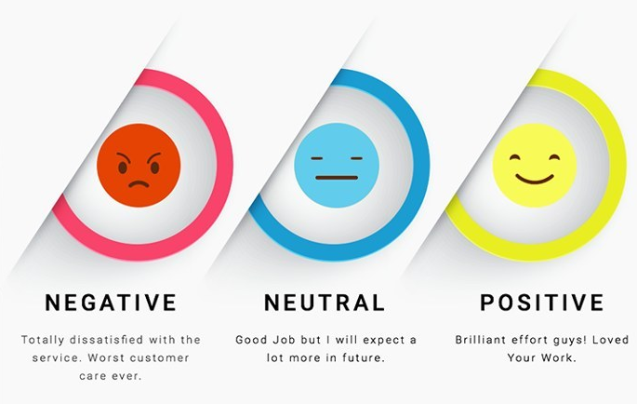
Quelle: https://www.kdnuggets.com/2018/03/5-things-sentiment-analysis-classification.html
Notes:
https://www.kdnuggets.com/2018/03/5-things-sentiment-analysis-classification.html

Slide 5
Sentiment based on Words
Document Level = Neutral
I watched a bad movie last night. Luckily, the next movie was much better.
Sentence 1 = Negative
Sentence 2 = Negative
Notes:
https://www.kdnuggets.com/2018/03/5-things-sentiment-analysis-classification.html

Slide 6
Sentiment based on Words (ASPECTS)
I watched a bad movie last night. Luckily, the next movie was much better.
Movie: Negative
Movie: Positive
Notes:
https://www.kdnuggets.com/2018/03/5-things-sentiment-analysis-classification.html

Slide 7
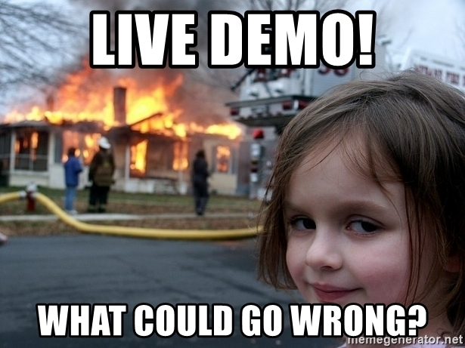
Notes:
https://www.kdnuggets.com/2018/03/5-things-sentiment-analysis-classification.html

Slide 8
Exercise
Task

Slide 9
Word Based binary Sentiment Classifiction
Predict sentiment of unseen movie reviews
25 000 reviews for training, equal split positive/negative
(You can reduce the amount for training/test to speed up development)
Calculate class probability, feature probability and the probability of each word belonging to each class
Use logarithmus naturalis (ln) to avoid underflow
discard unknown or zero-frequent tokens!

Slide 10
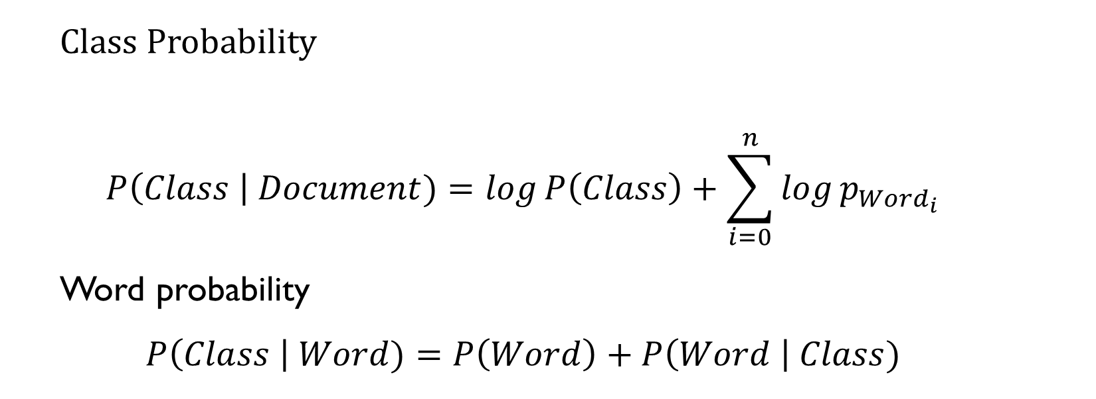
Word Based binary Sentiment Classifiction
Class Probability
$$P\left(Class \right| Document)=\log{P\left(Class\right)}+\sum_{i=0}^{n}{\log{p_{{Word}_{i}}}}$$
Word probability
$$P\left(Class \right| Word)=P\left(Word\right)+P\left(Word \right| Class)$$

Slide 11
Word Based binary Sentiment Classifiction STEPS
Load text files
Tokenize and remove stopwords
Calculate for each token:
Number of occurences in the documents
Number of occurences per class (positive/negative)
Write prediction function which normalizes the probabilites
Run test script and modify your code to improve results
(You should end up with around 70% accuracy)

Slide 12
Word Based binary Sentiment Classifiction BONUS
Bouns 1)
Calculate integrate the TF/IDF value (document frequency ratio to word frequency) to improve accuracy
Bonus 2)
Change granularity to sentence level or aspect-level (rule-based)
Bonus 3)
Try to improve performance with word bi- and trigrams as well as character bi- and trigrams

Slide 13
Exercise
Implementation

Slide 15
Conclusion

Slide 16



Conclusion
~ 70 % Accuracy => 7/10 Classifications are correct
Simple Algorithm which uses probabilistic Properties
Nice Excercise, in practice you would use on of these:
And many more!

Slide 17
Further QUESTIONS ?

Slide 18
FeedbacK
„I liked...“
„For future workshops it would be nice...“
„Overall the ... was very good“

Slide 19
BACKUP

Slide 20
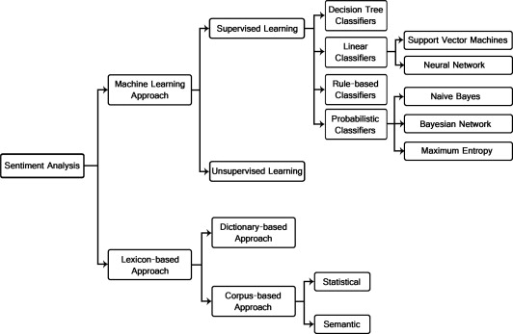

Slide 21
Probaibilistic Sentiment Classification
Word-based (Unigram, 1 Word = 1 Feature)
Probability -> Frequency for xi / Frequency x
Granularity:
Word-Level (Aspects)
Sentence-Level
Document-Level
Unseen words:
Backoff / Laplace Smoothing
Discard words

