Slide 1
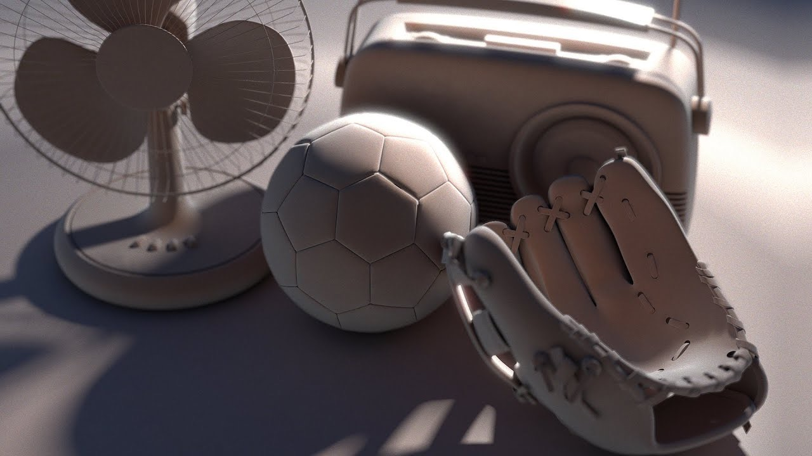

Slide 2
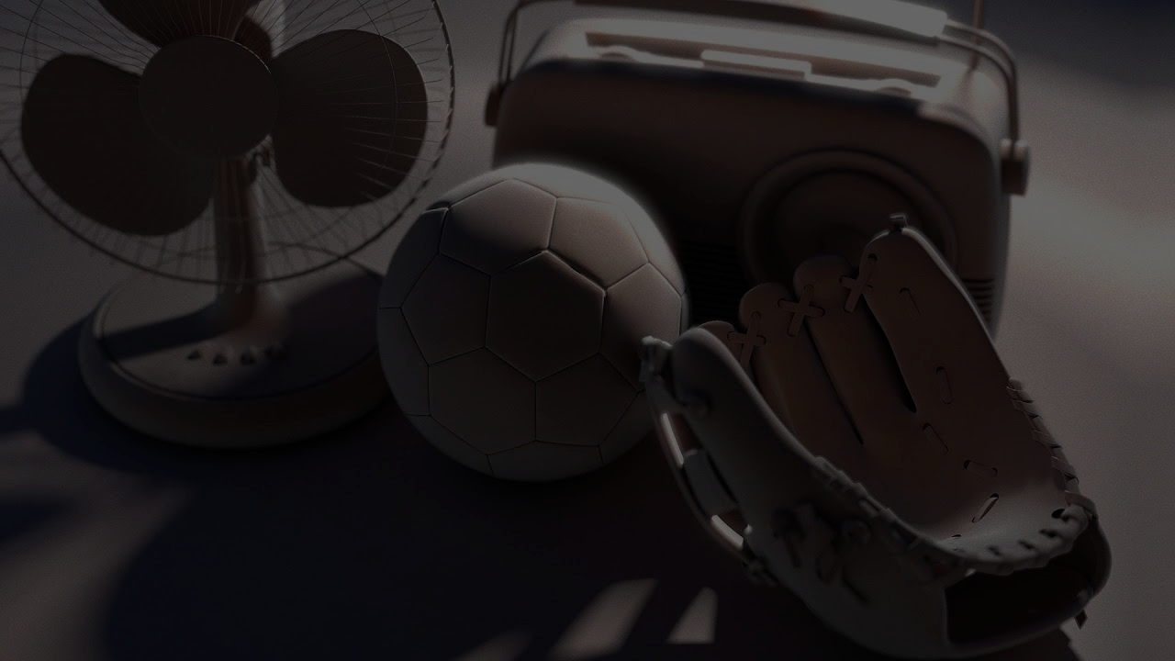
Rendering Light and Shadow with Vulkan
Robin Wragg

Slide 3
Rationale
A “graphics programmer” is a good career path
Easy to show my skills to potential employers
I can utilize my existing knowledge of Vulkan
Lights and shadows make a big difference to any scene
Gives a good foundation to build from
Rendering is fun!

