Slide 1
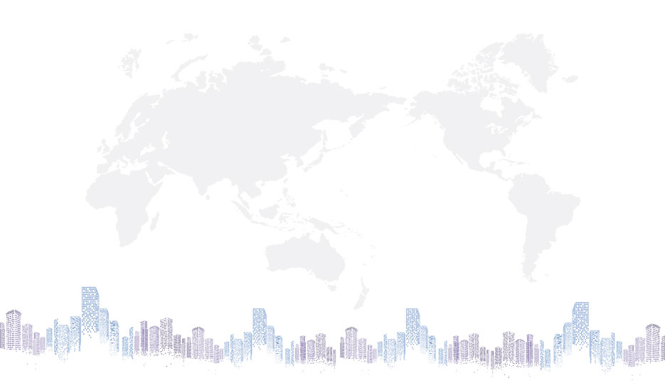

GWIS Service Sustainability Program
（SSP）Project Current Status Report
2020
Chinasofti GWIS SSP Team
January 21, 2020
Chinasofti HSBC业务线

Slide 2
Agenda
Overview
CWX and Imaging View Delivery Process
CWX and Imaging View Delivery Plan
SSP Communication Plan
Current Status and Analysis(progress, risks)

Slide 3
Service Sustainability Program Overview
Background
CWX: GWIS user are still using CWD3(Windows7) as their workstation to access GWIS system, nowadays, CWD3（Windows 7）is too old and out of support in 2020 and Local IT upgrade user workstation to CWX (Windows 10) , Chinasofti GWIS SSP team would work to support and ensure 110 GWIS application can be used without any issue in CWX.
Imaging View: GWIS user are still using Imaging professional 2.8 as one software to view image in GWIS system, nowadays, this software is too old and out of support in 2002 and Captiva IT Team Tonny is to replace this viewer, Chinasofti GWIS SSP team would work to apply Tonny’s new software solution and plugins to GWIS for user to view image successfully as before. GWIS IT team should deploy new plugins on 23 Windows GWIS Sites.
Project Delivery Cycle
December 20, 2019 --- June 30, 2020
Acceptance Criteria for CWX
Project /Plan/Schedule/User contact point/Local IT contact/Communication Email
List of Programs/Shortcut/Icons/Installation Package
Installation setting/binary gathering(e.g. map drive, registry, exe, dll, etc)
Testing defect list/Testing report
Setup/operation procedure
User acceptance test sign-off
Acceptance Criteria for Imaging View
Solution for all target apps and source code
Project scope/Plan/Schedule/Quotation
Setup/operation procedure
Business UAT TEST case List
User acceptance test sign-off

Slide 4
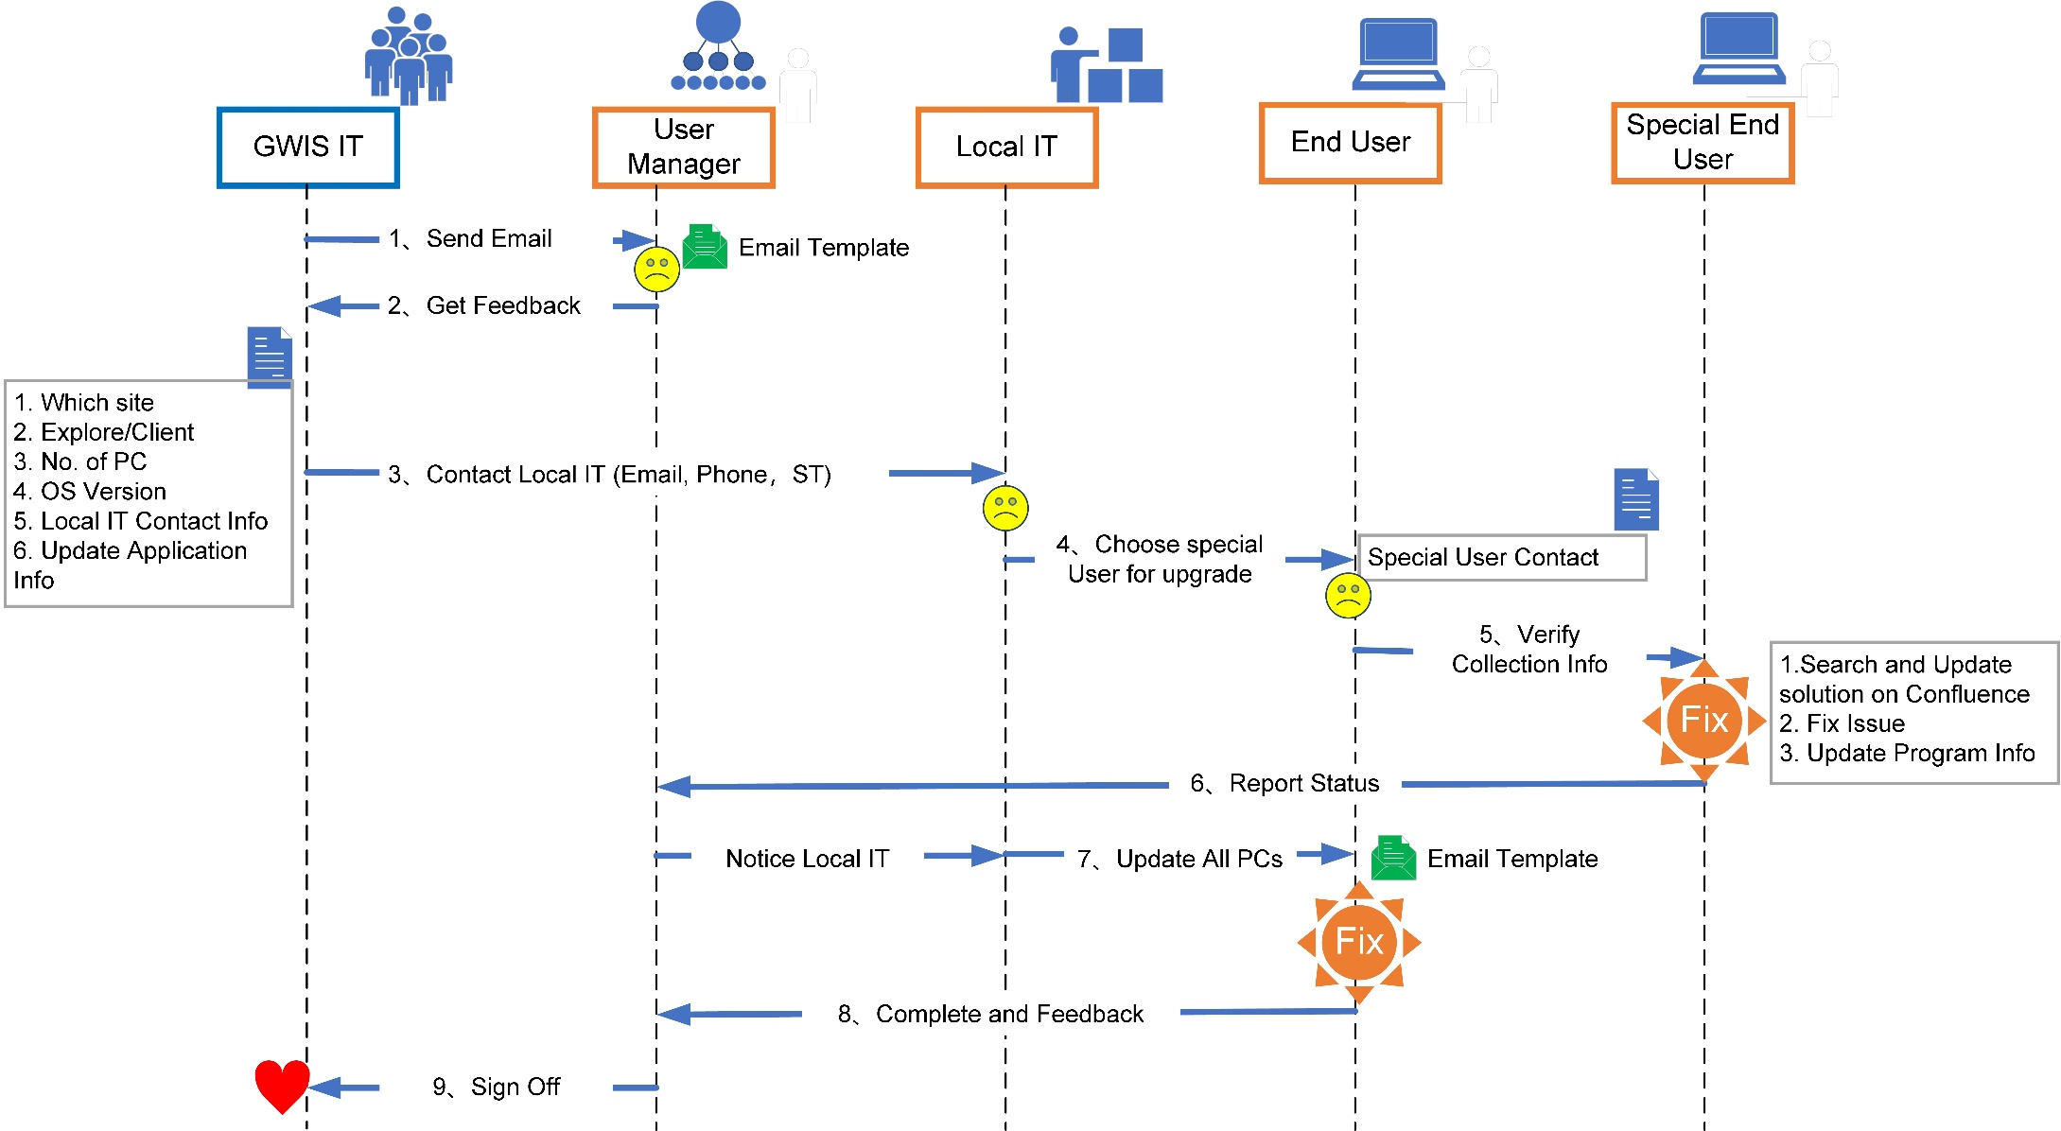
CWX Delivery Process
Delivery Life Cycle
Iteration
Template
Email
Deliverables
Weekly Report
Management Tools
Confluence (Knowledge Share)
Excel and Share Folder
Check Point
Team review after get sign off
Application status daily check
Project Tracking
Demo

Slide 5
Imaging View Delivery Process
Delivery Life Cycle
Waterfall + Iteration
Template
Weekly Report
Management Tools
Confluence (Knowledge Share)
Excel and Share Folder
Source Code(SVN), Test Cases(Excel)
Bug & Issue Tracking(Excel)
Check Point
Team Code Review
Team Solution Review
Project Tracking
Project Tracking Excel
Original Component Function Analysis
New Component Development & Bug Fix
New Component Knowledge Transfer
Windows GWIS Integration Solution
New Component Bug Fix
New Component
Test
Windows GWIS Integration Development
Tonny
Windows GWIS Integration Test
GWIS IT
Windows GWIS Integration Sign Off
Windows GWIS Integration Post Service
Windows GWIS Integration Deployment

Slide 6
SSP Team Structure
HSBC IT Customer
Brain
SSP Project Management Team
SSP Project Monitor Team
Welsney ，Jack，
Joinny，Hulk
Bonnie
Wonders，Eric
Kevin，Gary
Chinasofti
QA
CWX Delivery Team
Imaging View Delivery Team
Team 1
Team 2
Team 3
TTL
TTL
TTL
Shared Resource
…
…
IT support engineer
IT support engineer
IT support engineer
IT support Engineer
IT support Engineer
Developer
Tester

Slide 7
CWX Delivery Plan

Slide 8
Imaging View Delivery Plan
Milestone1 (January 1, 2020 --- February 28, 2020)
Complete function analysis for Imaging View
Knowledge Transformation
Get a stable component
Figure out Windows GWIS Integration Solution
Milestone2 (March 2, 2020 --- April 30, 2020)
Completed 12(Total 12) Imaging view sites Upgrade
Milestone3 (May 1, 2020 --- June 30, 2020)
Completed 11(Total 23) Imaging view sites Upgrade

Slide 9
Communication Plan
Communication Information | Attendance | Way of Communication | Frequency | Target | Owner
Exchange Meeting | SSP Project Management Team | Conference Call | Weekly | Review project status, risk, issues and discuss action | Chinasofti PM
Project Status Report | SSP Project Management Team & SSP Monitor Team | Weekly Report | Weekly | Report project weekly status, variance(scope, schedule), plan for next week, risk, issues and action | Chinasofti PM
CWX Acceptance of Deliverables | Hulk & Chinasofti Delivery Team | Face to Face Meeting | Biweekly | Review CWX deliverables and make conclusions of the acceptance | Hulk
Chinasofti Internal Project Review | Chinasofti Delivery Team & Chinasofti QA | Face to Face Meeting | Key Milestone | Review project status, variance（cost, scope, schedule, resource）, risk, issues and action | Chinasofti QA
Temporary conference | HSBC Customer & SSP Project Management Team & SSP Monitor Team | Conference Call | Random | Discuss emergencies and action | Anyone

Slide 10
CWX Status Summary and Analysis
CWX Tracking Definition and Status
A(58): Has Win10 workstations, no outstanding issue, pending IT apply to all workstation
B(13): Has Win10 workstations, have outstanding issue need to fix
C(28): No Win10 workstations or have not confirmed with user
D(11): All workstation upgraded to Win10, no outstanding issue, pending handover

Slide 11
Imaging View Status Summary
Summary
Analysis Original Component Function of GWIS Image Viewer
New Component Development (Tonny) and Test & Bug Fix (SSP team)
Knowledge transfer(Family with Plugin features, and prepare for GWIS integration solution ideas)

Slide 12
Risk Management

Slide 13
Risk Management

Slide 14
GWIS Service Sustainability Program
Project Current Status Report
2020
Thanks
Continuous Improvement
Chinasofti HSBC业务线

