Slide 1
2020 BOS Executive Governance Meeting
单击此处编辑副标题样式

Slide 2
AGENDA
1 Pod Resource Overall Status
2 Project Overview
3 Best Practice&Innovation&Showcase
4 Open Topic and Discussion

Slide 3
POD Resource Overall Status
POD | CSI POD Leader | Existing HC | Key Person
ITID | Shawn L M Shang | 6 | 6
BPM | Leo S YANG | 10 | 5
GWIS | Sam Z X DONG | 8 | 3+2
ICCM | Michael S Chen | 11 | 5+1 | 9(ICCM)+2(ICCM CORE)
DLO | Bonnie B L Xie | 12 | 4+1+1 | 7(DLO)+3(DPU)+2(CYS)
SSP（TM） | Evan P Wang | 5 | 2
SSP（FP） | Disa L Zhang | 10 | 5
ECM (&ML) | Bernie Y ZHOU | 14 | 5 | 4(ML)+9(ECM)+1(PMO)
SUPPORT | Alvin Z Gong | 15 | 2
AOTUMATION | Sam Z X DONG | 3 | 2

Slide 4
Skill Overall
L1,L2,L3的定义
BPM LITE
BPM SIL
BPM Test Asset
Opentext Extream
MainFrame
FileNet、Datacap、Captiva、Iupload、ICC、ARC
Platforms and tools
Workflow
CCM
ECM

Slide 5
Arrangement of GWIS
WorkFlow的人员资源整合
2020/3/1
2020/4/1
2020/5/1
2020/6/1
2020/7/1
2020/8/1
2020/9/1
2020/10/1
2020/11/1
Sam
Bernie
Alysa
Abe
Steven
BPM project
GWIS project
Transfer

Slide 6
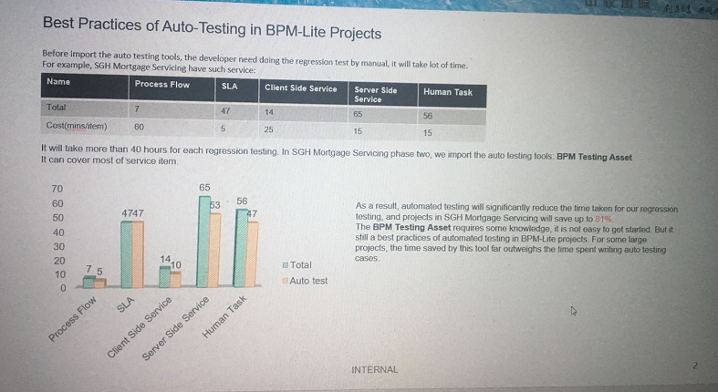
Best Practices of Auto-Testing in BPM-Lite

Slide 7
ITID XI‘an Team Capability(尚雷明周末太忙，还未提供更新版数据)
Team Manager/Contractor Lead | Shawn
Last Updated
Overall RAG Status | On Target
Team Capacity/Skill set Overall & Objectives
Capacity:6 Chinasoft & 1 HC(6 Senior,1 intermediate) Skill set : Weak on English skills, Strong on troubleshooting
Key Risks,Escalations & Assumptions
Resources are very limited but tasks are heavy,some teammates need to support weekend CO almost every week since India teammates can’t support frequently
Recent Achievements
√ Delivered 2 projects successfully √ Comleted over 90% of GWIS SSP sub-projects configuration √ Conducted 182 Cos from jan to April √ Resolved hundreds of Incidents
Project (Jan-April) | Sub-project | Completion Rate | OAT |  | Project Status
 |  |  | PASS | Ongoing | Number | Issues/ blocker
SSP GWIS | 11 | 90% | 10 | 1 | 0 | OTA (DB2)
ICCM | 1 | 90% | 1 | 0 | 0 | N/A
SSP BSC | 1 | 100% | 0 | 1 | 0 | N/A
SSP Filenet Arc | 1 | 60% | 0 | 1 | 1 | OS issues fixed
SSP Kana response | 1 | 100% | 1 | 0 | 0 | N/A
SSP AEM Forms Adoption | 1 | 100% | 1 | 0 | 0 | N/A
Next step
Optimize and improve standards for common tasks Apply more Automation(Ansible/HPSA/Shell script/Venafi) Track Root Cause and update in knowledge base
Blockers& Delays(Provide with mitigation plan)
SSP Filenet Arc Postconfig,returned servers to build team to rebuild
Cost Tracking | N/A

Slide 8
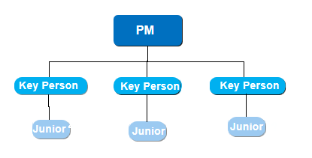
Project Overview – DLO
Team Management
Total CO number
Full Delivery CO
Update letter
New letter
Flow Migration
Next step
Improve our RTB capability to prepare fully take L2 support in XA

Slide 9
SSP FP Model （待hunter修改提供）
CWX Tracking Definition and Status
A(58): Has Win10 workstations, no outstanding issue, pending IT apply to all workstation
B(13): Has Win10 workstations, have outstanding issue need to fix
C(28): No Win10 workstations or have not confirmed with user
D(11): All workstation upgraded to Win10, no outstanding issue, pending handover

Slide 10
Project Overview – SSP(T&M)
Existing Problem
Lower coverage check points in checklist
Not well preparation before review meeting
Lack of record on testing result(evidence)
Not careful delivery in project team
Improvement Action
# | Action Item | Owner | Audit
1 | QA need join into SIT, checklist reviewing before product release, also monitor process and result. | Evan Wang | QA
2 | Request on saving evidence, such as test result, checklist item result, key step, and should to double check. | Evan Wang | QA
3 | To clear Critical and High level bug in Find bugs static check. | Evan Wang | QA
4 | To improve automation capacity on basic manual action, to reduce mistake. To analyze and make plan on automation item. | Evan Wang | QA

Slide 11
Project Overview – ICCM
Existing Problem
Necessary in improving on resource technical skill.
Lack of understanding on system structure and user business.
Slower response from India team's source.
Improvement Action
序号 | 改进措施 | Owner | Audit
1 | Rebuild guide document, and make it to be more clearer and easier using. Weekly sharing, to make multiple knowledge base. To prepare UAT test case, and test according to different user situation. | Michael Chen | QA
2 | To have review request. Senior staff to review the business design in advance. Release checklist Item review. | Michael Chen | QA
3 | To find out the root cause of incident, to complete checklist item and knowledge base. | Michael Chen | QA
Notes:
先说现状，计划怎么做，步骤
先诊断，治疗，看客户的建议

Slide 12
讲一些疫情相关数据？
WFH的人数？
整个2月每周都有多少人在家正常办公？
如何避免VPN白天不好的情况？

