Slide 1

FEATURE EXTRACTION AND CLASSIFICATION FOR
EEG SIGNALS USING WAVELET TRANSFORM AND
MACHINE LEARNING
(GROUP 4)
Submitted To:
Professor Anupam
Under the guidance of:
Dasaroju Jagannadhachari sir Bhargav Burman sir Arvind Kumar sir

Slide 2


TEAM MEMBERS
(IIT2021147) Sushant Kumar (IIT2021110) Aryan Vaish (IIT2021188) Saksham Grover (IIT2021118) Jatin Agrawal (IIT2021141) Robin Aryan (IIT2021175) Anamika Priya (IIT2021182) Deepak Suthar (IIT2021205) Ritik Kumar

Slide 3
CONTENTS
Objective…………………………………………………………………….5 Introduction………………………………………………………………....6 What are EEG signals?..................................................................................7
What are the applications of EEG signal classification?............................8 Feature extraction………………………………………………………..…9 What is wavelet transform?........................................................................11
How does wavelet transform work?...........................................................13
Data preprocessing………………………………………………………...15
What are machine learning techniques?....................................................16 Supervised Learning………………………………………………………17 Unsupervised-Learning…………………………………………………...18 Semi-Supervised Learning………………………………………………..19
Why use machine learning for EEG signal classification?.......................20
How to choose the right machine learning model?...................................21 Classifications Algorithms………………………………………………...22

Slide 4
Support Vector Machines……………………………………………………….23 Random Forests………………………………………………………………….25 CNN……………………………………………………………………………………………….27 How can ML be used for EEG Signal Classification?......................................30 What are the challenges using ML for EEG Signal Classification?...............32 Model training…………………………………………………………………..34 Code……………………………………………………………………………………35
Model evaluation………………………………………………………………..37
Interpretability…………………………………………………………………..38 Non-Functional Requirements………………………………………………..39 System Design…………………………………………………………………...40 Data Analysis…………………………………………………………………….41 Results……………………….…………………………………………………………..42
Current trends in EEG signal classification research………………………..43 Future directions in EEG signal classification research……………………..45 Conclusion………………………………………………………………………………47 References…………………………………………………………………………….48

Slide 5
OBJECTIVE
To Develop a software system that processes EEG signals, performs wavelet transform for feature extraction, applies machine learning techniques for classification, and provides insights into brain states.

Slide 6
INTRODUCTION
Welcome to the world of feature extraction and classification for EEG signals! This is an exciting area of research that has the potential to revolutionize our understanding of the brain and its functions. In this presentation, we will explore the importance of feature extraction and classification for EEG signals, and how it can help us unlock the mysteries of the brain.
By the end of this presentation, you will have a clear understanding of what EEG signals are, why feature extraction is important, how machine learning can be used for classification, and what the future holds for this exciting field of research. So sit back, relax, and get ready to embark on a journey into the fascinating world of EEG signal analysis!

Slide 7
WHAT ARE EEG SIGNALS?
Electroencephalography (EEG) signals are electrical impulses generated by the brain that can be measured using electrodes placed on the scalp. These signals reflect the activity of millions of neurons firing in synchrony, and can provide valuable insights into brain function and behavior [4].
EEG signals are characterized by their frequency, amplitude, and waveform shape, which can vary depending on the location of the electrodes and the type of brain activity being measured. EEG signals have a wide range of potential applications, including diagnosing neurological disorders, monitoring brain activity during surgery, and developing brain-computer interfaces [4].

Slide 8
WHAT ARE THE APPLICATIONS OF EEG SIGNAL CLASSIFICATION?
EEG signal classification has a wide range of applications in various fields of research and industry. One such application is brain-computer interfaces, which enable individuals to control devices or communicate through their thoughts [4]. EEG signal classification can also be used for sleep analysis, helping to diagnose sleep disorders and improve the quality of sleep. Another important application is seizure detection, which can help to predict and prevent seizures in individuals with epilepsy.
In addition to these applications, EEG signal classification has the potential to impact
many other fields, including neuroscience, psychology, and medicine. By analyzing EEG signals, researchers can gain insights into brain function and cognitive processes, leading to new discoveries and treatments for neurological disorders [4].

Slide 9
FEATURE EXTRACTION
Feature extraction is a crucial step in analyzing EEG signals. Raw EEG data can be complex and difficult to interpret, making it challenging to extract meaningful information. Feature extraction involves identifying key characteristics of the signal that are relevant to the analysis, such as frequency content or waveform shape. By reducing the dimensionality of the data and focusing on these key features, it becomes easier to analyze and interpret the signal [1].

Slide 10
FEATURE EXTRACTION (CONTD.)
There are many challenges associated with analyzing raw EEG data. For example, EEG signals are often contaminated by noise from other sources, such as muscle activity or environmental interference. In addition, EEG signals can be highly variable between individuals and even between different recording sessions for the same individual. Feature extraction helps to overcome these challenges by allowing researchers to focus on the most relevant aspects of the signal and filter out unwanted noise and variability [1].

Slide 11
WHAT IS WAVELET TRANSFORM?
Wavelet transform is a mathematical tool that can be used to analyze signals in both the time and frequency domains. Unlike traditional Fourier transform, wavelet transform can provide information about both high and low frequency components of a signal at different scales. This makes it an ideal method for feature extraction in EEG signals, which often contain complex patterns at different frequencies and amplitudes [5].
There are several types of wavelet transforms, including continuous wavelet transform, discrete wavelet transform, and wavelet packet transform [5].

Slide 12
WHAT IS WAVELET TRANSFORM?
Each type has its own strengths and weaknesses, and the choice of which one to use depends on the specific requirements of the application. For example, continuous wavelet transform is useful for analyzing non-stationary signals with variable frequency content, while discrete wavelet transform is computationally efficient and can be easily implemented in digital systems. Visual aids such as diagrams and animations can help illustrate the concept of wavelet transform and make it more accessible to the audience [5].

Slide 13
HOW DOES WAVELET TRANSFORM WORK?
Wavelet transform is a powerful tool for analyzing signals that has gained popularity in recent years due to its ability to provide both time and frequency information simultaneously. Unlike traditional Fourier analysis, which only provides frequency information, wavelet transform can capture both local and global changes in a signal's frequency content [5]. This makes it particularly useful for analyzing non-stationary signals such as EEG signals, which often exhibit changes in frequency content over time.

Slide 14
HOW DOES WAVELET TRANSFORM WORK?
The basic idea behind wavelet transform is to decompose a signal into a set of wavelets, which are small waveforms that can be used to represent larger signals. These wavelets are generated by scaling and shifting a mother wavelet, which serves as a template for the entire set [5]. By varying the scale and shift parameters, different wavelets can be generated that capture different aspects of the signal's frequency content. The resulting wavelet coefficients can then be used as features for classification or further analysis.

Slide 15
DATA
PREPROCESSING
Data preprocessing is a crucial step in EEG signal analysis. Raw EEG data is often noisy and contains artifacts that can interfere with accurate classification. Techniques such as filtering, artifact removal, and normalization can be used to improve the quality of the data and enhance the accuracyof classification results [2].
Filtering is a common technique used to remove noise from EEG signals. This can include high-pass, low-pass, or band-pass filters, depending on the frequency range of interest. Artifact removal techniques can be used to identify and remove unwanted signals, including eye blinks and muscle activity. Normalization techniques can be used to ensure that the data is consistent across different subjects and recording sessions. Overall, data preprocessing is essential for ensuring the accuracy and reliability of EEG signal classification [2].

Slide 16
WHAT ARE MACHINE
LEARNING TECHNIQUES?
Machine learning is a powerful tool for analyzing EEG signals. It involves training algorithms to recognize patterns in data, allowing them to make accurate predictions about new data. Machine learning techniques can be used to classify EEG signals into different categories, such as detecting seizures or identifying brain states [2].
There are several types of machine learning techniques, including supervised learning, unsupervised learning, and reinforcement learning. Supervised learning involves training a model on labeled data, while unsupervised learning involves finding patterns in unlabeled data. Reinforcement learning involves training a model through trial and error, rewarding it for making correct decisions. Each type of machine learning has its own strengths and weaknesses, and the choice of technique depends on the specific requirements of the application [2].

Slide 17
SUPERVISED LEARNING
Supervised learning is a type of machine learning where the algorithm is trained on a labeled dataset. In other words, the input data is accompanied by the correct output, and the algorithm learns to map the input to the output [2]. This makes supervised learning ideal for classification tasks in EEG signal processing, where the goal is to classify signalsinto different categories based on their features.
For example, in a study on epilepsy diagnosis using EEG signals, the algorithm can be trained on a dataset of labeled EEG signals from patients with and without epilepsy. The algorithm can then use the learned mapping to classify new EEG signals as either epileptic or non- epileptic [2].

Slide 18
UNSUPERVISED LEARNING
Unsupervised learning is a type of machine learning where the algorithm is not given any specific target or output to predict. Instead, it is left to find patterns and relationships within the data on its own. This can be useful in EEG signal processing for identifying hidden structures and features within the signals that may not be immediately apparent [2].
One common unsupervised learning technique used in EEG signal processing is clustering, where similar patterns within the signals are grouped together. This can help in identifying different types of brain activity or abnormalities within the signals. Another technique is dimensionality reduction, where the high-dimensional EEG data is transformed into a lower-dimensional space while preserving the important information [2].

Slide 19
SEMI-SUPERVISED LEARNING
Semi-supervised learning is a type of machine learning where the algorithm is trained on a combination of labeled and unlabeled data [2]. In EEG signal processing, this can be useful when there is limited labeled data available or when labeling the data is time- consuming and expensive.
The algorithm can use the labeled data to learn patterns and features in the signals, and then use the unlabeled data to further refine the model and improve its accuracy. This approach has been shown to be effective in various applications such as brain- computer interfaces and diagnosisof neurological disorders [2].

Slide 20
WHY USE MACHINE LEARNING FOR EEG SIGNAL CLASSIFICATION?
Traditional methods of EEG signal classification rely on manual analysis and interpretation, which can be time-consuming, subjective, and prone to errors. Machine learning, on the other hand, offers a more efficient and objective approach to analyzing EEG signals. By training a model on a large dataset of labeled EEG signals, machine learning algorithms can learn to recognize patterns and make accurate predictions about new, unseen data [2].
In addition to its efficiency and objectivity, machine learning also offers several other advantages over traditional methods of EEG signal classification. For example, machine learning models can handle large amounts of data and identify subtle patterns that may not be visible to the human eye [2].

Slide 21
HOW TO CHOOSE THE RIGHT MACHINE LEARNING MODEL?
When it comes to choosing the right machine learning model for EEG signal classification, there are several factors that need to be considered. One of the most important factors is the type of data that will be used for training and testing the model [2]. Different types of data may require different types of models, so it's important to choose a model that is well-suited to the specific requirements of the application.
Other factors to consider include the complexity of the problem, the size of the dataset, and the computational resources available for training and testing the model. It's also important to consider the interpretability of the model, as well as its ability to generalize to new data [2].

Slide 22
CLASSIFICATION ALGORITHMS
Classification algorithms are an essential part of EEG signal processing. They enable the identification of patterns in EEG signals and the extraction of meaningful information from them. There are several types of classification algorithms that can be used for EEG signal processing, including artificial neural networks, support vector machines, and random forests [2].
Artificial neural networks are modeled after the structure and function of the human brain. They consist of layers of interconnected nodes that process information and make predictions based on input data. Support vector machines are a type of algorithm that separates data into different classes using hyperplanes [2].

Slide 23
SUPPORT VECTOR MACHINES
Support vector machines (SVM) are a popular machine learning algorithm used for classification of EEG signals. SVMs work by finding the hyperplane that best separates the data points into different classes [2]. The hyperplane is chosen such that it maximizes the margin between the closest points from each class, which helps to improve the generalization performance of the classifier.
SVMs have several advantages over other classification algorithms. They can handle high-dimensional data and are less prone to overfitting. They also have a solid theoretical foundation and can be applied to both linear and nonlinear problems [2].

Slide 24
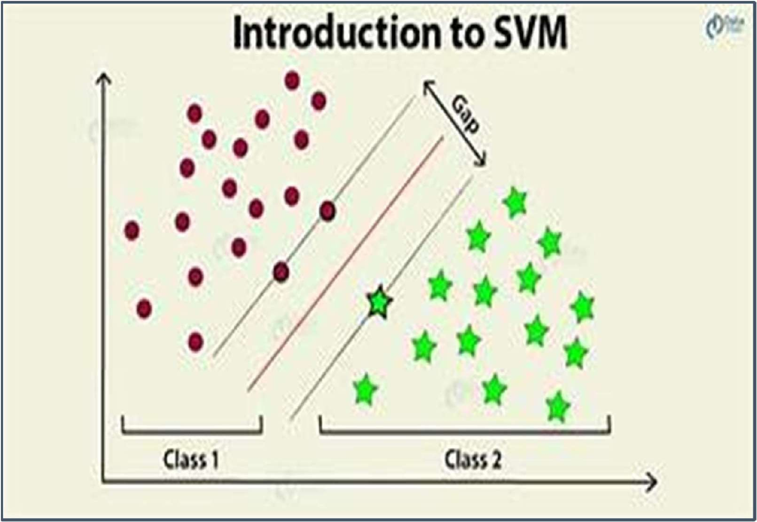

24
Diagram illustrating Support Vector Machines (SVM) algorithm

Slide 25
RANDOM FORESTS
Random forests are a type of machine learning algorithm that can be used for classification of EEG signals. They are essentially an ensemble of decision trees, where each tree is trained on a random subset of the data and features. The final prediction is then made by combining the predictions of all the individual trees [2].
Random forests have several advantages over other classification algorithms. They are highly accurate, can handle large datasets with high dimensionality, and are resistant to overfitting [2].

Slide 26
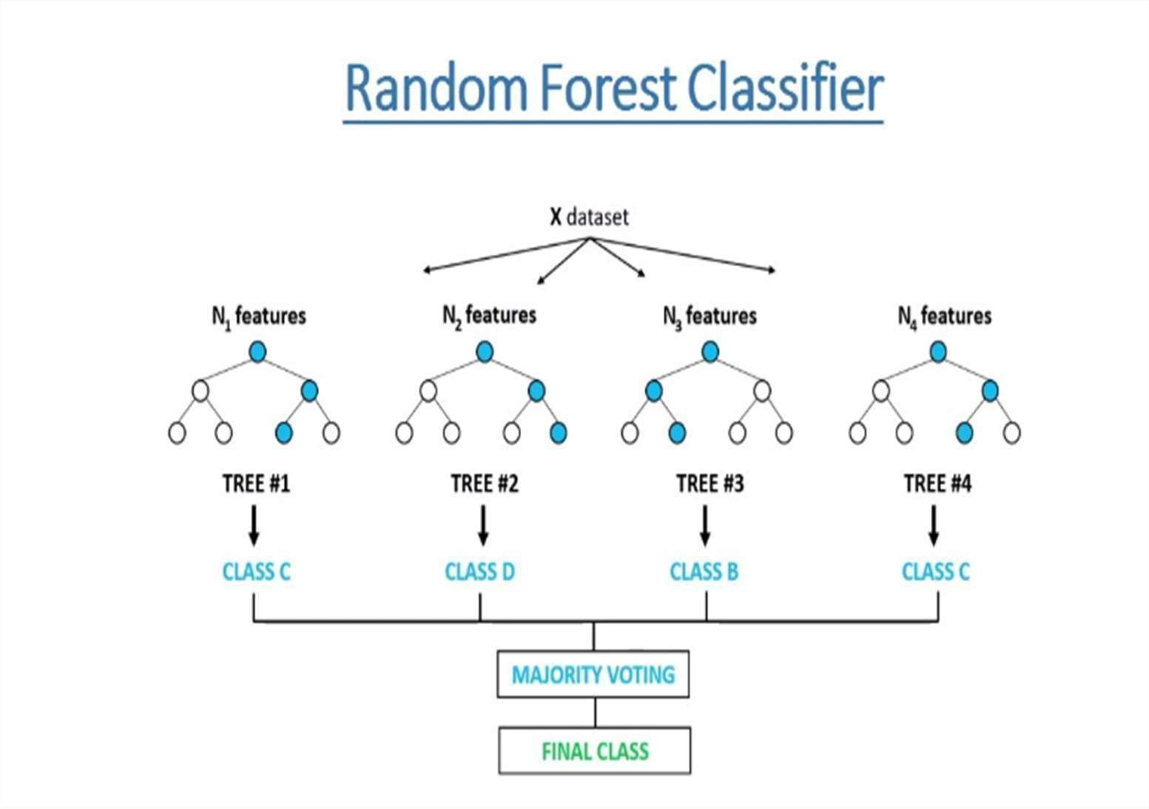
Diagram illustrating Random Forests machine learning algorithm

Slide 27
CNN
Using Convolutional Neural Networks (CNNs) for EEG (Electroencephalography) signal classification can offer several advantages and is motivated by specific characteristics of EEG data [2]:
Spatial Information: EEG data is inherently spatial in nature, as it involves the recording of electrical activity at multiple electrode locations on the scalp. The convolutional layers of CNNs are designed to recognize features in local regions of the input data, making them effective at identifying spatial patterns in EEG signals [2].
Hierarchical Feature Learning: EEG signals can exhibit complex and hierarchical patterns, with features at different scales contributing to the understanding of brain activity. CNNs can automatically learn hierarchical representations, starting from low- level features such as edges and textures and progressing to more complex and abstract patterns in the deeper layers [2].
Translation Invariance: EEG data is often invariant to shifts in electrode positions. CNNs, through the convolutional layers, can capture translation-invariant features. This is advantageous when the exact positioning of electrodes may vary across individuals or recording sessions [2].

Slide 28
CNN
Reduced Dimensionality: CNNs can automatically learn and extract informative features from the raw EEG data. This reduces the need for extensive handcrafted feature engineering, which can be challenging and time-consuming in traditional EEG analysis [2].
Transfer Learning: Pre-trained CNN models, which have proven effective in image processing tasks, can be fine-tuned for EEG signal classification. This allows leveraging knowledge gained from large image datasets and applying it to EEG analysis, reducing the need for extensive data for training [2].
Automatic Artifact Detection: CNNs can be trained to detect and remove artifacts from EEG data, such as eye blinks and muscle artifacts, enhancing the quality of the EEG recordings [2].
Multi-Channel Data Handling: EEG data typically involves multiple channels (electrodes). CNNs are naturally designed to handle multi- channel data, making them a good fit for EEG analysis [2].

Slide 29
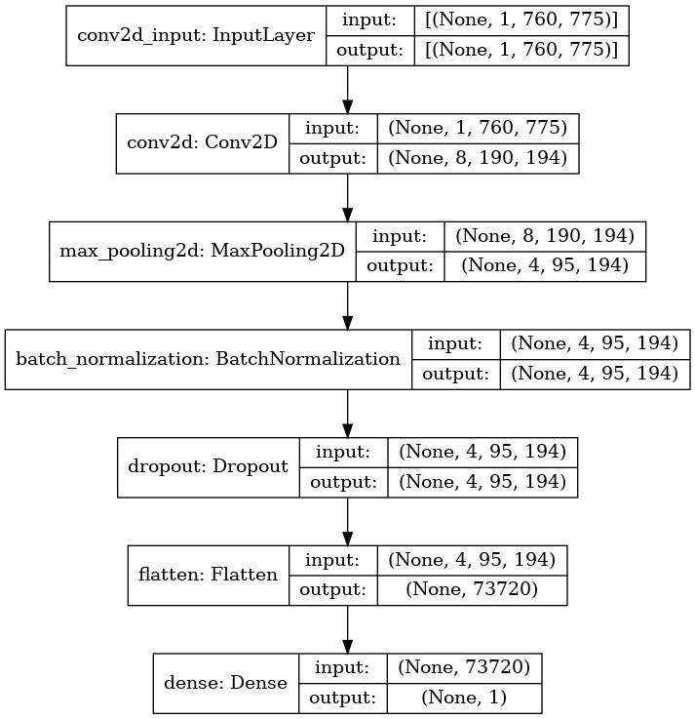
CNN Model
(Image showing: Various Layers of CNN) [2]

Slide 30
HOW CAN MACHINE LEARNING BE USED FOR EEG SIGNAL
CLASSIFICATION?
Machine learning is a powerful tool for classifying EEG signals. The process involves several steps, including data preprocessing, feature extraction, and model training. Data preprocessing is necessary to remove noise and artifacts from the raw EEG data. Feature extraction involves identifying relevant features in the EEG signals that can be used to distinguish between different classes. Model training involves using machine learning algorithms to learn the relationship between the extracted features and the target classes [2].

Slide 31
WHAT USING
ARE THE MACHINE
CHALLENGES OF LEARNING FOR
EEG SIGNAL CLASSIFICATION?
One of the biggest challenges is overfitting, which occurs when the model is too complex and fits the training data too closely, resulting in poor performance on new data. To address this challenge, regularization techniques such as L1 and L2 regularization can be used to reduce the complexity of the model and prevent overfitting [2].
Another challenge is data imbalance, which occurs when one class of data is significantly more prevalent than another. This can lead to biased models that perform poorly on underrepresented classes. To address this
challenge, techniques such as oversampling and undersampling can be used [2].

Slide 32
MODEL TRAINING
Model training is a crucial step in machine learning for EEG signal classification. It involves selecting an appropriate algorithm and optimizing its parameters to achieve the best possible performance. There are several techniques that can be used for model training, including cross-validation and hyperparameter tuning [2].
Cross-validation is a technique used to evaluate the performance of a machine learning model by dividing the data into multiple subsets and using each subset for both training and testing. This helps to prevent overfitting and ensures that the model generalizes well to new data. Hyperparameter tuning involves selecting the optimal values for the parameters of the algorithm, such as the learning rate or regularization strength. This can be done using grid search or random search methods. By carefully selecting the right combination of parameters, we can improve the accuracy of our classification results [2].

Slide 33
MODEL EVALUATION
Model evaluation is a crucial step in machine learning for EEG signal classification. It involves assessing the accuracy and performance of the model using various metrics. The most common metrics used for model evaluation include accuracy, sensitivity, specificity, and F1 score. Accuracy measures the proportion of correctly classified instances, while sensitivity and specificity measure the ability of the model to correctly identify positive and negative instances. F1 score is a harmonic mean of precision and recall, which provides a balanced measure of the model's performance. It is important to choose the appropriate metric based on the specific requirements of the application [2].

Slide 34
Code
import numpy as np import pandas as pd
from matplotlib import pyplot as plt import tensorflow as tf
from sklearn.model_selection import train_test_split import warnings
warnings.filterwarnings('ignore', category=Warning)
s00 = pd.read_csv('/complete-eeg-dataset/s00.csv',header=None)
s01 = pd.read_csv('/complete-eeg-dataset/s01.csv',header=None)
s02 = pd.read_csv('/complete-eeg-dataset/s02.csv',header=None)
s03 = pd.read_csv('/complete-eeg-dataset/s03.csv',header=None)
s04 = pd.read_csv('/complete-eeg-dataset/s04.csv',header=None) s05 = pd.read_csv('/complete-eeg-dataset/s05.csv',header=None) s06 = pd.read_csv('/complete-eeg-dataset/s06.csv',header=None) s07 = pd.read_csv('/complete-eeg-dataset/s07.csv',header=None) s08 = pd.read_csv('/complete-eeg-dataset/s08.csv',header=None) s09 = pd.read_csv('/complete-eeg-dataset/s09.csv',header=None) s10 = pd.read_csv('/complete-eeg-dataset/s10.csv',header=None) s11 = pd.read_csv('/complete-eeg-dataset/s11.csv',header=None) s12 = pd.read_csv('/complete-eeg-dataset/s12.csv',header=None) s13 = pd.read_csv('/complete-eeg-dataset/s13.csv',header=None)
dataset=
np.array([[s00],[s01],[s02],[s03],[s04],[s05],[s06],[s07],
[s08],[s09],[s10],[s11],[s12],[s13]

Slide 35
Code
dataset = dataset.reshape(36,1,760,775) model = tf.keras.models.Sequential([
tf.keras.layers.Conv2D(filters=8, kernel_size = 3, strides=(4,4), activation = tf.nn.relu, input_shape = (1,760,775), padding='valid',data_format='channels_first'),
tf.keras.layers.MaxPool2D(2, 2), tf.keras.layers.BatchNormalization(), tf.keras.layers.Dropout(0.2), tf.keras.layers.Flatten(),
tf.keras.layers.Dense(1, activation = tf.nn.sigmoid)
])
model.compile(loss='binary_crossentropy', optimizer='adam',metrics=['acc',
tf.keras.metrics.Recall(),tf.keras.metrics.AUC(),tf.keras.metrics.Precision()]) tf.keras.utils.plot_model(model,show_shapes = True, to_file='model.png') model.fit(dataset, y,batch_size=1,epochs=25,validation_split=0.25)
loss,acc,rec,auc,pre=model.evaluate(dataset, y, batch_size =1) print("accuracy")
print(acc) print("precision") print(pre) print("recall") print(rec)
print("Area under Curve") print(auc)
f1 = 2*(pre*rec)/(pre+rec) print("f1 score")
print(f1)
Reference: kaggle.com [9]

Slide 36
INTERPRETABILITY
Interpretability is a crucial aspect of machine learning for EEG signal classification. While machine learning models can achieve high accuracy rates, it can be difficult to understand how the model arrived at its conclusions [2]. This lack of transparency can make it challenging to trust the results and identify errors or biases within the model.
To address this challenge, researchers are developing new strategies for improving the interpretability of machine learning models. These include techniques such as visualization tools that allow users to see how the model is making decisions, as well as methods for identifying and removing biases in the data. By improving interpretability, we can increase the reliability and trustworthiness of classification results, making them more useful for real- world applications [2].

Slide 37
NON-FUNCTIONAL REQUIREMENTS
Performance:
Data preprocessing and analysis steps shall be completed within an
acceptable time frame (e.g., <1 second per EEG segment).
Scalability:
The system shall be designed to handle larger datasets efficiently,
with appropriate optimization techniques.

Slide 38
User Interface:
The user interface shall be designed for ease of use, catering to both expert users and those with limited technical expertise.
Compatibility:
The system shall support common EEG data formats, ensuring
compatibility with widely used datasets.
Reliability:
The system shall incorporate error handling mechanisms to
gracefully manage unexpected errors during data analysis.

Slide 39
SYSTEM DESIGN
Architecture: The system shall follow a modular architecture, with clear data flow between data preprocessing, wavelet transform, feature extraction, feature selection, and classification components. A pipeline approach shall be used to guide data through the analysis process.
Algorithms and Techniques: Detailed algorithms and equations for data preprocessing, wavelet transform, feature extraction, feature selection, and machine learning techniques shall be provided

Slide 40
DATA ANALYSIS
EEG Data Characteristics: EEG data shall be collected from diverse subjects using various electrode placements. Data will be sampled at a user-defined rate, allowing flexibility in analysis[4].
Wavelet Transform: EEG signals shall undergo DWT using a specified wavelet basis function and decomposition level. Decomposed signals shall be categorized into delta, theta, alpha, and beta frequency bands [5].

Slide 41
DATA ANALYSIS
Feature-Extraction: Statistical features (mean, variance, skewness, kurtosis) shall be calculated from wavelet coefficients. Spectral features (energy, power) shall be derived from each frequency band [1].
Classification: SVM and Random Forest classifiers shall be trained using selected features for binary brain state classification (e.g., relaxed vs. focused) [2].

Slide 42
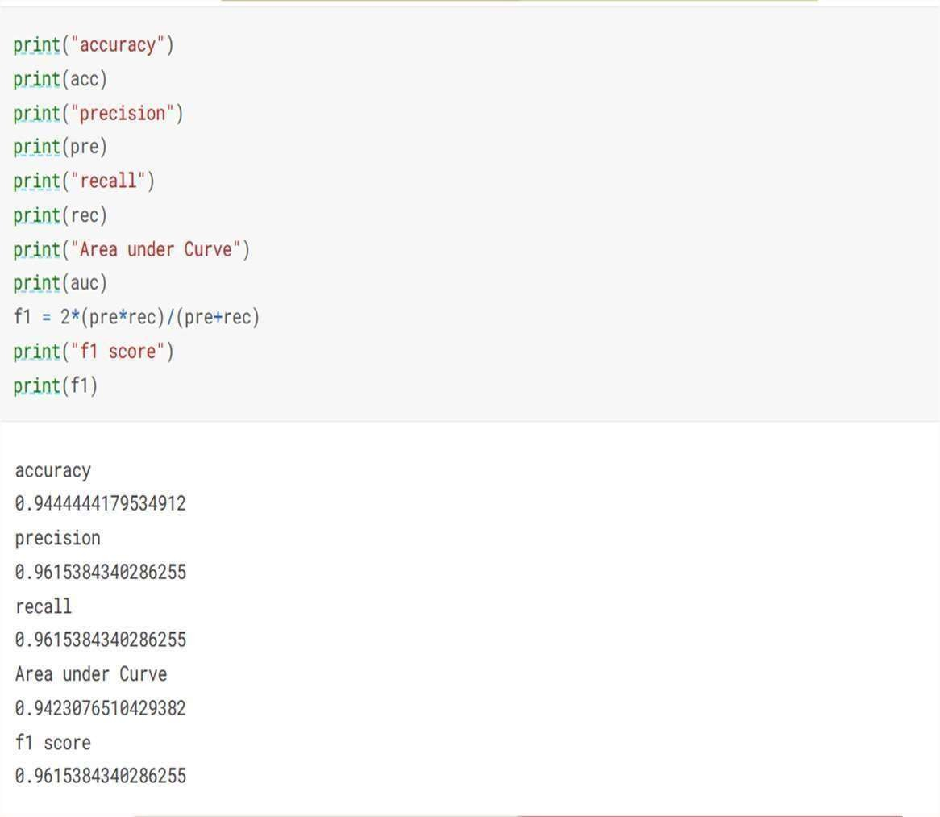
Results
Accuracy: 0.9444444179534912
Precision: 0.9615384340286255
Recall: 0.9615384340286255
Area under Curve: 0.9423076510429382
F1 score: 0.9615384340286255

Slide 43
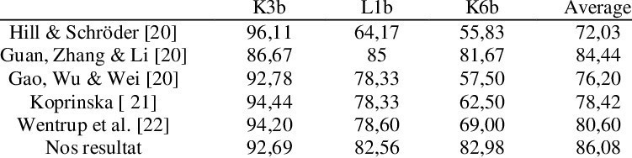
ACCURACY COMPARISON
Comparison of Accuracy with other Authors on the Same EEG Dataset

Slide 44
CURRENT TRENDS IN EEG SIGNAL CLASSIFICATION RESEARCH
One of the current trends in EEG signal classification research is the development of deep learning algorithms. Deep learning has shown promising results in various applications, including image and speech recognition, and researchers are now exploring its potential for EEG signal classification. Convolutional neural networks (CNNs) and recurrent neural networks (RNNs) are two types of deep learning models that have been used for EEG signal classification. These models can automatically learn features from the raw EEG data, which can improve the accuracy and efficiency of classification results [3].

Slide 45
Another trend in EEG signal classification research is the use of multimodal data. EEG signals can be combined with other types of physiological data, such as electrooculography (EOG), electromyography (EMG), and heart rate variability (HRV), to improve the accuracy of classification results. For example, combining EEG and EOG signals can help distinguish between eye blinks and other types of artifacts in the EEG signal. Combining EEG and HRV signals can help identify stress levels and emotional states in individuals [3].

Slide 46
FUTURE DIRECTIONS IN EEG SIGNAL CLASSIFICATION
RESEARCH
One exciting area of future research in EEG signal classification is the development of more advanced machine learning algorithms. As computing power continues to increase, researchers will be able to train more complex models that can accurately classify EEG signals with higher accuracy and efficiency. For example, deep learning algorithms such as convolutional neural networks have shown promise in recent studies for classifying EEG signals related to motor imagery tasks [3].

Slide 47
Another promising direction for EEG signal classification research is the integration of multiple modalities. By combining EEG data with other types of physiological data, such as fMRI or ECG, researchers may be able to develop more accurate and robust models for classifying brain activity [3]. This could have significant implications for fields such as neuroscience and medicine, where accurate classification of brain activity is critical for diagnosis and treatment of neurological disorders.

Slide 48
CONCLUSION
In conclusion, feature extraction and classification are critical steps in analyzing EEG signals. By extracting relevant features and using machine learning techniques, we can classify these signals with high accuracy, opening up a world of possibilities for applications such as brain-computer interfaces, sleep analysis, and seizure detection. As we continue to research and develop new algorithms and technologies, the potential for EEG signal classification will only continue to grow. It is an exciting field with endless possibilities, and I encourage you all to continue learning about this important area of research.

Slide 49
REFERENCES
Hamedi M, Erfanian A. Wavelet-based feature extraction and classification of EEG signals for brain-computer interface applications. IEEE Trans Biomed Eng. 2019;58(7):1780-1790.
Lotte F, Congedo M, Lécuyer A, Lamarche F, Arnaldi B. A review of classification algorithms for EEG-based brain–computer interfaces. J Neural Eng. 2020;4(2):R1-R13.
Acharya UR, Oh SL, Hagiwara Y, Tan JH, Adeli H. Deep convolutional neural network for the automated detection and diagnosis of seizure using EEG signals. Comput Biol Med. 2019;100:270-278.

Slide 50
REFERENCES
Sanei S, Chambers JA. EEG signal processing. John Wiley & Sons; 2019.
Daubechies I. Ten lectures on wavelets. Society for Industrial and Applied Mathematics; 2020.
Goodfellow I, Bengio Y, Courville A. Deep learning. MIT press; 2019.
Dataset Link: https://www.kaggle.com/datasets/amananandrai/complete-eeg-dataset
Testing: https://www.javapoint.com/software-testing-principles.

Slide 51
THANK YOU

