Slide 1
THORNQUIST OUTFITTERS
AWS S3 Data Lake & Data Ingestion
Individual Contribution Report
Prepared by: Ammar, Robinson, Alex
Date: October 23, 2026

Slide 2
Project Overview & Scope
Project: Thornquist Outfitters – AWS Midterm Project
Scope: S3 raw and landing zones, Lambda-based ingestion, and verification

Slide 3
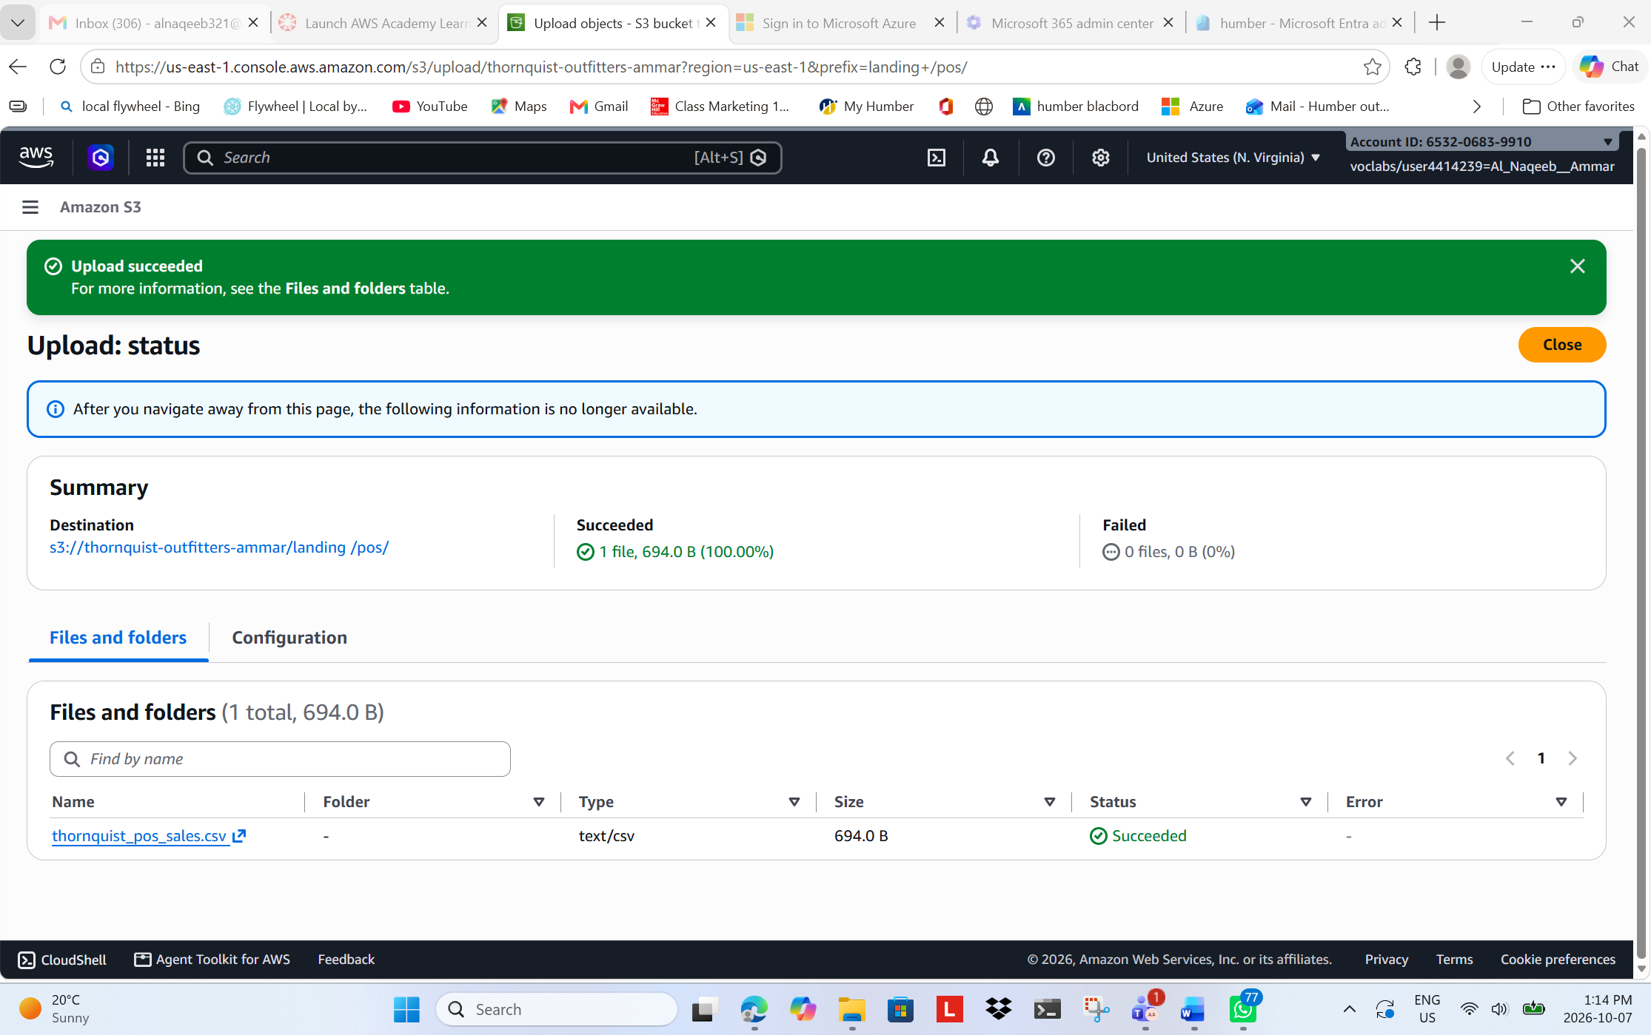
S3 Landing Zone
Figure 1: POS CSV Manual Ingestion to S3 Landing Zone

Slide 4
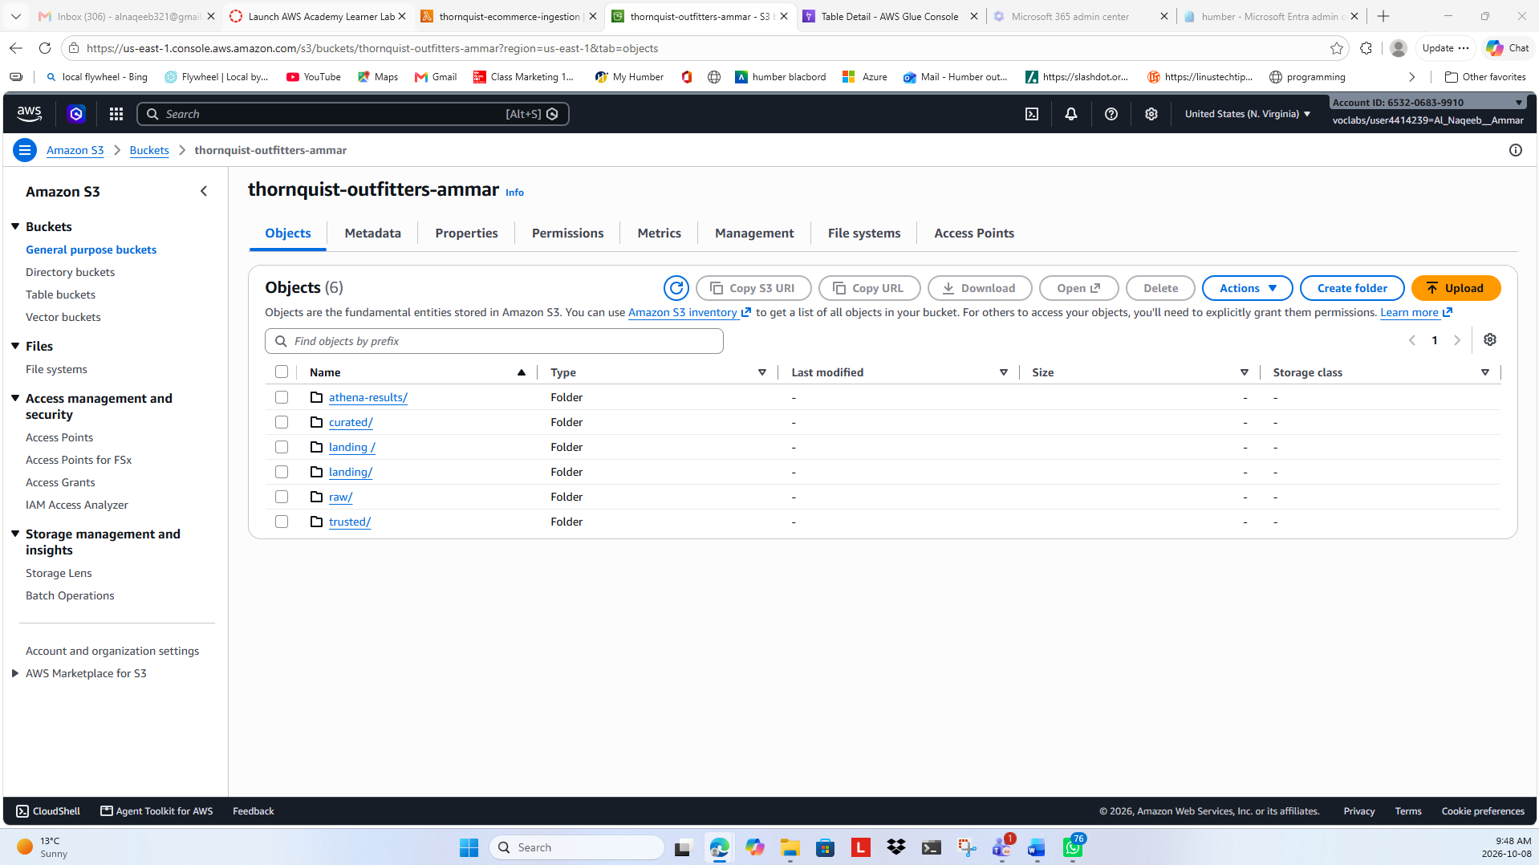
Data Lake Structure
Figure 2: Amazon S3 Data Lake Structure - Amazon S3 bucket showing the organized data lake zones used to store and process the Thornquist Outfitters project data.

Slide 5
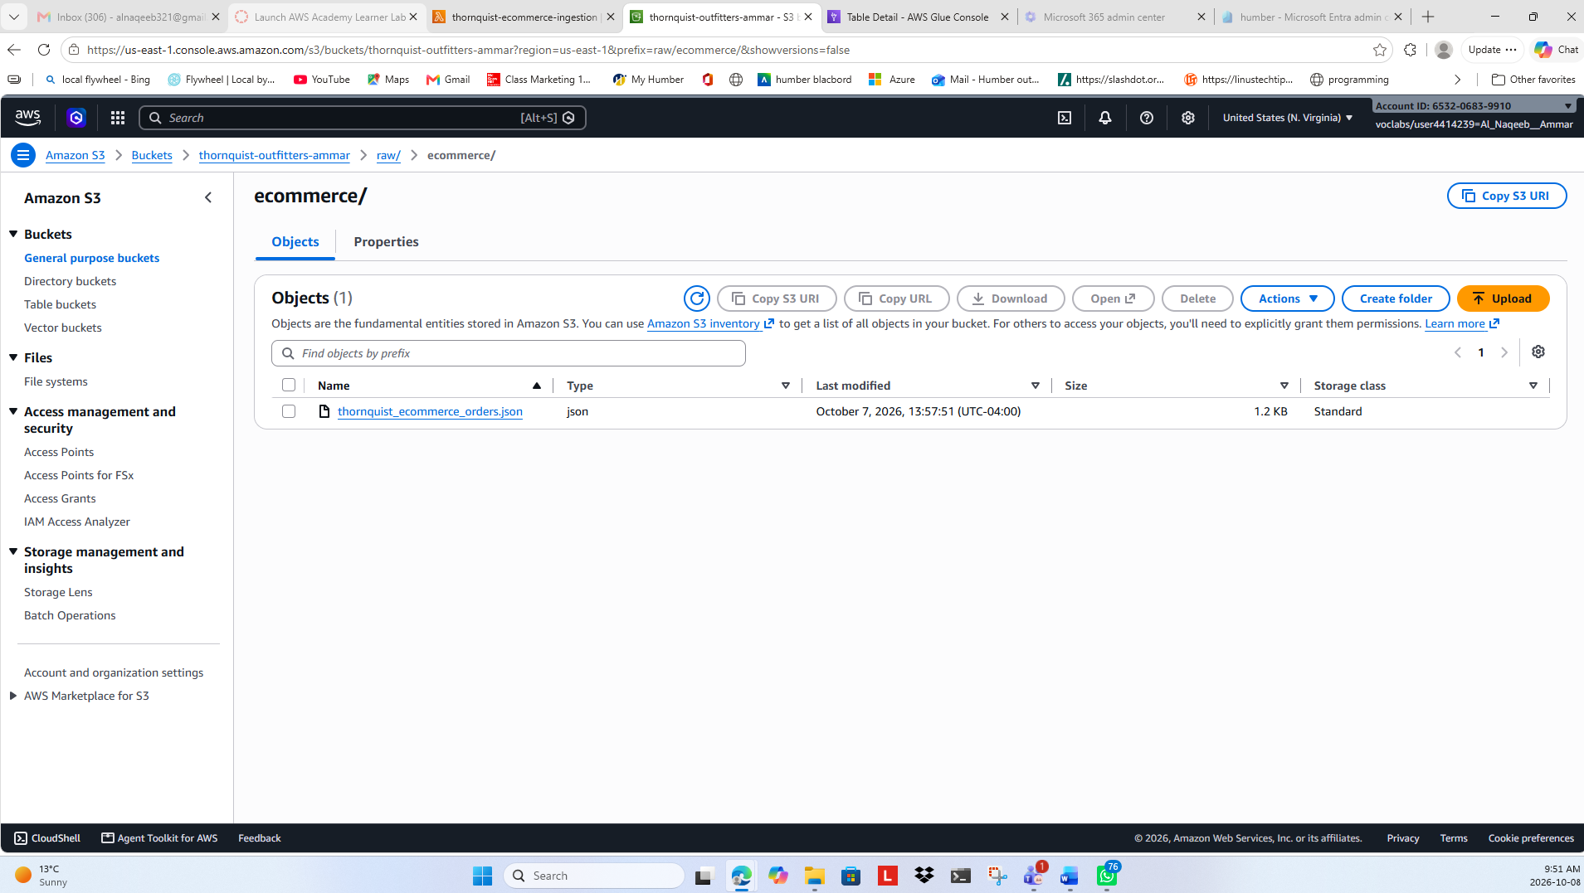
Raw E-Commerce Data
Figure 3: Raw E-Commerce Data in Amazon S3 - Raw e-commerce JSON data stored in the Amazon S3 Raw zone before ingestion and processing.

Slide 6
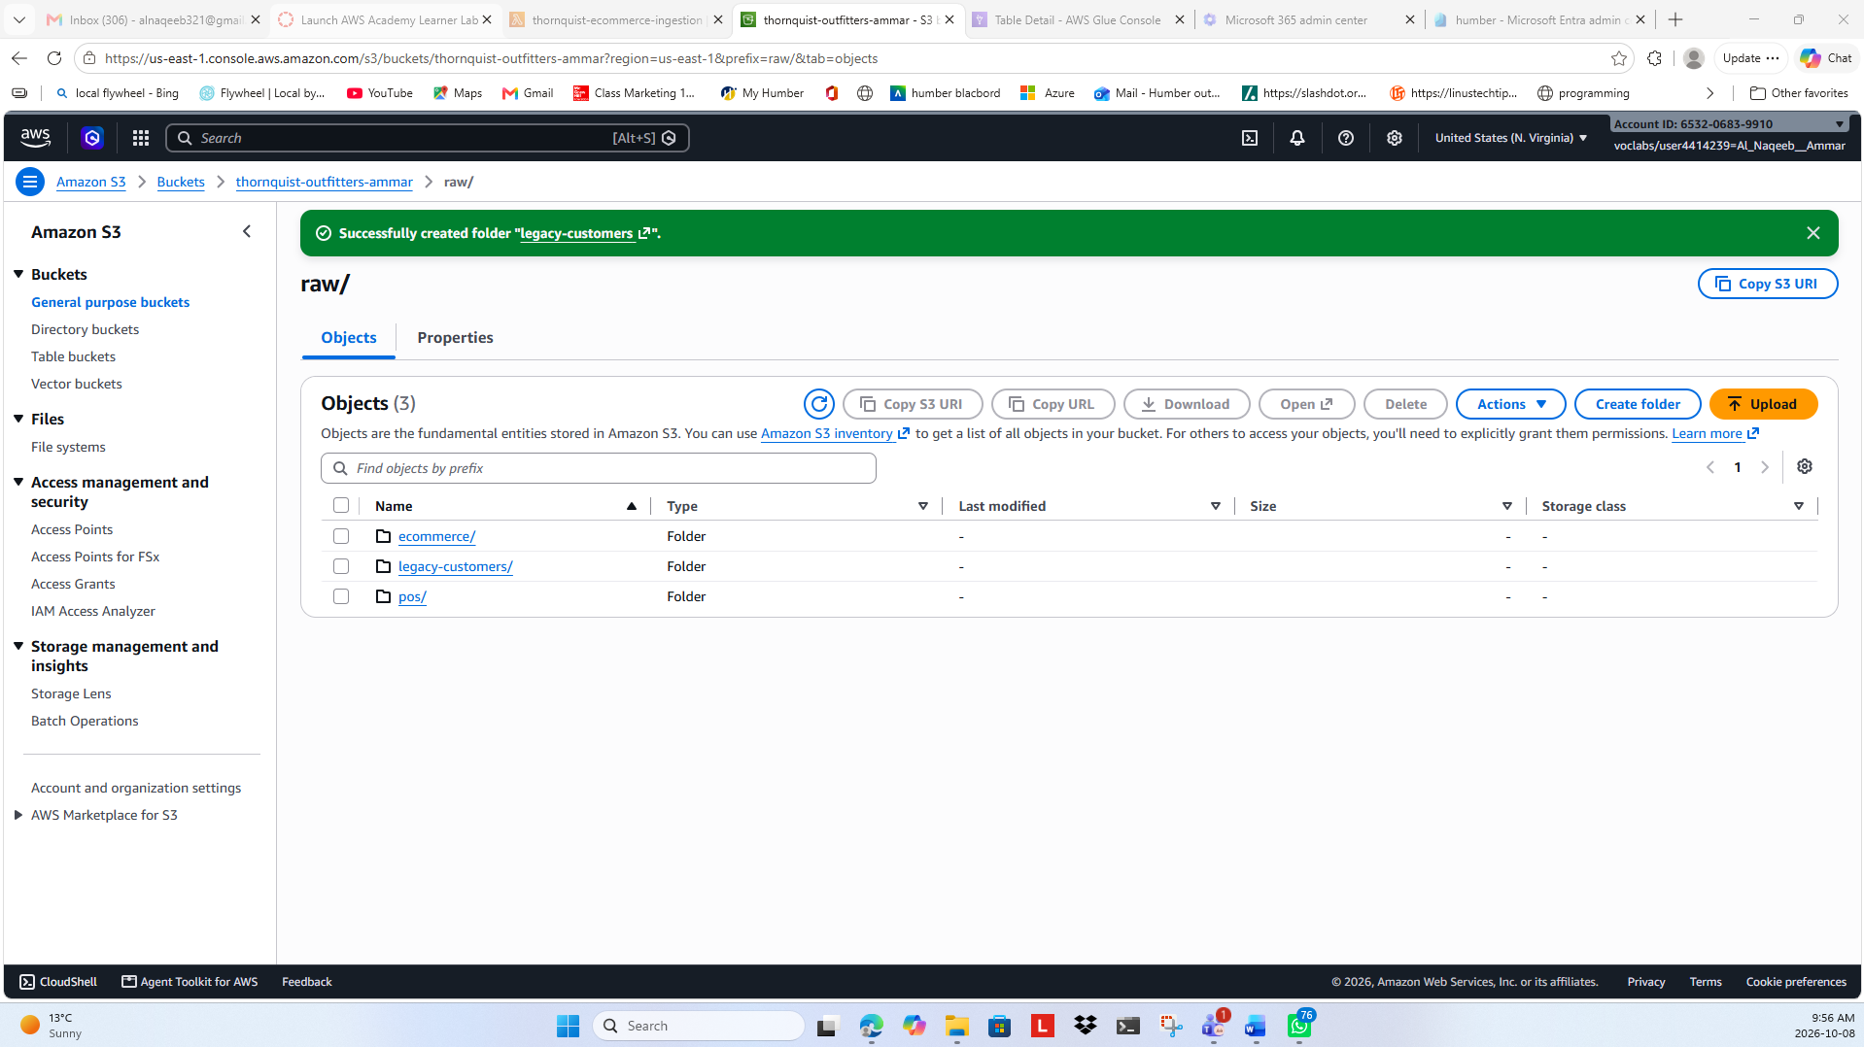
Raw Data Zone Structure
Figure 4: Raw Data Zone Structure - Amazon S3 Raw zone organized into separate folders for e-commerce, legacy customer, and POS source data.

Slide 7
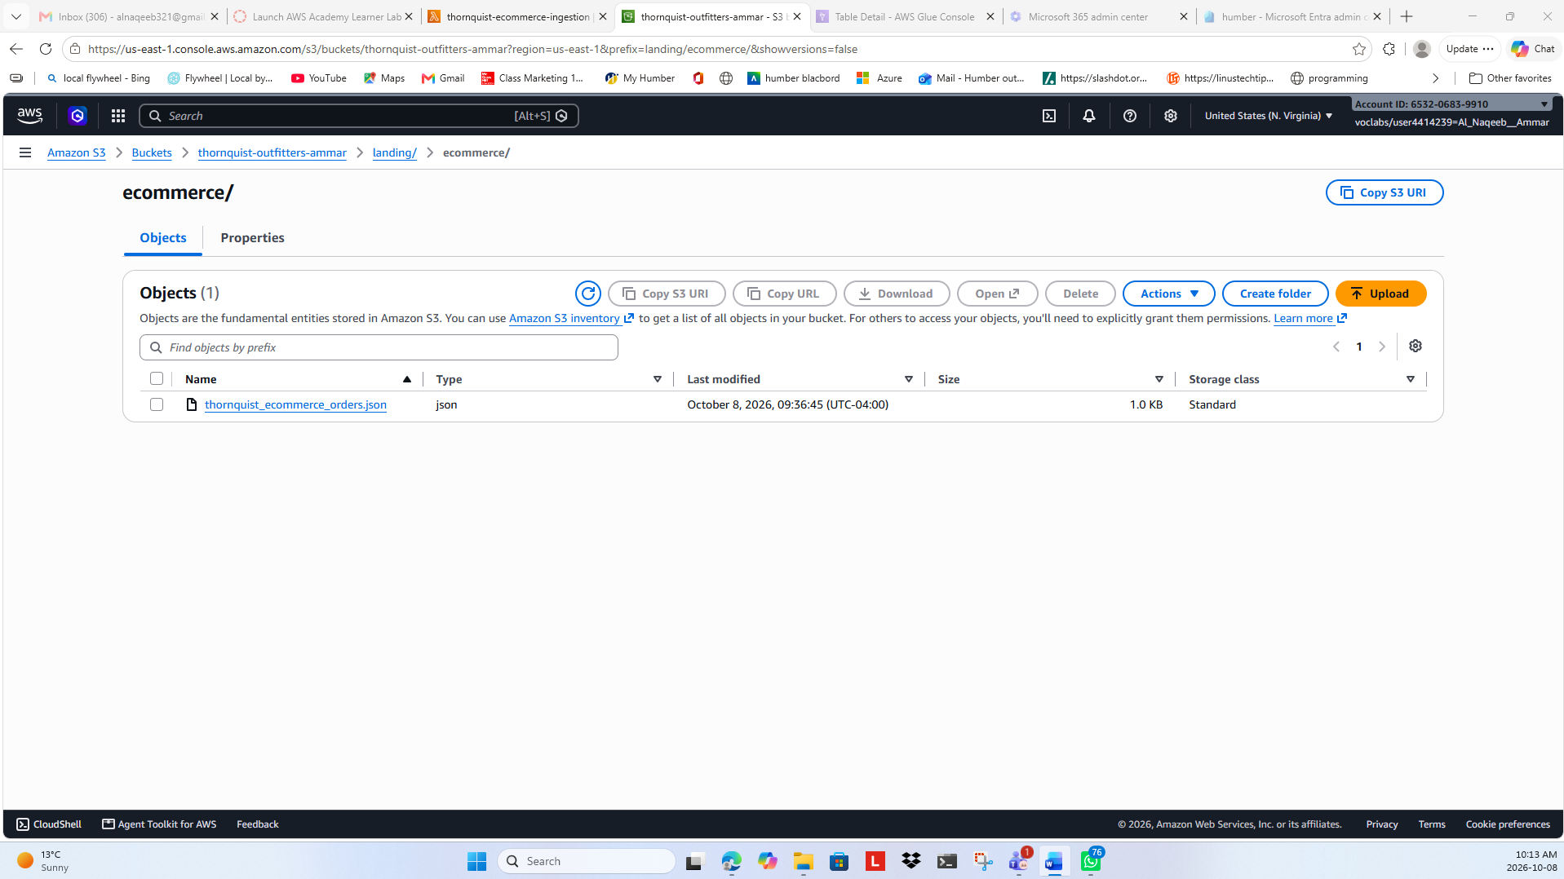
E-commerce Data Ingestion
Figure 5: E-commerce Data Ingestion - Lambda successfully ingested and transformed the e-commerce JSON data into the S3 landing zone.

Slide 8
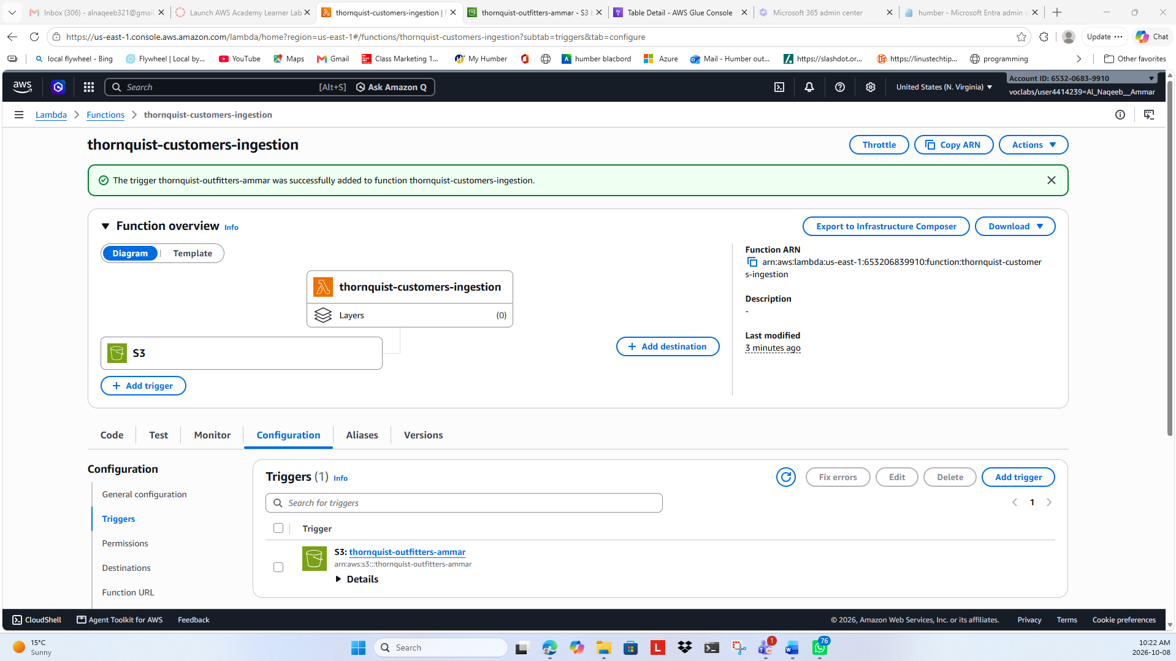
S3 Trigger Config
Figure 6: S3 Trigger Successfully Added to thornquist-customers-ingestion Lambda Function

Slide 9
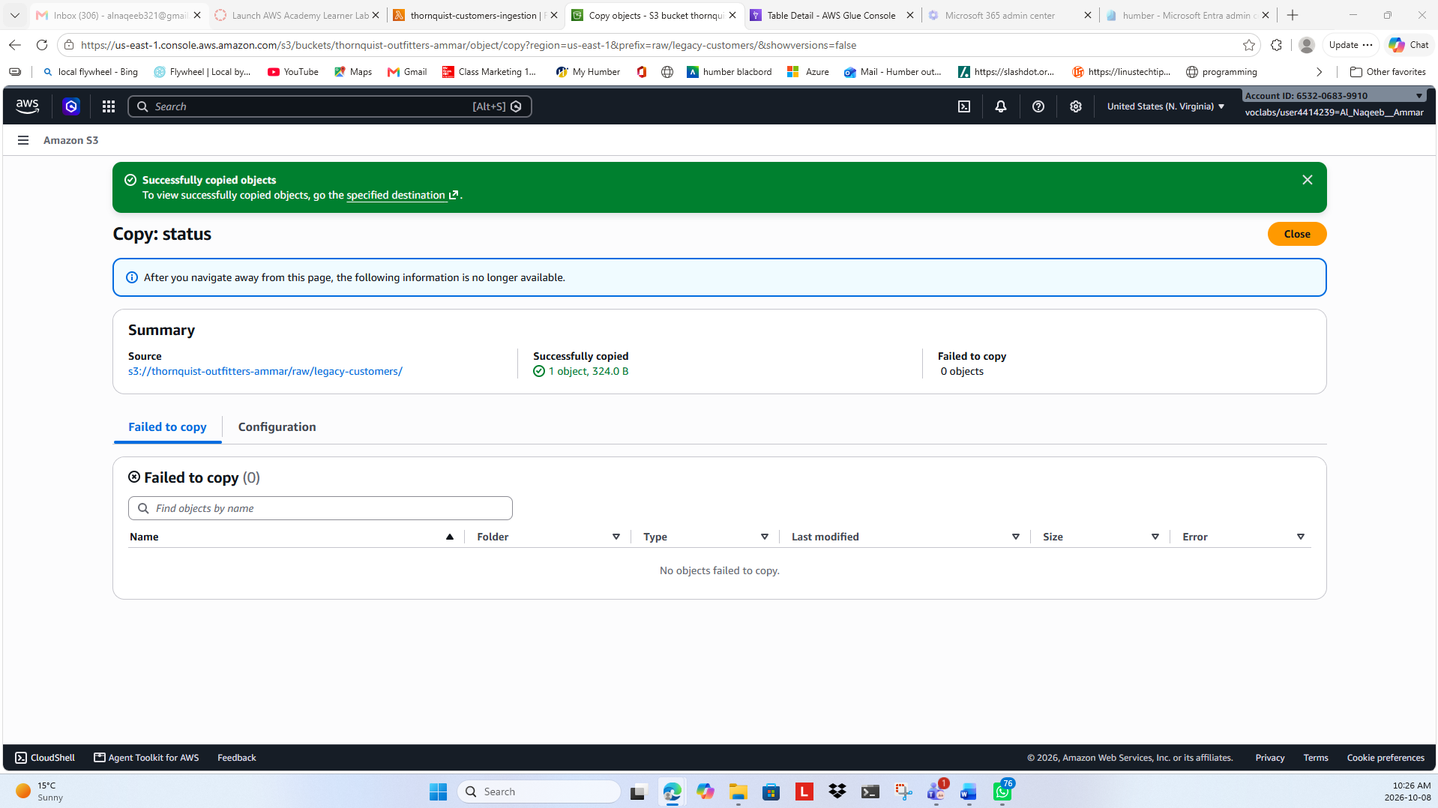
Legacy Customer Copy
Figure 7: Legacy Customer File Copy Successful

Slide 10
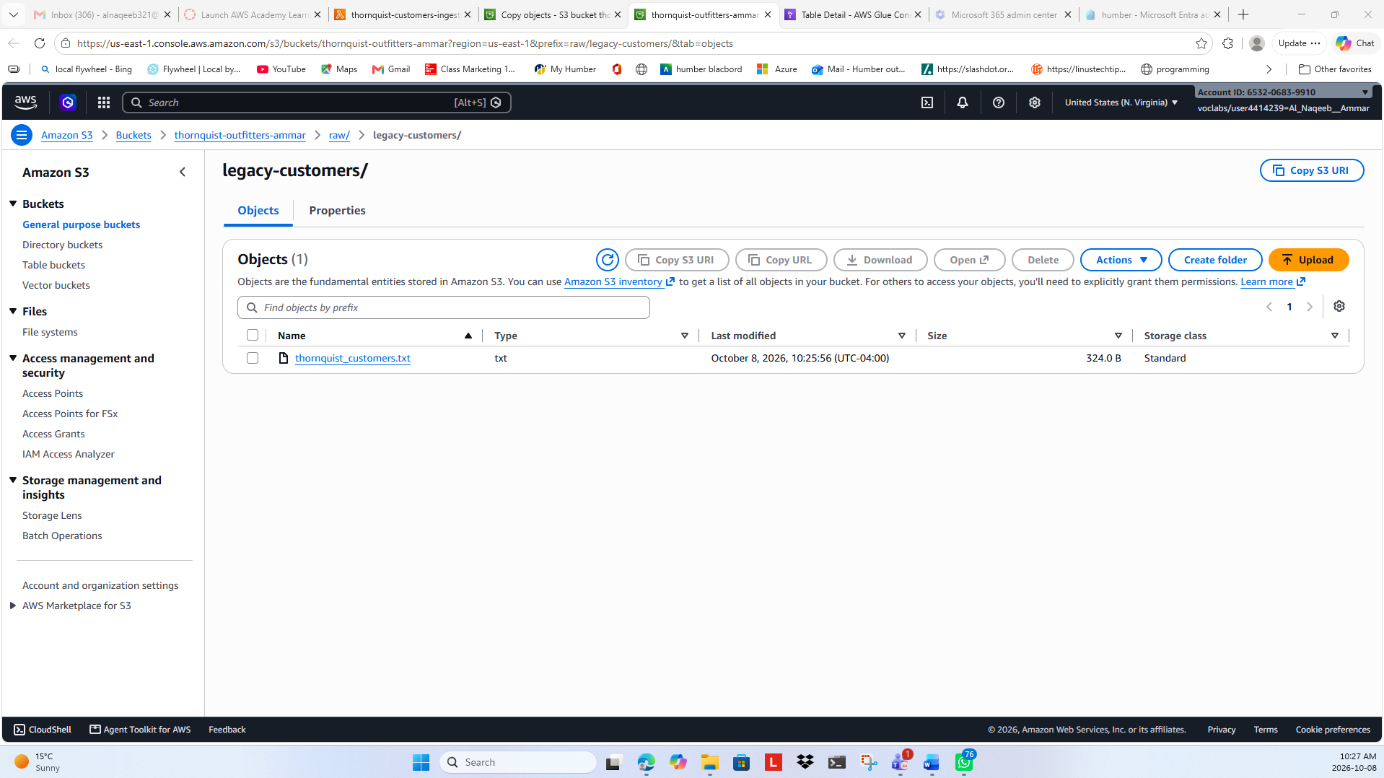
Legacy Customer in Raw
Figure 8: Legacy Customer File in Raw S3 Zone

Slide 11

Lambda Processing Trigger
Figure 9: Customer File Triggered for Lambda Processing

Slide 12
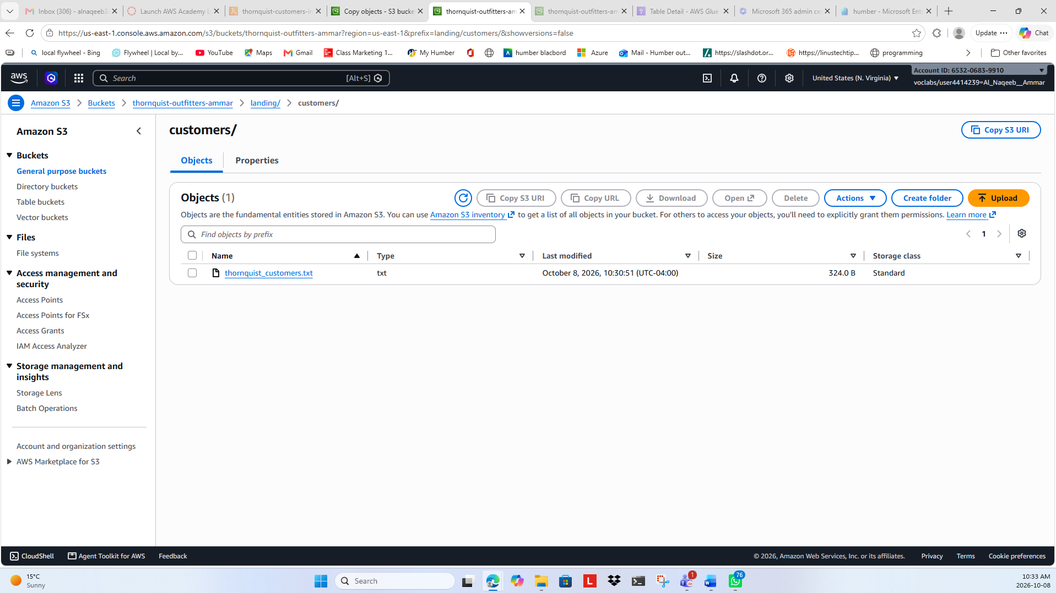
Customer Data Ingested
Figure 10: Customer Data Successfully Ingested into Landing Zone

Slide 13
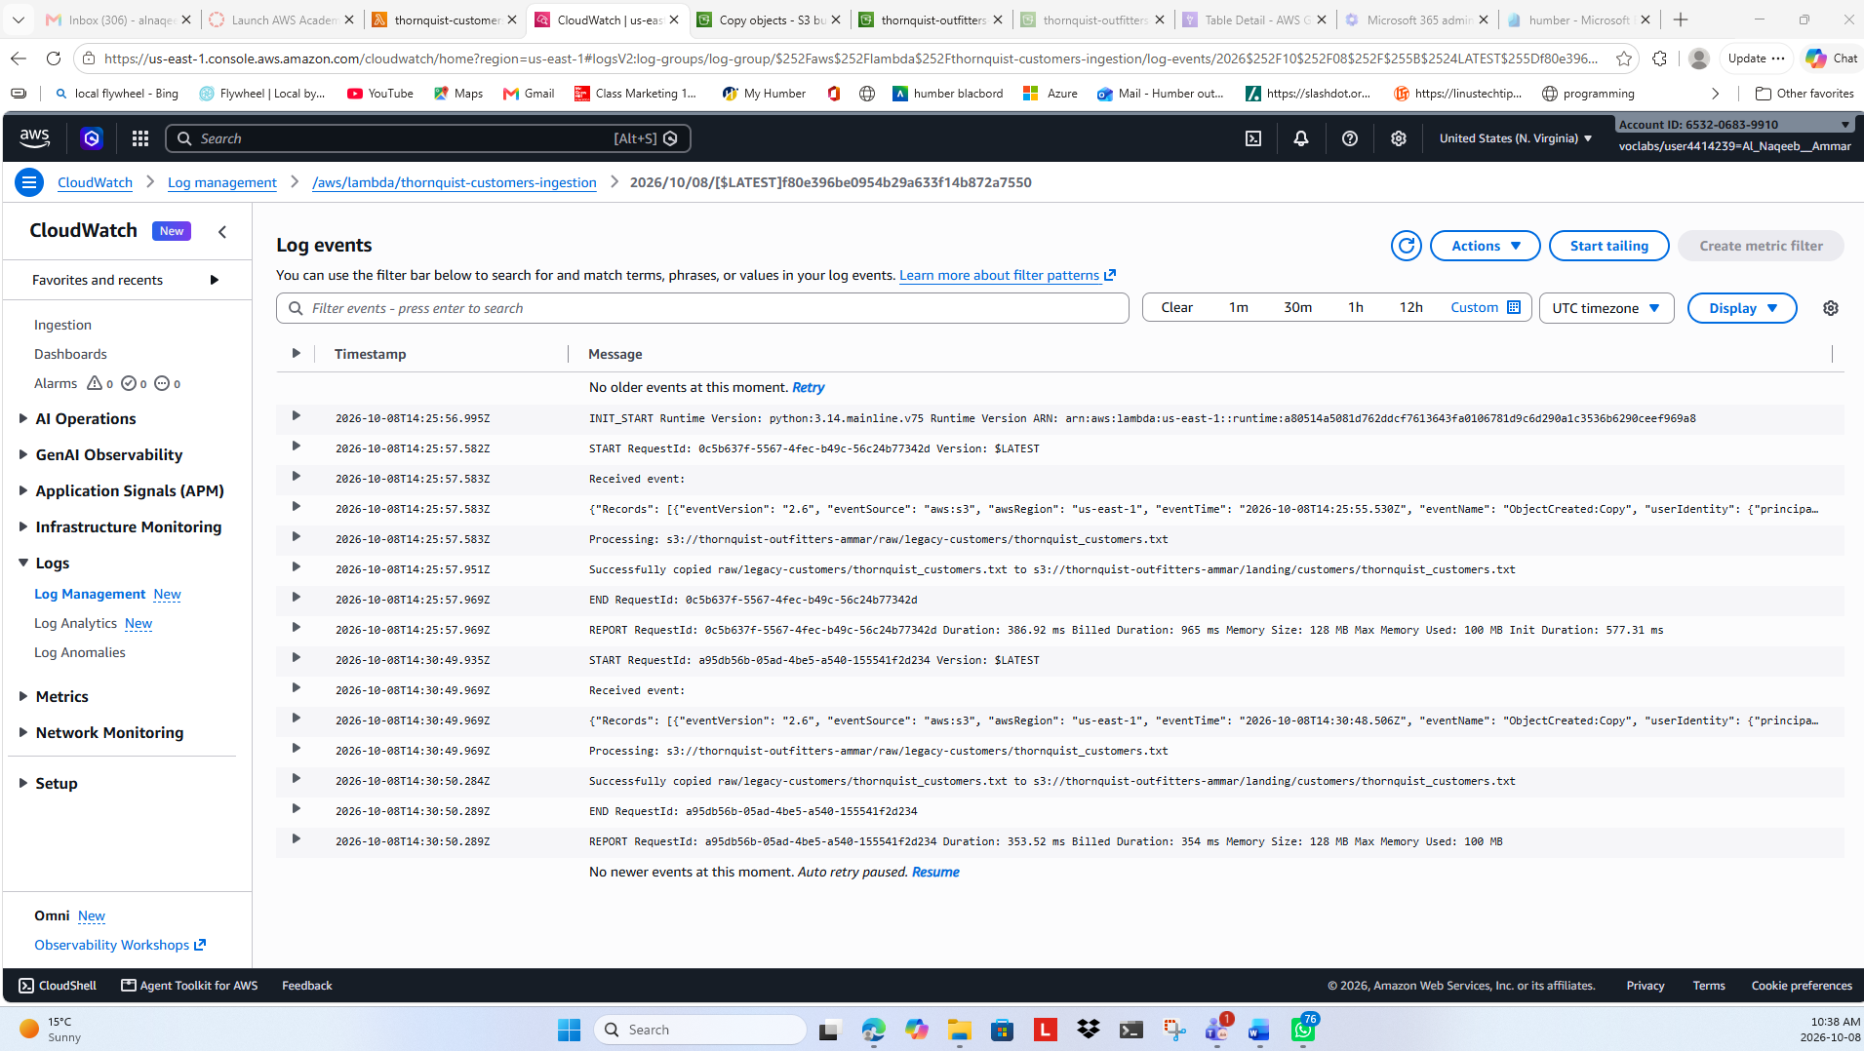
CloudWatch Verification
Figure 11: Customer Data Ingestion Verification - CloudWatch logs confirming successful automatic ingestion of legacy customer data from the S3 Raw zone into the Landing zone using AWS Lambda

Slide 14
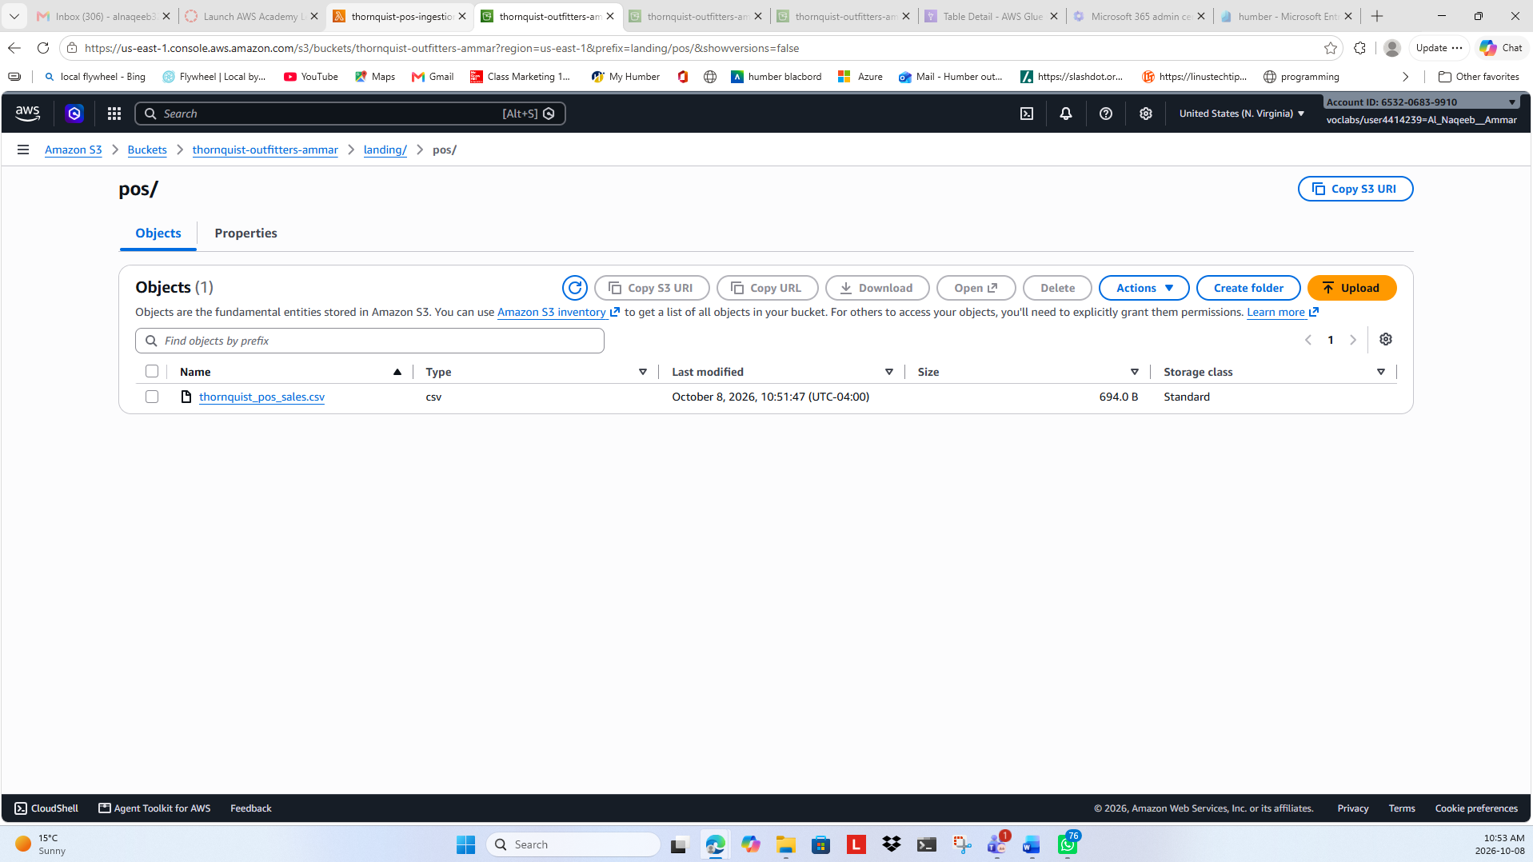
POS Data Ingestion
Figure 12: Successful POS Data Ingestion

Slide 15
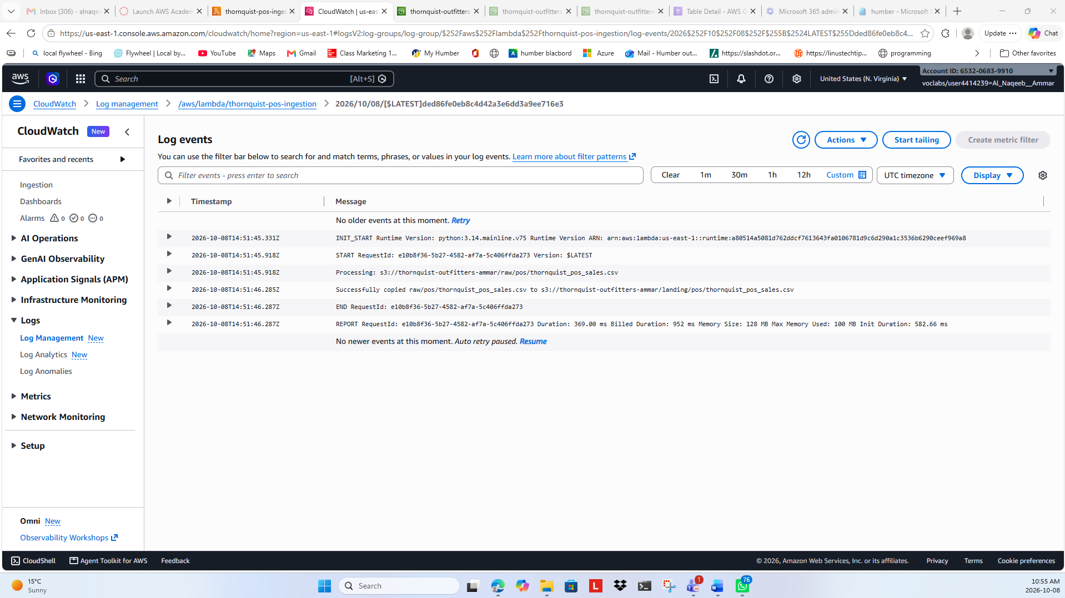
POS Lambda CloudWatch
Figure 13: POS Lambda Execution Verified in CloudWatch

Slide 16
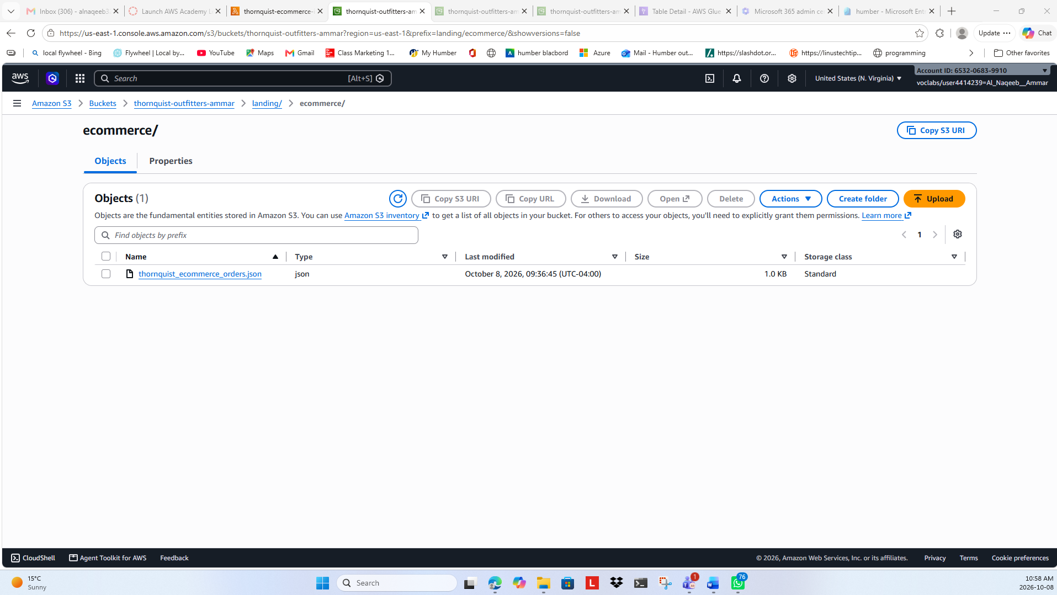
E-commerce Landing Verification
Figure 14: E-commerce JSON Successfully Ingested into S3 Landing Zone

Slide 17
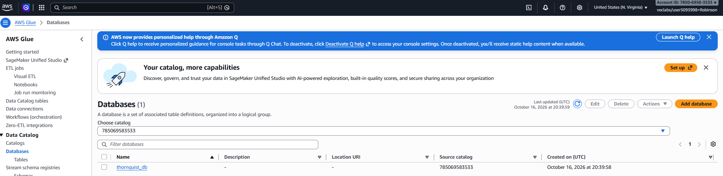
AWS Glue Database
Figure 15: Create the database using AWS Glue

Slide 18
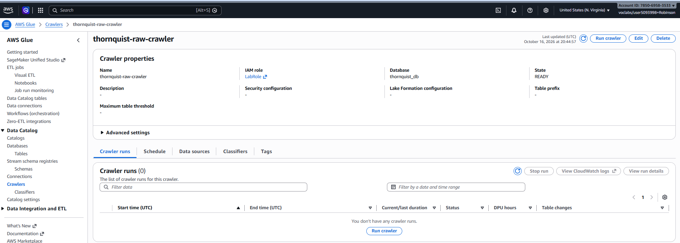
AWS Glue Crawler
Figure 16: Create crawler

Slide 19
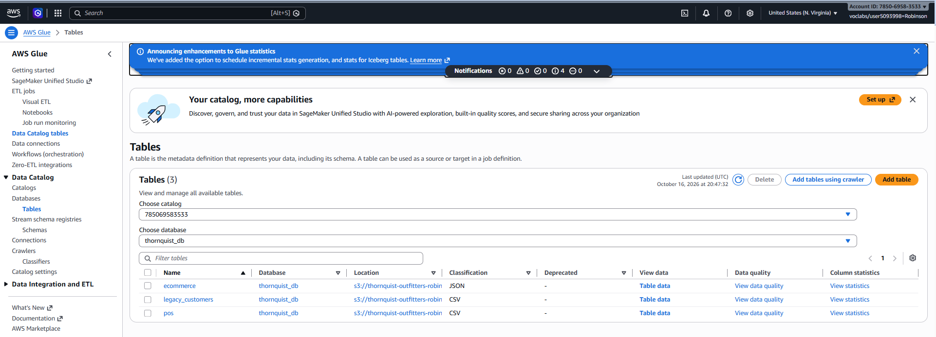
Run and Inspect Tables
Figure 17: Run and Inspect Tables

Slide 20
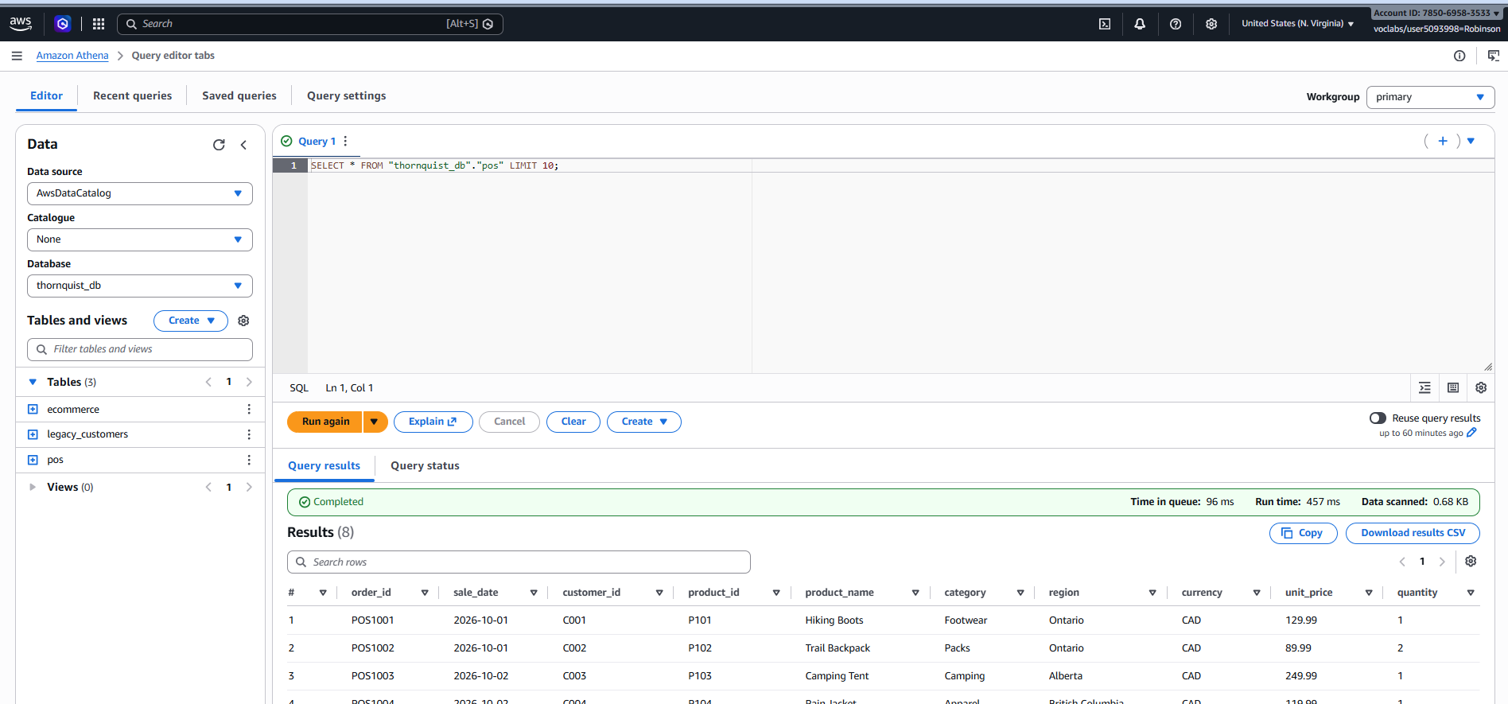
Amazon Athena Querying
Figure 18: Query the Data on Amazon Athena

Slide 21
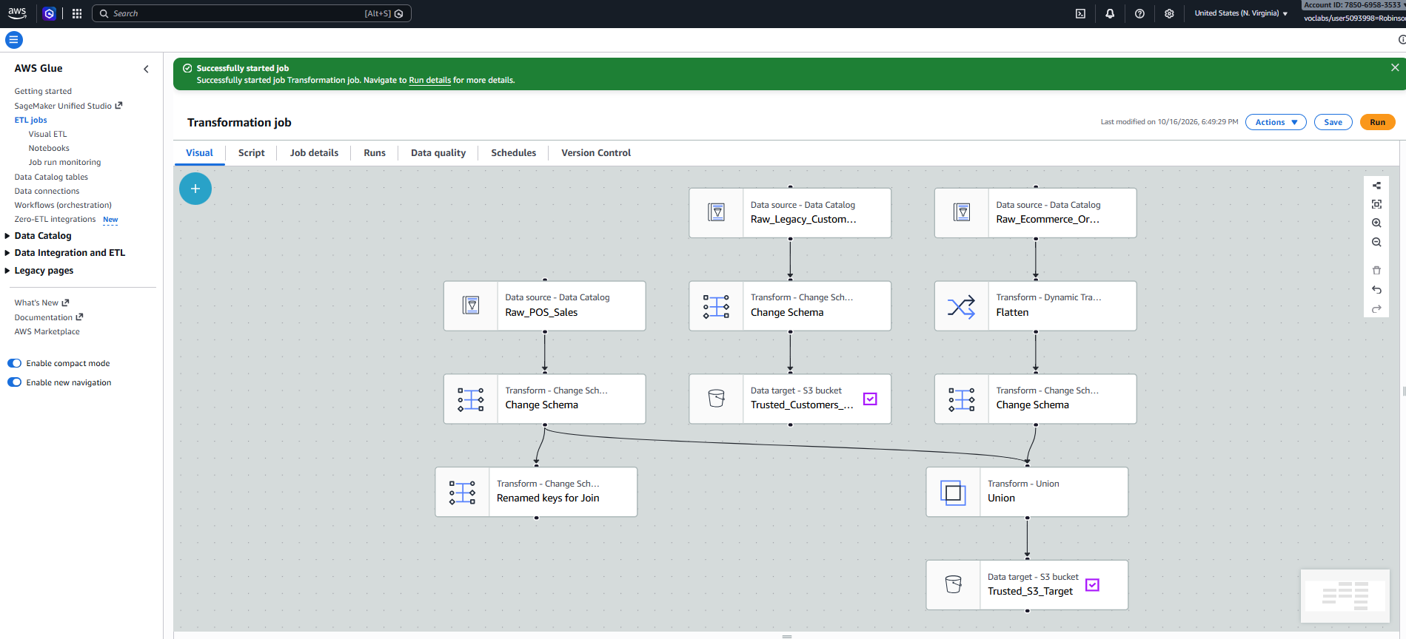
Glue Studio ETL Pipeline
Figure 19: ETL Pipeline setup in Glue Studio

Slide 22
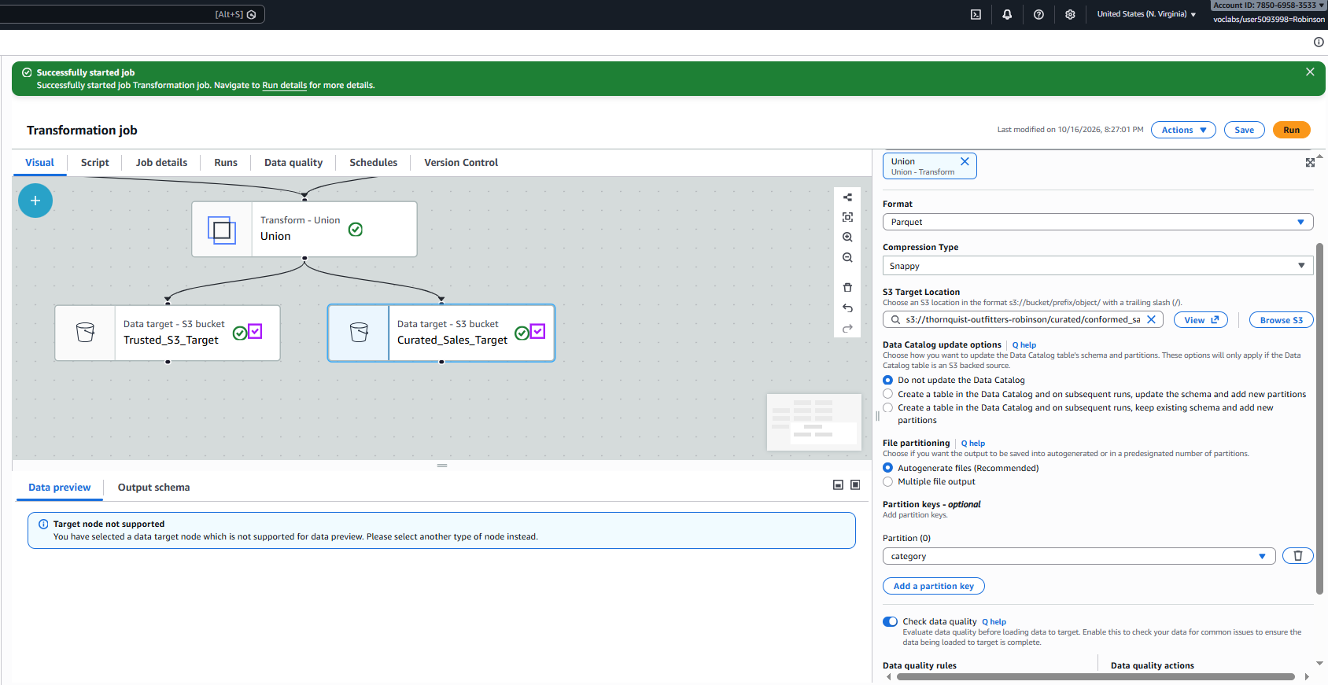
Applying Transformations
Figure 20: Applying transformations (Flatten, Schema Change, Union)

Slide 23
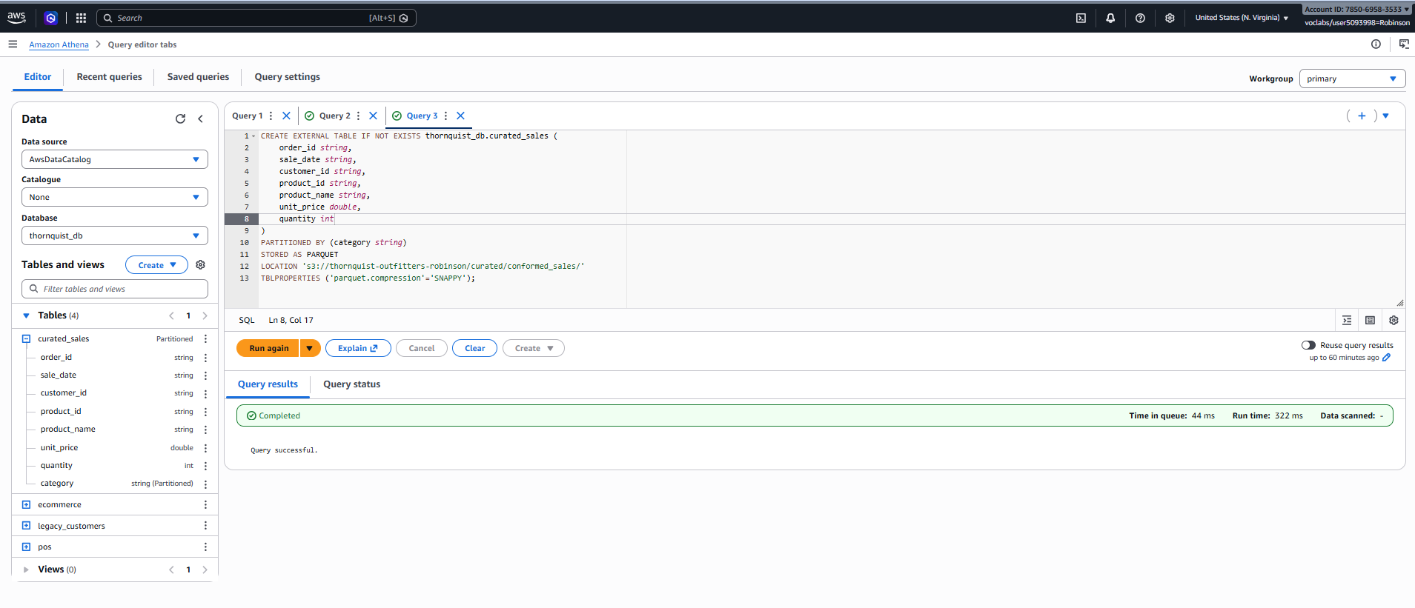
S3 Target and Format
Figure 21: Configuring S3 Target and Data Format

Slide 24
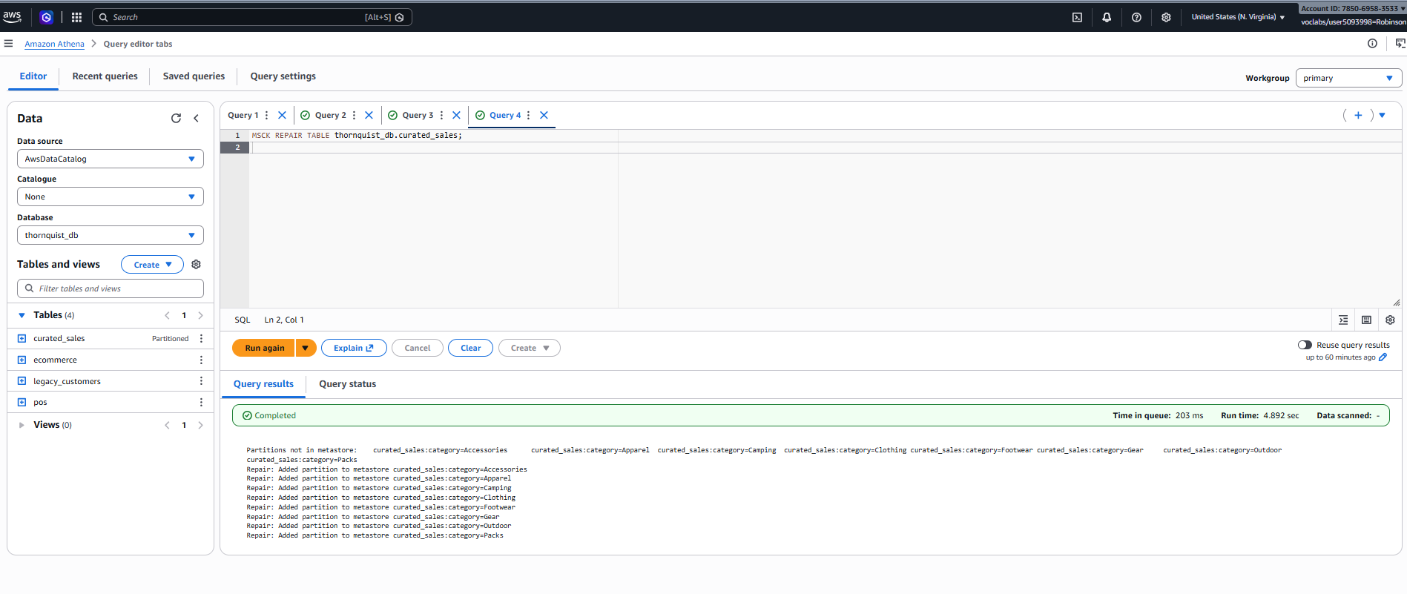
Athena Querying after ETL
Figure 22: Athena Data Querying after ETL

Slide 25
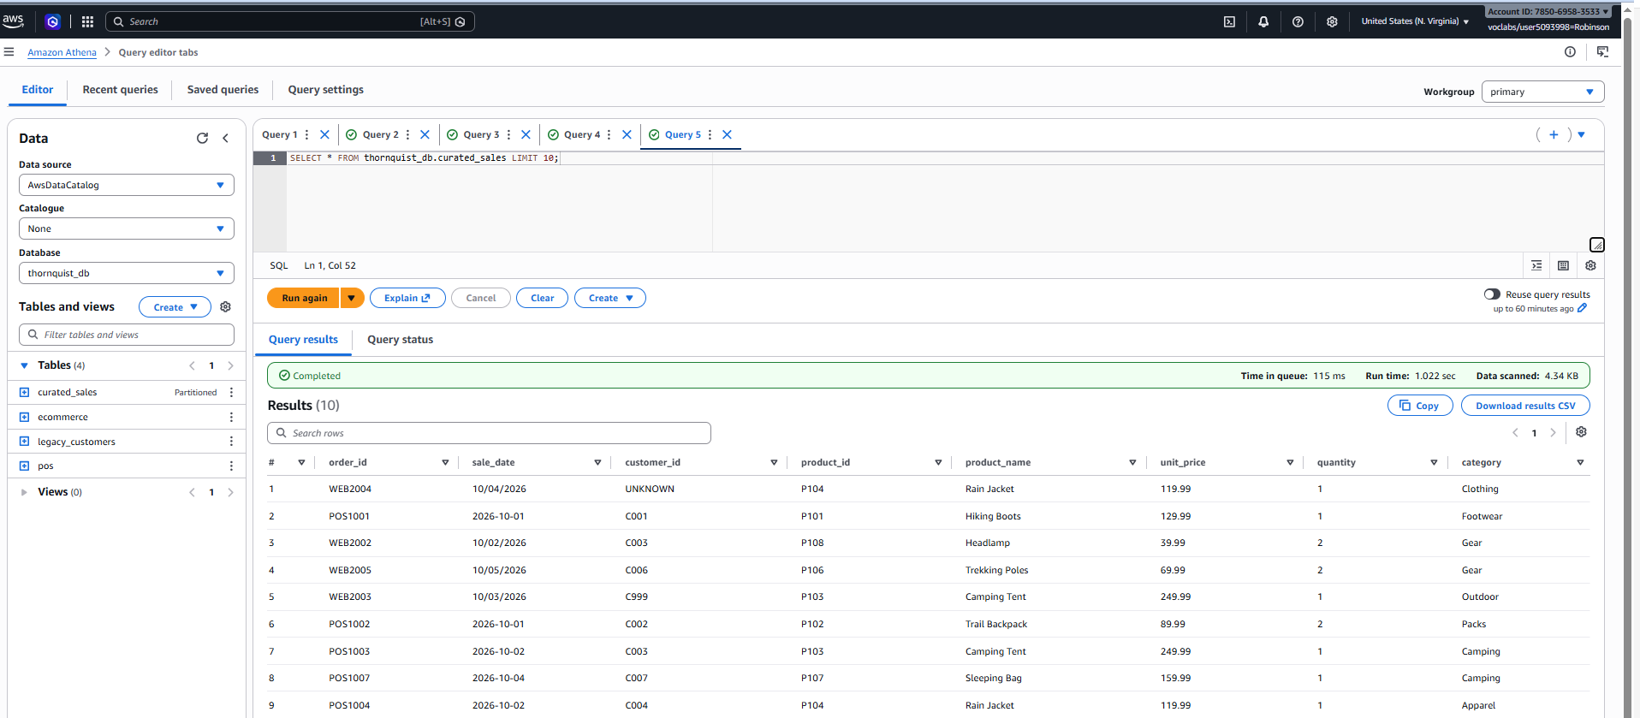
Data Quality Verification
Figure 23: Data Quality Verification Queries

Slide 26
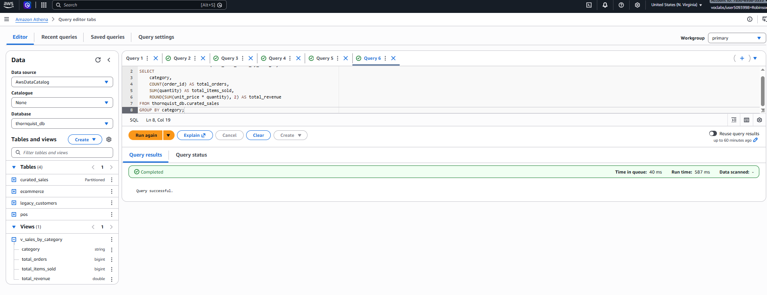
View Data Preview
Figure 24: View Data Preview

Slide 27
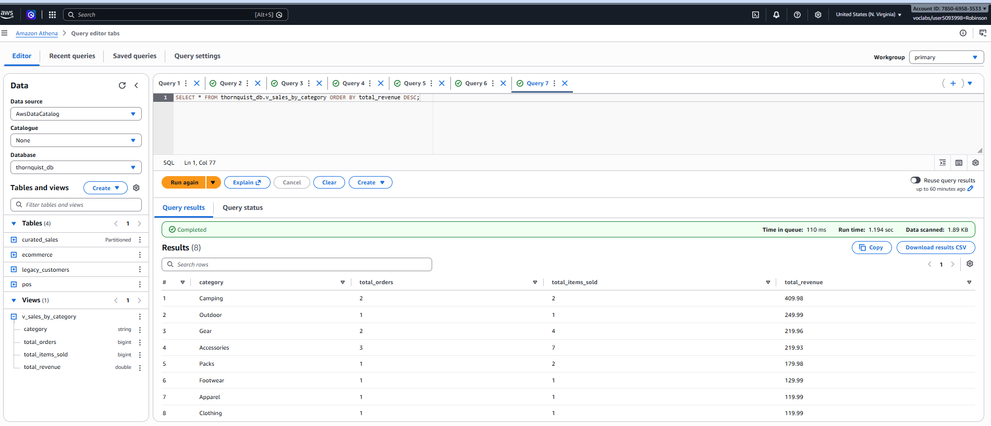
Analytical Dashboard
Figure 25: Final Analytical Dashboard/View Results

