Slide 1
Regression models for modeling climate-hydropower relation

Slide 2
Data
Weather variables
Temperature (NUTS2)
Precipitation (NUTS2)
Load
CF of HRE
CF of HRO

Slide 3
Try to understand the physical/technical phenomenon
Plot the data and try to find some relation that could be exploited
Correlation, lagged correlation
Do you need to transform the data?

Slide 4
Regression Algorithm
Run several regression algorithms
Linear regression (use different basis functions)
Decision tree
Artificial Neural Network
Support Vector Regression

Slide 5
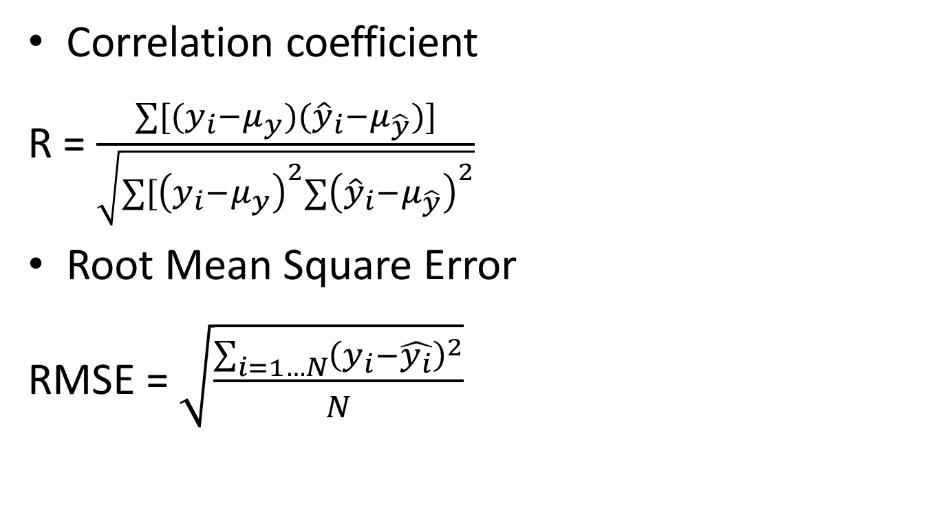
Measure error
Correlation coefficient
R = $\frac{∑[(y_{i}−μ_{y})({\hat{y}}_{i}−μ_{\hat{y}})]}{\sqrt{∑[{\left(y_{i}−μ_{y}\right)}^{2}∑{\left({\hat{y}}_{i}−μ_{\hat{y}}\right)}^{2}}}$
Root Mean Square Error
RMSE = $\sqrt{\frac{\sum_{i=1…N}{{\left(y_{i}−\hat{y_{i}}\right)}^{2}}}{N}}$

Slide 6

Mean Absolute Error
MAE = $\frac{1}{N}\sum_{i}^{N}{|y_{i}−\hat{y_{i}}|}$

