Slide 1
Beer Analysis EDA
DS 6306: Doing Data Science
Presented by Chance Robinson and Thomas Karba

Slide 2
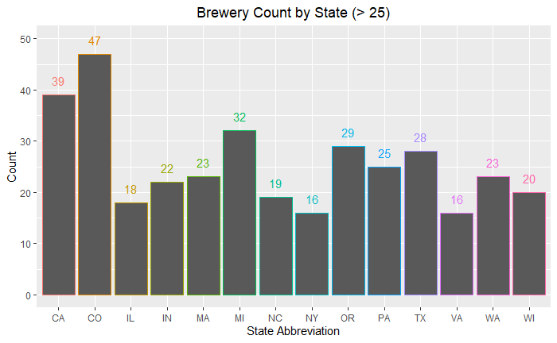
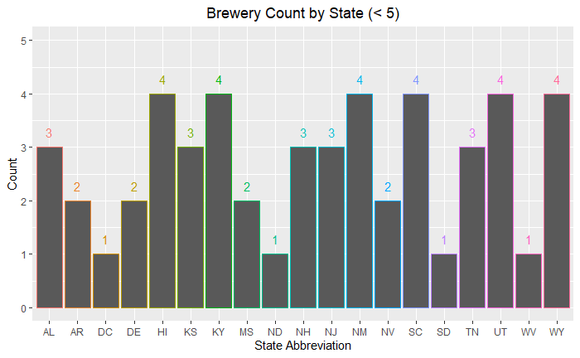
Brewery Count by State
How many breweries are present in each state?
Note that all 50 states have at least one brewery listed, including the District of Columbia (DC), for a total of 51.

Slide 3
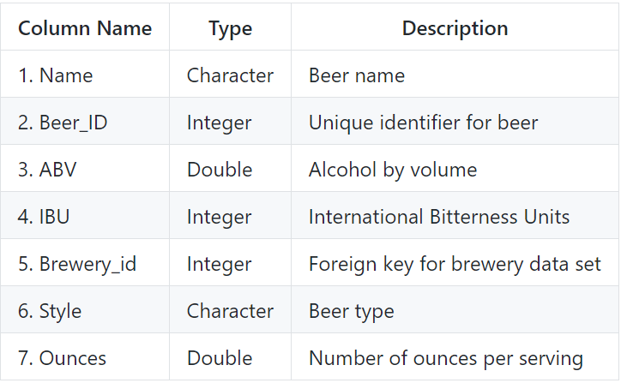
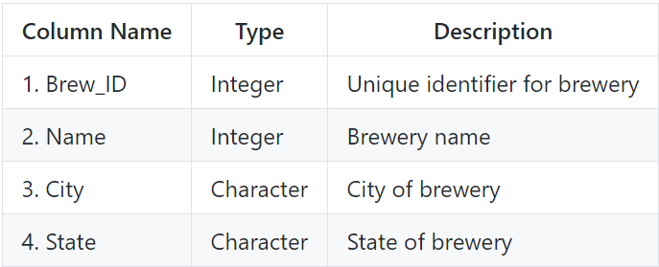
Available Data Sets
Beers
Breweries

Slide 4
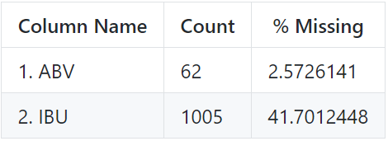
Missing Values
The ABV (Alcohol by Volume) and IBU (International Bitterness Unit) columns have missing values
In particular, the IBU field as over 40% of the records with a blank value for this data point.

Slide 5
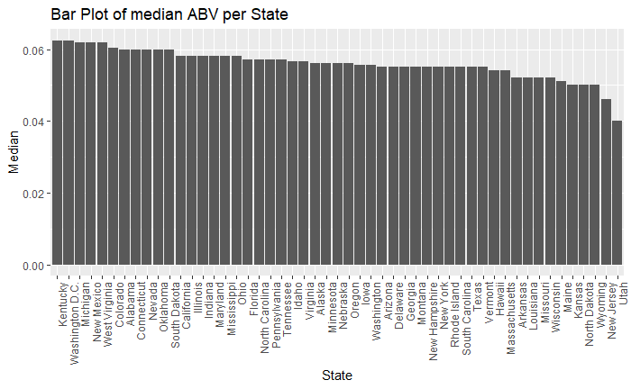
Median ABV per State
From visually inspecting the graph, most states have a relatively close spread. The summary statistics show that 50% of the available data fall within the interval
(0.05 to 0.067)

Slide 6
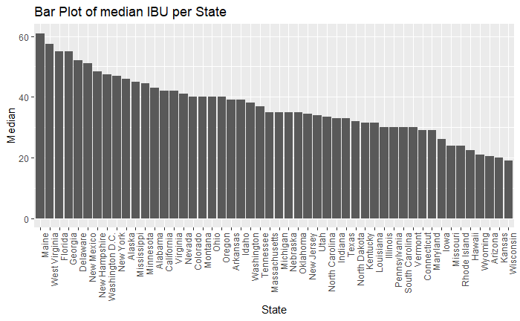
Median IBU per State
There is much more variation in the IBU data, possibly due to missing values or regional preferences.

Slide 7
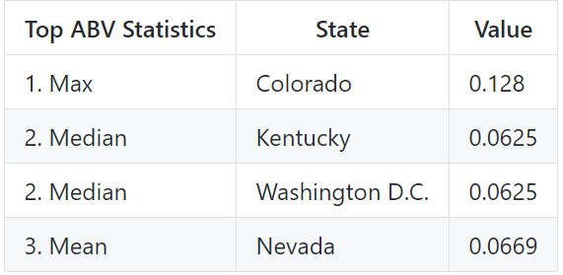
Maximum Values by State (ABV)
There are different measures of center, etc.. that might be useful in determining state trends.
Depending on the statistic of interest, the answer varies

Slide 8
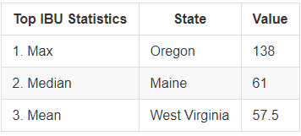
Maximum Values by State (IBU)
Similar differences can be seen across the IBU statistics

Slide 9
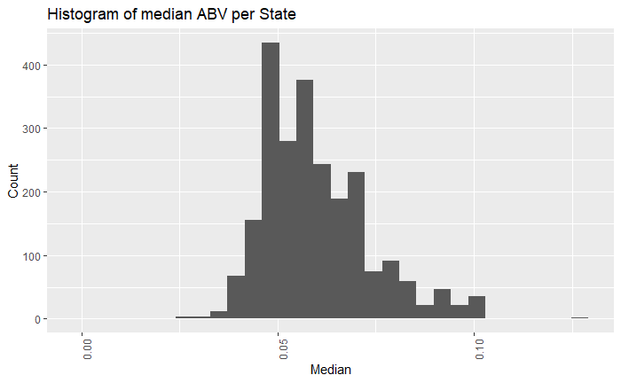
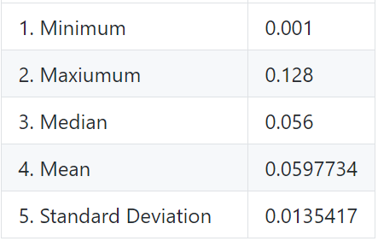
Summary Statistics (ABV)
The distribution of the ABV data is slightly right skewed, with most values falling within ~0.014 units of the mean of ~0.06.

Slide 10
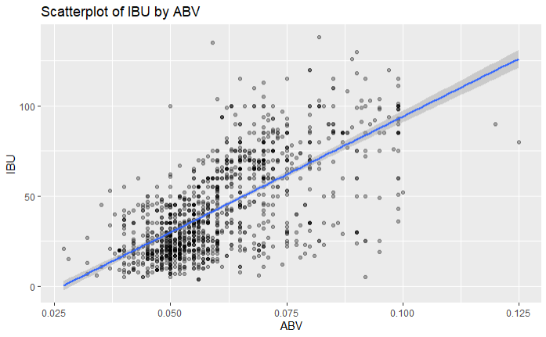
IBV to ABU Relationship
There appears to be a linear relationship between a beer's International Bitterness Units (IBU) and the Alcohol by Volume (ABV). The stronger a beer is, the more likely it is to rate higher on the bitterness scale.

