Slide 1
US Craft Beers and Breweries
DS 6306: Doing Data Science
Presented by Chance Robinson and Thomas Karba

Slide 2
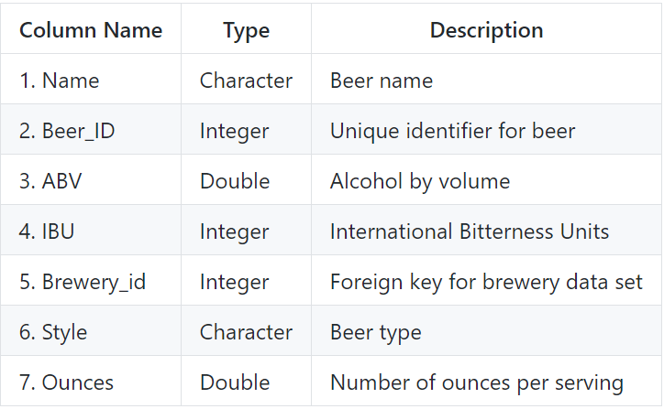
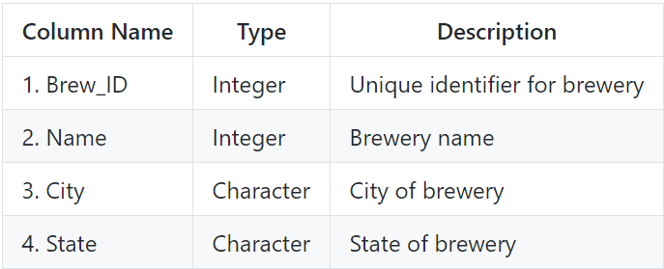
Data Sets and Definitions
Beers
Breweries
Notes:
2,410 US craft beers
558 US craft breweries

Slide 3
Questions of Interest
TOPIC | Time
Discovery Brewery Count by State Missing Values Median ABV/IBU per State Maximum Values ABV Summary Statistics/ Distribution IBU to ABU Relationship | 7 minutes

Slide 4
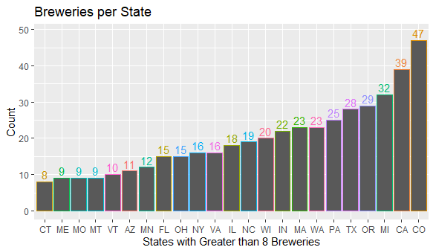
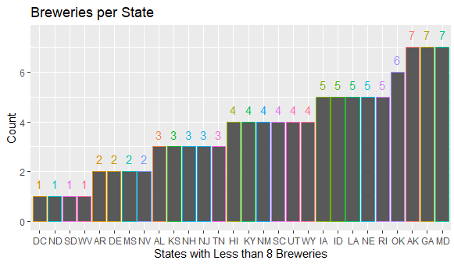
Brewery Count by State
How many breweries are present in each state?
Note that all 50 states have at least one brewery listed, including the District of Columbia (DC), for a total of 51.

Slide 5
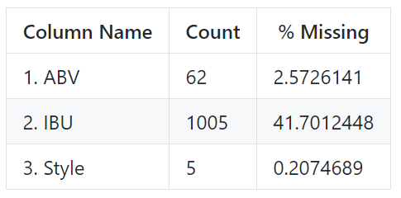
Missing Values
The ABV (Alcohol by Volume), IBU (International Bitterness Unit) and Style columns have missing values
In particular, the IBU field as over 40% of the records with a blank value for this data point.

Slide 6
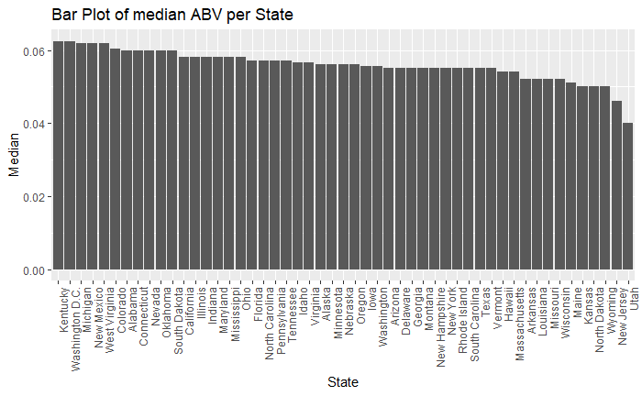
Median ABV per State
From visually inspecting the graph, most states have a relatively close spread. The summary statistics show that 50% of the available data fall within the interval
(0.05 to 0.067)

Slide 7
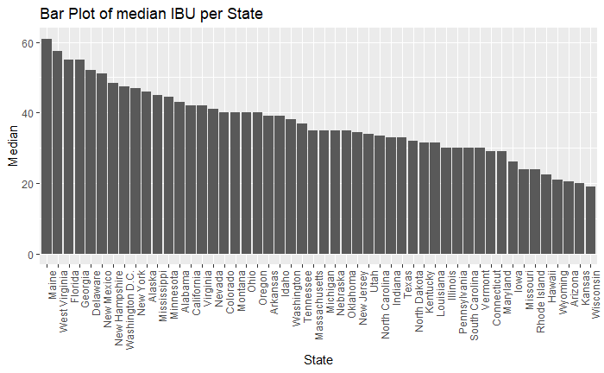
Median IBU per State
There is much more variation in the IBU data, possibly due to missing values or regional preferences.

Slide 8
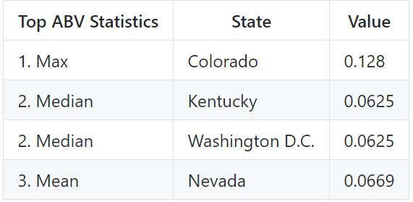
Maximum Values by State (ABV)
There are different measures of center, etc.. that might be useful in determining state trends.
Depending on the statistic of interest, the answer varies

Slide 9
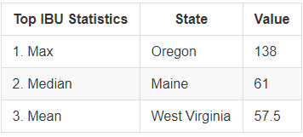
Maximum Values by State (IBU)
Similar differences can be seen across the IBU statistics

Slide 10
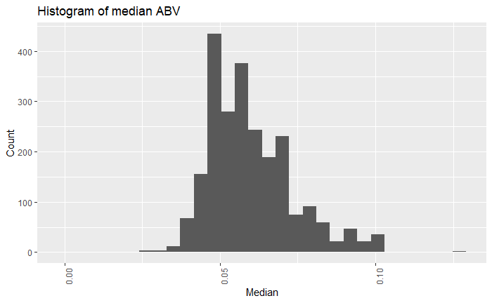
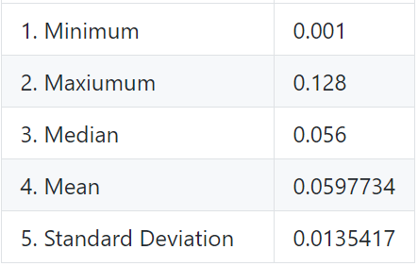
Summary Statistics (ABV)
The distribution of the ABV data is slightly right skewed, with most values falling within ~0.014 units of the mean of ~0.06.

Slide 11
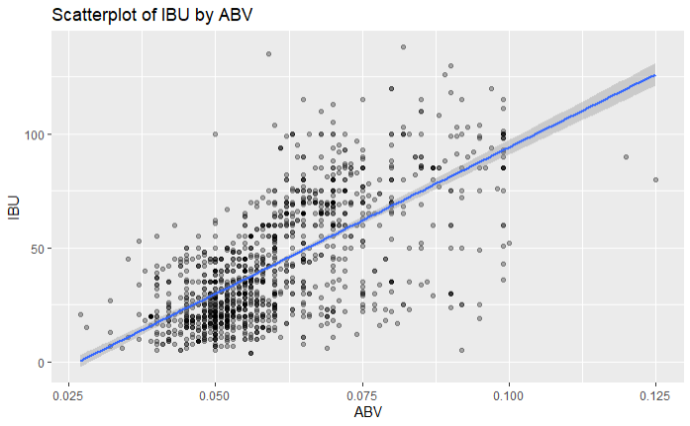
IBV to ABU Relationship
There appears to be a linear relationship between a beer's International Bitterness Units (IBU) and the Alcohol by Volume (ABV). The stronger a beer is, the more likely it is to rate higher on the bitterness scale.

