Slide 1
US Craft Beers and Breweries
DS 6306: Doing Data Science
Presented by Chance Robinson

Slide 2
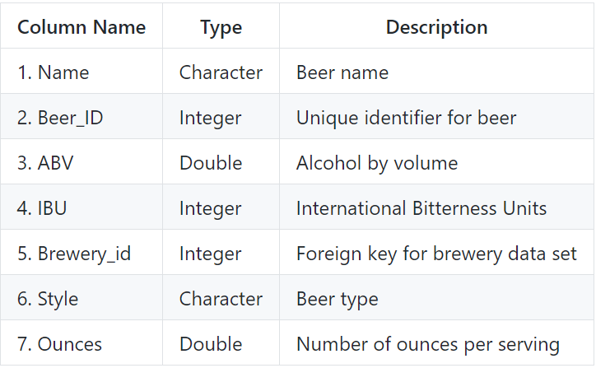
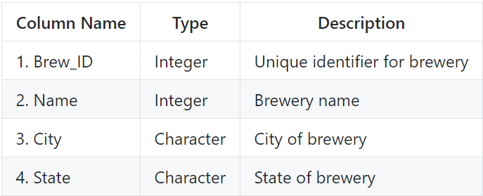
Data Sets and Definitions
Beers
Breweries
558 Breweries
2,410 US Craft Beers
Notes:
2,410 US craft beers
558 US craft breweries

Slide 3
Questions of Interest
TOPIC | Time
Discovery Brewery Count by State Missing Values Median ABV/IBU per State Maximum Values ABV Summary Statistics/ Distribution IBU to ABU Relationship IPAs (India Pale Ales) and other types of Ale Opportunities | 7 minutes

Slide 4
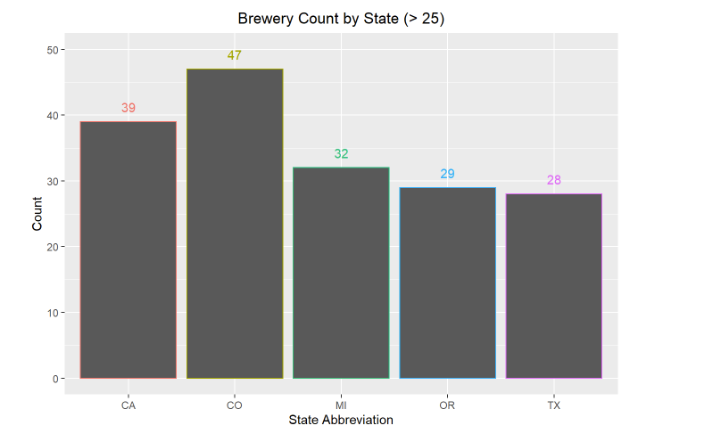
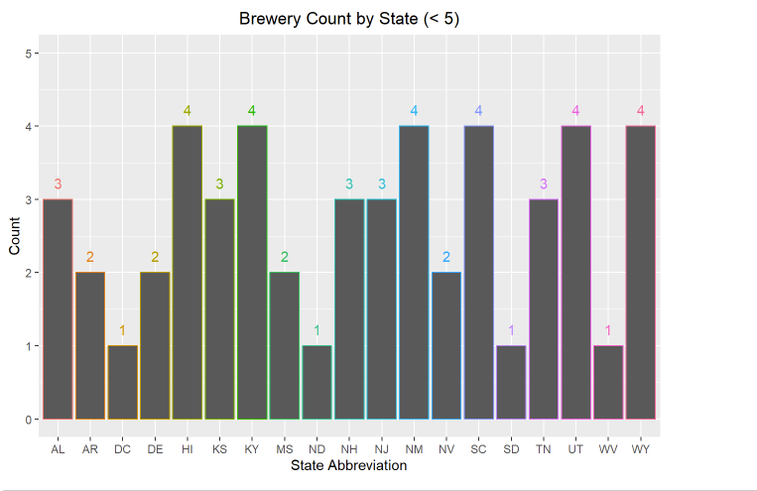
Brewery Count by State
How many breweries are present in each state?
Note that all 50 states have at least one brewery listed, including the District of Columbia (DC), for a total of 51.

Slide 5
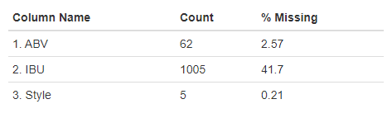
Missing Values
The ABV (Alcohol by Volume), IBU (International Bitterness Unit) and Style columns have missing values
In particular, the IBU field as over 41% of the records with a blank value for this data point.

Slide 6
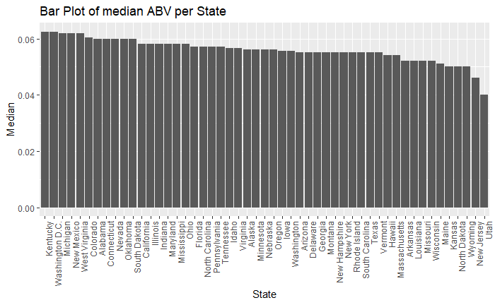
Median ABV per State
From visually inspecting the graph, most states have a relatively close spread. The summary statistics show that 50% of the available data fall within the interval
(0.05 to 0.067)

Slide 7
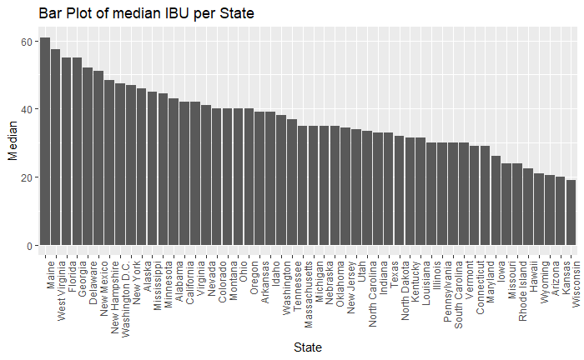
Median IBU per State
There is much more variation in the IBU data, possibly due to missing values or regional preferences.

Slide 8
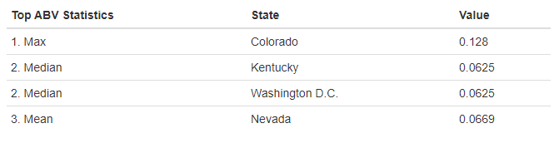
Maximum Values by State (ABV)
There are different measures of center, etc.. that might be useful in determining state trends.
Depending on the statistic of interest, the answer varies
Notes:
maximum alcoholic (ABV) beer? Colorado
most bitter (IBU) beer? Oregon

Slide 9
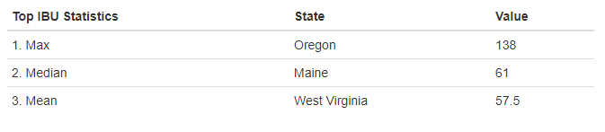
Maximum Values by State (IBU)
Similar differences can be seen across the IBU statistics

Slide 10
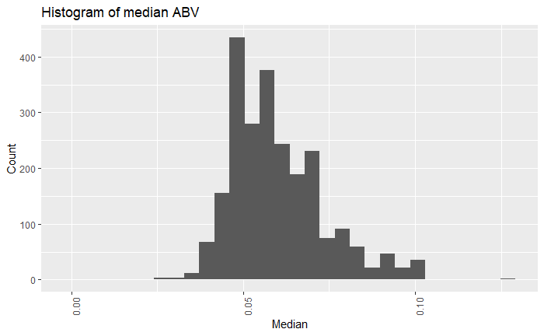
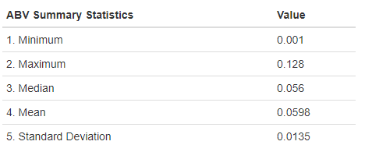
Summary Statistics (ABV)
The distribution of the ABV data is slightly right skewed, with most values falling within ~0.014 units of the mean of ~0.06.
Notes:
he distribution of the ABV data is slightly right skewed, with most values falling within ~0.014 units of the mean of ~0.06.

Slide 11
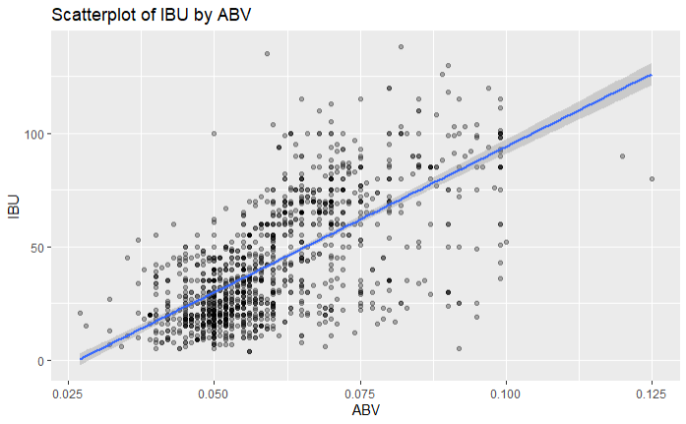
IBU to ABV Relationship
There appears to be a linear relationship between a beer's International Bitterness Units (IBU) and the Alcohol by Volume (ABV). The stronger a beer is, the more likely it is to rate higher on the bitterness scale.
Notes:
Roughly 67% of the variation of a beer’s IBU rating can be explained by the ABV for observations which had both attributes to review.

Slide 12
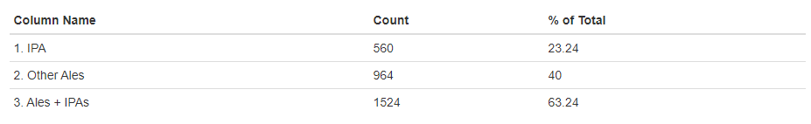
IPAs and other types of Ale
IPA Style beers make up almost ¼ of all beers contained in this study

Slide 13
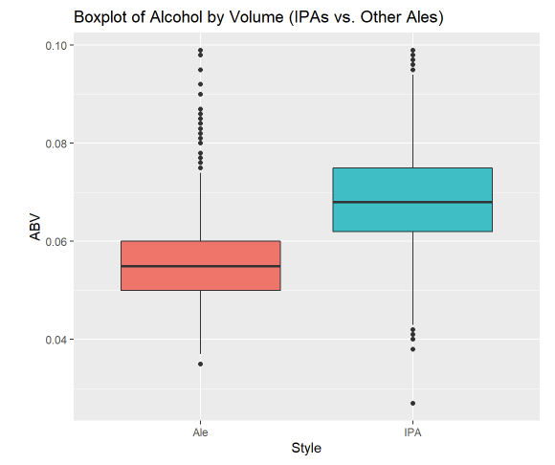
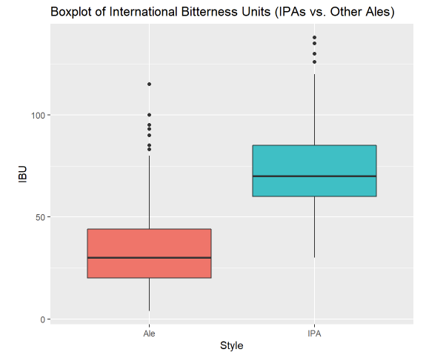
ABV and IBU Comparisons
The ABU and IBV data show similarities in spread/ variance
Notes:
This could be beneficial with the missingness of the IBU values as Alcohol by Volume could serve as a substitute.

Slide 14
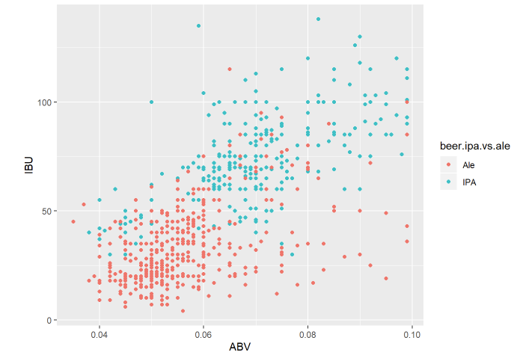
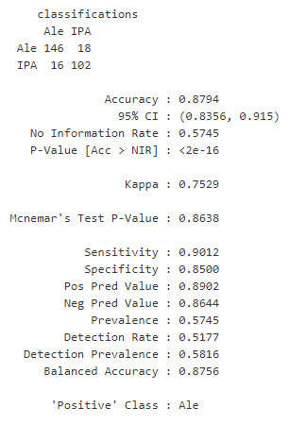
Beer Style Predictions
ABV and IBU served as good predictors of a beer’s style
Notes:
he distribution of the ABV data is slightly right skewed, with most values falling within ~0.014 units of the mean of ~0.06.

Slide 15
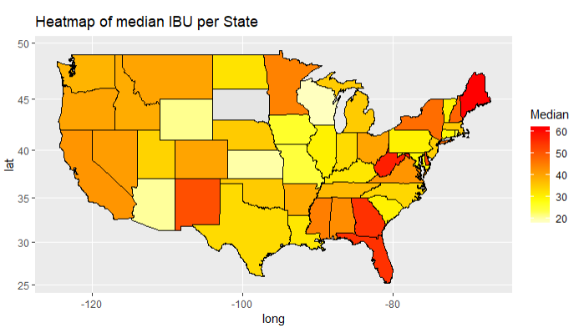
IBU Concentration
The case could be made that the states in the Northeast and South have the highest concentration of median IBU
Notes:
Roughly 67% of the variation of a beer’s IBU rating can be explained by the ABV for observations which had both attributes to review.

Slide 16
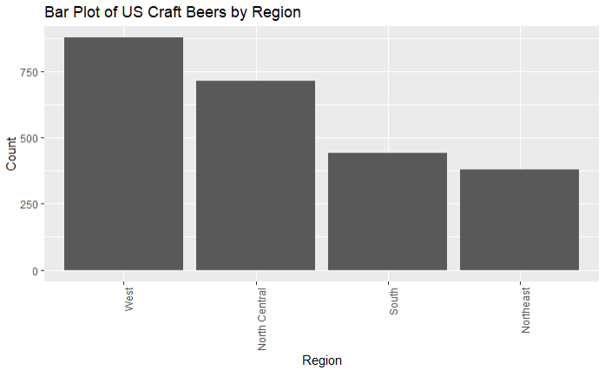
Regional Comparisons
Many of these states happen to be in regions with lower craft beer counts
Notes:
Florida and Main in particular

Slide 17
Conclusion
ABV (Alcohol by Volume) and IBU (International Bitterness Units) serve as good predictors of beer styles
Regional preferences can be seen in the charts for a beer’s bitterness
There are fewer craft beers/ breweries in the Northeast and South regions
Opportunities for product differentiation with lower IBU ratings

