Slide 1
Talent Management Case Study
DS 6306: Doing Data Science
Presented by Chance Robinson

Slide 2
Questions of Interest
TOPIC | Time
Discovery Case Study Overview EDA Insights Model Comparisons for Classification Continuous Variable Prediction Outcome Conclusion | 7 minutes

Slide 3
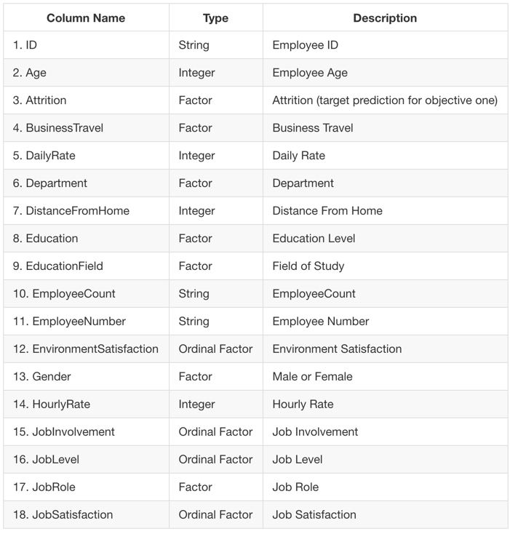
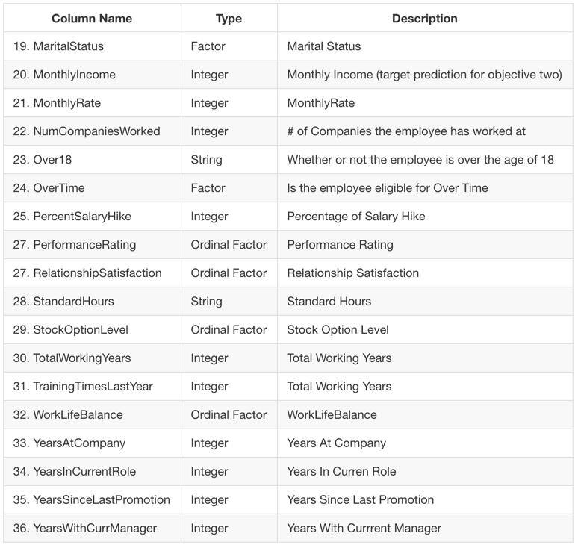
Data Dictionary
870 observations with 36 columns
Notes:
2,410 US craft beers
558 US craft breweries

Slide 4
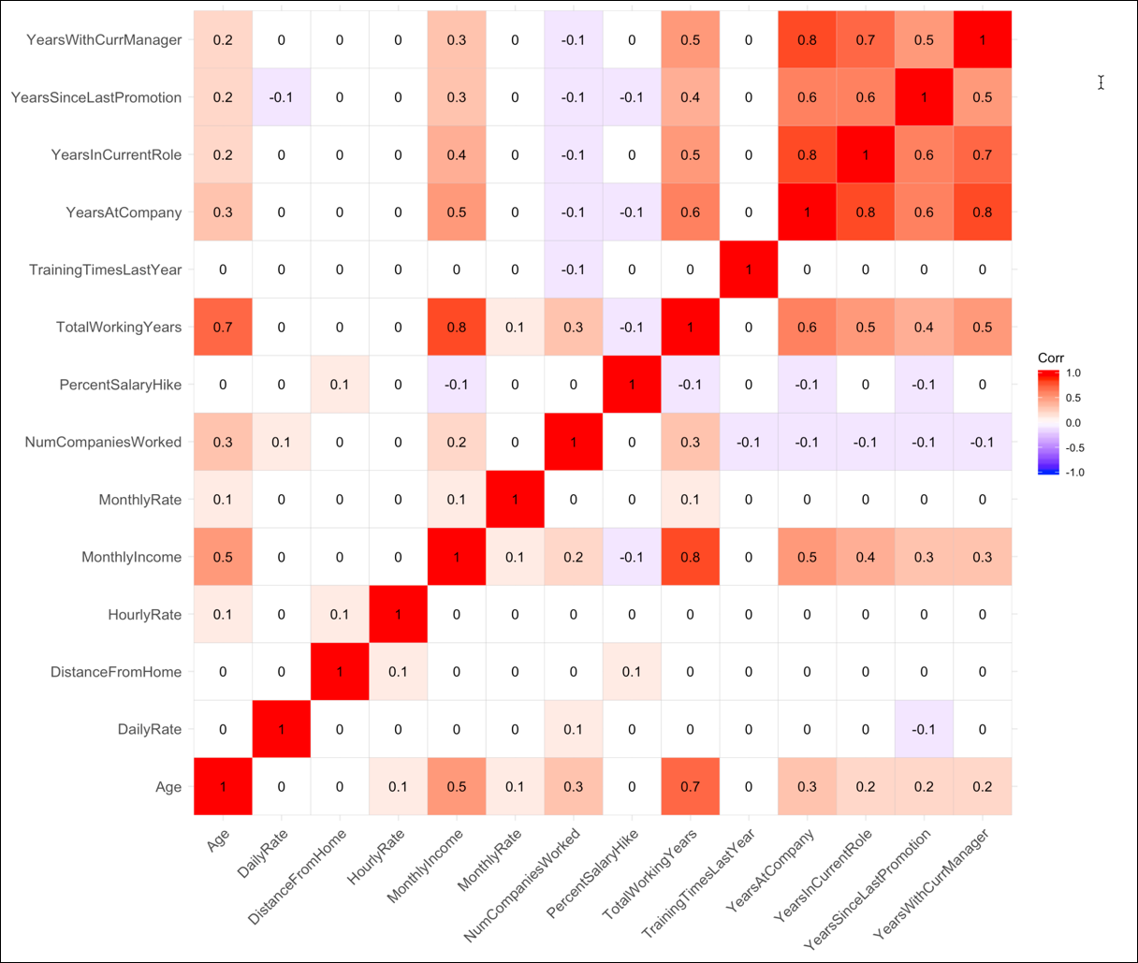
Correlation Plot

Slide 5
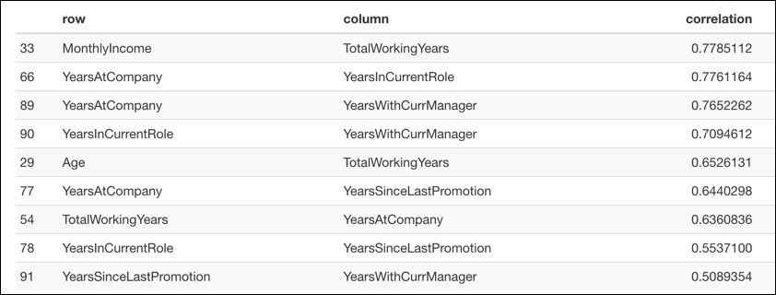
Correlation Matrix
Monthly Income seems to be relatively correlated with the employee’s total working years

Slide 6
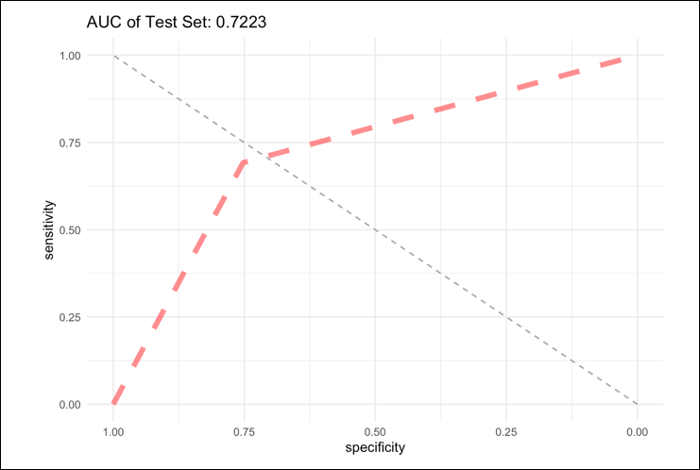
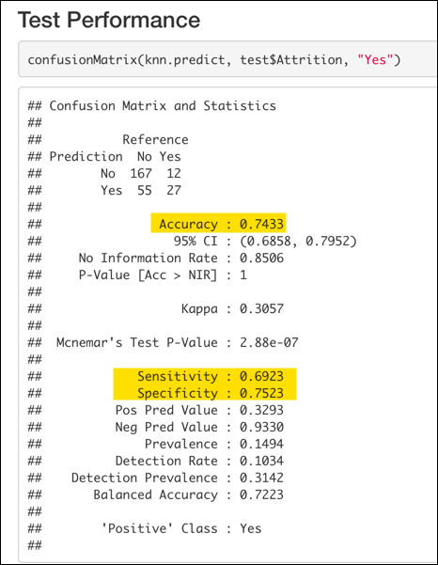
Attrition Prediction (KNN)
Using a 10-fold Cross-Validated resampling with k = 15, the model was able to achieve an an AUC (Area under the Curve) of 0.7223 against our test data set.

Slide 7
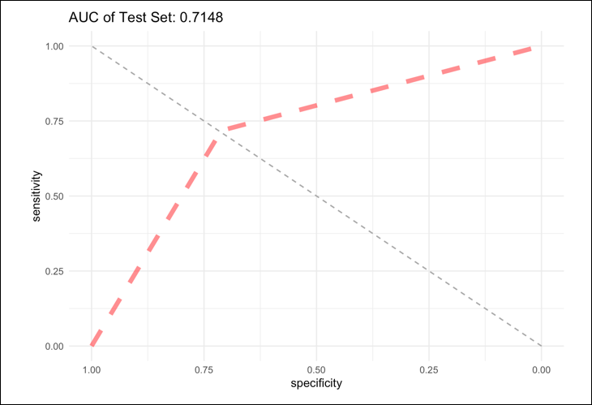
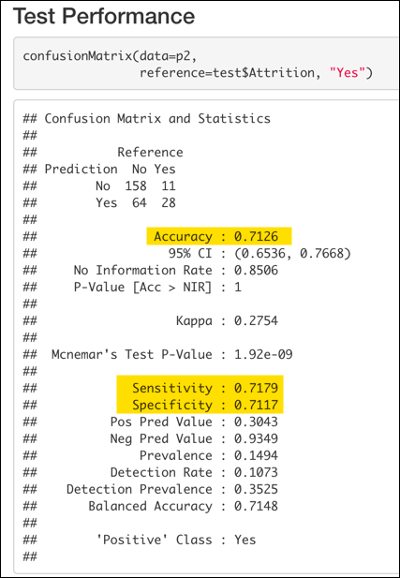
Naive Bayes
With a 70/30 train-test split with were able to achieve an AUC of 0.7148.

Slide 8
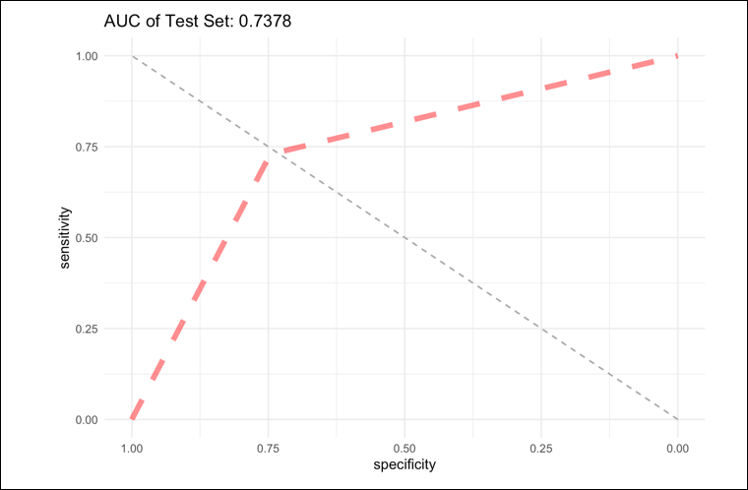
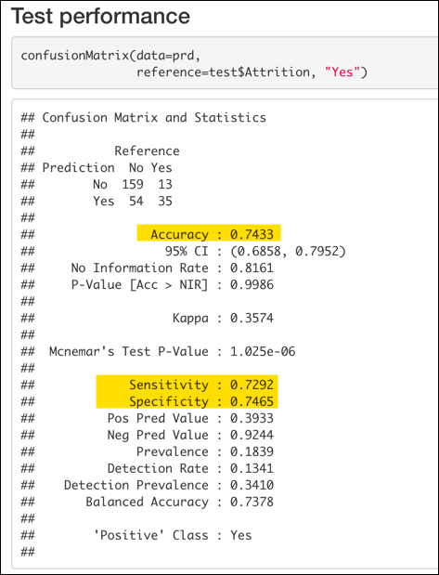
Random Forest
With the same 70/30 train-test split with the random forest model had an AUC of 0.7378

Slide 9
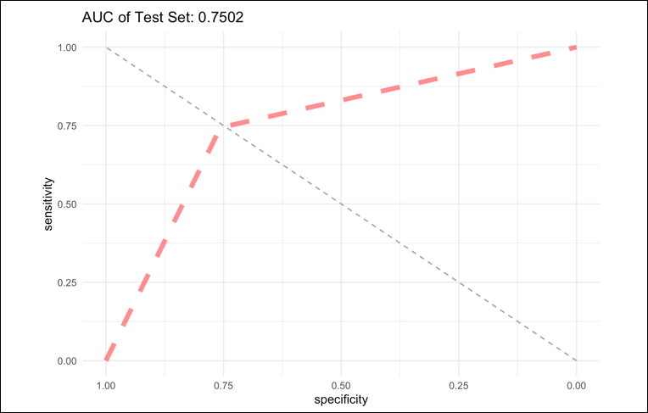
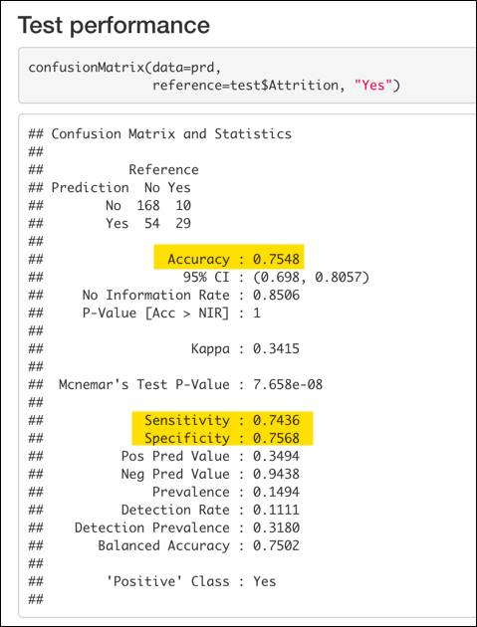
Support Vector Machines
And finally, we have the results for the best performing model with an AUC of 0.7502.

Slide 10
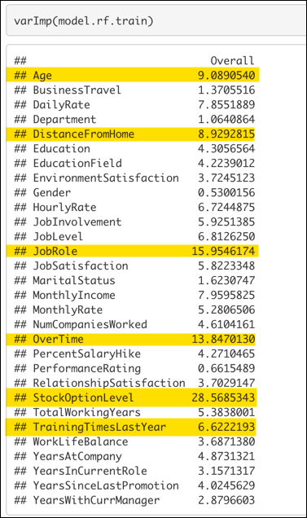
Variable Importance
Some models were capable of detecting which variables factored in most to the predictive accuracy of the given model
Stock Option Level
Overtime
Job Role
Age
Distance from Home
Notes:
Roughly 67% of the variation of a beer’s IBU rating can be explained by the ABV for observations which had both attributes to review.

Slide 11
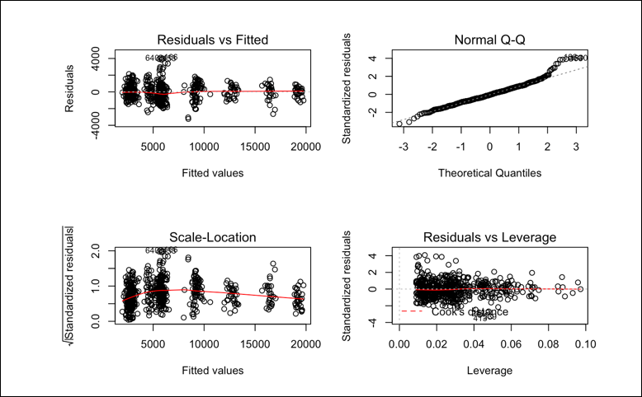
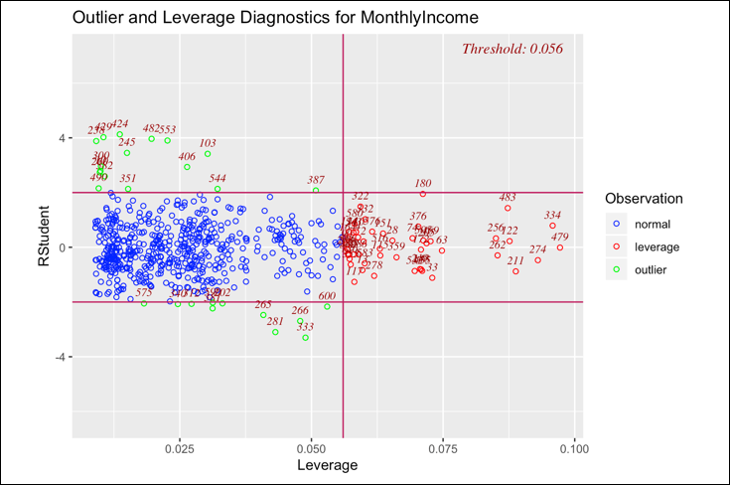
Salary Predictions
Assumption Checking
Residual Plots
Outliers and Leverage Points
Notes:
maximum alcoholic (ABV) beer? Colorado
most bitter (IBU) beer? Oregon

Slide 12
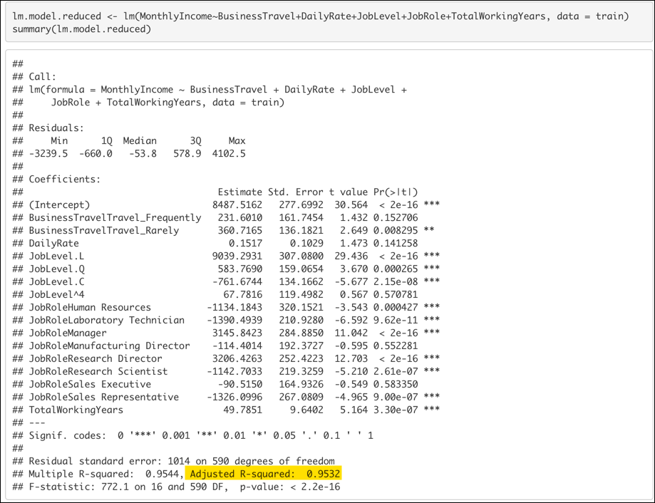
Multiple Linear Regression
Reduced Model
Business Travel
Daily Rate
Job Level
Job Role
Total Working Years

Slide 13
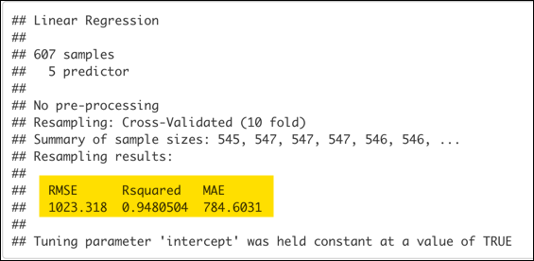
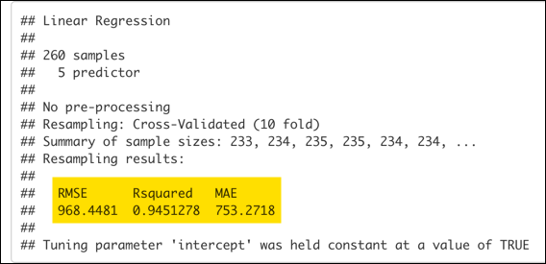
Cross Validation
Using a similar strategy of 10-fold cross validation, we were able to net lower RMSE and Adjusted R-Squared scores on the test set.
Train
Test

Slide 14
Conclusion
Model Performance was not substantially different between the classification models that were reviewed
Machine Learning algorithms can outperform classical models even with relatively small data sets
Cross Validation can hopefully net us similar results to our trained model against unseen data.

