Slide 1
Talent Management Case Study
DS 6306: Doing Data Science
Presented by Chance Robinson

Slide 2
Agenda
TOPIC | Time
Discovery Case Study Overview EDA Insights Model Comparisons for Classification Continuous Variable Prediction Outcome Conclusion | 5-7 minutes

Slide 3
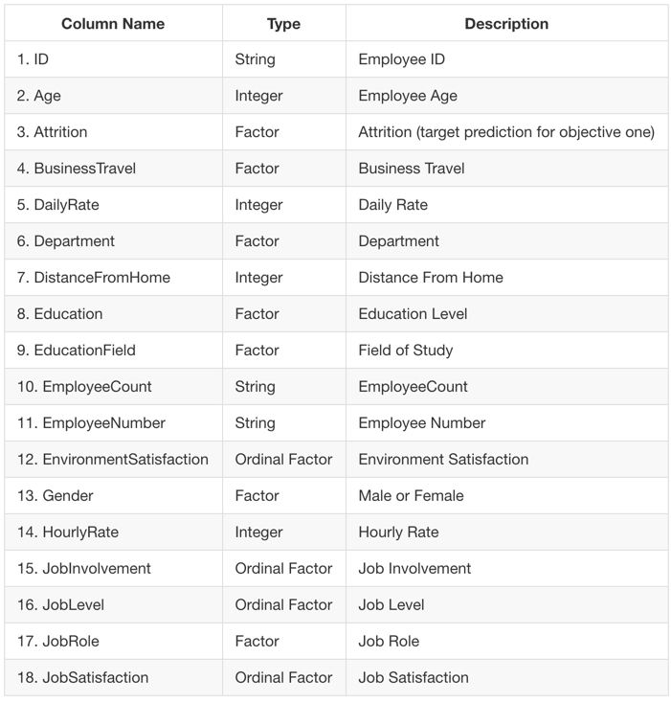
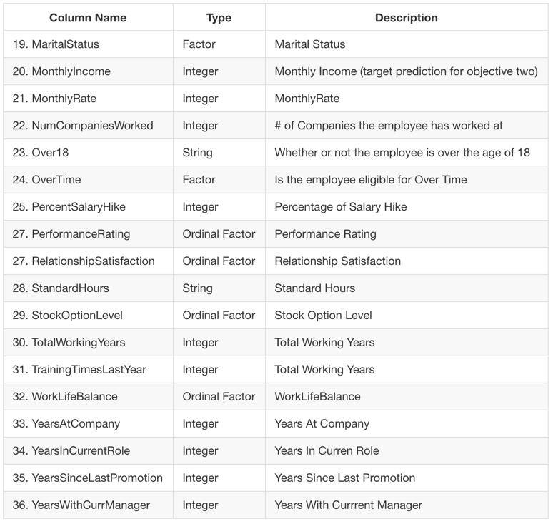
Data Dictionary
870 observations with 36 columns

Slide 4
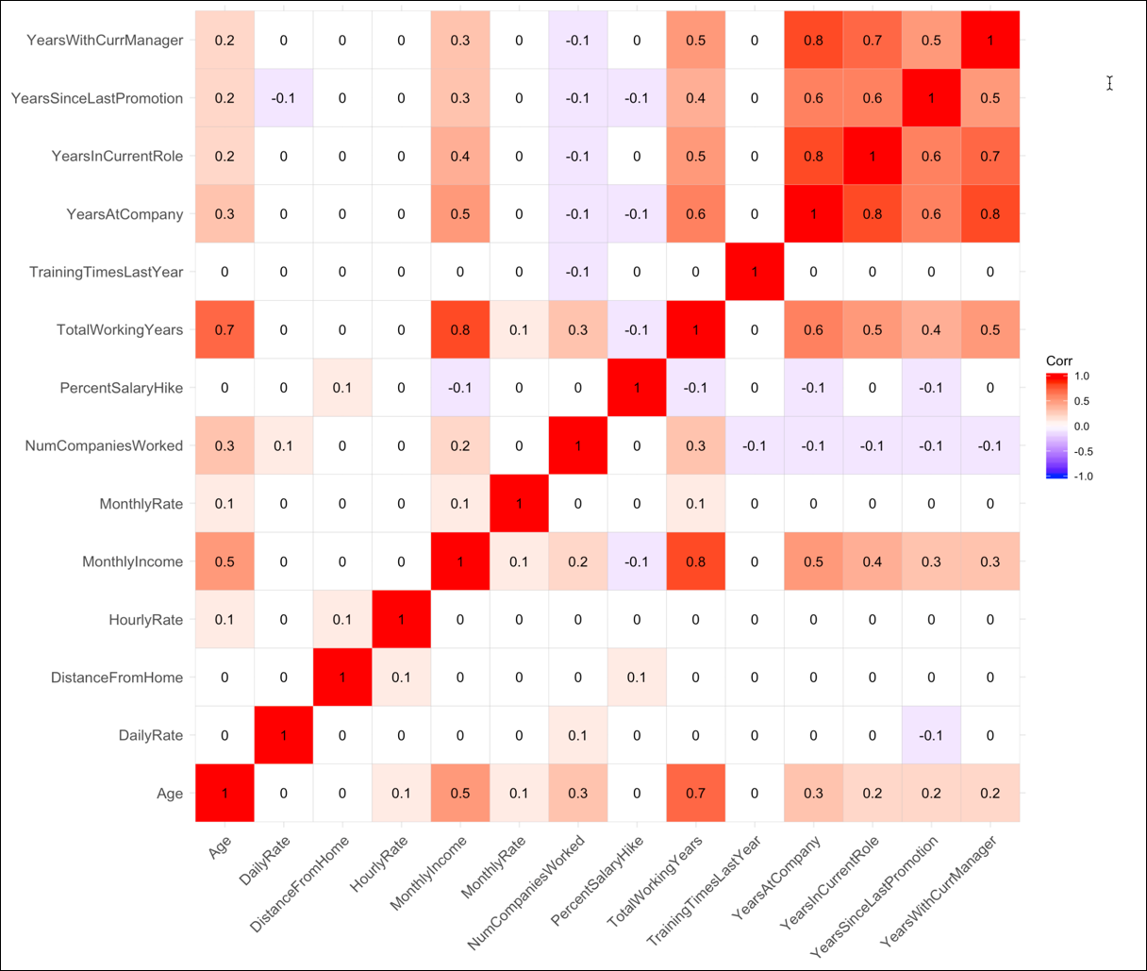
Correlation Plot

Slide 5
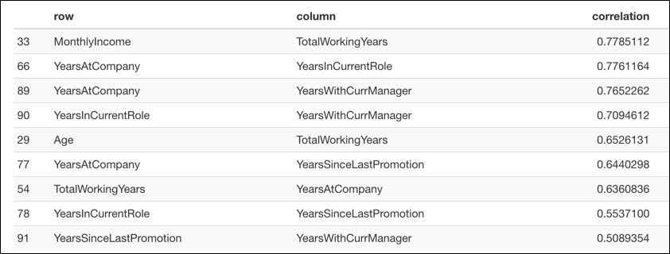
Correlation Matrix
As we saw on the previous slide, “years” based data points are correlated with other time-based measures, in addition to Monthly Income.

Slide 6
Attrition Prediction Models
KNN
K-Nearest Neighbors Clustering Classifier
Naïve Bayes
Probabilistic Classifier
Logistic Regression
Supervised learning classifier with decision boundaries
Random Forest
Multiple Decision Trees Averaged Out
Support Vector Machines
Similar to Logistic Regression but with wider buffers (vectors) between classes

Slide 7
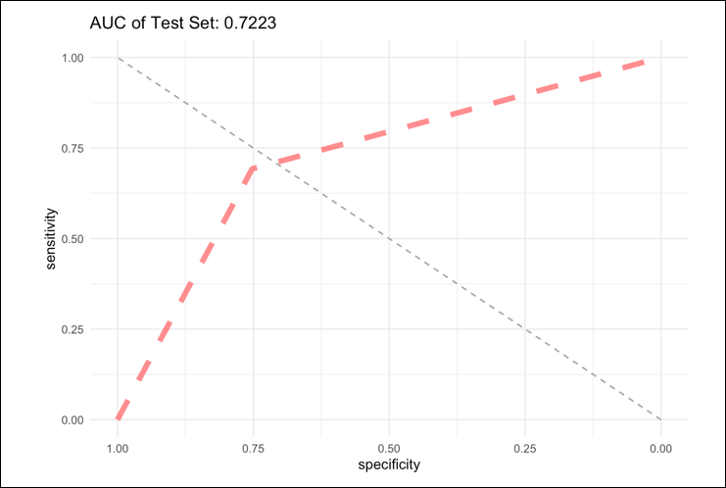
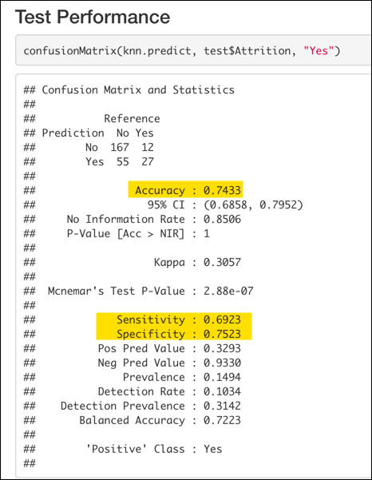
KNN
Using a 10-fold Cross-Validated resampling with k = 15, the model was able to achieve an AUC (Area under the Curve) of 0.7223 against our test data set.

Slide 8
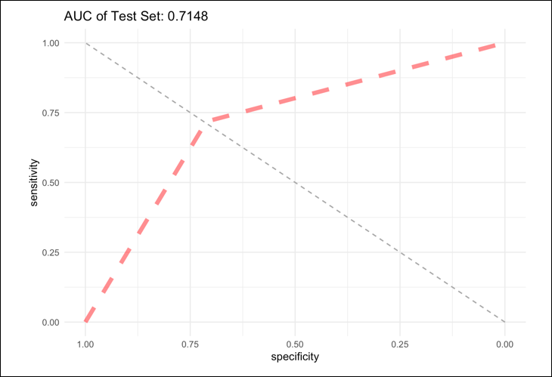
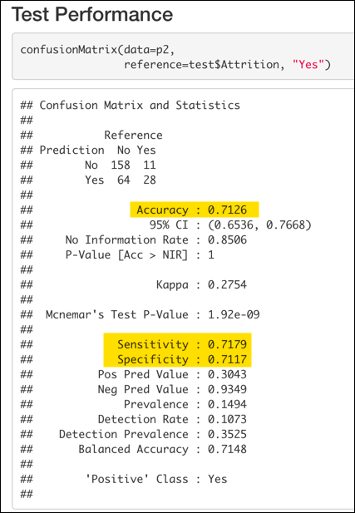
Naive Bayes
With a 70/30 train-test split with were able to achieve an AUC of 0.7148.

Slide 9
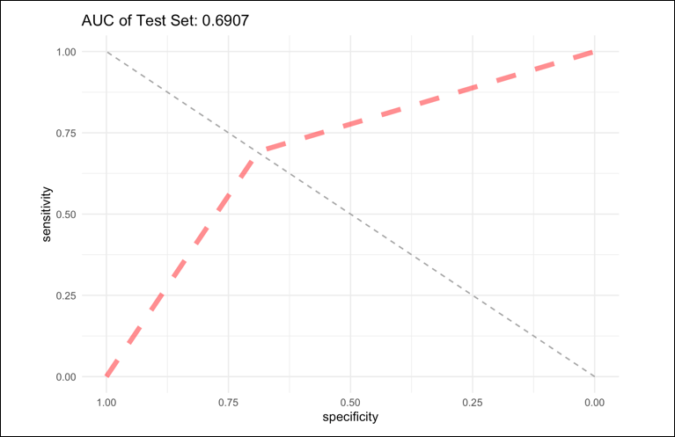
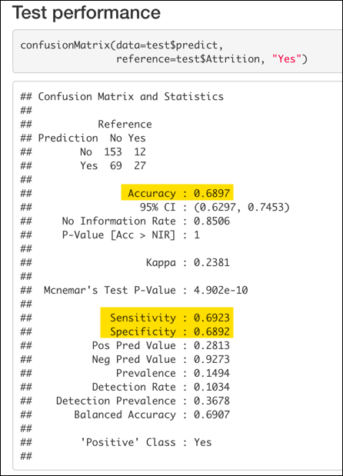
Logistic Regression
This model produced our lowest AUC of 0.6907.

Slide 10
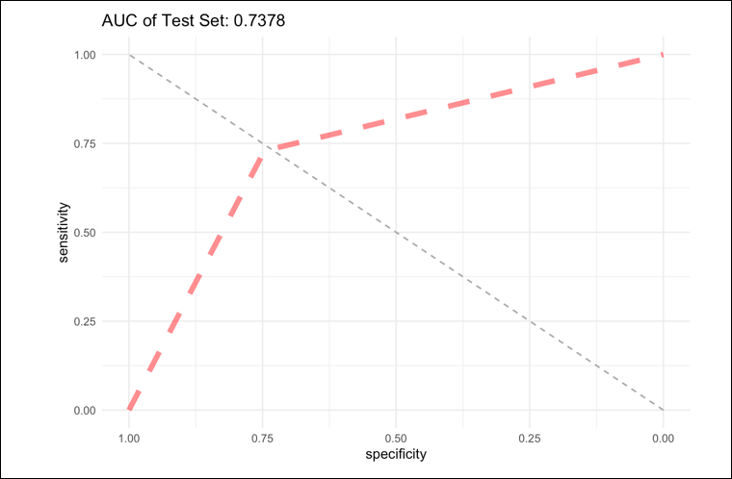
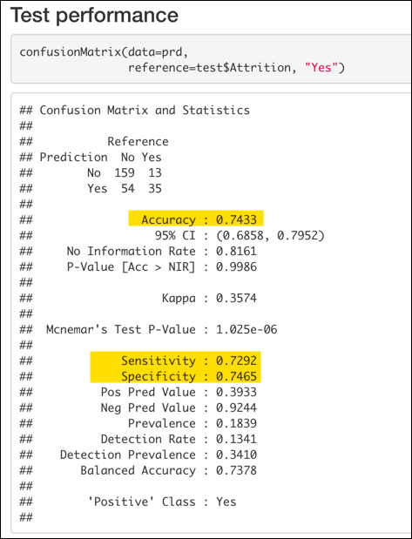
Random Forest
With the same 70/30 train-test split with the random forest model had an AUC of 0.7378

Slide 11
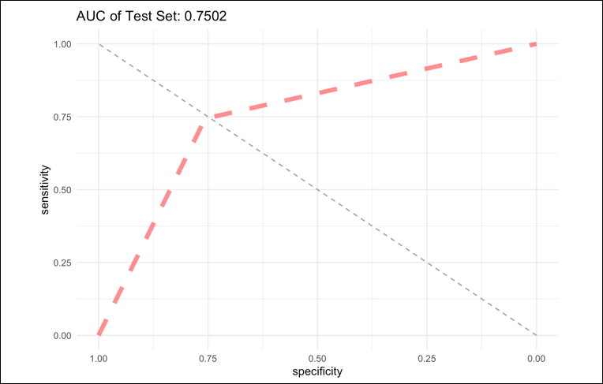
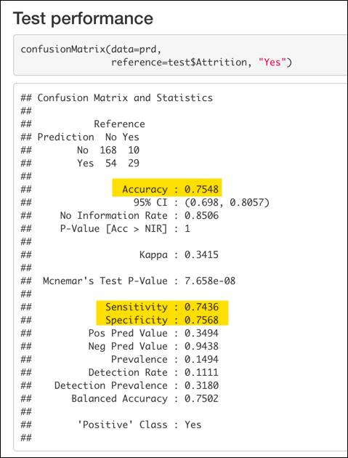
Support Vector Machines
And finally, we have the results for the best performing model with an AUC of 0.7502.

Slide 12
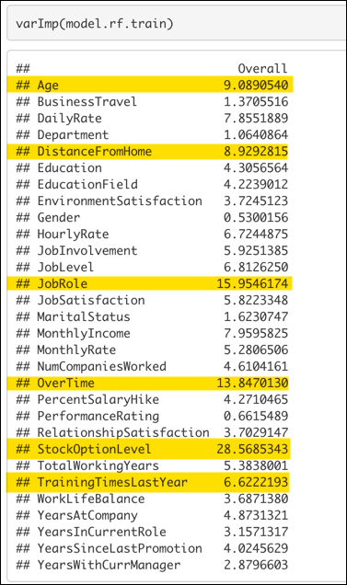
Variable Importance
Some models were capable of detecting which variables factored in most to the predictive accuracy of the given model
Stock Option Level
Job Role
Overtime
Age
Distance from Home
Training Times Last Year
Notes:
Roughly 67% of the variation of a beer’s IBU rating can be explained by the ABV for observations which had both attributes to review.

Slide 13
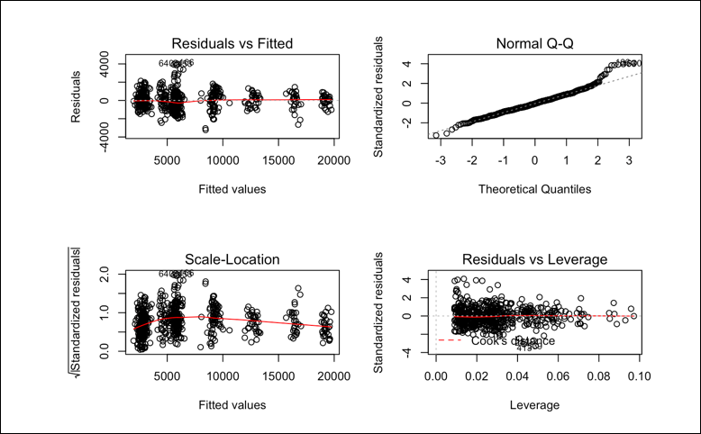
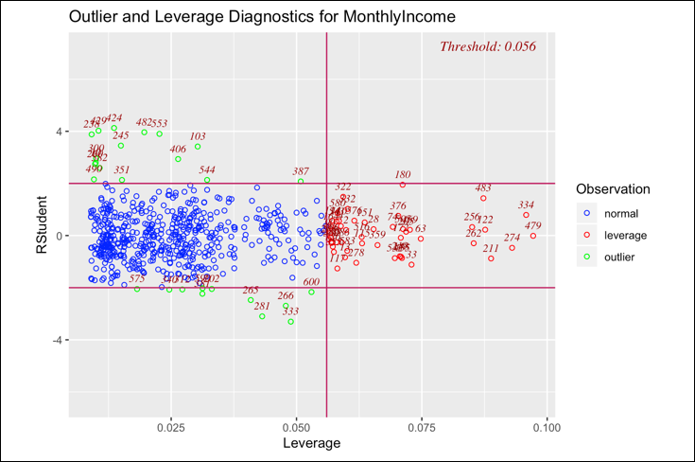
Salary Predictions
Assumption Checking
Residual Plots
Outliers and Leverage Points
Notes:
maximum alcoholic (ABV) beer? Colorado
most bitter (IBU) beer? Oregon

Slide 14
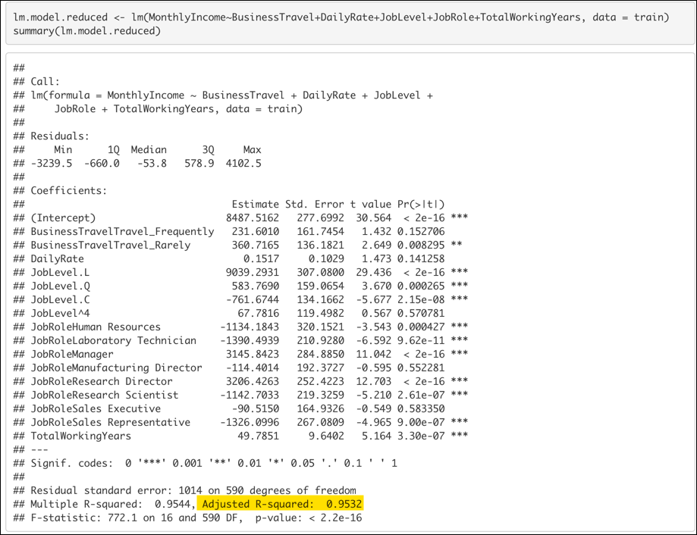
Multiple Linear Regression
Reduced Model
Business Travel
Daily Rate
Job Level
Job Role
Total Working Years

Slide 15
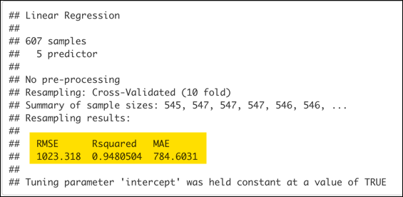
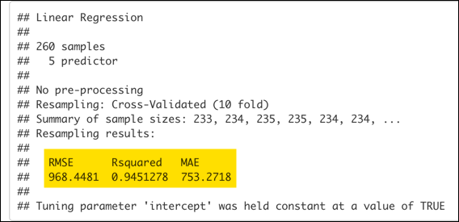
Cross Validation
Using a similar strategy of 10-fold cross validation, we were able to net lower RMSE and Adjusted R-Squared scores on the test set.
Train
Test

Slide 16
Conclusion
Model Performance surprisingly was not substantially different between the classification models that were reviewed
Machine Learning algorithms can outperform classical models even with relatively small data sets
Cross Validation was also instrumental in our ability to control for overfitting as we generally saw unrealistic performance outcomes with using only the training data set to validate against.

