Slide 1
Bike-Sharing Demand Final Presentation
DS 6373: Time Series
Presented by Chance Robinson and Kebur Fantahun
Notes:
PRESENTATION LINK: https://youtu.be/eX-eew_r7gw
Kebur
Hi, My name is Kebur, my teammate is Chance, and we would like to present our final analysis on bike sharing demand.

Slide 2
Agenda
TOPIC | Time
Discovery Introduction Data Set and Definitions Univariate Model Recap ARMA(25,1) Multivariate Models Vector Auto-Regressive (VAR) Multi-Layered Perceptron (MLP) Model Comparisons Summary | 7 minutes
Notes:
Kebur

Slide 3
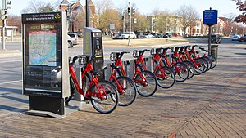
Introduction
A ‘green’ service that makes transportation accessible
Widely popular system; “500 bike-sharing programs around the world” –Kaggle
Members of the Capital Bike Sharing can opt for single trips, 24-hour passes or Annual Memberships
https://www.kaggle.com/c/bike-sharing-demand/overview
https://en.wikipedia.org/wiki/Bicycle-sharing_system
https://www.capitalbikeshare.com/
Notes:
Kebur
I would like to introduce what bike-sharing is. Bike-sharing is a service that allows people to pick up a bike from one dock, use it and return it to the same or another docking station all for a small fee, sometimes for free. As opposed to transport like cars, bikes offer an inexpensive, eco-friendly option to urban people by promoting less pollution and dealing with less traffic. As such, bike-sharing programs have become very popular and in turn provide a wealth of data on the mobility in a city.
This dataset outlines attributes related to customers’ travel. Data gathered by the rental companies includes things like the date, temperature, count of users, humidity and more. The explicit collection of data has the potential to assist in understanding the highs and lows of bike demand which could influence; when to offer a sale, which areas require redistribution, and in general when the best time to offer rentals is. Future data to inquire about and include could be the demographics of the city, the style of current marketing and how often redistribution is needed.
Here’s Chance

Slide 4
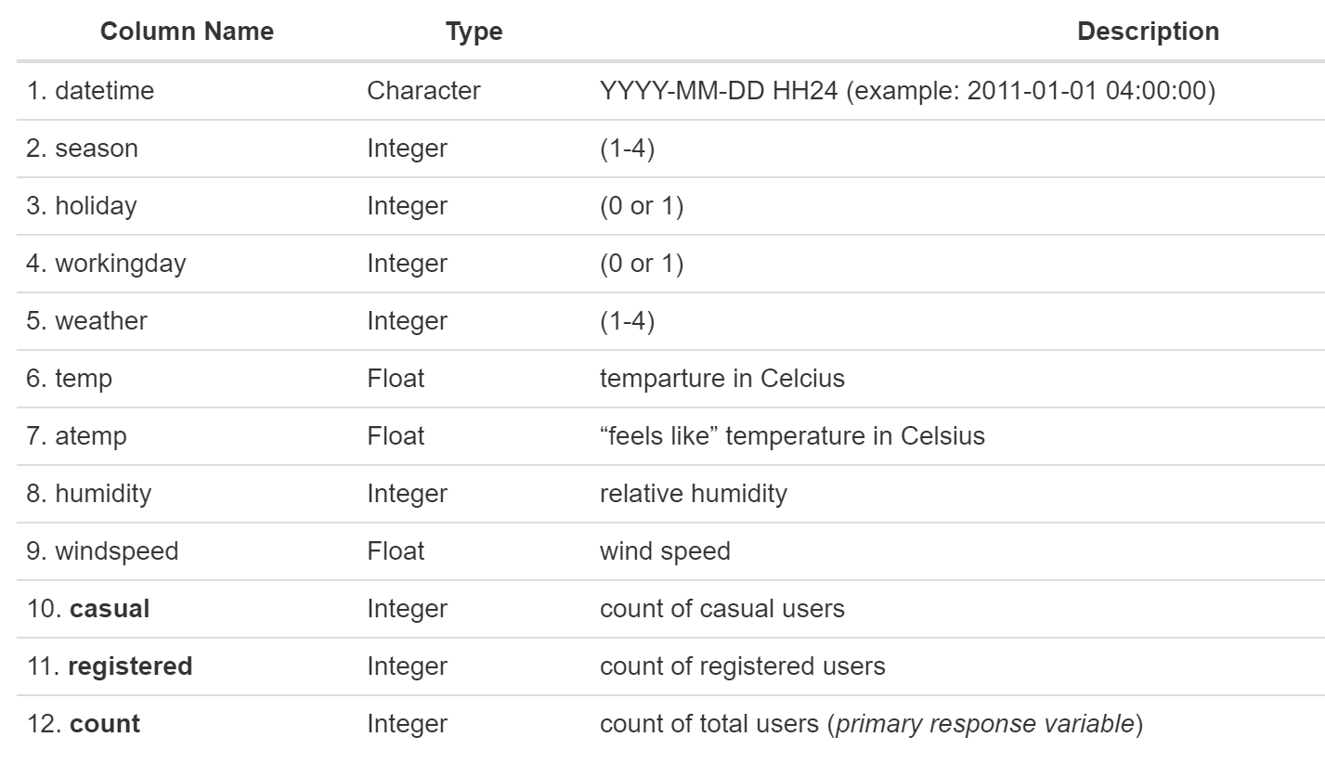
Data Sets and Definitions
train.csv (10,886 observations)
test.csv (6,493 observations)
Notes:
Chance
With our data set, we have 2 years' worth of monthly data split on the 19th of the month. …and this means that we don’t have actual counts from the 20th and on and unfortunately can’t use the entire training set. Because of that, we’ll be focusing on one month out of the 24 available.
You can see here that we also have additional categorical and continuous variables that will be used in our multivariate VAR and MLP models…which will touch on here in a bit.

Slide 5
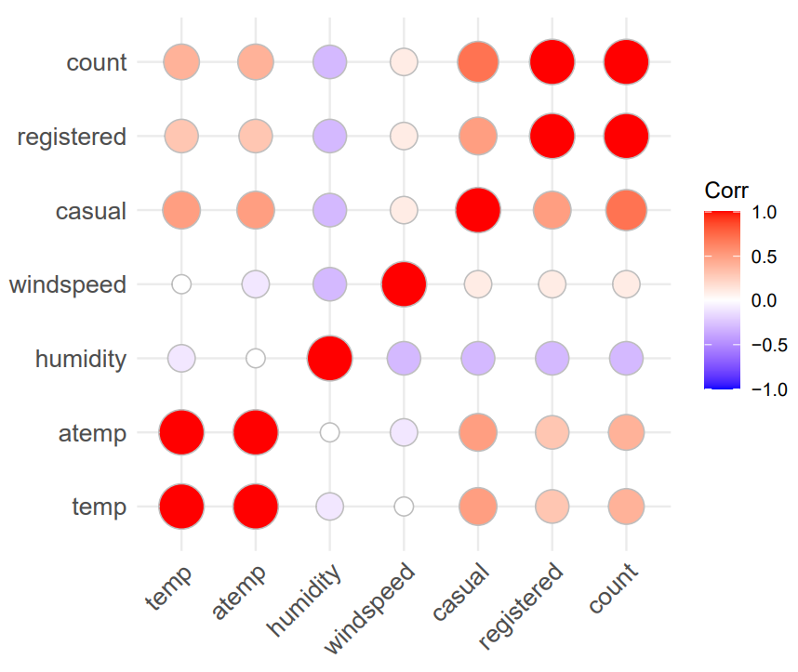
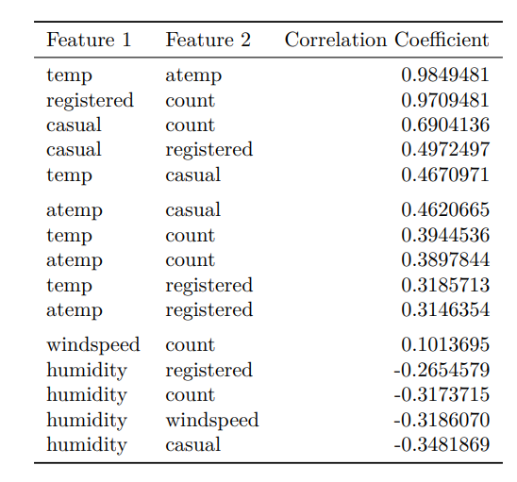
Correlation Matrix
Casual and Registered Users are strongly correlated with our primary response variable and will be dropped.
Notes:
Kebur
With count being the primary response variable, we will drop casual and registered users as these two make up the count itself. Following the table on the right, or the reddest dots, we can see that temp and atemp, are highly correlated. We will only use temp to avoid collinearity which would break our model assumptions that the data should be independent. We do not see all the categories here but the features we focus on are count, temp, humidity, weather and hour.

Slide 6
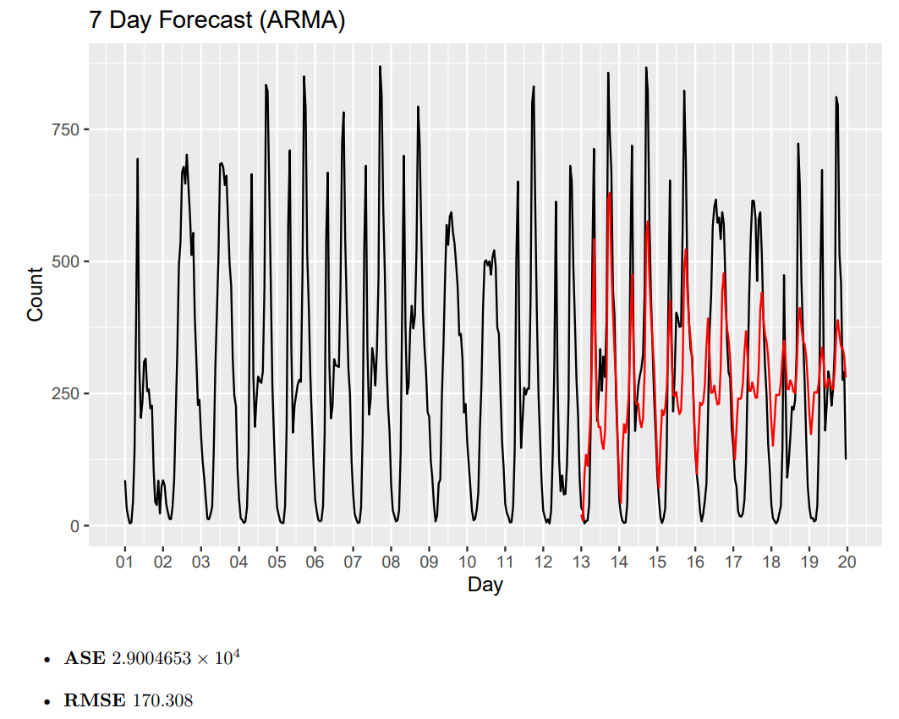
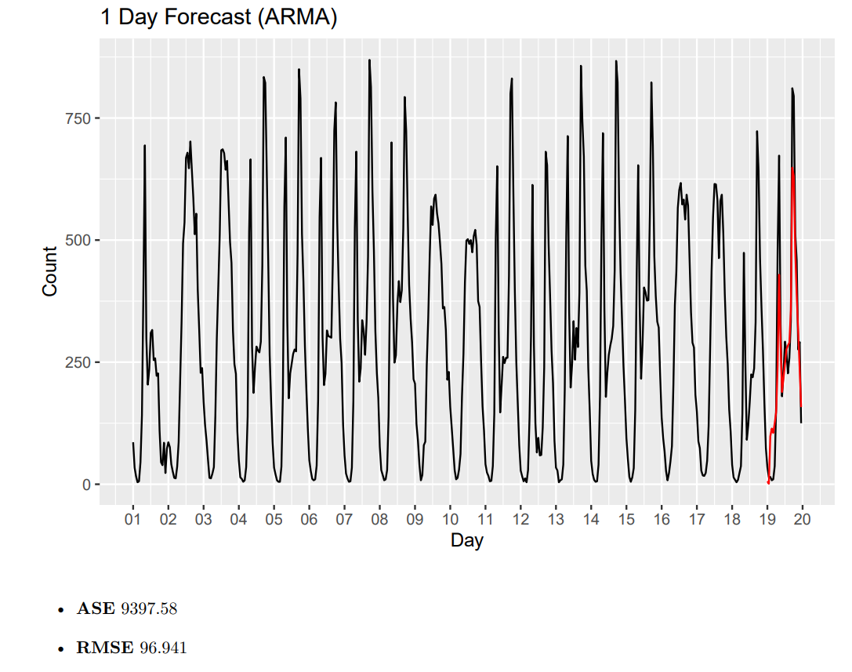
ARMA Model Forecasts
Realization from June 2012 (1st – 19th)
Long-Term forecasts start off well but tended to the mean after several days.
Notes:
Chance
Just a recap of our univariate analysis, we chose a realization from June 2012. We did attempt to attain stationarity by differencing and adding in seasonal components, but ultimately the ARMA(25,1) model was more effective at both short and long-term predictions.
Long-Term in our case was 7 days (or 168 observations out into the future)
Short-Term was 1 day (or 24 observations into the future)
Notice the poor performance on the long-term forecasts which grew closer to the mean the further out you went. This likely contributes to the higher ASE and RMSE scores when compared to other models.

Slide 7
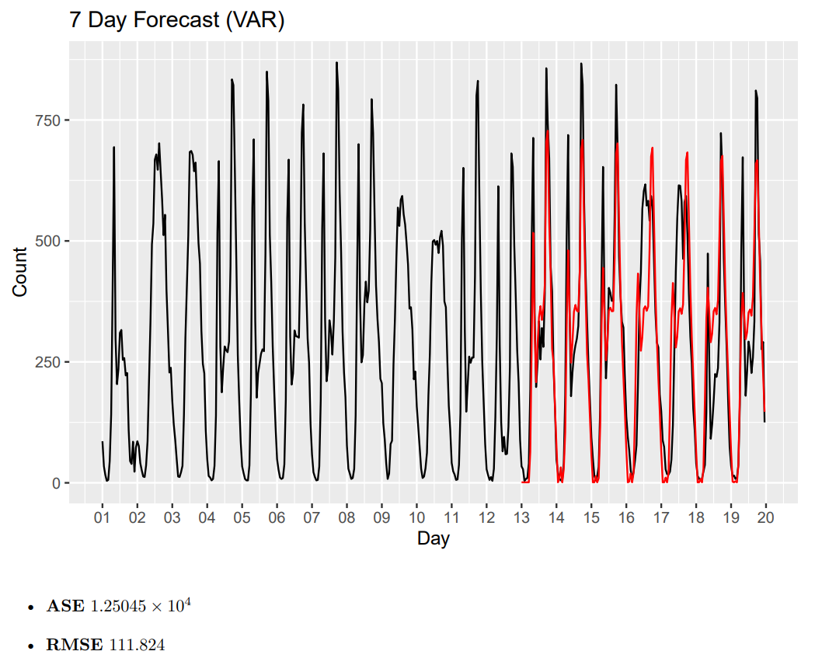
Long-Term Forecast (VAR)
Forecast Horizon
24 Hours x 7 Days
Hyperparameters
Multivariate Max Lag (24)
Type (Constant)
Additional Variables
Temperature
Humidity
Weather
Hour
VAR performs slightly better than ARMA.
Notes:
Kebur
Since we have hourly data, and we are forecasting in terms of days we use 24x7=168 observations when we look at the forecast horizon. (1 day = 24 observations)
VAR performs slightly better than ARMA. -> Although we have not included a seasonal component, the model seems to follow a sinusoidal/seasonal pattern.
The const. term in the VARselect means that a constant is included as a deterministic regressor by the VAR model in each equation.
The main premise of the VAR model is that, not only is the main realization ‘count’ considered, but we now add in simultaneous data such as temp, humidity, weather and hour which makes the model multivariate. Setting the maximum lag allows VAR to figure out the best lag combination between all the variables included.
---
CWR: From Chapter 10 of new book > “Since VAR models do not distinguish between dependent and independent variables, the goal is to use all of the variables and to simultaneously forecast all variables”.

Slide 8
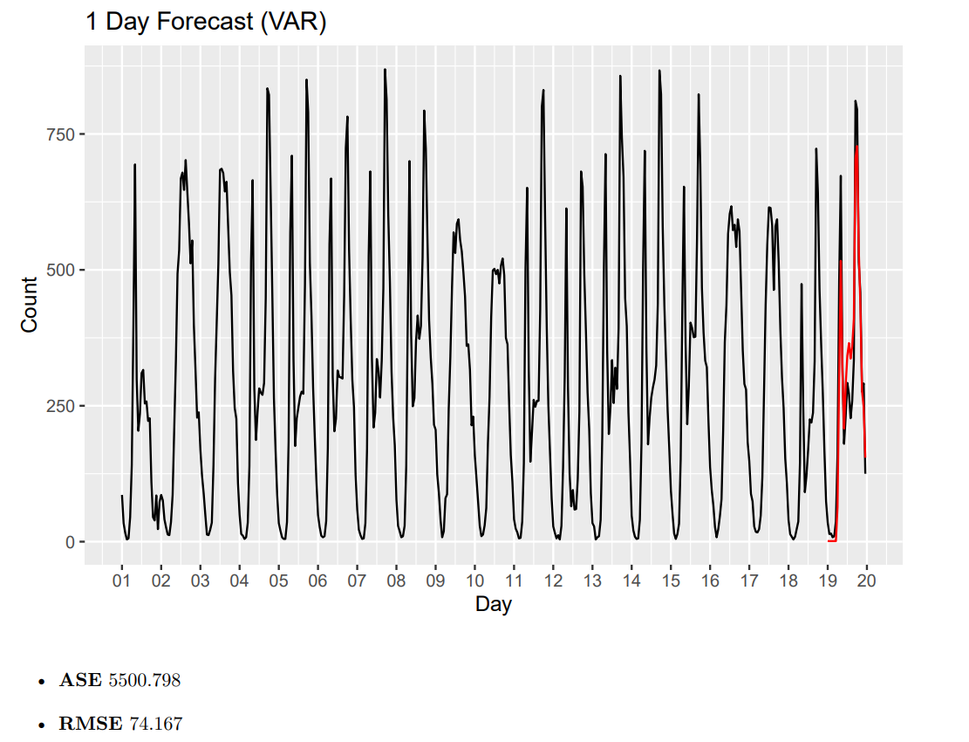
Short-Term Forecast (VAR)
Forecast Horizon
24 Hours
Hyperparameters
Multivariate Max Lag (24)
Type (Constant)
Additional Variables
Temperature
Humidity
Weather
Hour
VAR performs best on the short-term forecast.
Notes:
Kebur
Compared to MLP, VAR seems to run very quickly. If the analysis becomes more time-sensitive, VAR would be favorable to other models.

Slide 9
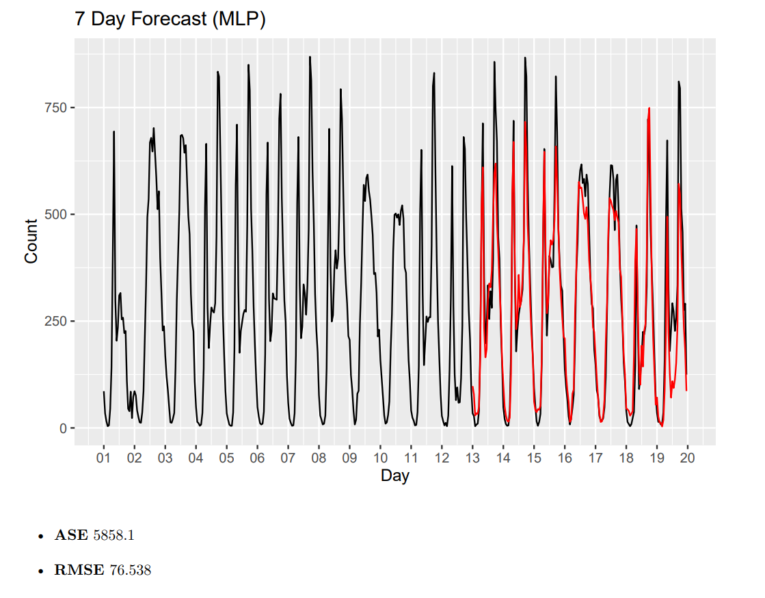
Long-Term Forecast (MLP)
Forecast Horizon
24 Hours x 7 Days
Hyperparameters
Univariate Lags (168)
Allow Deterministic Seasonality (F)
Difference Order (0)
Exogenous Variables
Temperature (1)
Humidity (1)
Weather (1)
Hour (24)
Forecasts pick up on both the hourly and the weekly trends.
Notes:
Chance
Setting the lags to the same number as the forecast horizon, 7 days = 168, actually helped the performance of this model. MLP had the best long-term predictions of all model types.
There were certainly a lot of hyperparameters to fine tune, and here are some of the ones that worked bests for us. Notice how the lags can differ based on the parameter.
allow.det.season - Permit modelling seasonality with deterministic dummies.
Xreg - Exogenous regressors. Each column is a different regressor and the sample size must be at least as long as the target in-sample set, but can be longer.
xreg.lags - This is a list containing the lags for each exogenous variable. Each list is a numeric vector containing lags. If xreg has 3 columns then the xreg.lags list must contain three elements. If NULL then it is automatically specified.
Difforder - Vector including the differencing lags. For example c(1,12) will apply first and seasonal (12) differences. For no differencing use 0. For automatic selection use NULL.

Slide 10
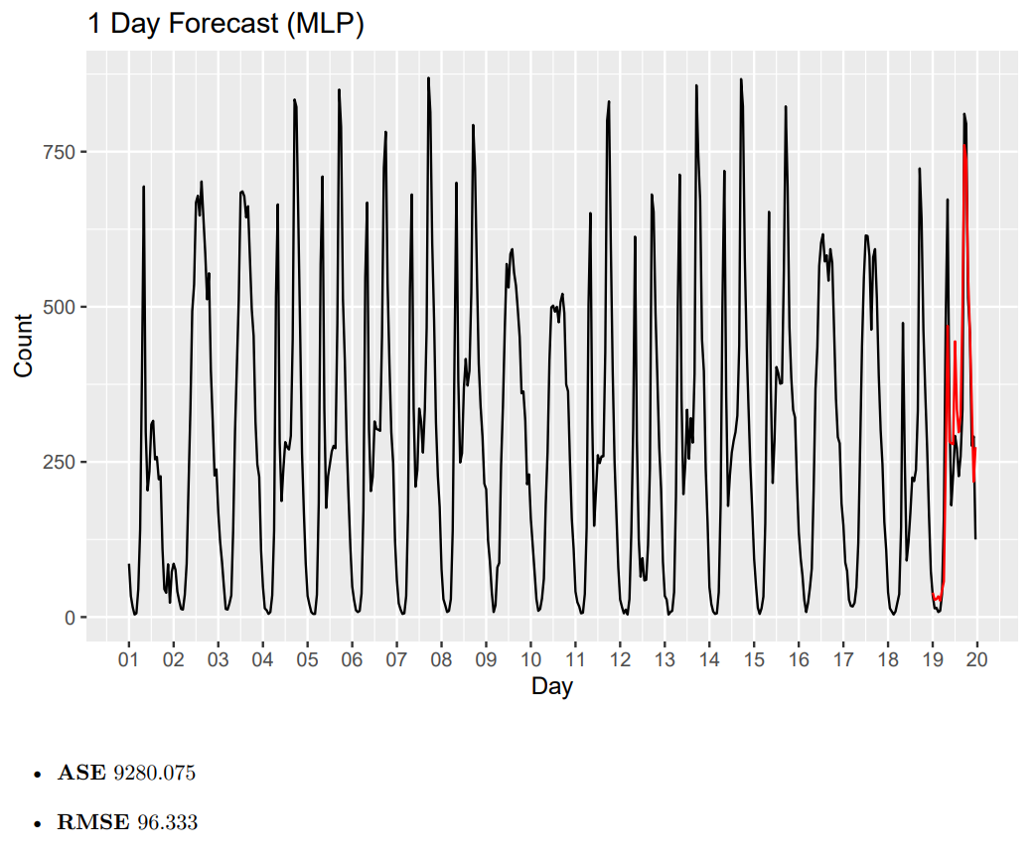
Short-Term Forecast (MLP)
Forecast Horizon
24 Hours
Hyperparameters
Univariate Lags (24)
Allow Deterministic Seasonality (F)
Difference Order (0)
Select Lags (F)
Exogenous Variables
Temperature (24)
Humidity (24)
Weather (24)
Hour (24)
Note that both the ASE and RMSE are worse than the long-term forecast.
Notes:
Chance
The lags were set differently for the short-term forecasts both on the target and exogenous variables. Interestingly enough, the performance was better for our long-term forecasts, but these particular settings seemed to work best for us here.
allow.det.season - Permit modelling seasonality with deterministic dummies.
Xreg - Exogenous regressors. Each column is a different regressor and the sample size must be at least as long as the target in-sample set, but can be longer.
xreg.lags - This is a list containing the lags for each exogenous variable. Each list is a numeric vector containing lags. If xreg has 3 columns then the xreg.lags list must contain three elements. If NULL then it is automatically specified.
Difforder - Vector including the differencing lags. For example c(1,12) will apply first and seasonal (12) differences. For no differencing use 0. For automatic selection use NULL.

Slide 11
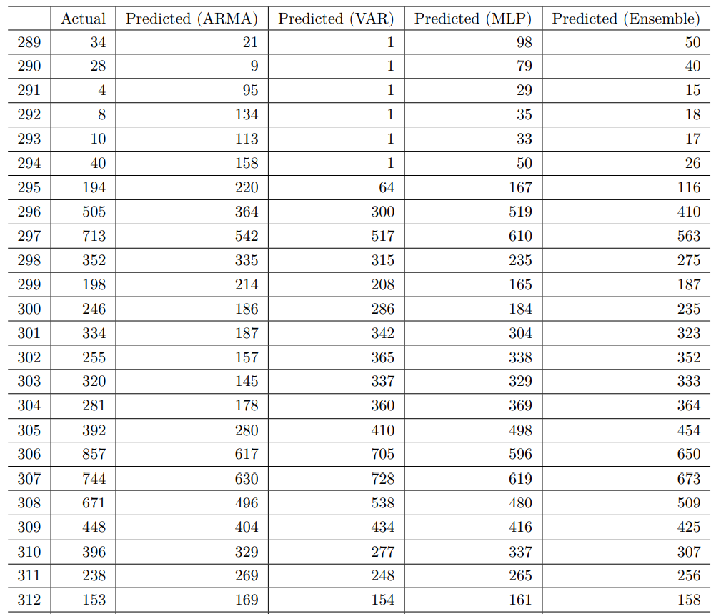
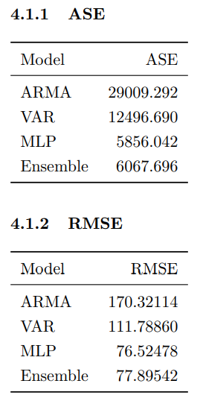
Model Comparisons (7 Days)
The MLP model outperformed other model types when forecasting 7 days in advance.
Notes:
Kebur
Here, we include the ensemble model error to compare. Our ensemble is built out of a rounded average between VAR and MLP. It turns out that for the 7-day, “long-term”, forecast the MLP performs best. Followed by the ensemble, var and then finally arma. Var likely performs better because it considers other data that happened at the same time compared to a strict ARMA(25,1). Similarly, the MLP model may perform well because of its ability to use multiple layers to understand how all the time series work together, with lag in mind.

Slide 12
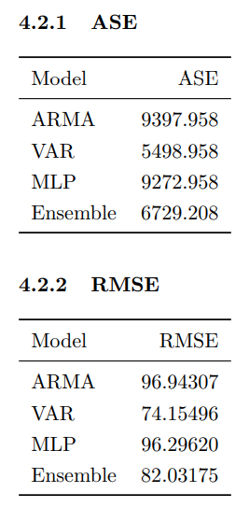
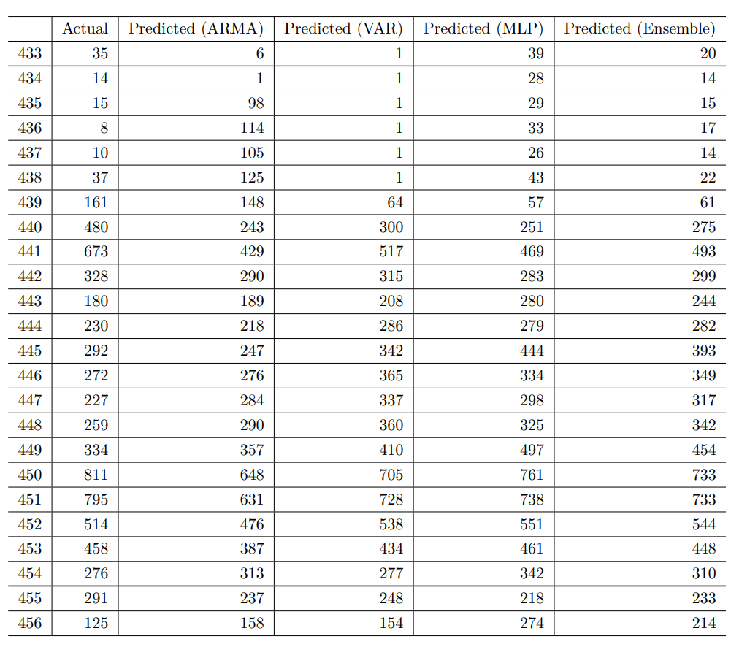
Model Comparisons (1 Day)
The VAR model significantly outperformed other model types when forecasting 24 hours in advance.
Notes:
Chance
VAR was the preferred method for short term forecasts. But note that the first six observations all have 1s as these were imputed. VAR had a tendency to predict negative values early on, which wouldn’t make any sense given that our hourly counts should never be zero or less. And it turns out that there were not any observations with fewer than one. ..and so that’s the imputation strategy that was used.

Slide 13
Summary
Model Selection
Could be influenced based on your forecast horizon
Lag Considerations
Parameter tuning for lags can sometimes net very different results
Conditions for Stationarity
Using stationary approaches on non-stationary data can be useful
Notes:
Chance
Model Selection
- VAR was great for short term forecasts whereas MLP was better for long term
Lag Considerations
- performance often varied with different forecast horizons or even model types (so its worth trying different options depending on your requirement)
Stationarity
- stationary modeling outperformed other techniques with our non-stationary data set (goes to show you not to discard those techniques even if there’s evidence that it might not be fit for use based on the conditions)
And that’s it for our analysis of the bike share data, thank you for your time.

