Slide 1
Bike Sharing Demand EDA
DS 6373: Time Series
Presented by Chance Robinson and Kebur Fantahun
Notes:
PRESENTATION LINK: https://youtu.be/eX-eew_r7gw
Kebur
Hi, My name is Kebur, my teammate is Chance and we would like to present our explorartory data analysis on bike sharing demand.

Slide 2
Agenda
TOPIC | Time
Discovery Introduction Data Set and Definitions Stationarity ACFs Spectral Density ARMA Model Factored form AIC ASE Rolling Window ASE Forecast Visualizations | 3 minutes
Notes:
Kebur

Slide 3
Introduction
Bike rentals where the customer can pick up and drop off a bike at their leisure at several locations has become popular. This dataset outlines attributes related to the travel of customers. Data gathered by the rental companies includes things like the date, temperature, count of users, humidity and more. The collection of attributes has the potential to assist researchers in developing an understanding of the mobility in a city.
Notes:
Kebur
Bike sharing programs have become very popular and provide a wealth of data on the mobility in a city.
Here’s Chance

Slide 4
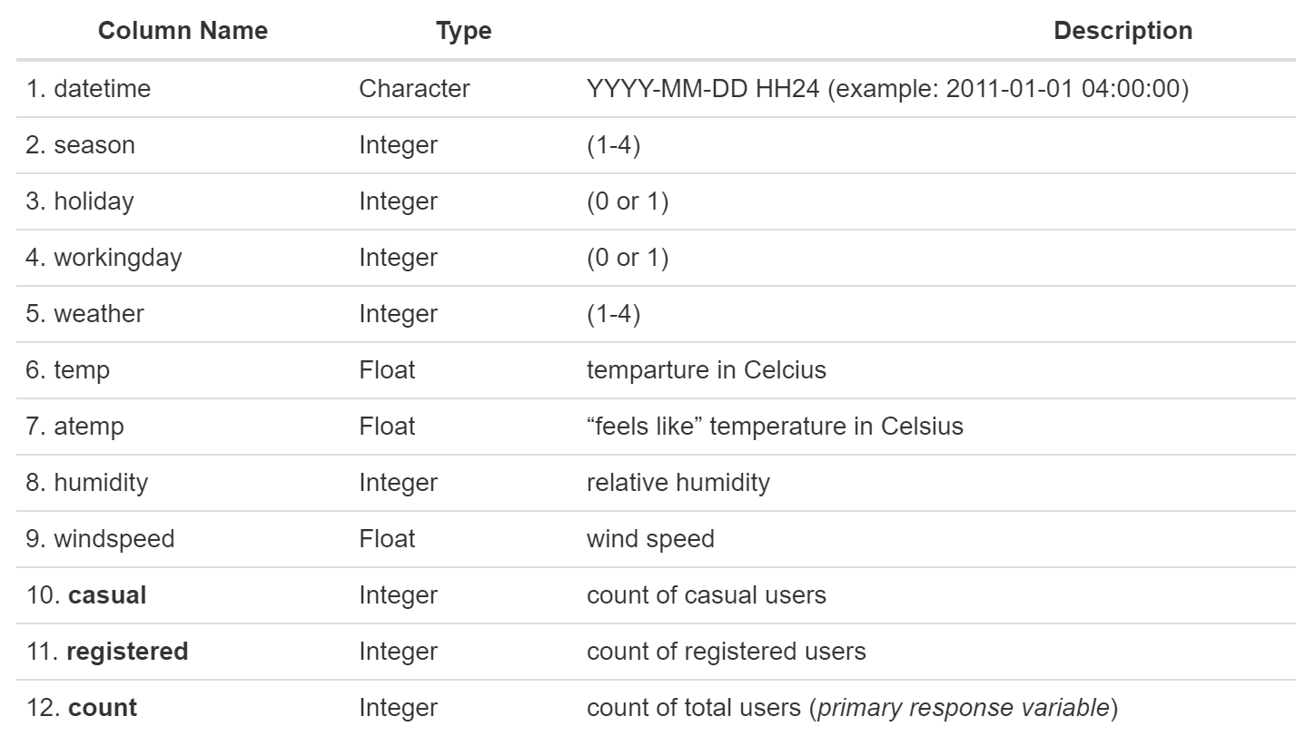
Data Sets and Definitions
train.csv (10,886 observations)
test.csv (6,493 observations)
Notes:
Chance

Slide 5
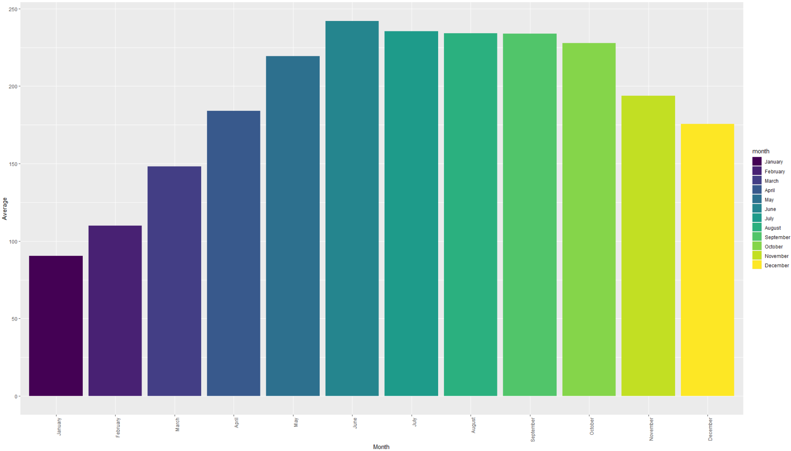
Average Hourly Rentals by Month
Notes:
Kebur
June 2012 (highest volume, and reason we used that time segment for modeling)
here is the avg hourly rental by month, we chose June 2012 as it had the highest volume of all the months. All the other months could be useful in future models
Here’s Chance

Slide 6
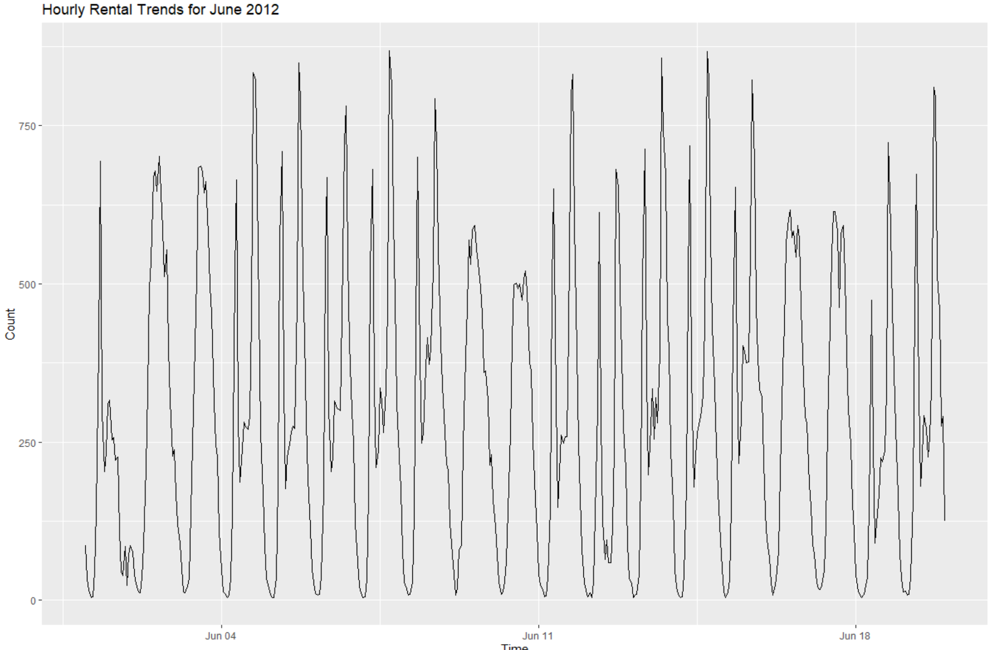
Stationarity
Realization from June 2012 (1st – 19th)
We will assume stationarity and model the time series with the requirement for constant mean and variance having been met.
Notes:
Chance

Slide 7
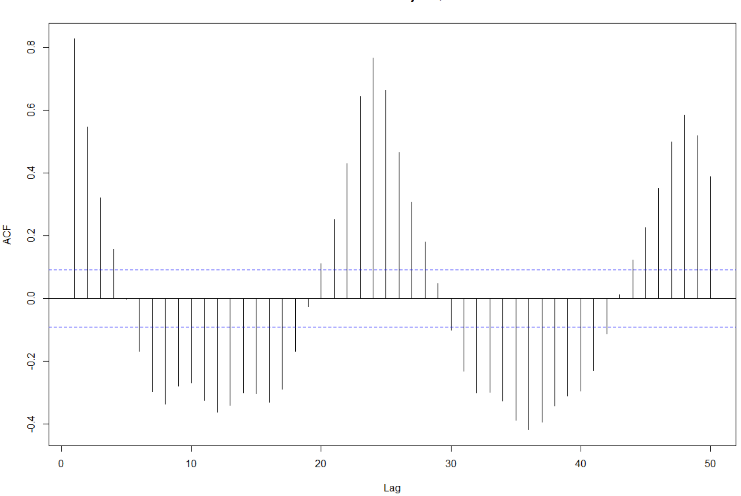
Auto-Correlation Plot
Strong sinusoidal trend with a period of 24, which would likely reflect the hourly cycles from how the data was recorded.
Notes:
Kebur
We see a peak at 24, this reflects the hourly cycle that the data is based off

Slide 8
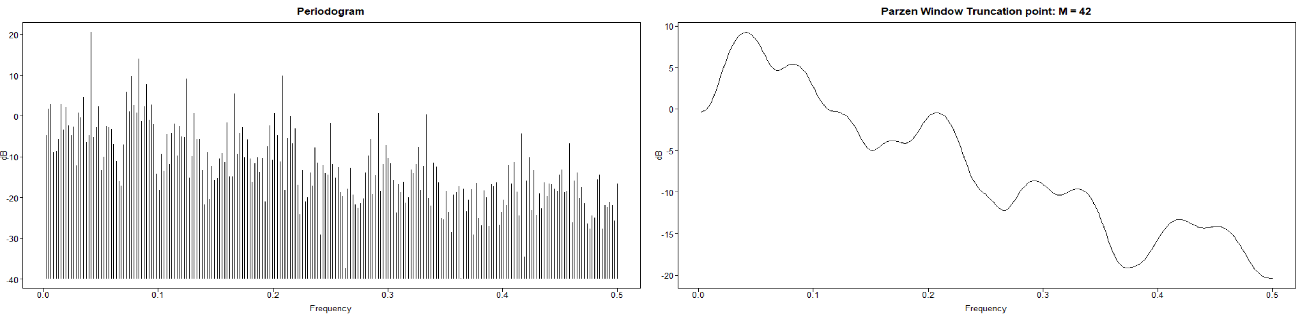
Spectral Density
A peak can be seen in the spectral density at around 0.04. Which would equate to a period of 24, which is what would be expected again from the frequency of our data set. You can also visually confirm this from the number of cycles in the realization and divide that by the total number of observations. (19 / 456 ~ 0.0417) From there the period can be calculated with 1 / frequency. (or ~24)
Notes:
Chance

Slide 9
ARMA(25,1) Model
(1−0.80B+0.15B2+0.04B3−0.05B4+0.02B5+0.09B6−0.09B7+0.30B8−0.34B9+0.10B10+0.12B11−0.06B12+0.03B13+0.05B14−0.09B15+0.20B16−0.16B17+0.05B18+0.10B19−0.06B20−0.003B21+0.06B22−0.13B23−0.45B24+0.31B25)(Xt−287.18)= (1+0.30B)at; σ2=5623.31
Mean
287.18
σ2
5623.31
AIC
8.99
Notes:
Kebur

Slide 10
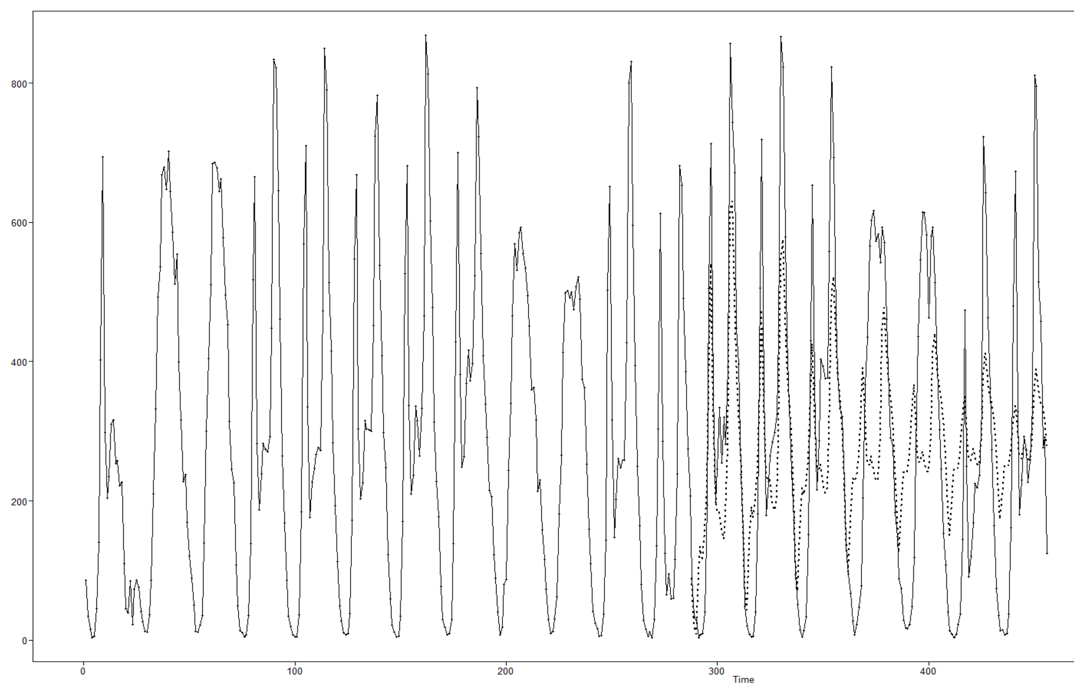
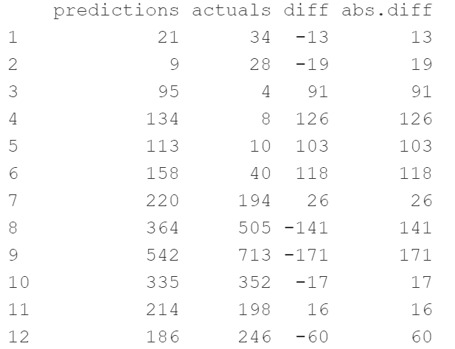
Long-Term Forecast (7 days)
ASE
29,005
RMSE
170
Notes:
Chance

Slide 11
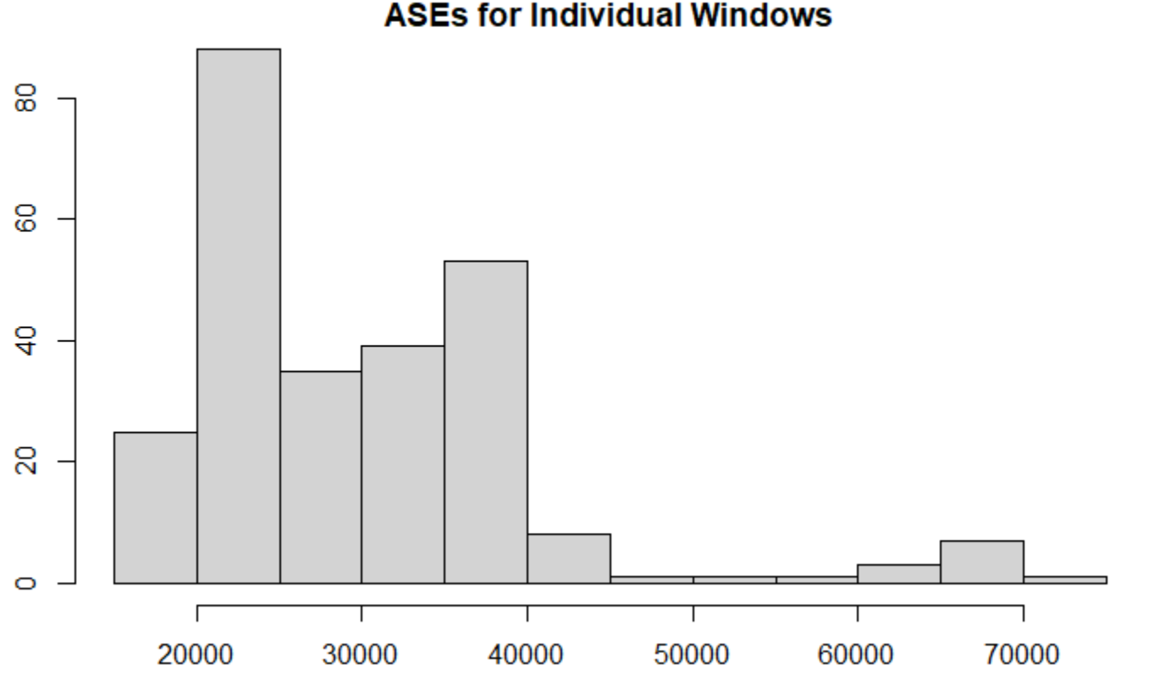
Long-Term Forecast (7 days)
Rolling Window ASE
30,053 (mean)
27,033 (median)
Original ASE
29,005
Notes:
Chance

Slide 12
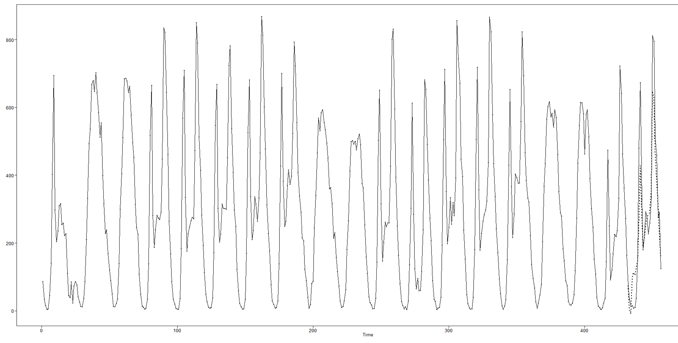
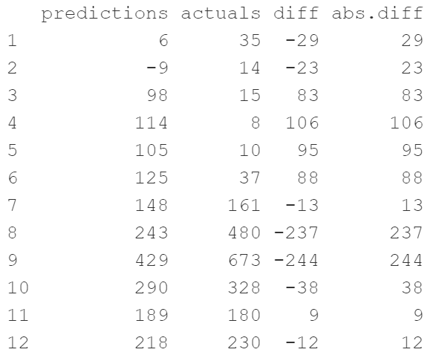
Short-Term Forecast (1 day)
ASE
9,398
RMSE
97
Notes:
Kebur

Slide 13
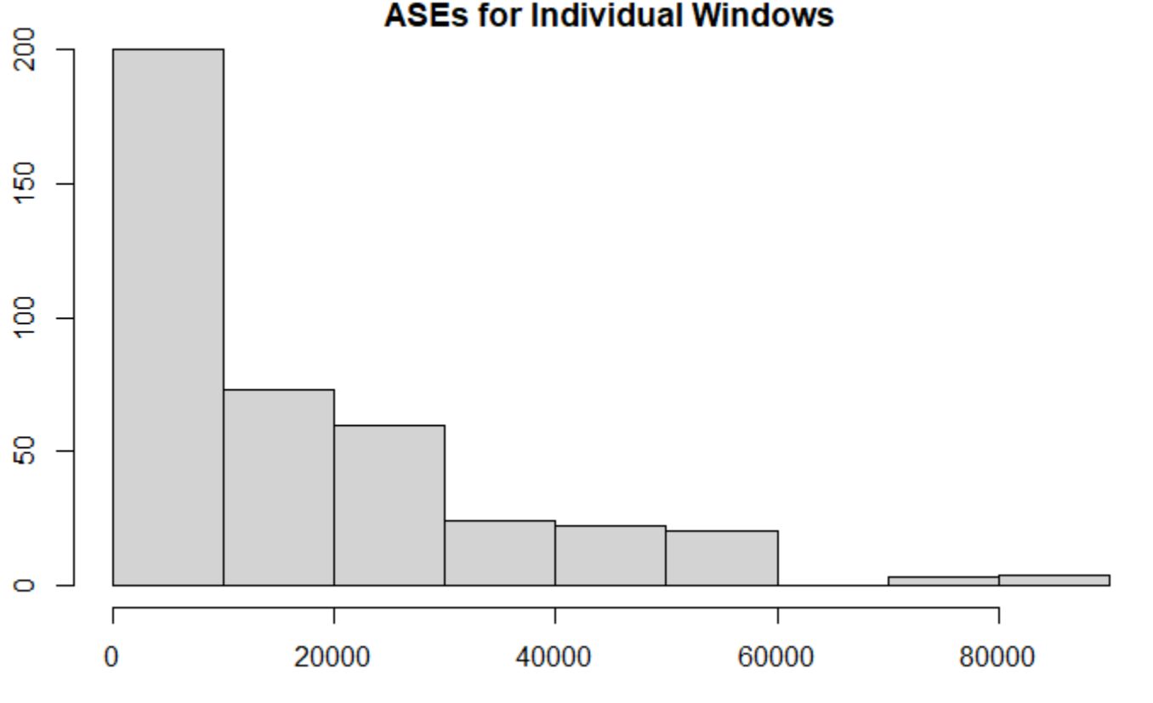
Short-Term Forecast (1 day)
Rolling Window ASE
17,002 (mean)
10,648 (median)
Original ASE
9,398
Notes:
Kebur

Slide 14
Next Steps
VAR Model
Utilize other categorical and numeric features
Neural Network
Ensemble
Expanded Training data set
Include all months and test against the last ~11 days of each (as opposed to just June 2012)
Notes:
Chance

Slide 15
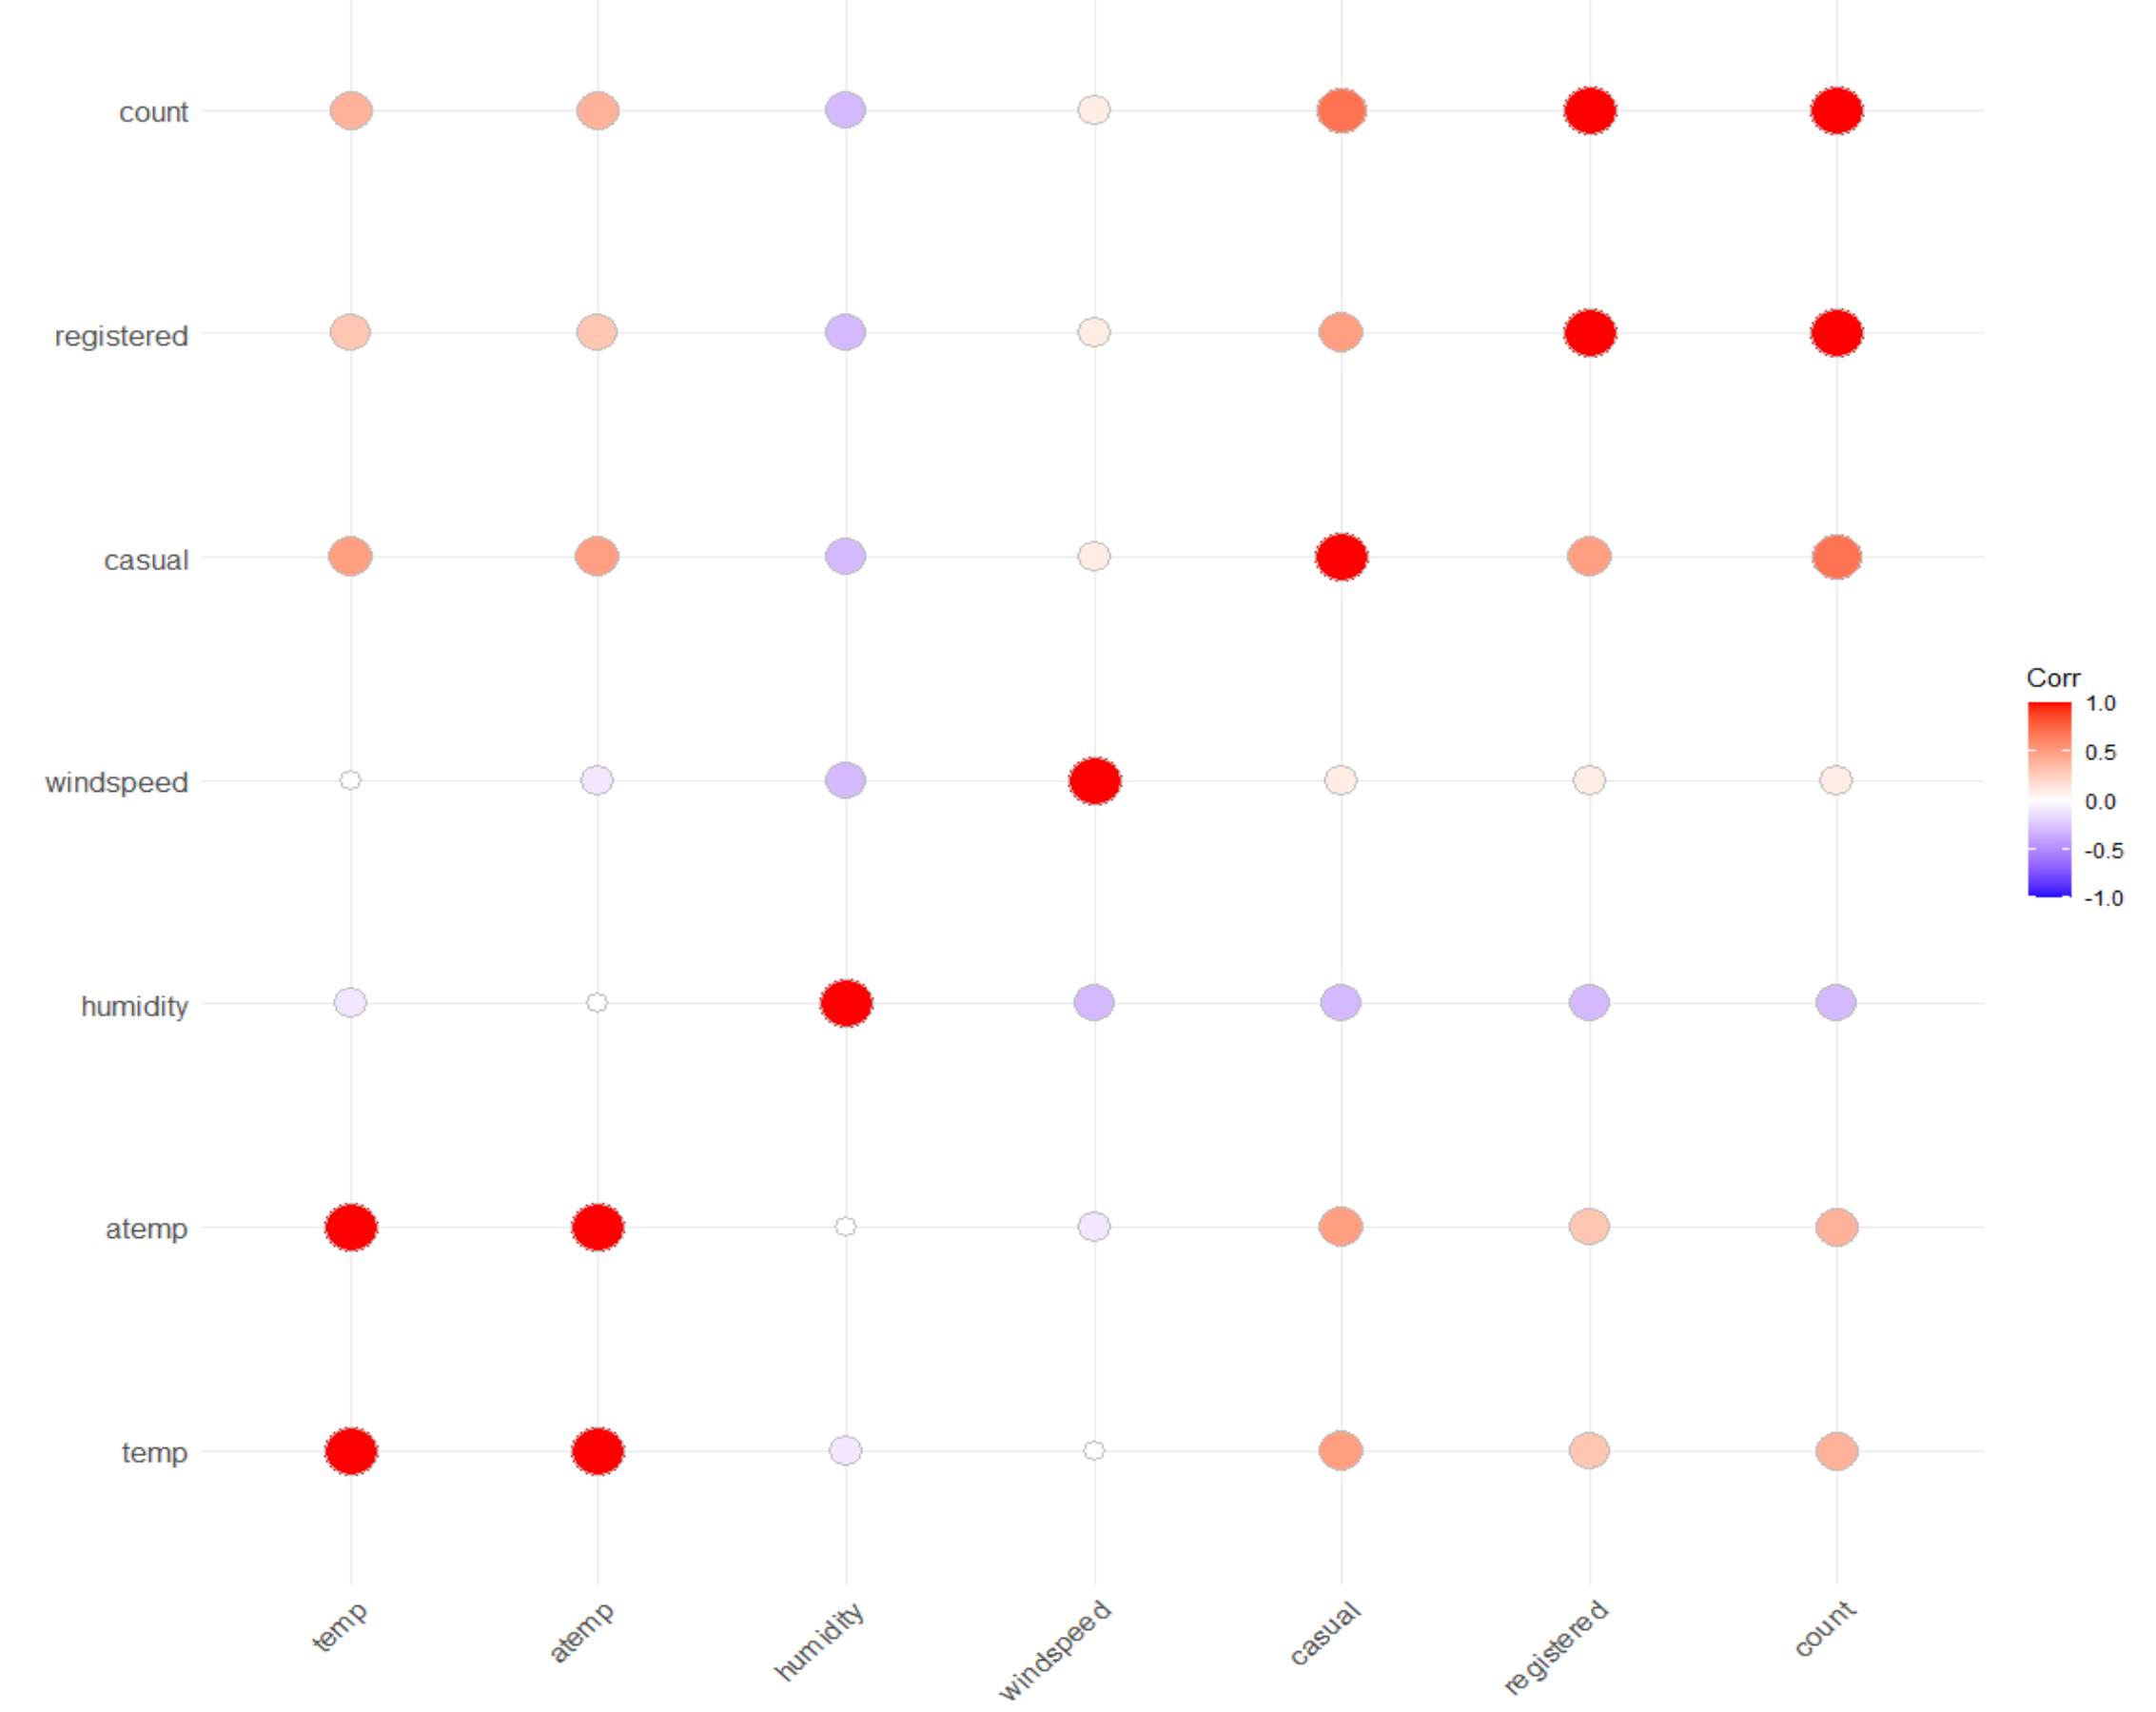
Correlation Matrix
Casual and Registered Users are strongly correlated with our primary response variable and should be dropped.
Notes:
Extra

