Slide 1
US Wildfire Analysis
DS 6346: Cloud Computing
Presented by Chance Robinson, Jeff Washburn and Sreeni Prabhala

Slide 2
Abstract
Goal of this project
Research of cloud technology on how it can be used to deploy a machine learning model that is fronted by an API endpoint to make predictions on cloud infrastructure
Question of interest
Given the size, location, date and other relevant features from the dataset, can we predict the cause of a wildfire in a cloud based, scalable way?
Remember Cloud is:
Model of computing where servers, networks, storage, development tools, and even applications (apps) are enabled through the internet.
5 characteristics of cloud computing environment
On-demand self-service: User can provision computing resources without human intervention including server time, storage, and software resources
Broadband Network Access: Resources can be accessed through public network
Resource Pooling: Services are pooled to serve multiple consumers using multi-tenant model. Physical and virtual resources allocation are dynamic based upon demand
Rapid Elasticity: Resources can be elastically provisioned and related to enable scaling whereas consumers seem to get virtually unlimited resources
Measured Services: Automatically optimize and control resources where resources utilization can be monitored, reported and controlled.
Notes:
2,410 US craft beers
558 US craft breweries

Slide 3
Data set Overview
1.88 Million US Wildfires - 24 years of geo-referenced wildfire records
Wildfires have broken out all over the western region of the United States in 2020, devastating communities and creating smoke plumes that can be seen even from space via satellite images. Some billows of smoke have carried over to places as far away as London, and it has been said that cities such as San Francisco and Seattle have some of the lowest quality of air on the entire planet currently due to the fires. As one of us lives close to the Bobcat Fire in California, which has currently burned over 93 thousand acres of land, the team thought it would be an interesting topic to delve into the data that has been collected in this domain over the past quarter century or so to mine any insights.
Kaggle dataset on 24 years of wildfires in the United States from 1992 to 2015.
Core attributes on each fire captured including:
Discovery Date
Final fire size
Point location (least as precise as Public Land Survey System) section (1-square mile grid)
In all, the data set includes 1.88 million geo-referenced wildfire records that equates to 140 million acres burned over the 24-year timeframe.

Slide 4
Solution Aspect - Methodology
Cloud to help predict the cause of wildfires:
Ascertain dataset
Explore data doing exploratory data analysis
Create classification models
Naive Bayes
Decision Trees
Measure model performance
Deploy model to AWS infrastructure
Create gateway for REST based API call
Use AWS lambda to deploy model to then fulfill prediction request
Track model execution request using Amazon’s Relational Database Service (Amazon RDS)

Slide 5
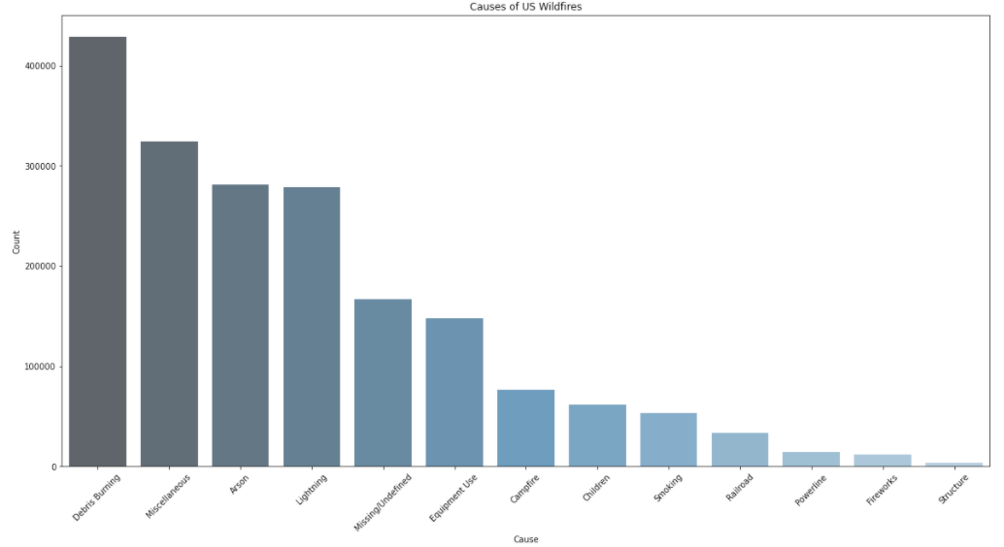
EDA - Visualization
Distribution of the causes of wildfires as seen in Fig 1.
Fig 1 - Causes of US Wildfires

Slide 6
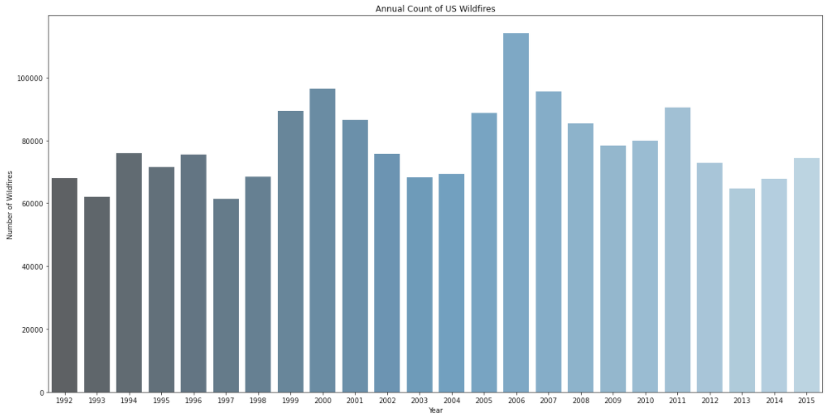
EDA - Visualization
Looking at the number of wildfires per year, it’s somewhat consistent year over year. While some years are higher, especially 2006, distribution of fires is spread out over the years as seen in Fig 2.
Fig 2 - Annual Count of US Wildfires

Slide 7
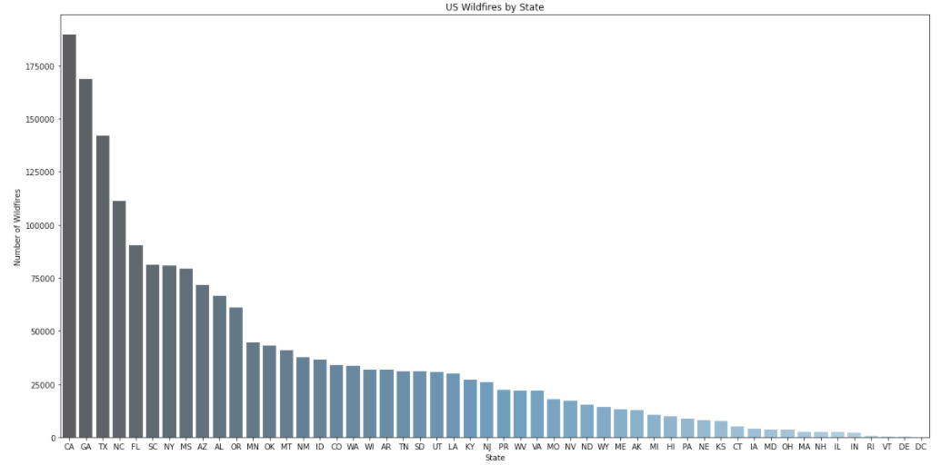
EDA - Visualization
Now looking at the wildfires by state, there’s a skew in the data on the state. The first 10 states make up a large majority of total number of wildfires as seen in Fig 3.
Fig 3 - US Wildfires by State

Slide 8
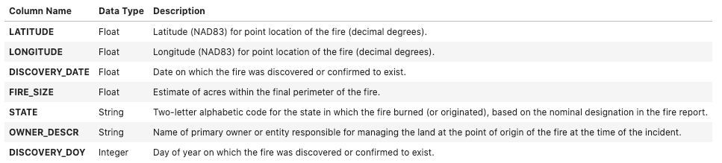
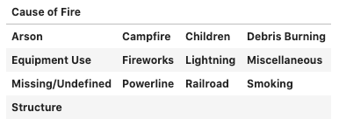
Modeling
To predict cause of a fire, used classification modeling
Naive Bayes
Decision Tree
Table 1 describes the features that were used from the dataset and our predictor classification label is the STAT_CAUSE_DESCR with Table 2 showing the possible classifications
Table 1 – Model Features
Table 2 – Predictor Classification Labels

Slide 9
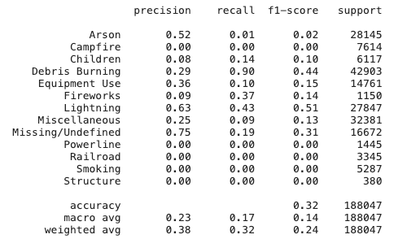
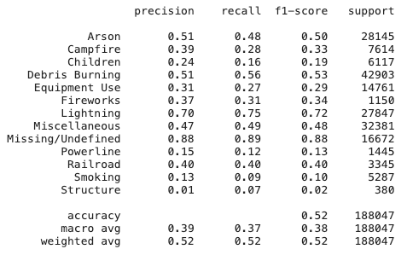
Model Performance
Once the model has been defined, predictions can be made on new and unseen data. Table 3 below shows the performance of each of the models
Naïve Bayes | Decision Tree
Table 3 – Model Performance

Slide 10
Cloud Deployment
Next is the cloud deployment and at a high overview utilized:
Configure Serverless framework
API Gateway
Lambda functions
RDS
Chance will now walk you through each of those cloud components and how it was deployed to AWS

Slide 11
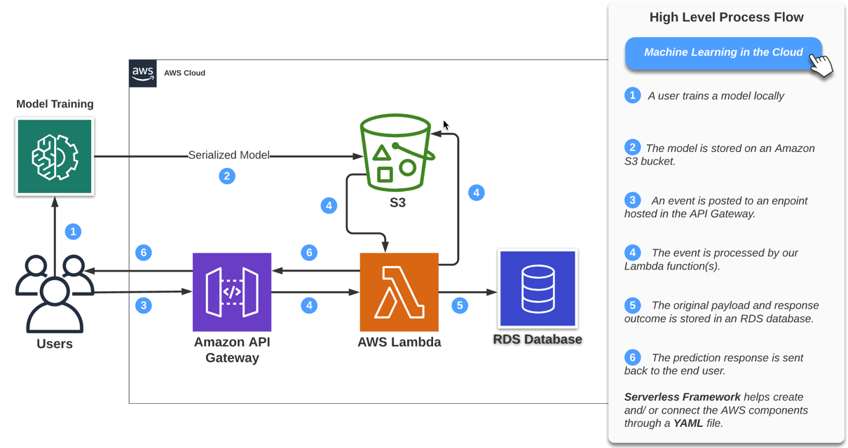
AWS Serverless Predication Flow
Serverless Framework generates cloud formation code through your project’s YAML file configuration.

Slide 12
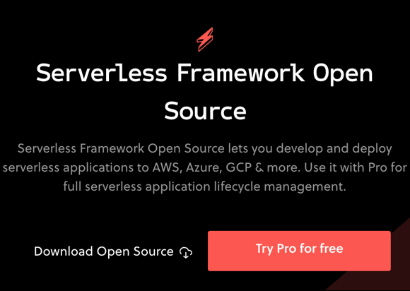
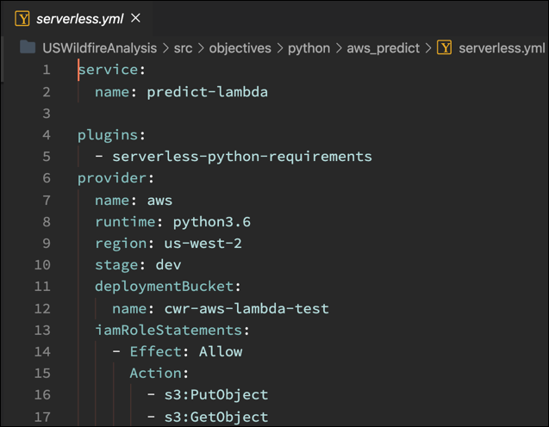
Serverless Framework
Open-source framework built with Node.js (supports a variety of cloud platforms and programming languages)
Notes:
https://blog.richardkeller.net/anatomy-of-a-serverless-yaml-file/#:~:text=Serverless.-,yml,YAML%20file%20is%20the%20provider.

Slide 13
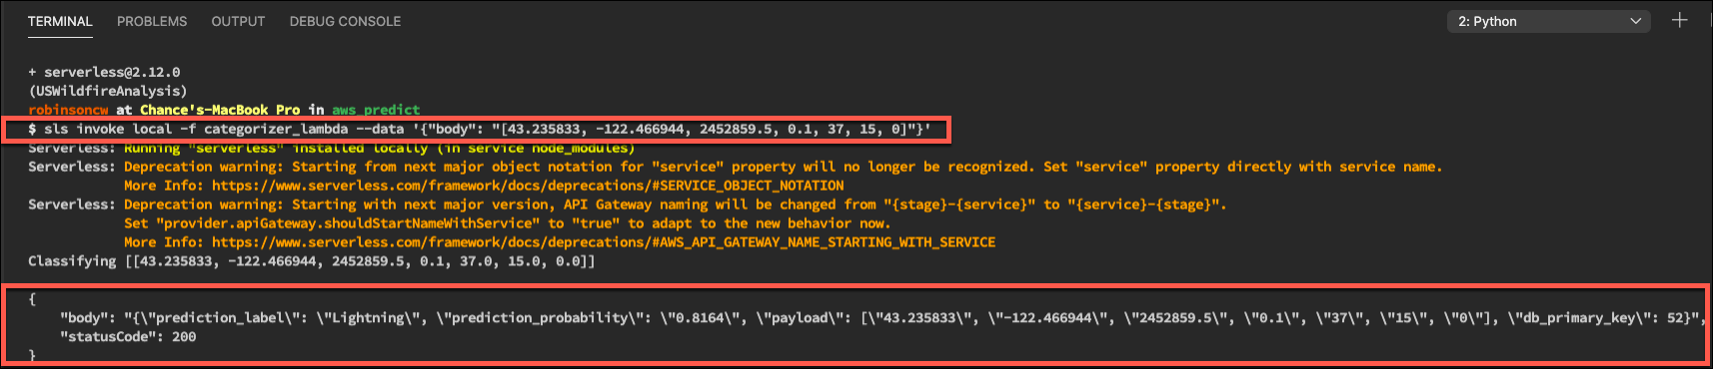
Local Setup and Validation
The sls invoke command allows you to test the solution locally (sls is an alias for serverless)
As software can change with upgrades, lock in your versions for reproducibility

Slide 14
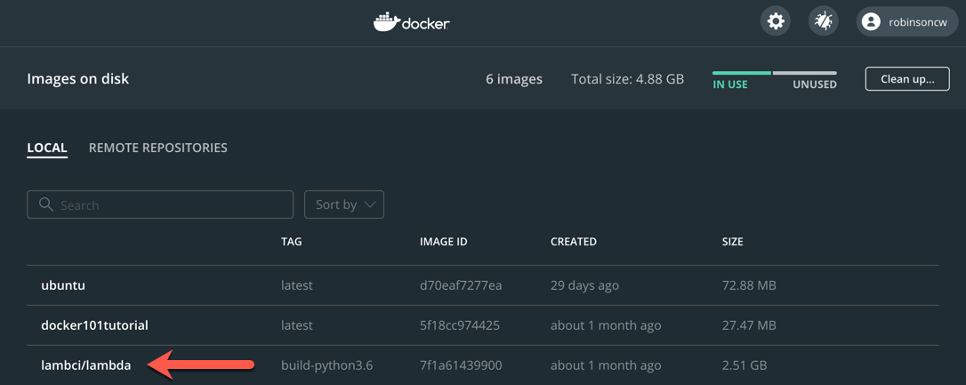
Build Dependencies with Docker
A sandbox environment that is almost identical to the one set up in AWS Lambda (libraries, environment variables, etc..)
https://github.com/lambci/docker-lambda
Notes:
https://github.com/lambci/docker-lambda
https://www.serverless.com/blog/serverless-python-packaging
(venv) $ serverless deploy
2 Serverless: Parsing Python requirements.txt
3 Serverless: Installing required Python packages for runtime python3.6...
4 Serverless: Docker Image: lambci/lambda:build-python3.6
5 Serverless: Linking required Python packages..

Slide 15
Demo
TOPIC | Time
Discovery Show YAML file configuration Open Pipfile and package.json files Review the python directory structure Invoke the lambda function locally Deploy to AWS Confirm the results | 3 minutes

Slide 16
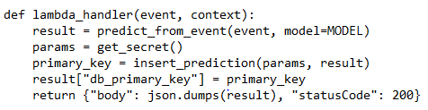
RDS Integration
Application uses a PostgreSQL on RDS to capture the predictions along with the corresponding payloads
Purpose of this data is to monitor the effectiveness of the prediction model, and tune it further as needed

Slide 17
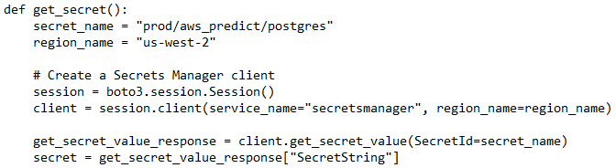
Secrets Manager
Advantages of Secrets Manager:
Offers built-in integration for databases on RDS
Secures applications
Allows rotating credentials natively
Enables access control using AWS AIM policies
Steps involved:
Store a new secret - choose Credentials for RDS database; enable encryption
Attach it to RDS DB instance that accesses this credential
In the application, retrieve secret and decrypt using Secrets Manager API
Use the secret to establish connection to the RDS database

Slide 18
RDS Proxy
What is it?
Fully managed, high-availability proxy for RDS
Helps make applications scalable, secure, and resilient
Why do we use it?
Serverless applications deal with database connections at a high rate causing memory and computing resources contention
RDS Proxy allows pooling and sharing connections, improving the efficiency
Authentication and access can be managed through Secrets Manager and IAM
How do we set it up?
Setup network prerequisites, if not already present – VPC, subnets, EC2 instance, and internet gateway
Setup DB credentials in Secrets Manager
Setup IAM policy to access proxy through Secrets Manager
Create RDS Proxy with relevant connectivity details above and required connection pool parameters
In the application, retrieve secret and decrypt using Secrets Manager API
Use the secret to establish connection to the RDS database

Slide 19
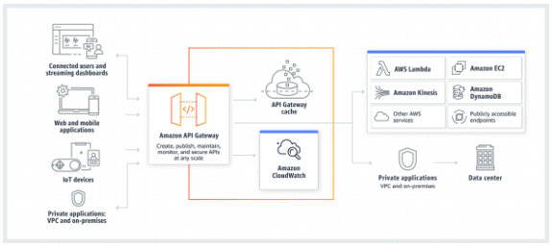
API Gateway
What is it?
AWS service for creating, publishing, maintaining, monitoring, and securing REST, HTTP, and WebSocket APIs
What does it do?
Creates a unified front-end for microservices
Provides DDoS protection and throttling –CloudFront and API Gateway Cache
Authenticates and authorizes requests – Cognito User Pools, Cognito Federated Identities, Custom Authorizers
Throttles, meters, and monetizes API usage – CloudWatch & Usage Plans
Reference: https://docs.aws.amazon.com/apigateway/latest/developerguide/welcome.html
Notes:
User Pools – Shares authentication details; cannot deal with authorizations
IAM Federated – Validates accesses against IAM
Custom – checks cache; validates against IAM

Slide 20









Securing Serverless Applications
Mobile Apps
Amazon CloudFront
Static Content
Amazon S3
Geo-Restriction
Private Content
DDoS
Bucket Policies
ACLs
Internet
Websites
Dynamic Content
Amazon API Gateway
AWS Lambda
Amazon RDS
3rd Party Services
DDoS
Identity Pools
Federated Identities
IAM Policies
Throttling
Code reviews
Security scans
Static analysis
RDS Proxy
Secrets Manager
Reference: https://www.youtube.com/watch?v=AV24RTvbgWA

