Slide 1
US Wildfire Analysis
DS 6346: Cloud Computing
Presented by Chance Robinson, Jeff Washburn and Sreeni Prabhala

Slide 2
Abstract
Goal of this project
Research and development of cloud technology and it can be used to train a model and make predictions on cloud infrastructure.
Question of interest
Given the size, location, date and other relevant features from the dataset, can we predict the cause of a wildfire in a cloud based, scalable way?
Remember Cloud is:
Model of computing where servers, networks, storage, development tools, and even applications (apps) are enabled through the internet.
5 characteristics of cloud computing environment
On-demand self-service: User can provision computing resources without human intervention including server time, storage, and software resources
Broadband Network Access: Resources can be accessed through public network
Resource Pooling: Services are pooled to serve multiple consumers using multi-tenant model. Physical and virtual resources allocation are dynamic based upon demand
Rapid Elasticity: Resources can be elastically provisioned and related to enable scaling whereas consumers seem to get virtually unlimited resources
Measured Services: Automatically optimize and control resources where resources utilization can be monitored, reported and controlled.
Notes:
2,410 US craft beers
558 US craft breweries

Slide 3
Data set Overview
1.88 Million US Wildfires - 24 years of geo-referenced wildfire records
Wildfires have broken out all over the western region of the United States in 2020, devastating communities and creating smoke plumes that can be seen even from space via satellite images. Some billows of smoke have carried over to places as far away as London, and it has been said that cities such as San Francisco and Seattle have some of the lowest quality of air on the entire planet currently due to the fires. As one of us lives close to the Bobcat Fire in California, which has currently burned over 93 thousand acres of land, the team thought it would be an interesting topic to delve into the data that has been collected in this domain over the past quarter century or so to mine any insights.
Kaggle dataset on 24 years of wildfires in the United States from 1992 to 2015.
Core attributes on each fire captured including:
Discovery Date
Final fire size
Point location (least as precise as Public Land Survey System) section (1-square mile grid)
In all, the data set includes 1.88 million geo-referenced wildfire records that equates to 140 million acres burned over the 24-year timeframe.

Slide 4
Solution Aspect - Methodology
Cloud to help predict the cause of wildfires:
Ascertain dataset
Explore data doing exploratory data analysis
Create classification models
Naive Bayes
Decision Trees
Measure model performance
Deploy model to AWS infrastructure
Create gateway for REST based API call
Use AWS lambda to deploy model to then fulfill prediction request
Track model execution request using Amazon’s Relational Database Service (Amazon RDS)

Slide 5
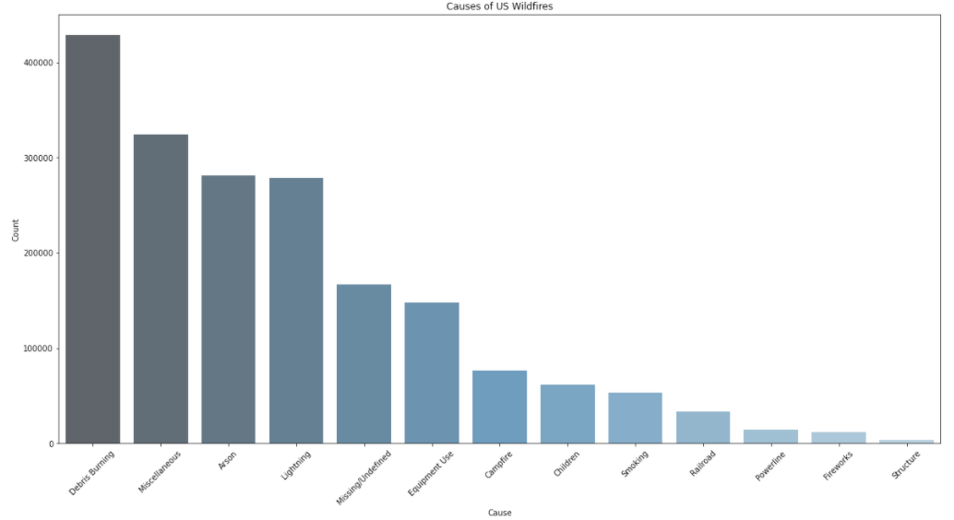
EDA - Visualization
Distribution of the causes of wildfires as seen in Fig 1.
Fig 1 - Causes of US Wildfires

Slide 6
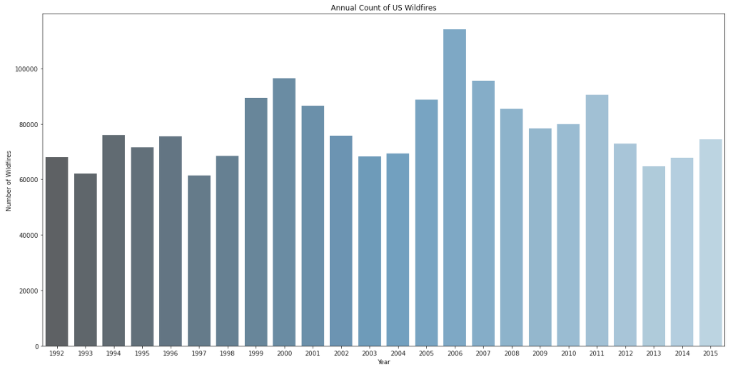
EDA - Visualization
Looking at the number of wildfires per year, it’s somewhat consistent year over year. While some years are higher, especially 2006, distribution of fires is spread out over the years as seen in Fig 2.
Fig 2 - Annual Count of US Wildfires

Slide 7
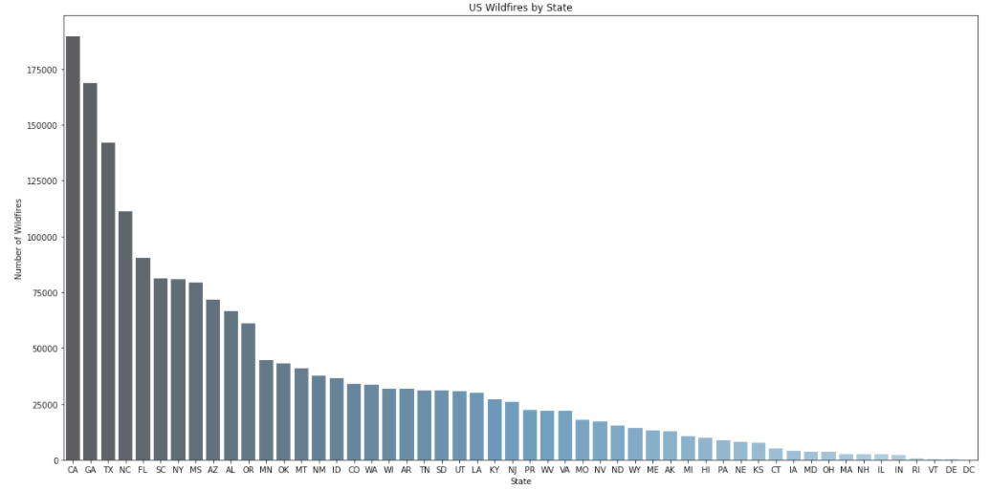
EDA - Visualization
Now looking at the wildfires by state, there’s a skew in the data on the state. The first 10 states make up a large majority of total number of wildfires as seen in Fig 3.
Fig 3 - US Wildfires by State

Slide 8
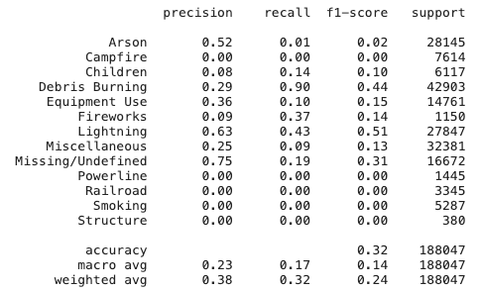
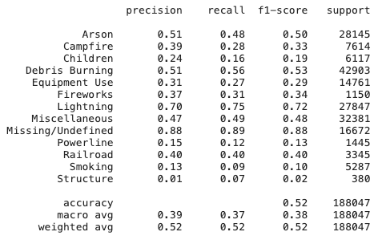
Model Performance
Once the model has been defined, predictions can be made on new and unseen data. Table 3 below shows the performance of each of the models
Naïve Bayes | Decision Tree
Table 3 – Model Performance

Slide 9
Cloud Deployment
Next is the cloud deployment and at a high overview utilized:
Configure Serverless framework
API Gateway
Lambda functions
RDS
Chance will now walk you through each of those cloud components and how it was deployed to AWS

Slide 10
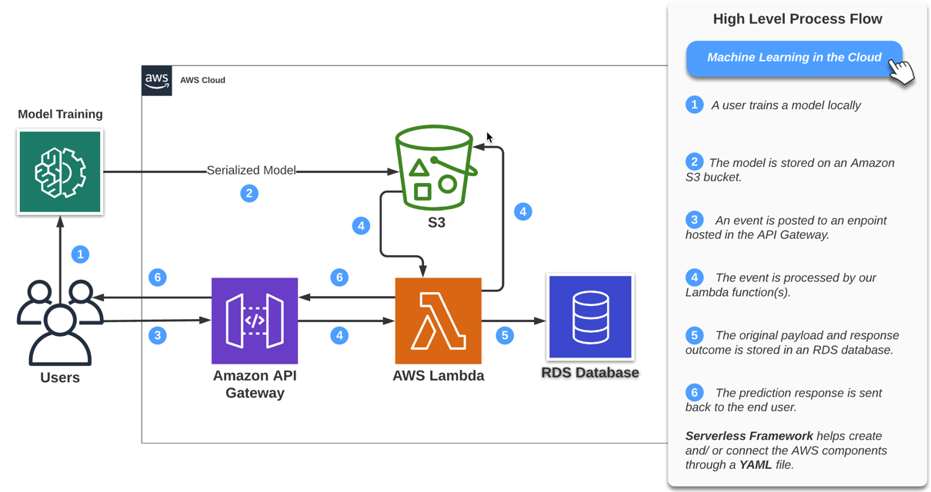
AWS Serverless Predication Flow
Serverless Framework generates cloud formation code through your project’s YAML file configuration.

Slide 11

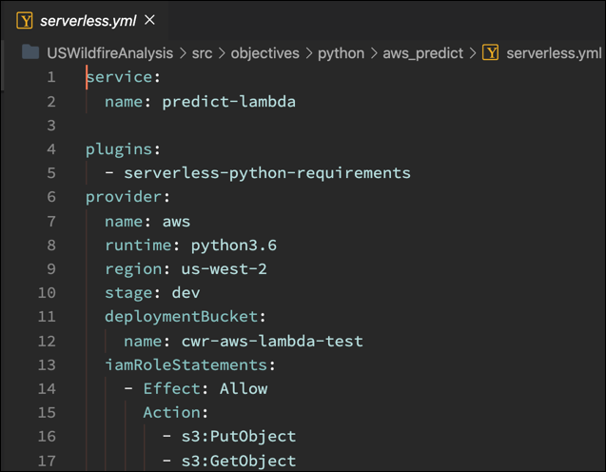
Serverless Framework
Open-source framework built with Node.js (supports a variety of cloud platforms and programming languages)
Notes:
https://blog.richardkeller.net/anatomy-of-a-serverless-yaml-file/#:~:text=Serverless.-,yml,YAML%20file%20is%20the%20provider.

Slide 12
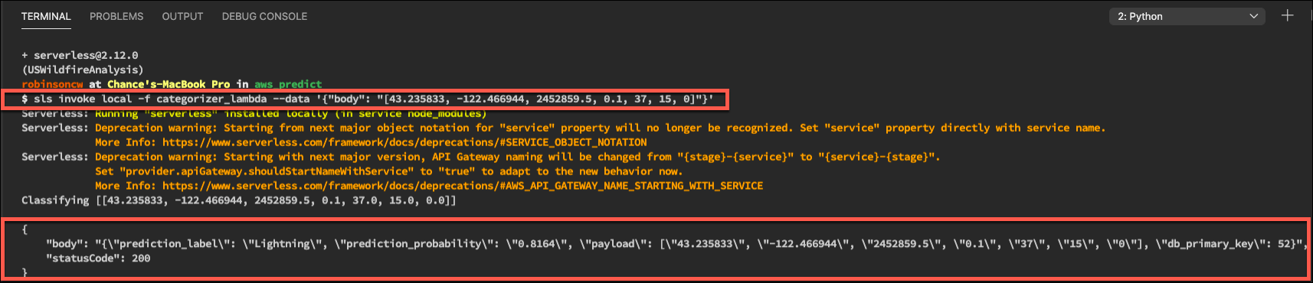
Local Setup and Validation
The sls invoke command allows you to test the solution locally (sls is an alias for serverless)
As software can change with upgrades, lock in your versions for reproducibility

Slide 13
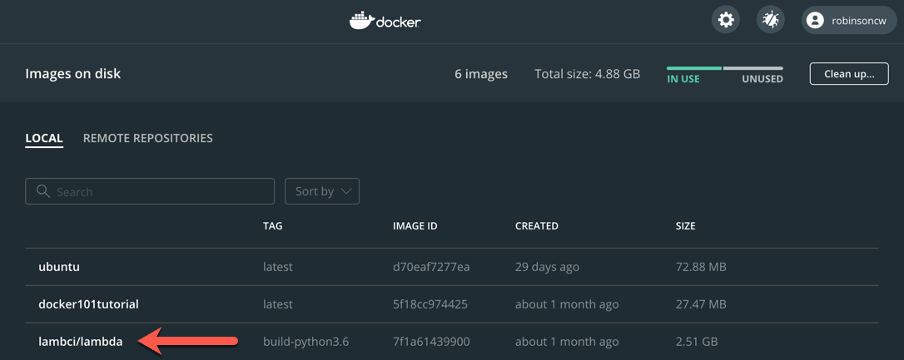
Build Dependencies with Docker
A sandbox environment that is almost identical to the one set up in AWS Lambda (libraries, environment variables, etc..)
https://github.com/lambci/docker-lambda
Notes:
https://github.com/lambci/docker-lambda
https://www.serverless.com/blog/serverless-python-packaging
(venv) $ serverless deploy
2 Serverless: Parsing Python requirements.txt
3 Serverless: Installing required Python packages for runtime python3.6...
4 Serverless: Docker Image: lambci/lambda:build-python3.6
5 Serverless: Linking required Python packages..

Slide 14
Demo
TOPIC | Time
Discovery Show YAML file configuration Open Pipfile and package.json files Review the python directory structure Invoke the lambda function locally Deploy to AWS Confirm the results | 3 minutes

Slide 15
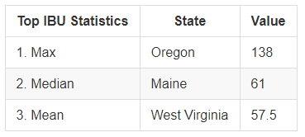
Maximum Values by State (IBU)
Similar differences can be seen across the IBU statistics

Slide 16
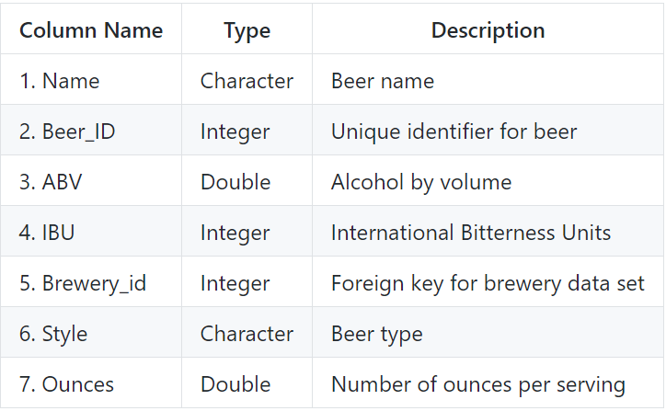
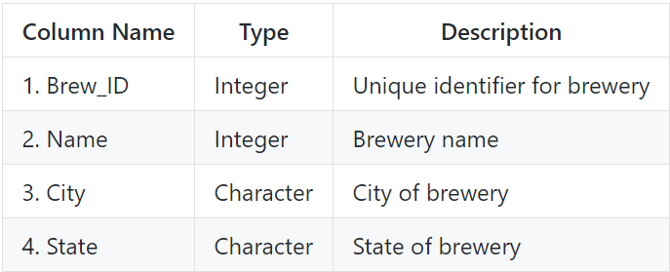
Data Sets and Definitions
Beers
Breweries
558 Breweries
2,410 US Craft Beers
Notes:
2,410 US craft beers
558 US craft breweries

Slide 17
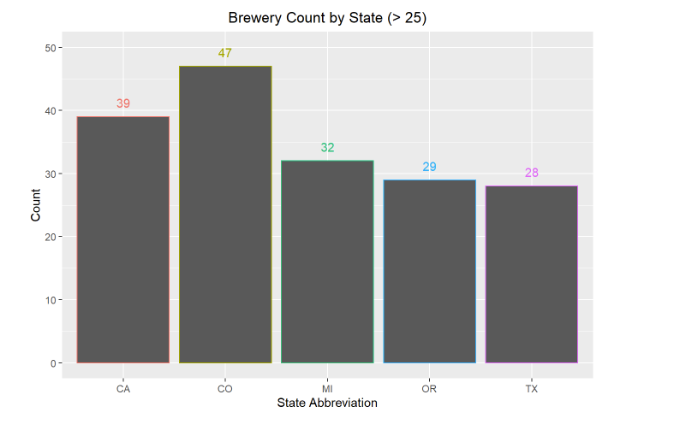
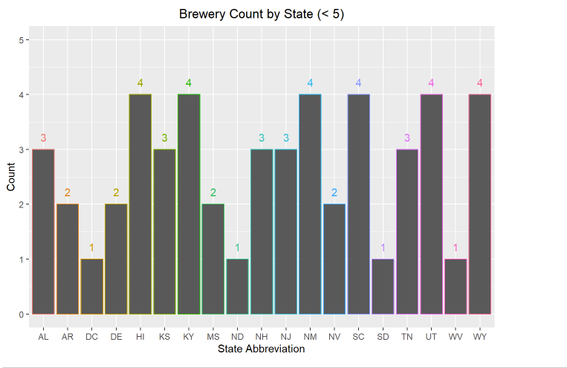
Brewery Count by State
How many breweries are present in each state?
Note that all 50 states have at least one brewery listed, including the District of Columbia (DC), for a total of 51.

Slide 18
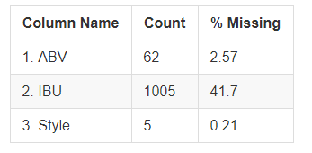
Missing Values
The ABV (Alcohol by Volume), IBU (International Bitterness Unit) and Style columns have missing values
In particular, the IBU field as over 41% of the records with a blank value for this data point.

Slide 19
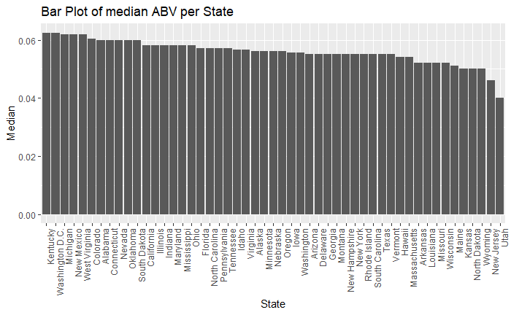
Median ABV per State
From visually inspecting the graph, most states have a relatively close spread. The summary statistics show that 50% of the available data fall within the interval
(0.05 to 0.067)

Slide 20
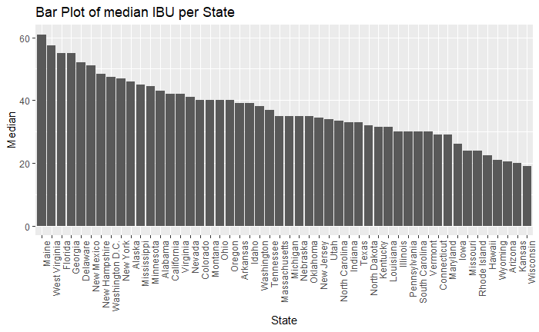
Median IBU per State
There is much more variation in the IBU data, possibly due to missing values or regional preferences.

Slide 21
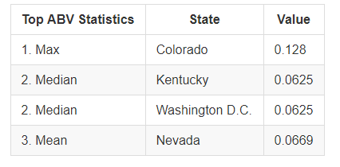
Maximum Values by State (ABV)
There are different measures of center, etc.. that might be useful in determining state trends.
Depending on the statistic of interest, the answer varies
Notes:
maximum alcoholic (ABV) beer? Colorado
most bitter (IBU) beer? Oregon

Slide 22
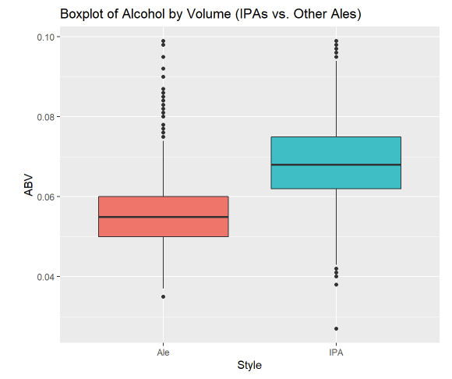
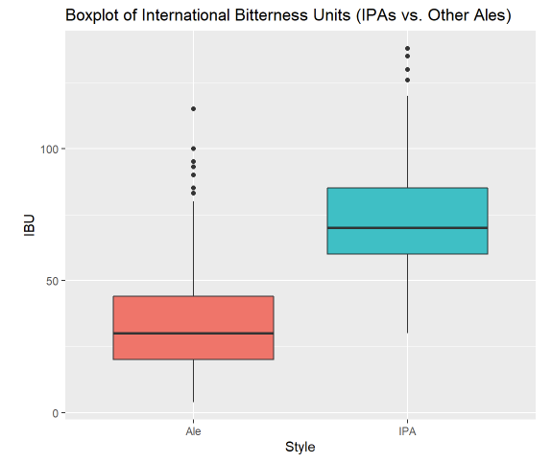
ABV and IBU Comparisons
The ABU and IBV data show similarities in spread/ variance
Notes:
This could be beneficial with the missingness of the IBU values as Alcohol by Volume could serve as a substitute.

Slide 23
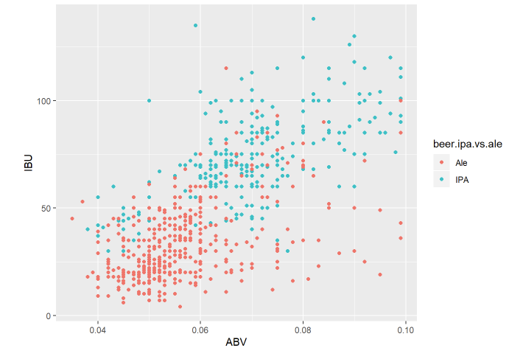
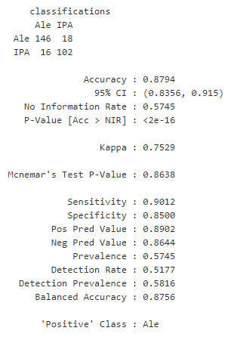
Beer Style Predictions
ABV and IBU served as good predictors of a beer’s style
Notes:
he distribution of the ABV data is slightly right skewed, with most values falling within ~0.014 units of the mean of ~0.06.

Slide 24
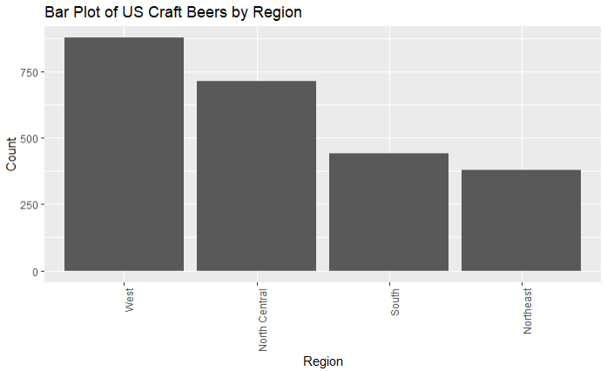
Regional Comparisons
Many of these states happen to be in regions with lower craft beer counts
Notes:
Florida and Main in particular

Slide 25
Conclusion
ABV (Alcohol by Volume) and IBU (International Bitterness Units) serve as good predictors of beer styles
Regional preferences can be seen in the charts for a beer’s bitterness
There are fewer craft beers/ breweries in the Northeast and South regions
Opportunities for product differentiation with lower IBU ratings

