Slide 1




Serendipity Identity Service
Microservice
Sidecar
Serendipity Progressive Web App
Serendipity Backend for Frontend

Slide 2
Identity Service
Microservice
Sidecar
Serendipity PWA
Serendipity BFF

Slide 3
Identity Server
Microservice
Sidecar
Serendipity PWA
Serendipity BFF

Slide 4

Identity Server
Microservice
Sidecar
Serendipity PWA
Serendipity BFF
Fine-grained Authorisation
Course-grained Authorisation
Open Policy Agent
Authorisation Server

Slide 5
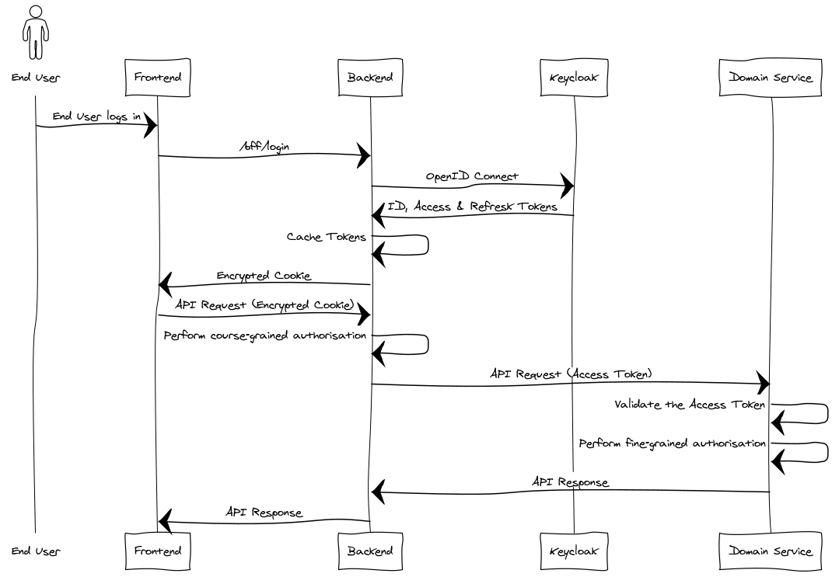
Notes:
title BFF AuthN & AuthZ
actor End User
participant Frontend
participant Backend
participant Keycloak
participant Domain Service
End User -> Frontend: End User logs in
Frontend -> Backend: /bff/login
Backend -> Keycloak: OpenID Connect
Keycloak -> Backend: ID, Access & Refresk Tokens
Backend -> Backend: Cache Tokens
Backend -> Frontend: Encrypted Cookie
Frontend -> Backend: API Request (Encrypted Cookie)
Backend -> Backend: Perform course-grained authorisation
Backend -> Domain Service: API Request (Access Token)
Domain Service -> Domain Service: Validate the Access Token
Domain Service -> Domain Service: Perform fine-grained authorisation
Domain Service -> Backend: API Response
Backend -> Frontend: API Response
<number>

