Slide 1






Serendipity
Identity Service
Core Services
Party Service
Orchestration Services
Human Tasks Service
Serendipity
Progressive Web App
Serendipity
Backend for Frontend
Reporting Services
Report Service
JasperReports Server

Slide 2

Serendipity
Identity Service
Core Services
Party Service
Orchestration Services
Human Tasks Service
Serendipity
Progressive Web App
Serendipity
Backend for Frontend
Reporting Services

Slide 3
Serendipity
Identity Service
Core Services
Party Service
Orchestration Services
Serendipity
Progressive Web App
Serendipity
Backend for Frontend
Human Tasks Service

Slide 4
Serendipity
Identity Service
Core Services
Party Service
Orchestration Services
Serendipity
Progressive Web App
Serendipity
Backend for Frontend
Human Tasks Service

Slide 5
Identity Service
Microservice
Sidecar
Serendipity PWA
Serendipity BFF

Slide 6
Identity Server
Microservice
Sidecar
Serendipity PWA
Serendipity BFF

Slide 7

Identity Server
Microservice
Sidecar
Serendipity PWA
Serendipity BFF
Fine-grained Authorisation
Course-grained Authorisation
Open Policy Agent
Authorisation Server

Slide 8
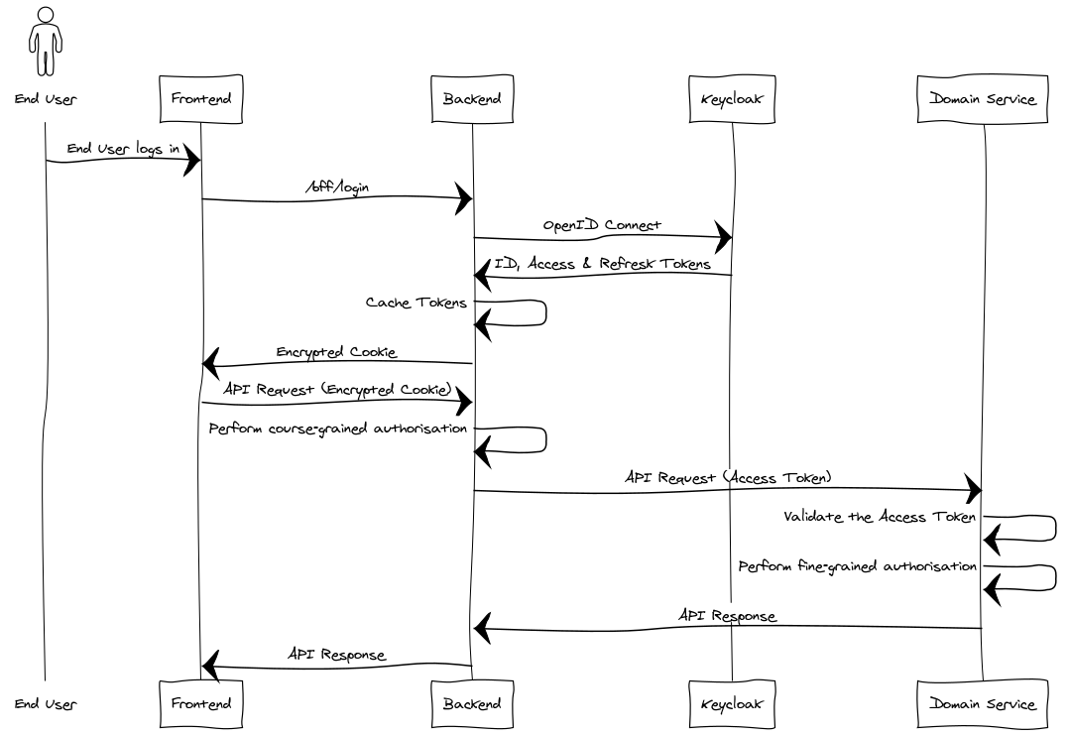
Notes:
title BFF AuthN & AuthZ
actor End User
participant Frontend
participant Backend
participant Keycloak
participant Domain Service
End User -> Frontend: End User logs in
Frontend -> Backend: /bff/login
Backend -> Keycloak: OpenID Connect
Keycloak -> Backend: ID, Access & Refresk Tokens
Backend -> Backend: Cache Tokens
Backend -> Frontend: Encrypted Cookie
Frontend -> Backend: API Request (Encrypted Cookie)
Backend -> Backend: Perform course-grained authorisation
Backend -> Domain Service: API Request (Access Token)
Domain Service -> Domain Service: Validate the Access Token
Domain Service -> Domain Service: Perform fine-grained authorisation
Domain Service -> Backend: API Response
Backend -> Frontend: API Response

