Slide 1
Assembly

Slide 2
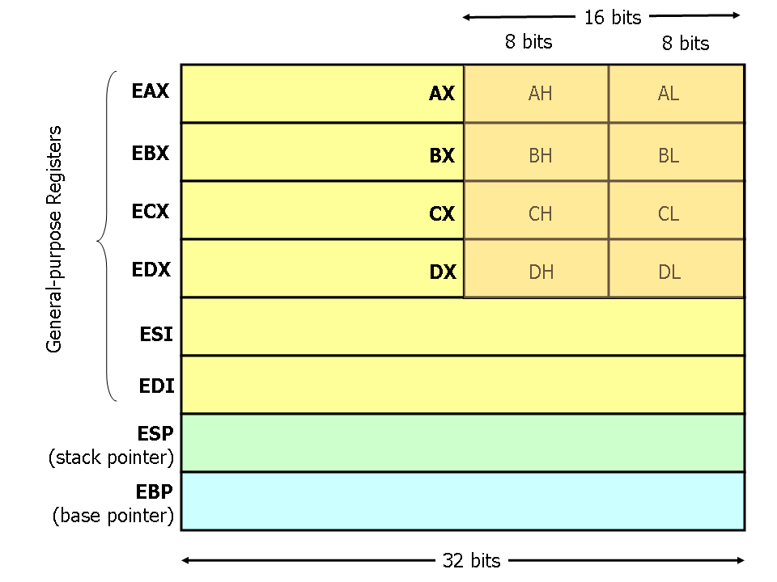

Slide 3
Syntax
mov <reg>,<reg>
mov <reg>,<mem>
mov <mem>,<reg>
mov <reg>,<const>
mov <mem>,<const>
<reg> = eax
<mem> = [eax]
<const> = name

Slide 4
Register vs Memory
eax vs [eax]:
mov %eax, $10
  Now, at the memory address of eax, the value 10 is stored. Loads the value stored at an address.
    Not the address
  What if we want to store an array in eax?
    We store the ADDRESS of where the values are stored instead!
lea %[eax]
  We load the address, and find the values stored consecutively
  Used for pointers. Only loads address
    Not the value

Slide 5
Operations
mov eax, [ebx]
mov eax, [esi-4]
mov [esi+eax], cl
mov edx, [esi+4*ebx]

Slide 6
Operations
mov eax, [ebx]
  Move the 4 bytes in memory at the address contained in EBX into EAX
mov eax, [esi-4]
  Move 4 bytes at memory address ESI + (-4) into EAX
mov [esi+eax], cl
  Move the contents of CL into the byte at address ESI+EAX
mov edx, [esi+4*ebx]
  Move the 4 bytes of data at address ESI+4*EBX into EDX

Slide 7
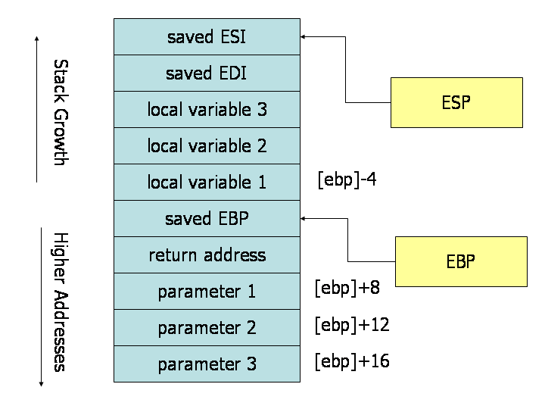
STACK

Slide 8
Operations
push <register>
  Remove value from <register> and put it on top of the stack
pop <register>
  Remove first value on stack and put it in <register>
lea <register>
  Load Effective address
add <reg1> <reg2>
Sub <reg1> <reg2>
  = (reg1 – reg 2)

Slide 9
Operations
jmp <addr/label>
  Jump to address
j<condition> <addr/label>
  Jump when:
  je = jump when equal
  Jz = jump when last result was zero
  ++
cmp <x1><x2>
  Compare <x1> and <x2>
Call <routine>
  ret (return)

