Slide 1
Curvature
Robert Swan
SDD Major 2010

Slide 2
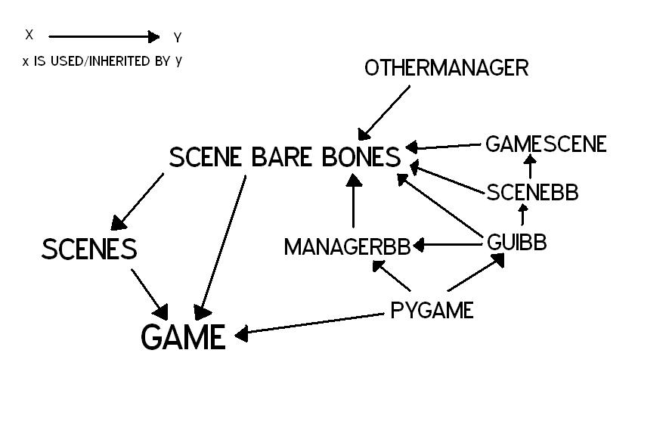
MODULES

Slide 3
SCENE BARE BONES
Extension of Libscene
Libscene was created for hangman, a primarily text-based game.
Thus needed to be heavily extended for a primarily graphic-based game
Unneeded / incomplete features were cut
New features were added
  Dedicated Settings/Theme/Score Managers
  GameScene
  Theme-based colours/images

Slide 4
GameScene
Inherits Scenebb, thus adding objects is sorted.
Load_tiles – loads file into a 3D array of tiles
Generate_tiles – creates scene objects based on the 3D array of tiles
Check_space – checks if tile movment is allowed
Check_collide – checks if hero movement is allowed
Notes:
Talk about each major func, explain basic alg behind it. Flowchart it !

Slide 5
Generate_tiles
Scene manager and pygame can’t manipulate and display text chars, so they have to be converted.
The chars were already in a 3D list, and so looping over this is as simple as 3 for loops.
After a sobj was created for each char at (x,y) the x is incremented, so as the make the next one right next to it.
After each line of chars, the x is reset and the y incremented, to make the new line below the previous
After each tile, it checks to see if the grid is wide enough, if not the x incremented a whole heap, and y is reset. If it is, that means its time to start a new row of tiles, and so x is reset and y incremented a whole bunch

Slide 6
BEGIN
Set tilex, tiley, blockx, blocky = 0
Set runs1, runs2, runs3 = 0
Create tile parent object
@ (tilex,tiley)
Append tile object to current_row
If runs3 <= blockarray length
runs3++
Create block object @ (blockx,blocky)
blockx++
No
Yes
runs 2++
runs3 = 0
blockx = 0
blocky++
If runs2 <= rowarray length
Append current_row to gridlist,
empty current_row
Yes
No
blockx,blocky = 0
tilex = 0
tiley++
runs2, runs3 = 0
runs1++
If grid has reached desired width
Yes
tiley++
Yes
No
If runs1 <= tilearry length
END
Fill last row of gridlist to desired length with None
No
Notes:
Blue = before/after, orange = biggest for (each tile), purple = middle (each row), red = smallest for (each icon)
blockx,blocky are relative to the tile parent

Slide 7
Check_space
Controls which tile moves, if any
Only a direction is taken as input because only one tile can move in any one direction
The tiles are all in a “gridlist” which is a 2D array which allows for simple and accurate tracking of their positions
When movement of a tile is called, check_space looks to see if the tile is
  At the end of it’s row; or
  If there is another tile next to it in the direction input
The function then returns the old and new indices of the tile
Which is then used to move the tile to its new position

Slide 8
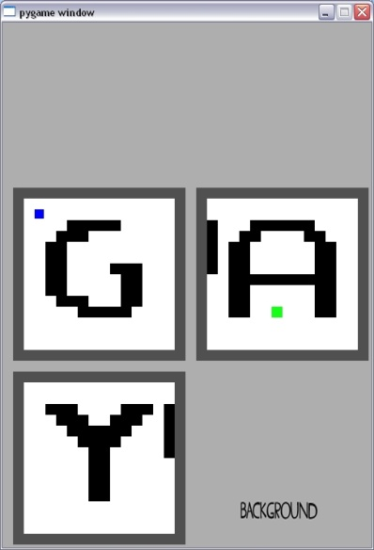
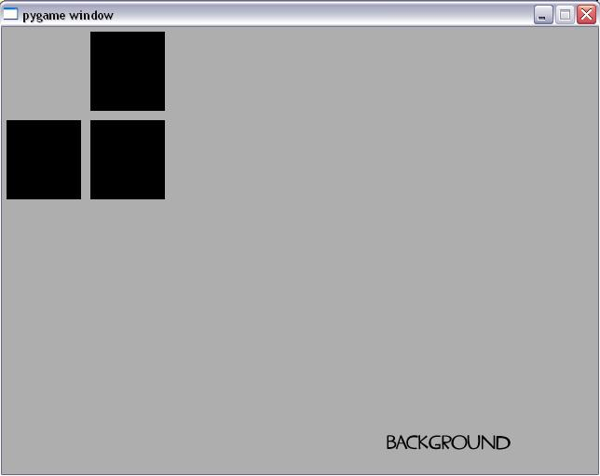
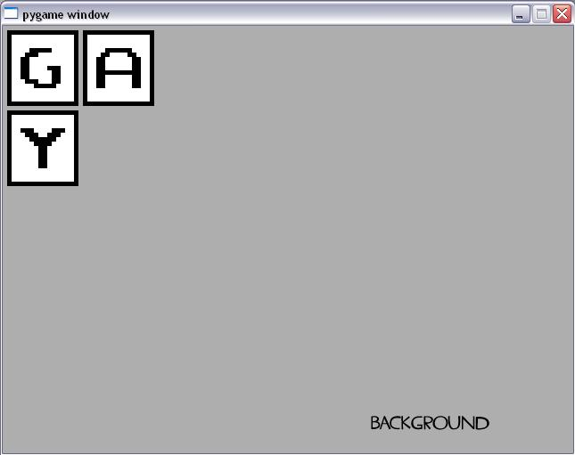
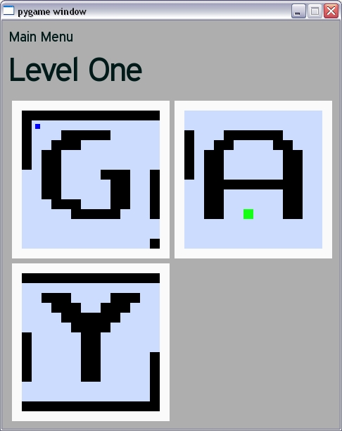
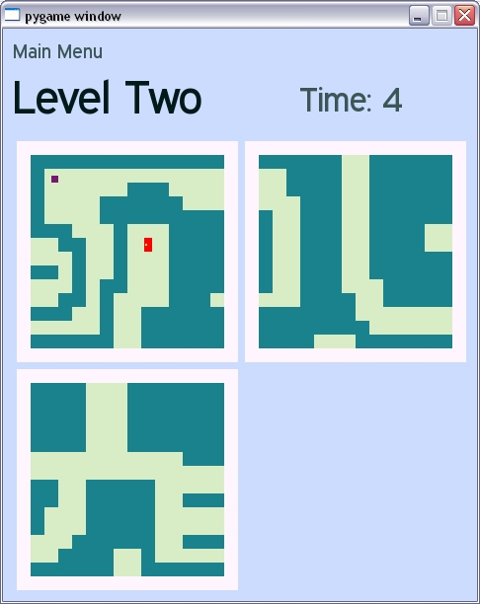
Top Row:
26/4, 20/5, 17/7
Bottom Row:
20/7, Final

