Slide 2
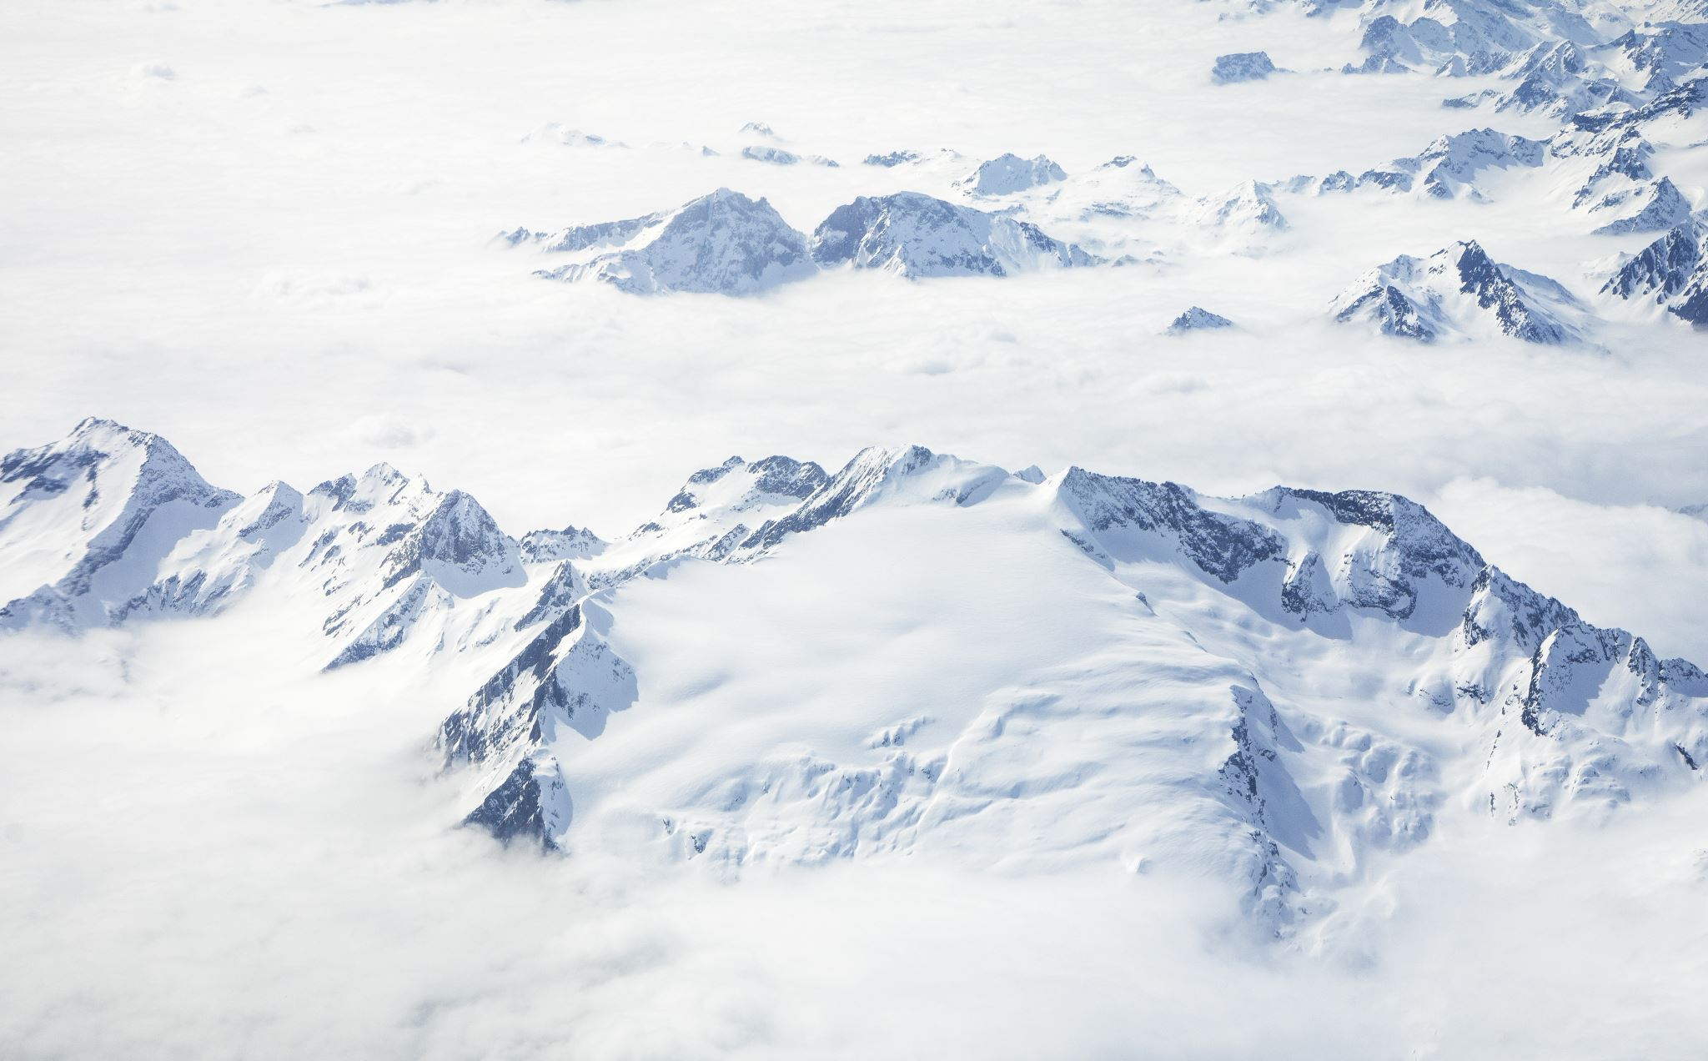
Switzerland

Slide 3
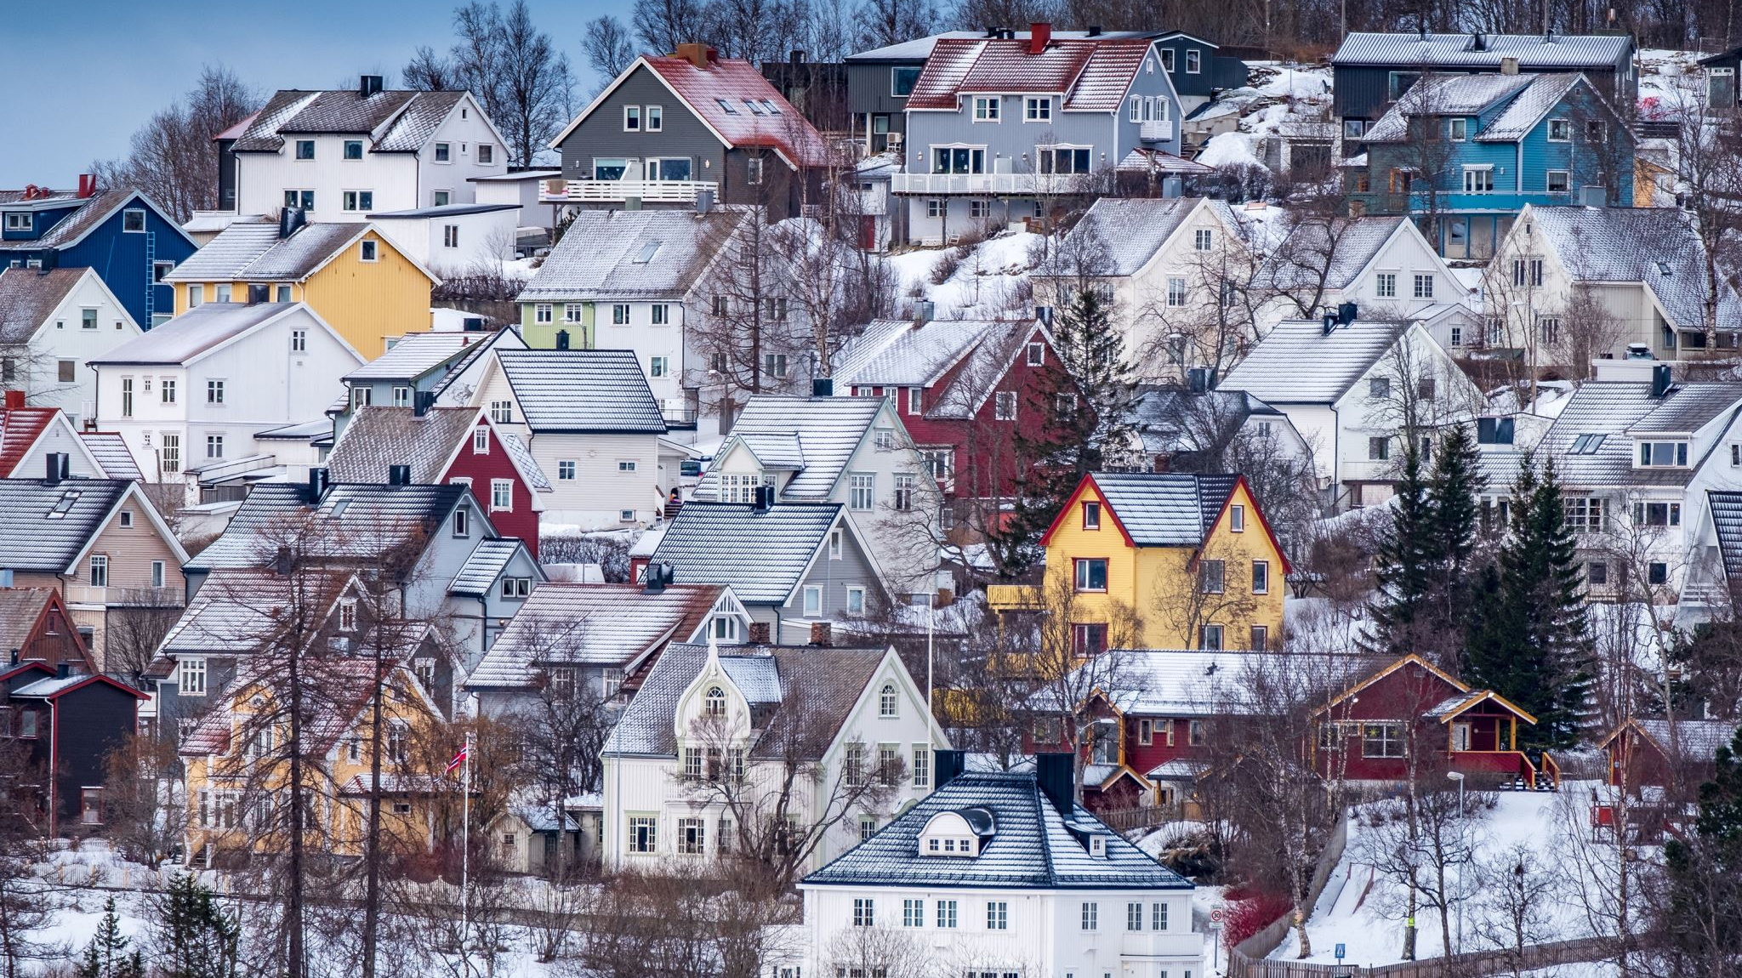
Swiss Statistics
Switzerland is a country with various types of tourist attractions.
With a GDP below Australia and above Sweden it is considered a rich country with the GDP of 800 Million $.
Switzerland stands as one of the richest countries by GPD Per Capita of 91 thousand $ standing above Norway and U.S.A
The Swiss Population is approximately 8,7 million, below Sweden and Australia
The land mass of Switzerland is approximately 41.285 km²
Notes:
lol

Slide 4
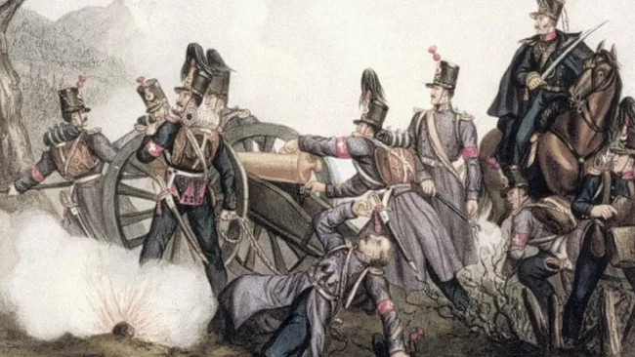
Swiss History
I find the history of the Swiss interesting,
as the last time they fought is 1845 which was a small civil war against Sonderbund
(more info can be found in the wiki page)

Slide 5
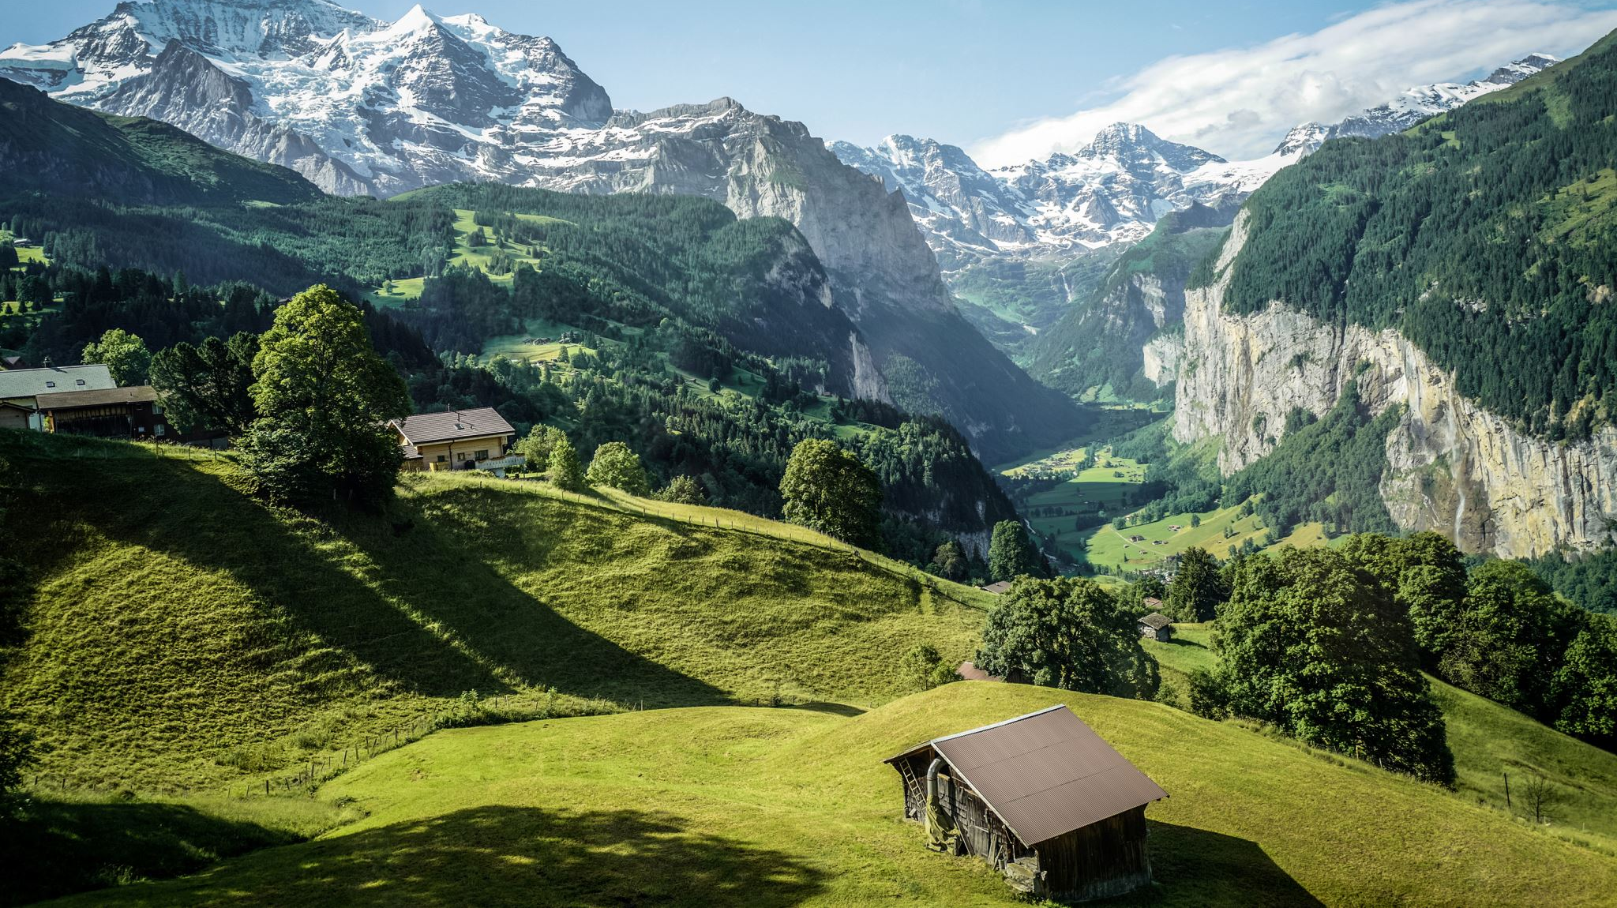
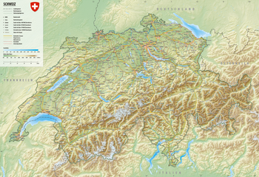
Swiss Geography
Switzerland is a landlocked country with a not-the-best geography.
Switzerland borders Italy, France, Germany, Austria and Liechtenstein
Switzerland is a country in Western/Central Europe
Its land mass is ranked 134 in the world
It's divided into 3 geographic regions which are:
Jura
Plateau
Alps

Slide 6

Swiss Foreign Policy
Swiss foreign policy is guided by neutrality, peace, and humanitarian values. It prioritizes diplomacy, mediation, and humanitarian aid while upholding human rights and democratic principles. Switzerland's commitment to these principles contributes to global stability and cooperation.

Slide 7
