Slide 1
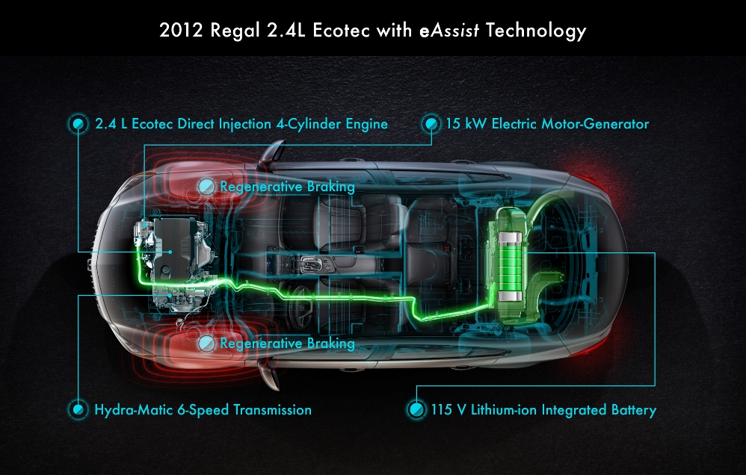
Regenerative Braking System

Slide 2
“What is regenerative braking ?”
A regenerative brake is an energy recovery mechanism which slows a vehicle by converting its kinetic energy into another form, which can be either used immediately or stored until needed.
This contrasts with conventional braking systems, where the excess kinetic energy is converted to heat by friction in the brake linings and therefore wasted.
The most common form of regenerative brake involves using an electric motor as an electric generator.

Slide 3

“How does it work?”
This system is used in hybrid cars & electric cars.
Which use motor for rotating wheels.

Slide 4
As we apply the brakes :
As brake pedals are pushed ,
poles of the motor get reversed in polarity.
The machine which was acting as
motor now acts as a generator.
“How does it work?”

Slide 5
“How does it work?”
The rolling vehicle wheels turn the motor armatures, and the motors act as generators.
For a given direction of travel, current flow through the motor armatures during braking will be opposite to that during motoring.

Slide 6
“How does it work?”
Therefore, the motor exerts torque in a direction that is opposite from the rolling direction and hence the vehicle stops.
Now the produced current is sent to either equipments like A.C., power window or back into the supply to charge the battery.
Regenerative braking can be used for various purposes like ‘KERS’ etc…

Slide 7
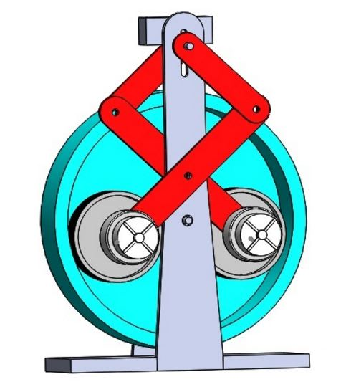

Slide 8


Slide 9
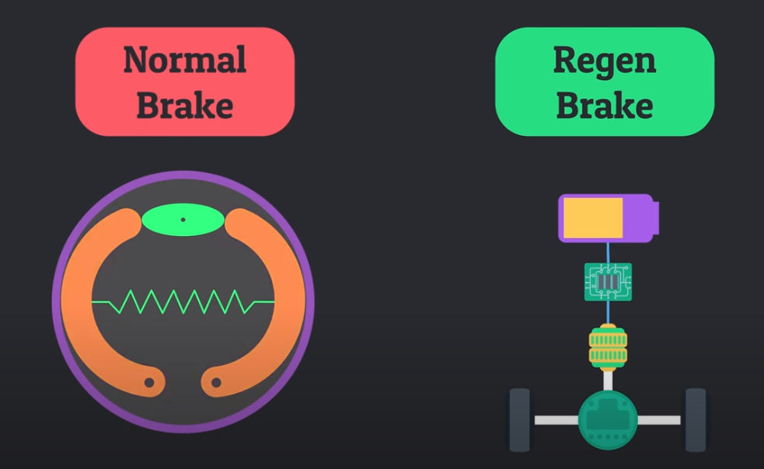

Slide 10
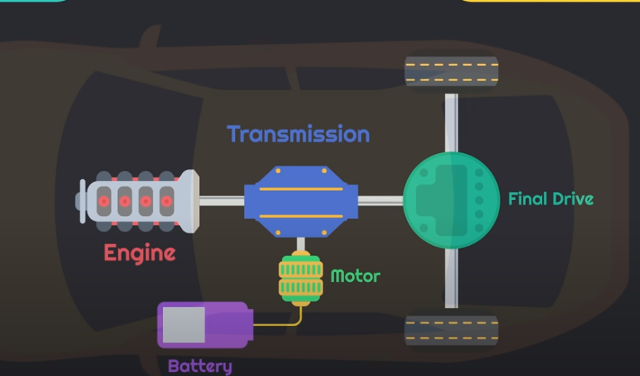

Slide 11

Uses & Applications
flywheels
The other most common type of regenerative braking is mechanical or kinetic.

Slide 12
Proposed System
We are using here DC motor for showing the actual result
When driver push the breaks the lights will glow (Here we are using 5v.3v LED’s for demo purpose)
As the braking system pushes frequently the energy will generate more.
We are rotation one wheel continuously and other wheel which is connected to main wheel, as break pushes the LED will glow

Slide 13
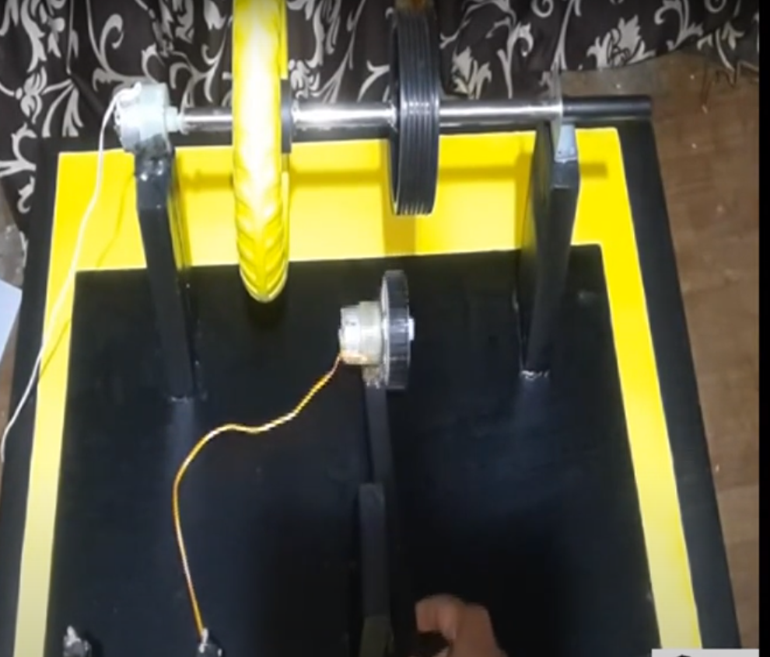

Slide 14
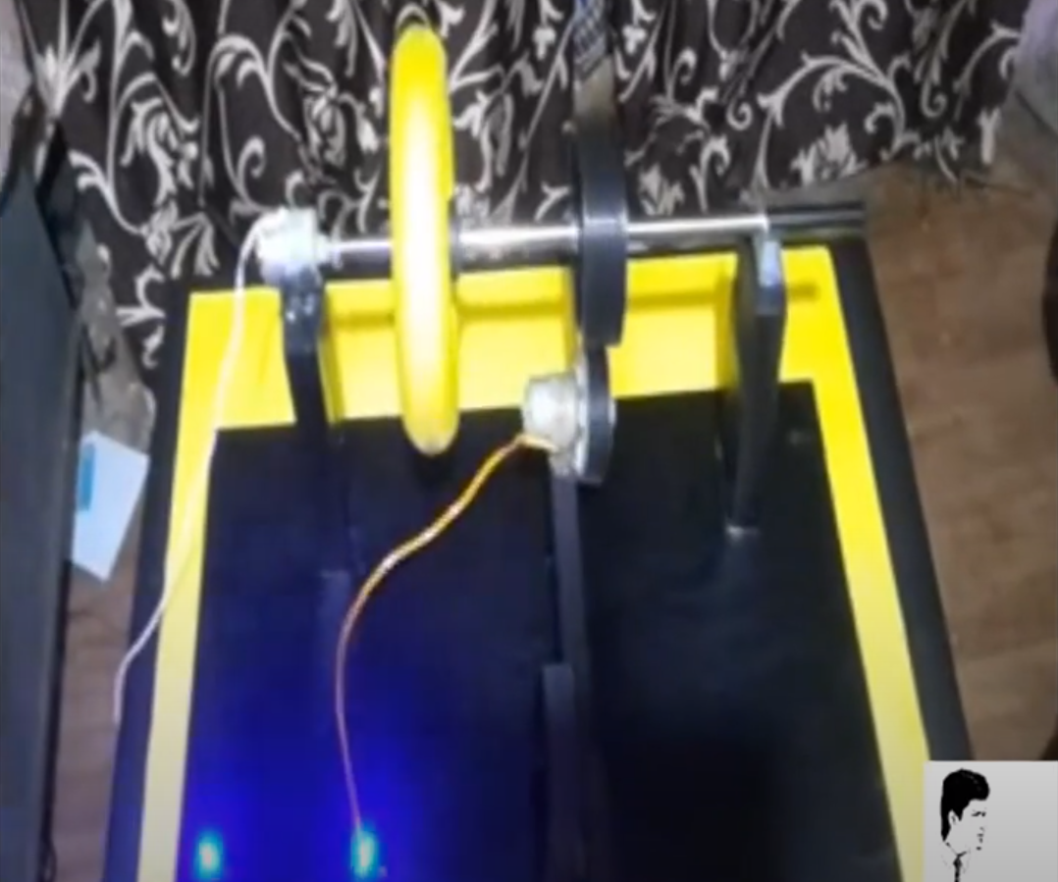

Slide 15
Hardware Requirements
1000 RPM DC Motor
Big Wheel
Small wheel
Iron rod
LED’s
Connecting wires
Motor shafts

Slide 16

Benefits
It saves lot of charging power required to charge the battery.
It supports use of hybrid and green vehicles.
It helps to reduce carbon emission , as in various methods used in it reduce fuel or power consumption
By saving carbon emission we save our carbon credits which can be sold to countries which exceed their limit.

Slide 17

Limitations
The regenerative braking effect drops off at lower speeds
Most road vehicles with regenerative braking only have power on some wheels and regenerative braking power only applies to only those wheels .
The friction brake is a necessary back-up in the event of failure of the regenerative brake.

Slide 18
Limitations
No regenerative braking effect can occur if another electrical component on the same supply system is not currently drawing power and if the battery or capacitors are already charged.
For this reason, it is normal to also incorporate dynamic braking to absorb the excess energy.

Slide 19
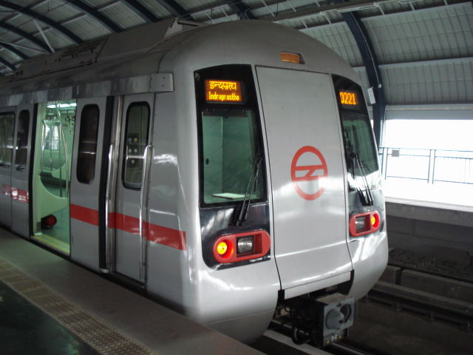
Delhi Metro
New Delhi's metro railway has prevented
90,000 metric tons of carbon dioxide from being emitted through its regenerative braking system.
The Delhi metro became the first railway project to be registered for carbon credits by the United Nations in 2007 for the regenerative braking system installed in 2004. The emissions were prevented during a three-year period, also cutting back on electricity use by 112,500 megawatt-hours
Notes:
Abhishek porwal 2009 uee 300
Prakhal goyal 2009 uee 285
Saurabh mishra 2009 uee 214

Slide 20
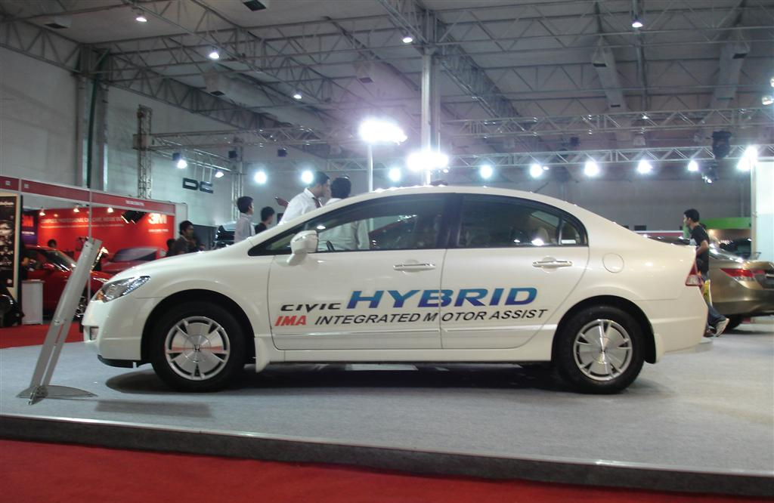
Any queries ?

Slide 21

Thank you!!!
For your patient hearing.

