Slide 1
Instructor-Led Nvidia Workshop
Options:
Fundamentals of Deep Learning (Basic Level)
Generative AI with Diffusion Models (It requires Pytorch and Deep Learning knowledge)
Benefits:
Access to a $500 workshop
Access to a fully configured, GPU-accelerated workstation in the cloud
Certificate upon successful completion of the assessment
Workshop Duration:
2 sessions (1 virtual , 1 in-person)
Instructor is based in Tacna, Nvidia covers airfare
Requirements for SIPAIM/USIL
Speaker Certificate
Nvidia Logo as Strategic Partner
1-night hotel

Slide 2
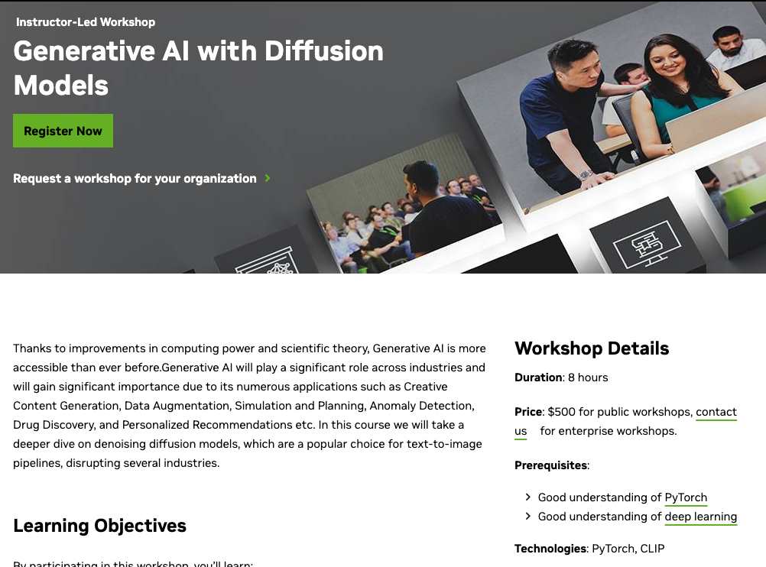
https://www.nvidia.com/en-gb/training/instructor-led-workshops/generative-ai-with-diffusion-models/

Slide 3
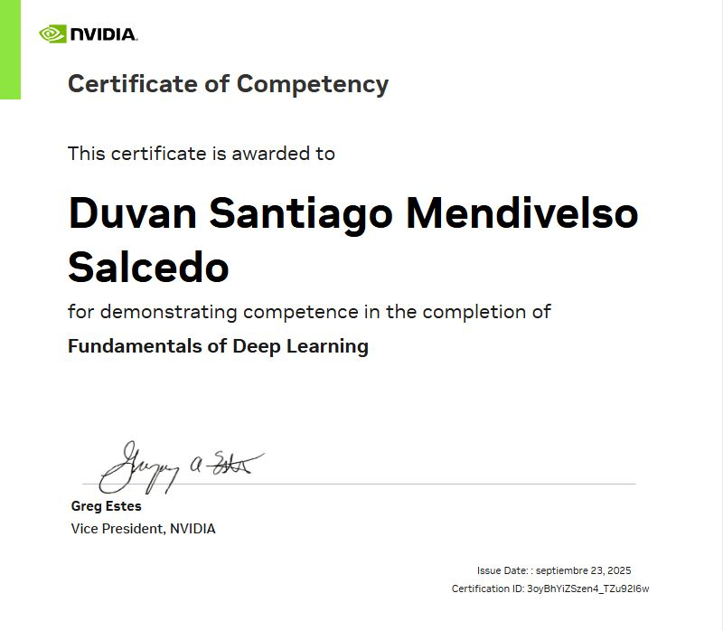
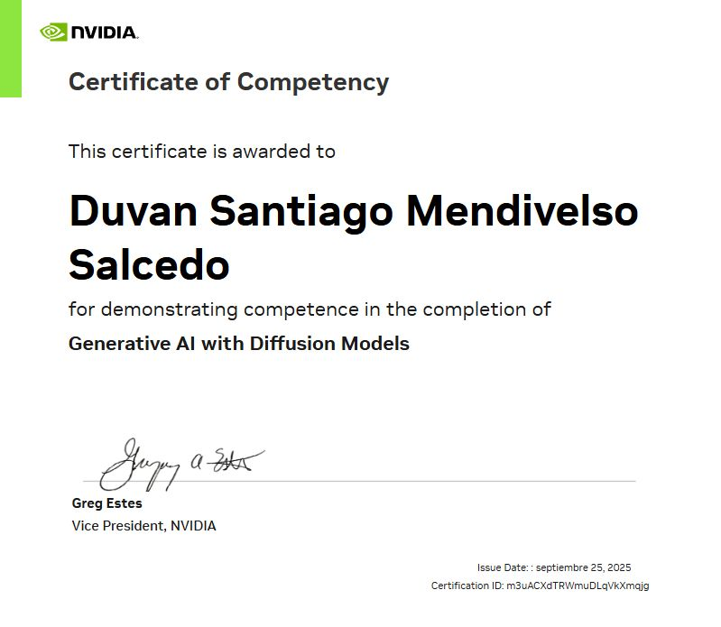
Certificates
Notes:
https://www.linkedin.com/posts/santiagomendivelso01_aiweek2025-ugcPost-7377065414524301313-x_ww?utm_source=share&utm_medium=member_desktop&rcm=ACoAABqO6gQBcxSqMnM1E4rUtV8bvuh3jN4JeNQ

