Slide 1
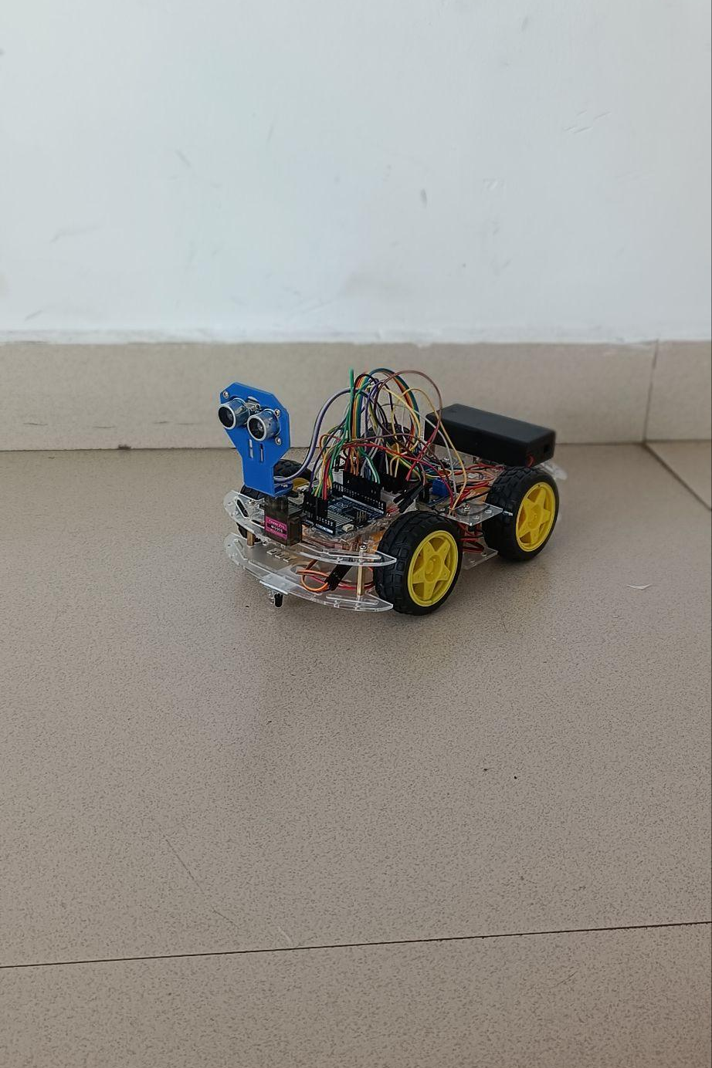
Navigator 1
Autonomous Robotics Platform
Engineered by Team Robonavigators — a fault-tolerant, AI Like-assisted rover powered by a custom embedded OS, untethered web interface, and six intelligent driving modes.

Slide 2
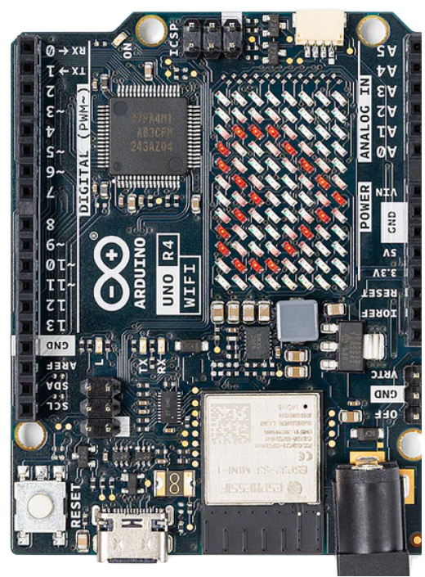
Built From the Ground Up
Navigator 1 bypasses off-the-shelf kits entirely. At its core is a custom 884-line C++ embedded operating system running on the Arduino UNO R4 WiFi — delivering real-time control, autonomous decision-making, and a standalone asynchronous web server in a single, crash-proof machine.
884 Lines of C++
Arduino UNO R4 WiFi
Custom embedded OS, zero dependencies
Native Wi-Fi, onboard LED matrix
Standalone Web Server
Asynchronous, zero-reload interface

Slide 3
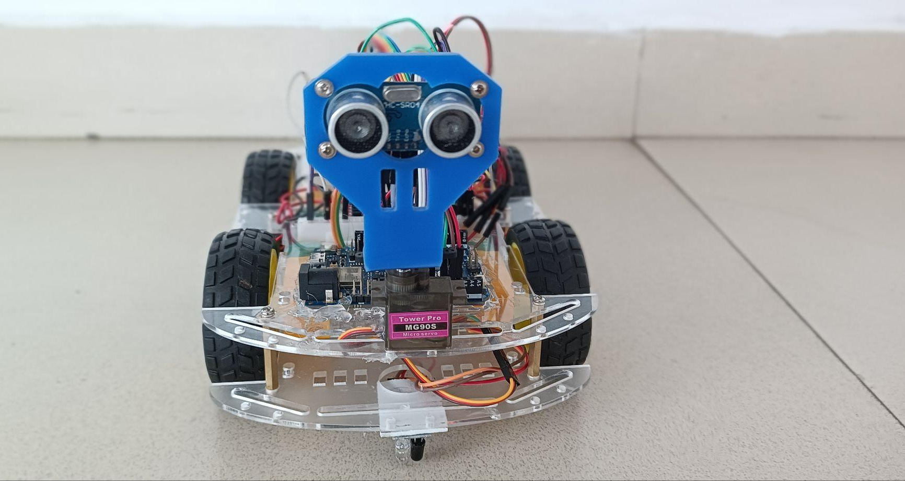
Hardware & Sensor Architecture
Advanced Sensor Array
Front & rear ultrasonic sensors for full 360° spatial mapping
Downward-facing IR sensor for cliff detection and drop-off prevention
180° servo-mounted radar for sweeping obstacle scans in Autopilot mode
Custom Charging Matrix
A proprietary 4-bay TP4056 independent charging station ensures perfectly balanced 18650 lithium-ion cells — eliminating the risks of series charging entirely.

Slide 4
Untethered Web OS
No laptop. No monitor. No tether. Navigator 1 boots into a fully functional web interface accessible from any smartphone or tablet.
Zero-Lag Dashboard
PC-Free Boot Sequence
Network Failsafes
Custom HTML/JS interface uses asynchronous fetch requests — commands execute and telemetry updates without ever reloading the page.
A physical hardware switch toggles AP/STA networks. The onboard LED matrix scrolls the assigned IP address — no external monitor needed.
A 4-second heartbeat catches dropped connections instantly. An 8-second boot timeout safely defaults to offline autonomous mode if Wi-Fi is unavailable.

Slide 5



ENGINEERING FIXES
8 Clever Fixes That Made Our Robot Smarter
Every robot has growing pains — here's how we solved each one!
🔋 The Jumpery Battery
🧦 Socks on Wood Floors
🚨 Runaway Robot Guard
📰 The Robot News Ticker
Issue: Battery levels jumped like a pogo stick.
Fix: A "Math Smoother" keeps readings steady.
Issue: Robot slid like socks on a slippery floor.
Fix: "Turbo-Stop" is a smart active braking system that instantly cancels the robot's forward momentum and prevents skidding by firing a split-second reverse motor pulse.
Issue: Disconnected phone? Robot drove forever!
Fix: "Check-in Timer" stops it after 4 silent seconds.
Issue: No screen to see the Wi-Fi address.
Fix: LED face scrolls the numbers like a news ticker.
⚡ Instant Control
🏨 Battery Hotel Rooms
Issue: Lag between button press and movement.
Fix: "High-Speed Brain" makes commands instant.
Issue: Charging batteries together caused damage.
Fix: Each battery gets its own "Room" to charge safely.
👻 Invisible Force Fields
⏸️ The Smart Pause
Issue: Someone stepping in front confused the robot.
Fix: It "Pauses Time" until the path clears.
Issue: Robots can't see walls or table edges.
Fix: "Magic Bumpers" (sensors) stop it before a crash.

Slide 6



Physics & Active Safety Engine
Smart Active Braking
Dual-Sensor Active Shield
Injects a 50ms reverse-torque pulse to lock the drivetrain and kill skidding momentum — replacing standard coasting.
A permanent 25cm virtual bumper front and rear. If breached, the OS overrides human input to prevent hardware damage.
Interrupt-Level Cliff Detection
Downward IR sensors trigger immediate active braking at table edges — rendering the rover effectively un-fallable.

Slide 7



Live Telemetry & Precision Monitoring
EMA-Filtered Battery Readings
Navigator 1 employs an Exponential Moving Average (EMA) software filter to deliver live, multimeter-accurate battery voltage readings directly to the web UI — smoothing out noise without sacrificing responsiveness.
The EMA filter continuously weights recent samples more heavily, providing a stable voltage readout even under dynamic motor load changes.

Slide 8



Six Intelligent Operating Modes
Navigator 1 ships with six distinct driving modes — each protected by the Active Safety Engine in the background.
Draw & Follow
Voice Control
Autopilot
Translates touchscreen drawings into physical floor vectors with auto-pause on obstacles.
Browser Web Speech API integration for zero-latency continuous voice commands.
Radar-assisted 180° scanning calculates and executes optimal avoidance paths.

Slide 9



Advanced Modes: Tracking & Remote
Object Follow
Smart Idle Shield (Default)
Remote Control
Dynamic spatial tracking locks onto targets while maintaining a safe 20cm–80cm standoff distance.
An active parking guard that safely retreats from frontal proximity — checking rear sensors first to avoid backing into walls.
Precision digital joystick navigation with the Active Shield always engaged in the background for collision-free manual driving.

Slide 10
Platform Capabilities at a Glance
884
6
Lines of C++
Smart Modes
Custom embedded OS
Each protected by the Active Safety Engine
25cm
50ms
Virtual Bumper
Brake Pulse
Dual-sensor Active Shield range
Reverse-torque injection for instant stop

Slide 11
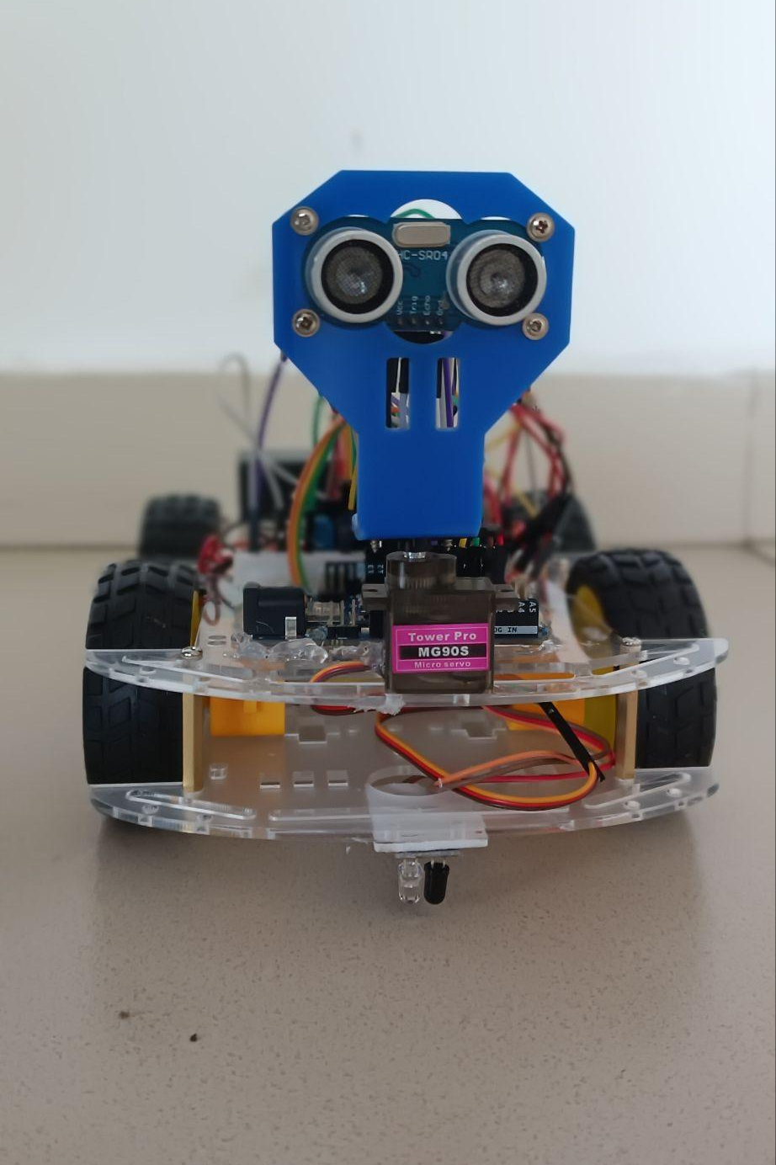
Navigator 1 — Ready to Deploy
A fully autonomous, crash-proof, untethered robotics platform — engineered without shortcuts, powered by custom software, and ready for real-world operation.
Custom OS
884-line C++ embedded system
Active Safety
Physics-based braking & shielding
Web Interface
Zero-lag, PC-free operation
6 Modes
Draw, Voice, Autopilot, Follow, Idle, RC

