Slide 1
Multi-Stage Healthcare Cost Prediction Pipeline
MEPS Longitudinal Data • 60,602 Patients • 6 Panels (2013–2018) • 31 Year-1 Features
⚙️ STAGE 0
🎯 STAGE 1
🧬 STAGE 1.5
💰 STAGE 2
Feature Engineering
Risk Tier Classification
Latent Factor Extraction
Cost Prediction
Raw MEPS ASCII → Parquet
📋 Demographics (6)
🏥 Utilization (4)
💊 Medication (9)
🔬 Chronic flags (4)
📊 Clusters (2)
💰 Y1 Cost (1)
Output: 39 features
Random Forest classifier
3 tiers based on Y2 cost:
Stable (≤ p75) — 75%
Rising (p75–p90) — 15%
Shock (> p90) — 10%
ROC-AUC = 0.833
Output: LATENT_RISK_SCORE
4 intermediate variables:
📈 Engagement Score
🔍 Undiagnosed Risk
⬆️ Escalation Score
💊 Adherence Risk
Cross-validated predictions
Captures within-tier signals
Tier-specific XGBoost
Target: log(1 + cost)
1 model per tier +
6 interaction features
R² (log) = 0.600
R² ($) = 0.480
Ablation confirms each
stage adds value
🔒 Data Leakage Prevention: All features Y1-only • Out-of-fold Stage 1 probabilities • Cross-validated Stage 1.5 factors • Panel-stratified splits

Slide 2
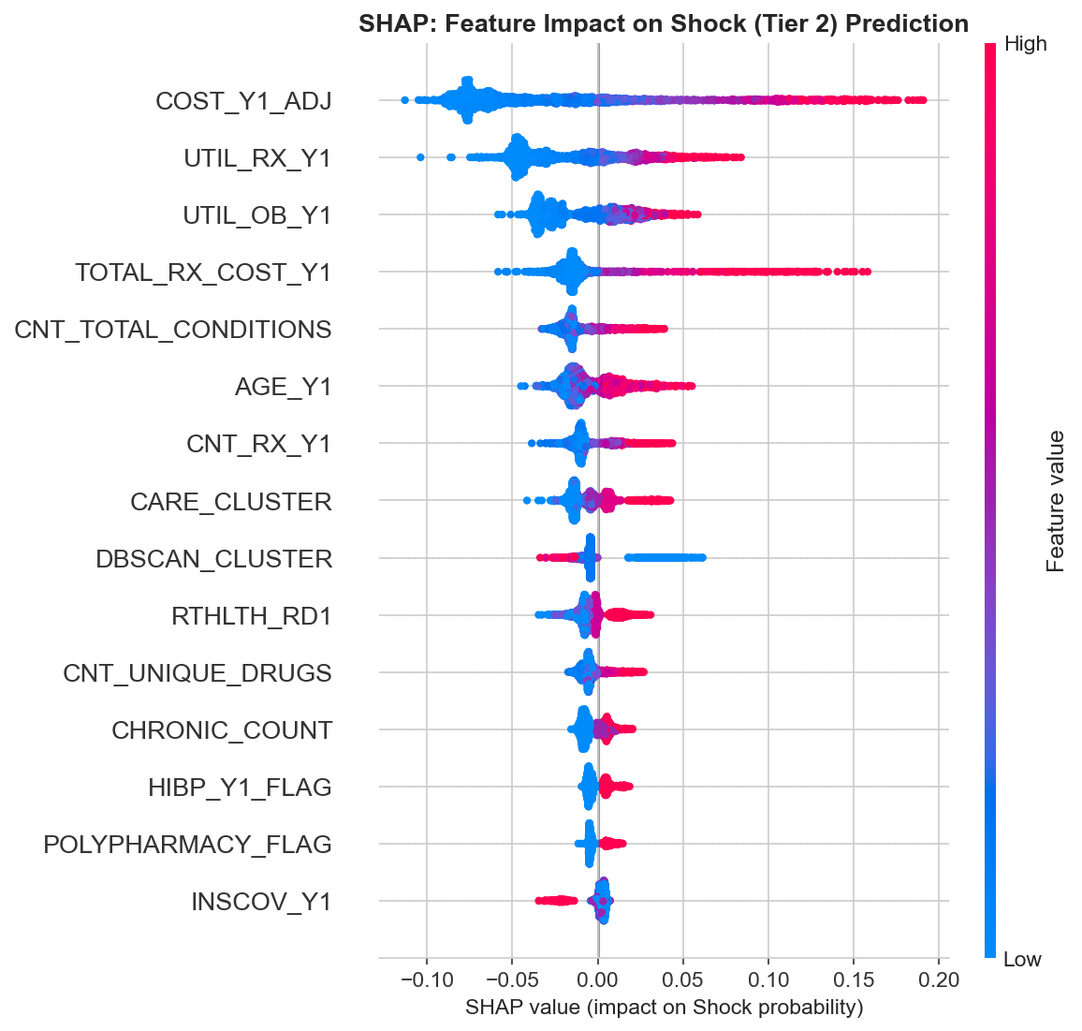
🎯 Stage 1: Risk Tier Classification — Results
Model Benchmark
Model Accuracy F1 Macro ROC-AUC
Random Forest ✓ 0.684 0.579 0.833
XGBoost 0.762 0.539 0.834
GradientBoosting 0.760 0.534 0.833
Logistic Reg 0.682 0.547 0.805
✓ Selected by F1 Macro (balanced across all 3 tiers)
Accuracy < 75% baseline is intentional: trades majority-class
precision for better minority-class detection.
Per-Class Performance
Tier Precision Recall F1 Support
🟢 Stable 0.90 0.76 0.82 6,531
🟡 Rising 0.32 0.58 0.42 1,504
🔴 Shock 0.55 0.44 0.49 1,103
Shock recall (44%) = key area for improvement.

Slide 3
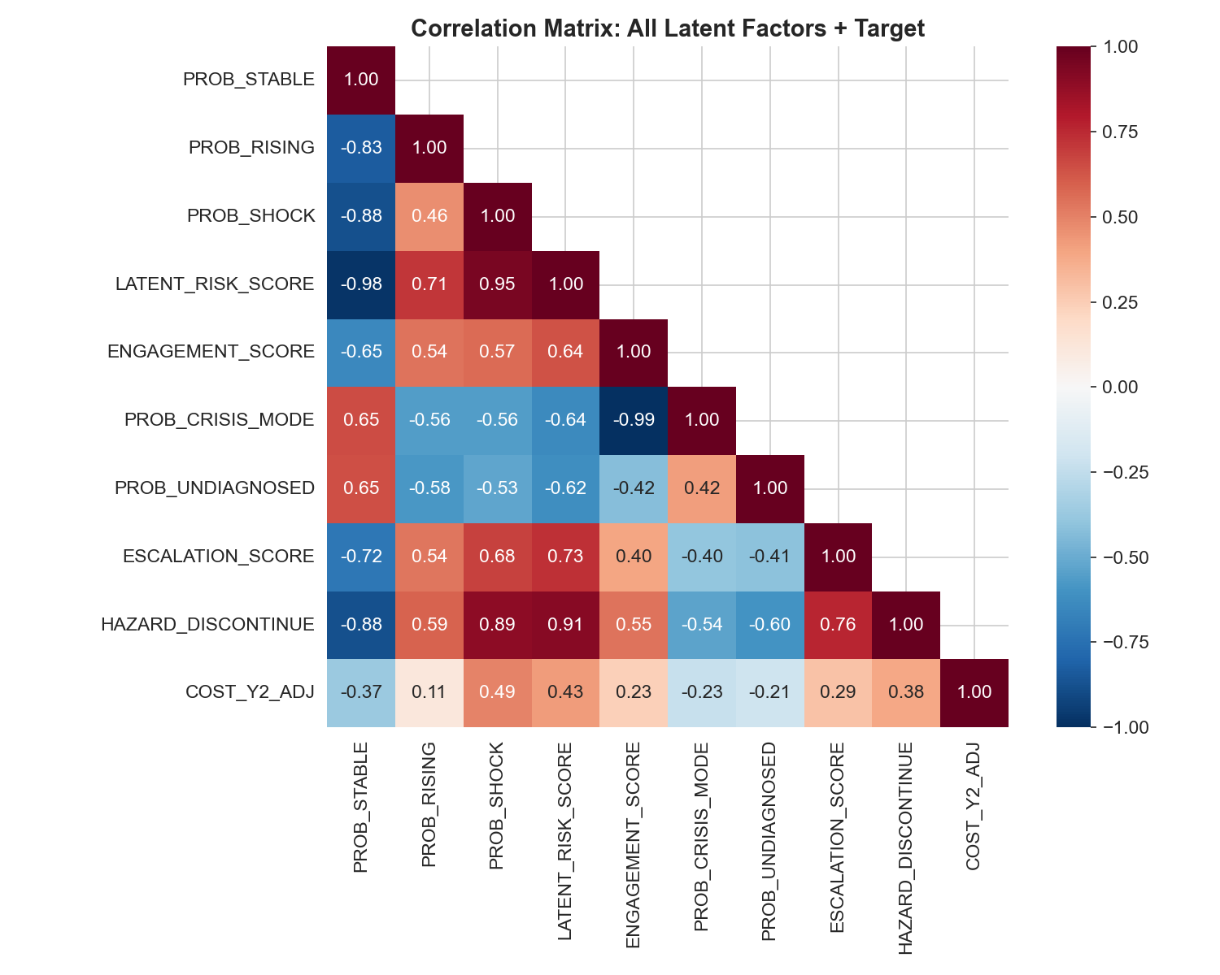
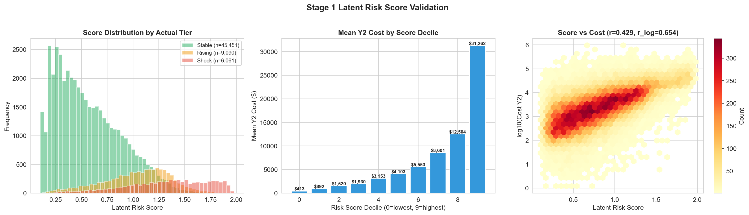
🧬 Stage 1.5: Intermediate Latent Factor Extraction
Stage 1 captures between-tier variation. Stage 1.5 captures within-tier clinical signals that raw features cannot express directly.
📈 Engagement Score
🔍 Undiagnosed Risk
⬆️ Escalation Score
💊 Adherence Risk
ENGAGEMENT_SCORE
Direct formula
PROB_UNDIAGNOSED
RF + CV predict
ESCALATION_SCORE
Composite index
HAZARD_DISCONTINUE
GB + CV predict
Proactive (office) vs crisis (ER) care pattern. Formula: Norm(OB) − Norm(ER) − 0.5×Norm(IP)
Identifies hidden risers: low Y1 cost but high Y2 risk. Target = IS_JUMPER.
Comorbidity-driven risk: chronic count + ill-defined Dx + IP stays + polypharmacy.
Medication adherence from Rx timeline: density, gap ratio, trailing gap, regularity.
❌ Removed: PROB_MH_DECLINE — r = 0.01 with cost, only MNHLTH_RD1 mattered (redundant with original feature)

Slide 4
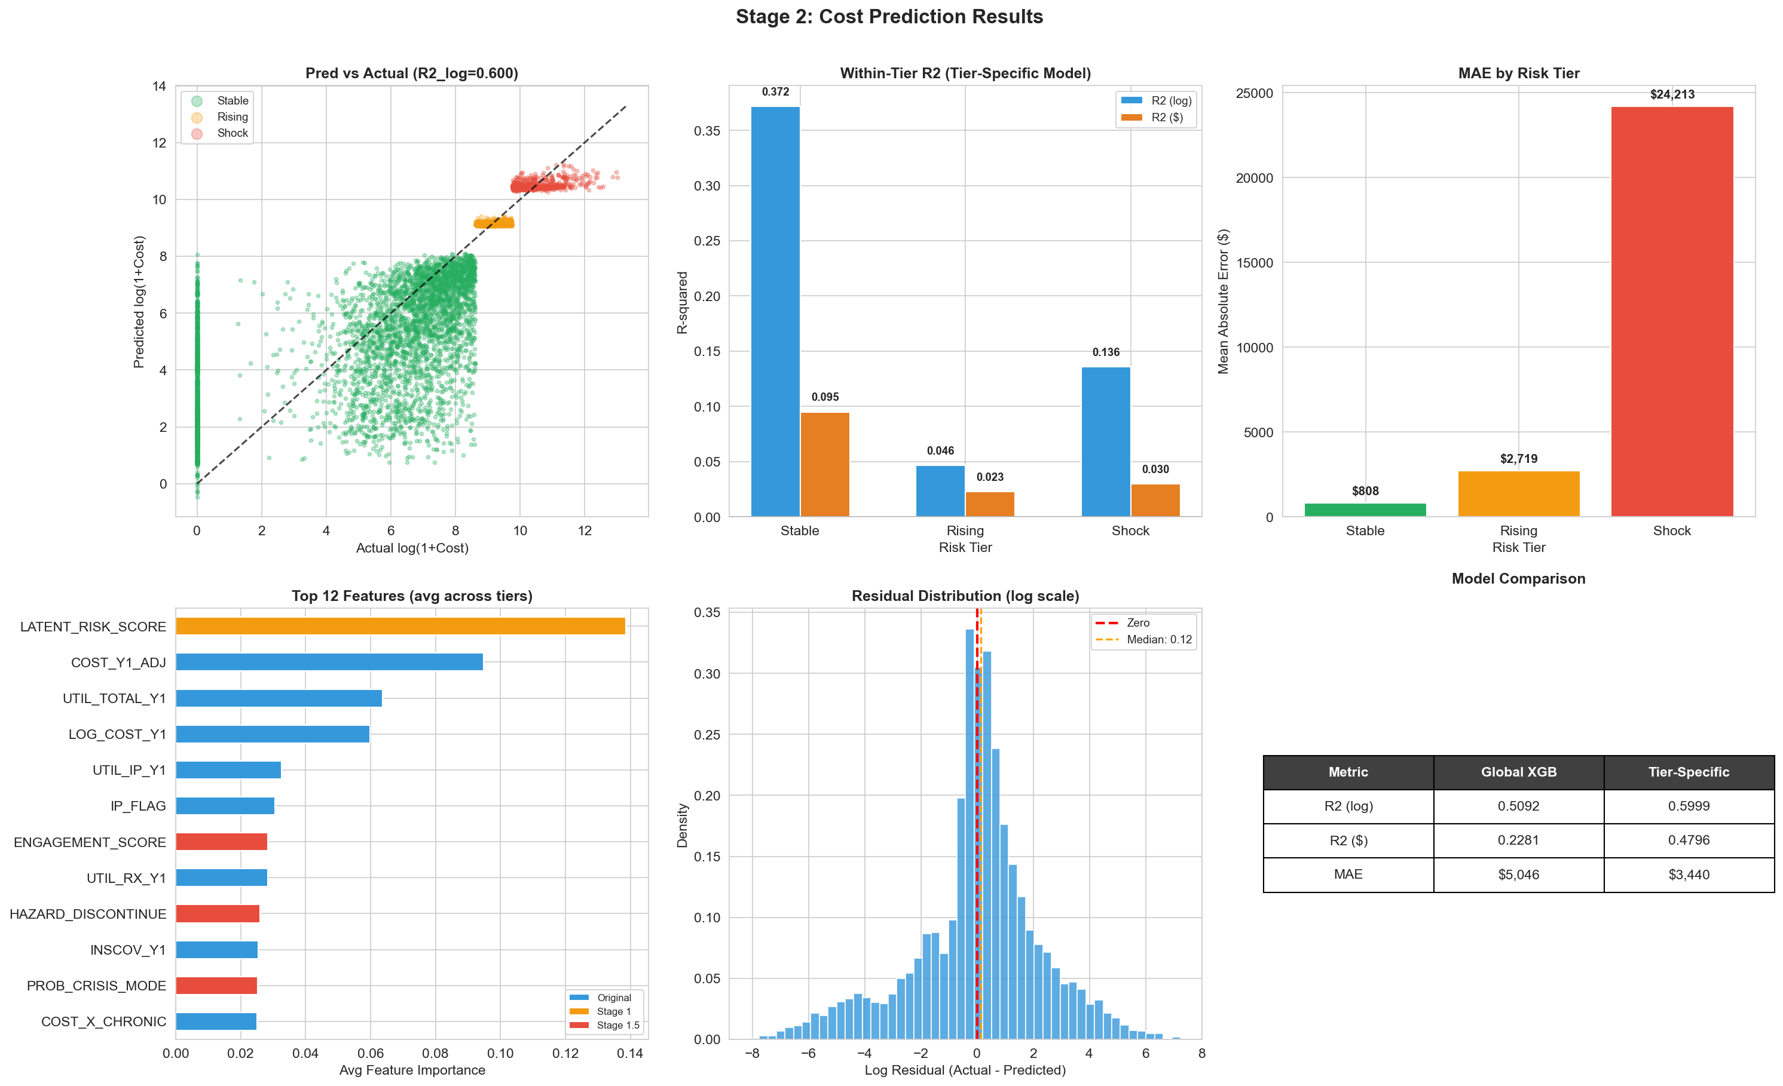
💰 Stage 2: Tier-Specific Expenditure Prediction — Results
Overall R²
log scale: 0.600
dollar: 0.480
Within-Tier R² (log)
🟢 Stable 0.372
🟡 Rising 0.046
🔴 Shock 0.136
MAE:
Stable $808 | Rising $2.7K
Shock $24.2K
Method
XGBoost per tier
Target: log(1+cost)
+ 6 interaction features
+ Stage 1.5 latent factors
Early stopping on val set

Slide 5
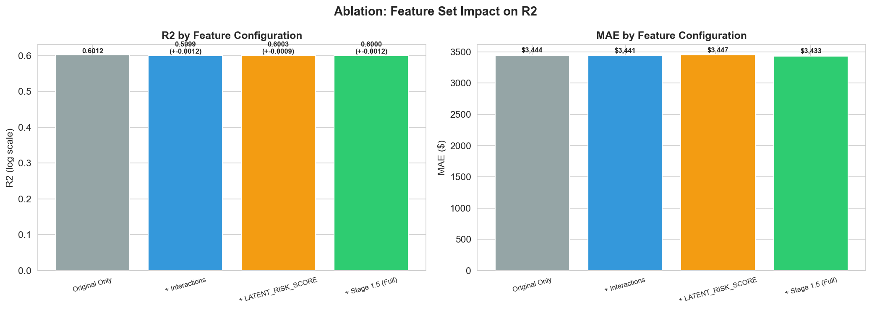
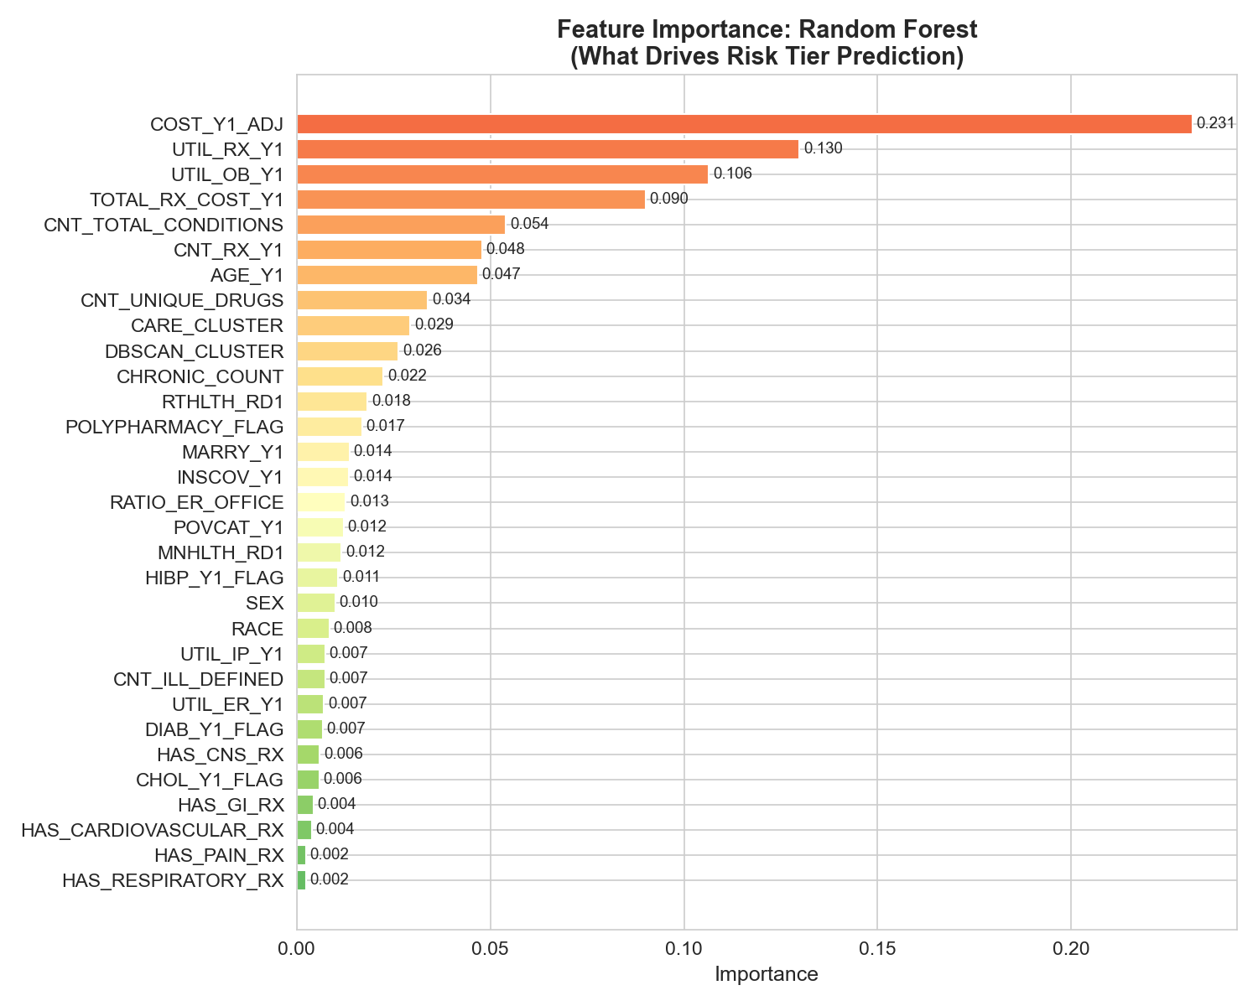
📊 Ablation Study & Key Findings
✅
Multi-Stage Justified
Each stage adds incremental R². Ablation confirms Stage 1.5 latent factors improve prediction beyond original features.
📈
R² = 0.60 (log)
Competitive for individual-level cost prediction from survey data. Standard in health economics (Bertsimas et al. 2008, Rose 2016).
🎯
Tier-Specific > Global
Separate models per tier outperform a single global model. Stage 1.5 factors drive within-tier differentiation.
⚠️
Limitations
Rising tier R² remains low (0.046). Shock recall at 44% in Stage 1. Survey data inherently limits precision.
🔮
Next Steps
Hyperparameter tuning (Bayesian optimization). Stacking ensemble. Feature selection refinement. External validation on held-out panels.

