Slide 1
Sudhanva S
BE MTech

Slide 2












INTRODUCTION
BE in Computer Science and Engineering
MTech in Industrial Automation and Robotics

Slide 3
Experience
Autonomous Driving
Mobile Robotics
Robot Manipulators

Slide 4
projects
The development activities carried out by myself as an individual contributor towards the set goals for the product intended

Slide 5
Autonomous Vehicle
Integration of pedestrian detection
Integration of pothole detection
Integration of height map based object detection
Mathematical modelling of kinematics for four wheel steering
Development of kinematics

Slide 6
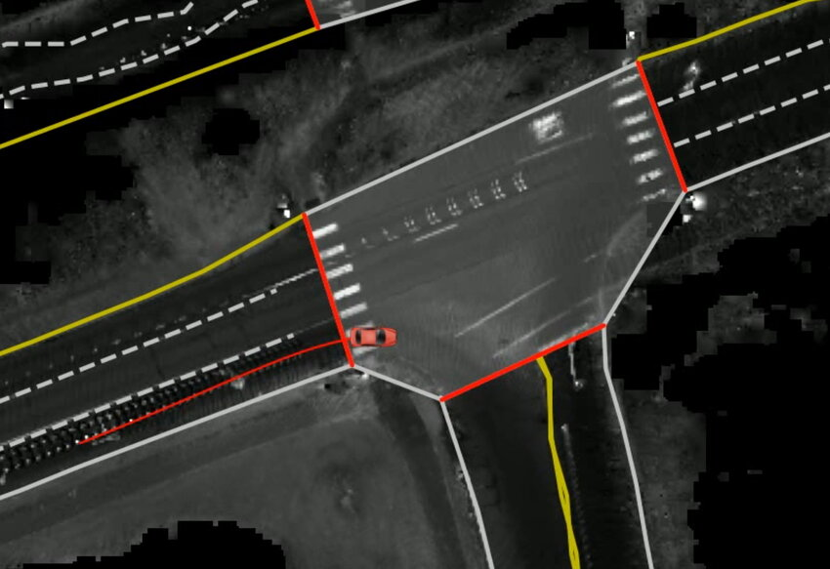
Autonomous Driving
Object modelling for HDMap creation software
PoC for curb detection
3D LiDAR mapping algorithm
Cross functional technical task force
Ref: https://www.researchgate.net/figure/An-online-HD-map-overlaying-lidar-intensity-as-a-vehicle-traverses-an-intersection-The_fig1_362987658

Slide 7
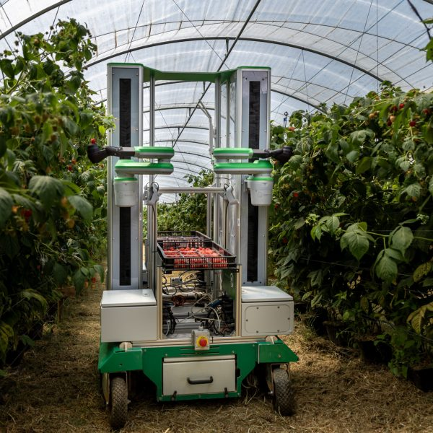
Agricultural Robot
State machine design and development for multi arm mobile robot
Integration of onboard diagnostics and error handling

Slide 8
Robot Vacuum Cleaner
Evaluation of Kalman Filter and Extended Kalman Filter for tracking objects
Development of EKF based tracker for object tracking

Slide 9
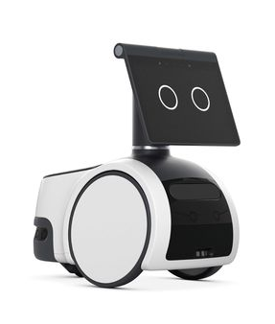
Amazon AStro
Migration of proprietary ROS packages to ROS2.
https://www.livemint.com/companies/news/amazon-unveils-jetsons-like-roaming-robot-for-the-home-11632873660701.html

Slide 10
Amazon’s internal product
ROS2 bring-up along with non-default features like zero-copy
Development of a new type of component container that enhanced the performance of ROS2 nodes by 80%
Whitelisting of network interfaces to make ROS2 Daemon immune to network changes.
Investigation and fix for ROS2 CLI hang and other bugs.

Slide 11
Recognitions and Appreciations

Slide 12
Recognitions
Payment
Utility
Security
NFT
Gaming
Used to complete transactions anywhere crypto is accepted
These tokens have a specific use within a blockchain
Tokens backed by securities
Authenticates ownership of specific assets
Used as in-game currency and traded with real world value

Slide 13





PORTFOLIO BUILDUP
Step 1
Step 2
Step 3
Step 4
Step 5
Choose a cryptocurrency exchange
Purchase preferred coins & create "wallet"
Research investment and trading options
Stake preferred coins in chosen company
Set exponential growth goals

Slide 14
AREAS OF FOCUS
Portfolio diversification
Short and long-term goals
Develop winning combinations to stay ahead of the market
Capitalize on direct ownership of digital coins
Invest in multiple blockchains​
Create an emergency fund
Add a second stream of income
Buy a house
Supplement retirement fund

Slide 15
HOW TO GET THERE
Strategize
Minimize risk
Utilize resources
Do your research and develop a plan with goals
Diversify your portfolio through coin ownership​
Follow the markets closely​
Be cautious of scams and "too good to be true" scenarios
Avoid "all-in" strategies
Apps and platforms help streamline user experience
Seek expert guidance from Krypto Logics team members​

Slide 16

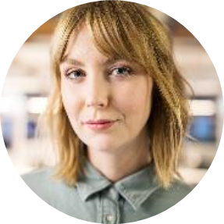
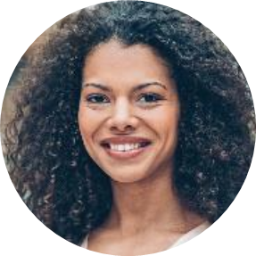
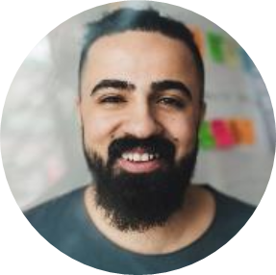
MEET OUR TEAM
Takuma Hayashi​
Mirjam Nilsson​
Flora Berggren​
Rajesh Santoshi​
President
Chief Executive Officer
Chief Operations Officer
VP Marketing

Slide 17
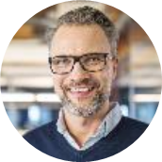
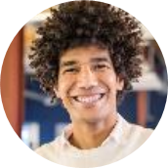
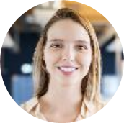
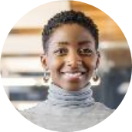
MEET OUR EXTENDED TEAM
Takuma Hayashi​
Mirjam Nilsson​
Flora Berggren​
Rajesh Santoshi​
President
Chief Executive Officer
Chief Operations Officer
VP Marketing
Graham Barnes
Rowan Murphy
Elizabeth Moore
Robin Kline
VP Product
SEO Strategist
Product Designer
Content Developer

Slide 18
SUMMARY
As a seasoned robotics engineer, I have acquired extensive hands-on experience across the entire system, from application development and algorithm design to platform-level modifications.

Slide 19
THANK YOU
Sudhanva S
pioneer.sudhu@gmail.com
www.tinyurl.com/sudhanva-s

