Slide 1
Film Transport Device Preliminary Design Alternatives
Andrew Bornstein
Anderson Li
June 1, 2012

Slide 2
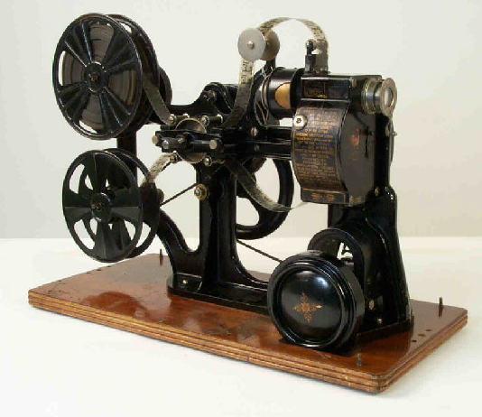
Digitizing Film Reels with Telecine
Preserve a library of 28mm films
Analog -> Digital conversion device
Cycle through each frame, capturing images with a HD digital camera

Slide 3
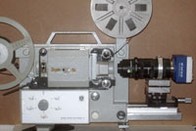
Creating A 28mm Telecine Device
Advance Frames for Digital Capture
Maintain Alignment
Minimize damage to the film

Slide 4
Modularized Design Approach
Film Gate
Film Transport
Sprocket Design
Up/Out-take reel control
Illumination
Camera Mount
Other Features

Slide 5
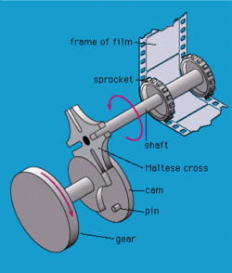
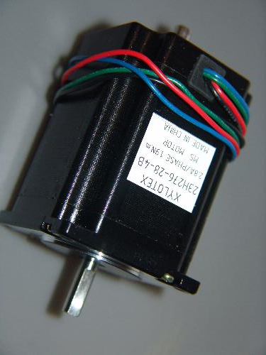
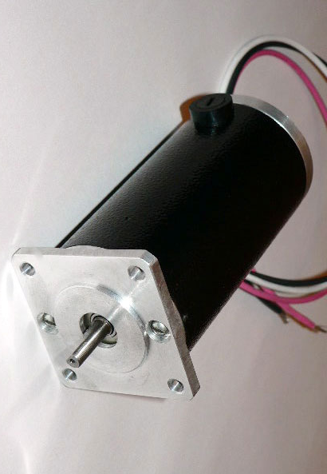
Drive System for Film Transport
Stepper Motor
Geneva Drive
DC Servo Motor

Slide 6
Drive System for Film Transport
Low Cost (already have the parts)
Simple Implementation (direct drive versus multiple shafts)
0.72 Degree step size gives relatively high resolution
Stepper motor gives good position control

Slide 7
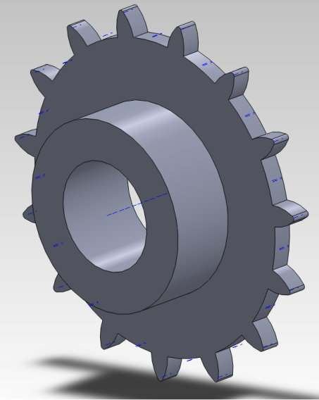
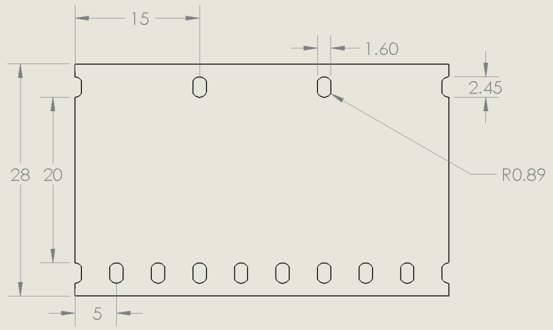
Sprocket Size
RADIUS (mm) | Teeth (coarse sprocket) | Teeth (fine sprocket) | Steps per Frame (STEPPER ONLY)
9.55 | 4 | 12 | 125
11.94 | 5 | 15 | 100
23.87 | 10 | 30 | 50

Slide 8
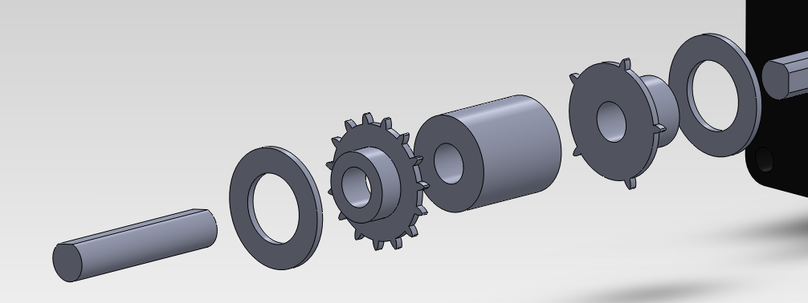
Sprocket Pair
A Compromise
11.94 mm
High angular resolution (stepper only)
Decent film to tooth contact ratio
Conservative space requirements
CNC milled from aluminum for accuracy

Slide 9
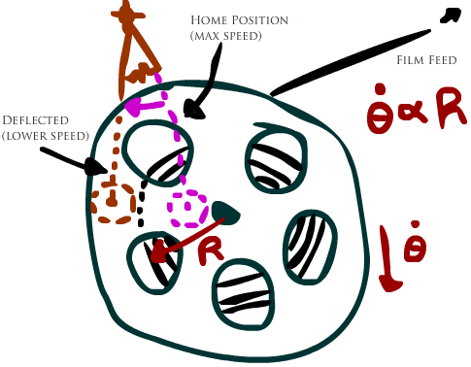
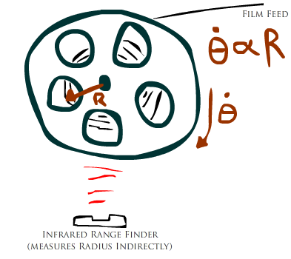
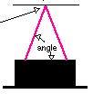
Up/Out-Take Reel Control
Potentiometer Rotation
Infrared Range Finder

Slide 10
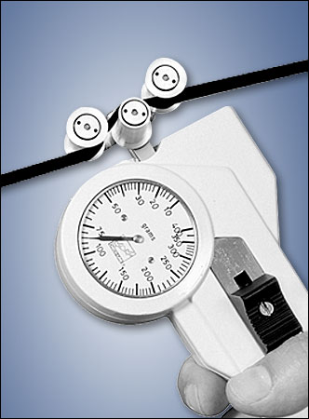
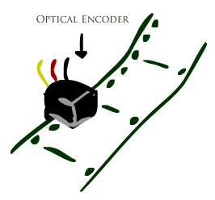
Up/Out-Take Reel Control
Tension Sensor
Boolean Optical Encoder

Slide 11
Rollers… Mounts… LED bank

