Slide 1
Film Transport Device Preliminary Design Alternatives
Andrew Bornstein
Anderson Li
June 1, 2012

Slide 2
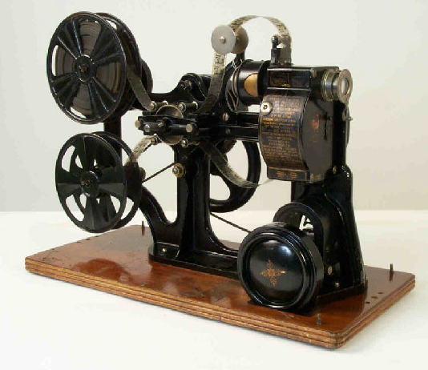
Digitizing Film Reels with Telecine
Preserve a library of 28mm films
Analog -> Digital conversion device
Cycle through each frame, capturing images with a HD digital camera

Slide 3
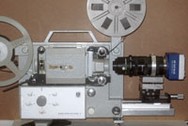
Creating A 28mm Telecine Device
Advance Frames for Digital Capture
Maintain Alignment
Minimize damage to the film

Slide 4
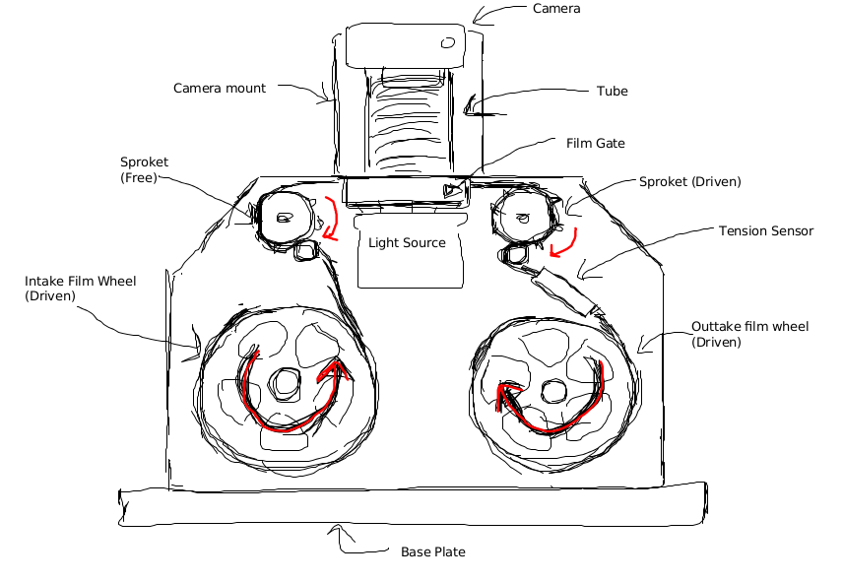
Modularized Design Approach
Film Gate
Film Transport
Sprocket Design
Up/Out-take reel control
Illumination
Camera Mount
Other Features

Slide 5
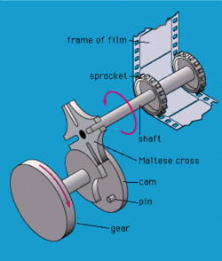
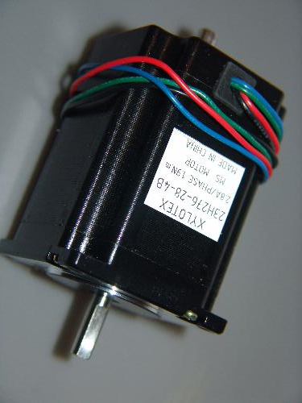
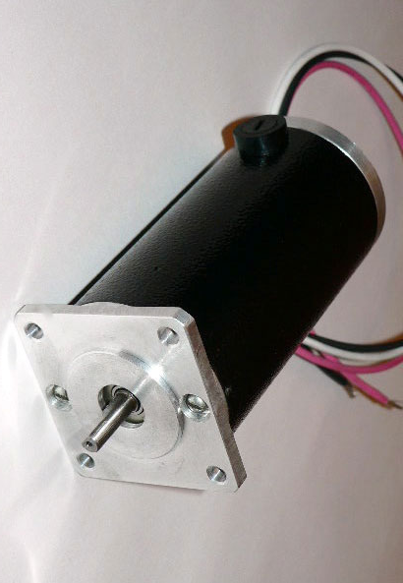
Drive System for Film Transport
Stepper Motor
Geneva Drive
DC Servo Motor

Slide 6
Drive System for Film Transport
Low Cost (already have the parts)
Simple Implementation (direct drive versus multiple shafts)
0.72 Degree step size gives relatively high resolution
Stepper motor gives good position control

Slide 7
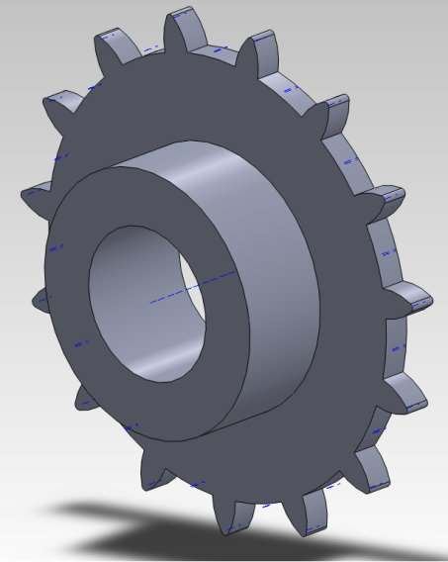
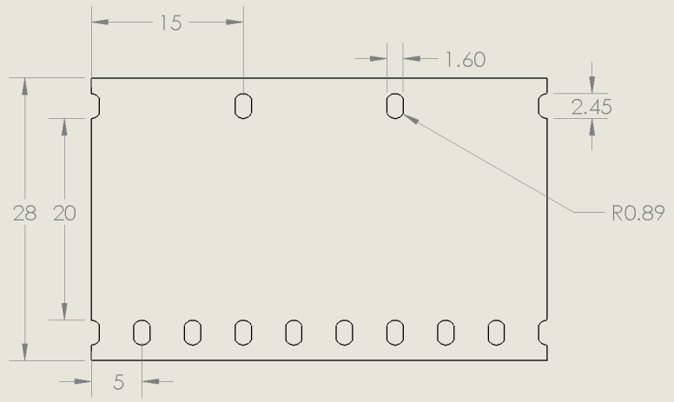
Sprocket Size
RADIUS (mm) | Teeth (coarse sprocket) | Teeth (fine sprocket) | Steps per Frame (STEPPER ONLY)
9.55 | 4 | 12 | 125
11.94 | 5 | 15 | 100
23.87 | 10 | 30 | 50

Slide 8
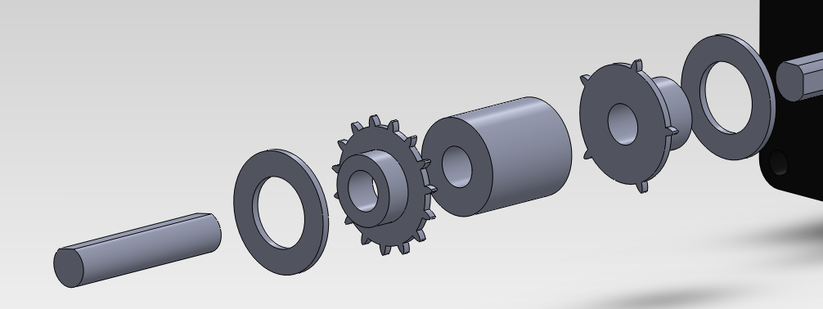
Sprocket Pair
A Compromise
11.94 mm
High angular resolution (stepper only)
Decent film to tooth contact ratio
Conservative space requirements
CNC milled from aluminum for accuracy

Slide 9
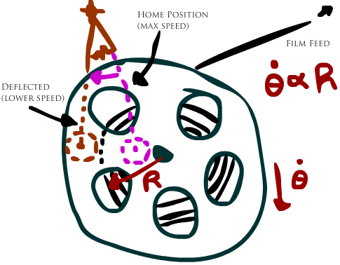
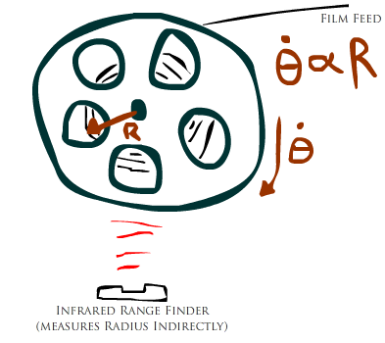
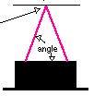
Up/Out-Take Reel Control
Potentiometer Rotation
Infrared Range Finder

Slide 10
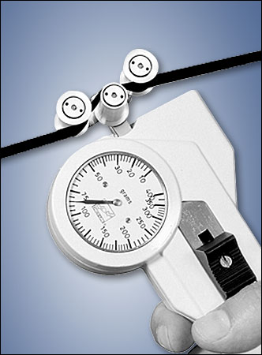
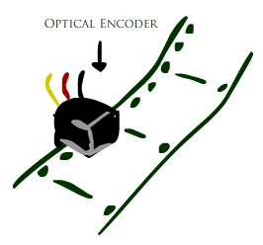
Up/Out-Take Reel Control
Tension Sensor
Boolean Optical Encoder

Slide 11
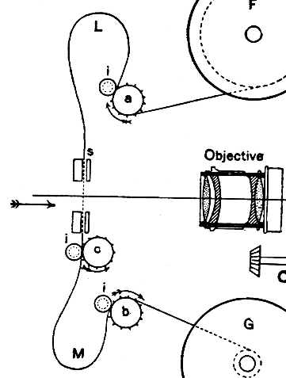
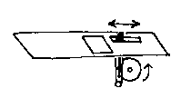
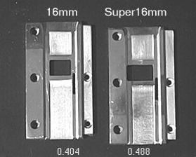
Film Gates
Notes:
The purpose of a film gate is to align and center the film while the image being projected through a hole in the film gate. In most projectors the film gate also advances the film using a claw mechanism driven by a cam as shown in the diagram above. However for this project the advancement of the film is to be driven by a stepper motor. Therefore the objective for this mechanism is to strictly center and align the film within an error less than a thousandth of an inch and let the film slide across the gate with minimum wear on the film.

Slide 12
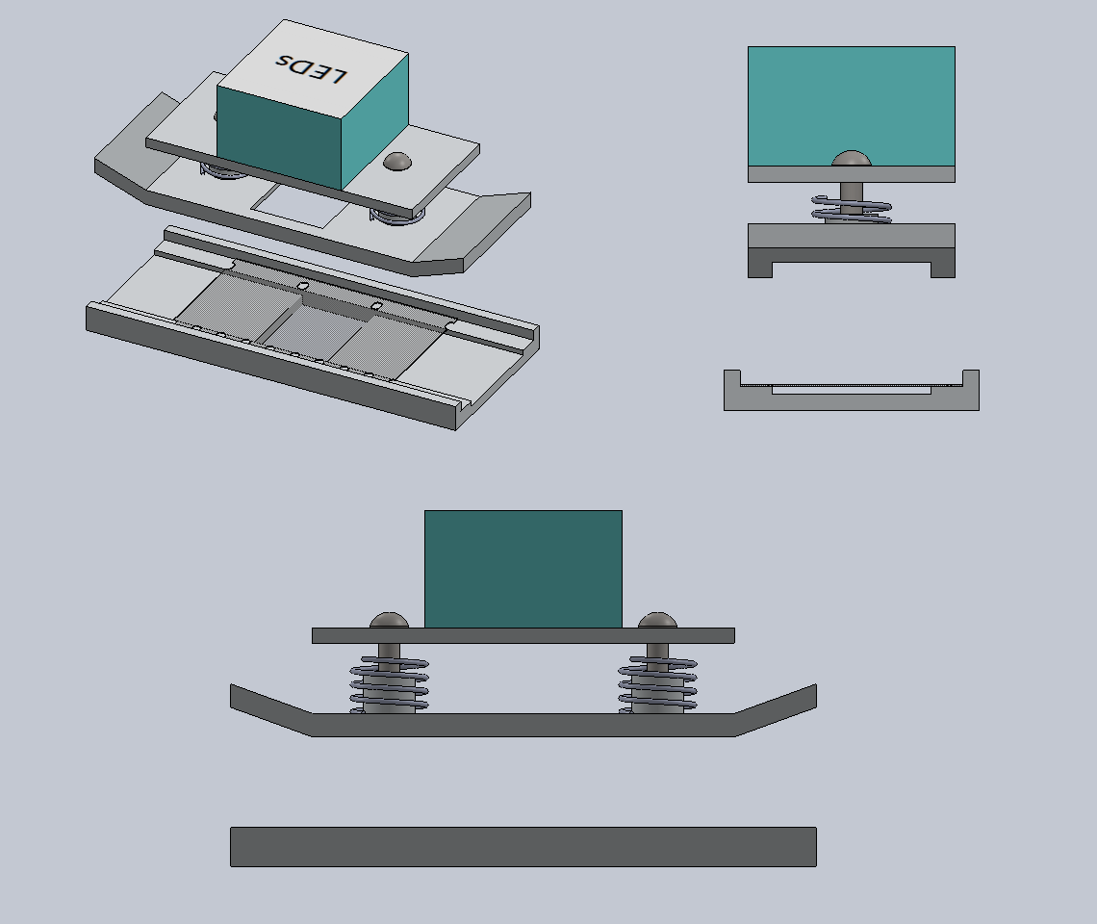
Flim Gate – Design #1
Pressure plate on top
Easier to machine
Missing side to side alignment
Notes:
The design concept for the film gate is to sandwich the film between a base plate and a pressure plate. To minimize wear and tear of the film, slots are cut in both plates so only the side edges of the film is in contact. The pressure plate is also spring loaded for a secure press on the film. This design is fairly easy to machine but it is missing any side to side alignment. With film that is this old it is very likely for the film to miss-align by more than thousand of an inch.

Slide 13
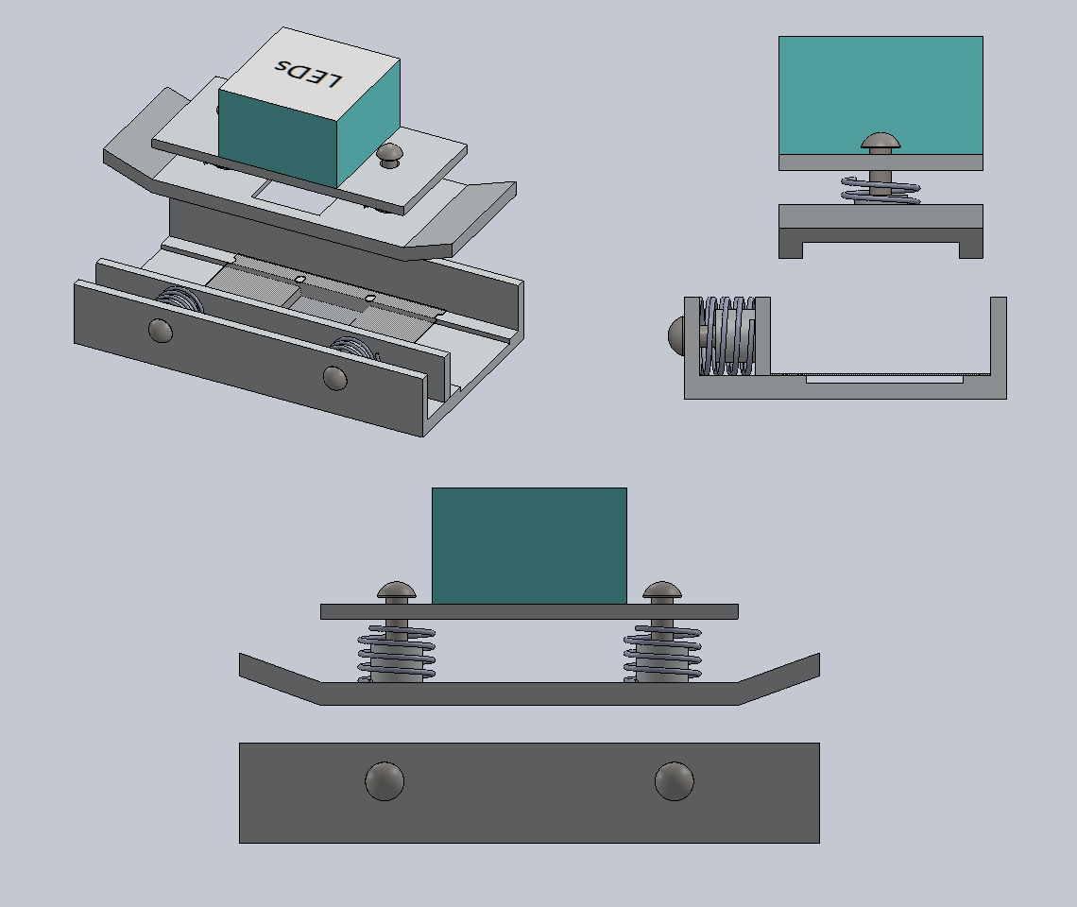
Film Gate – Design #2
Forced side alignment
Similar to pressure plate design
Possible film catching
Notes:
The second design improves on the first design by adding a side plate for the side alignment of the film. Similar to the pressure plate on top, the side plate is spring actuated and can be adjusted by turning the screws. The issues with this concept is that the side plate is in contact with the base plate so if there is a gap between the two the film might catch on the device and damage the film. Since the side plate is in a single piece there is also the possibility of the alignment at one end of the gate interfering with the other end.

Slide 14
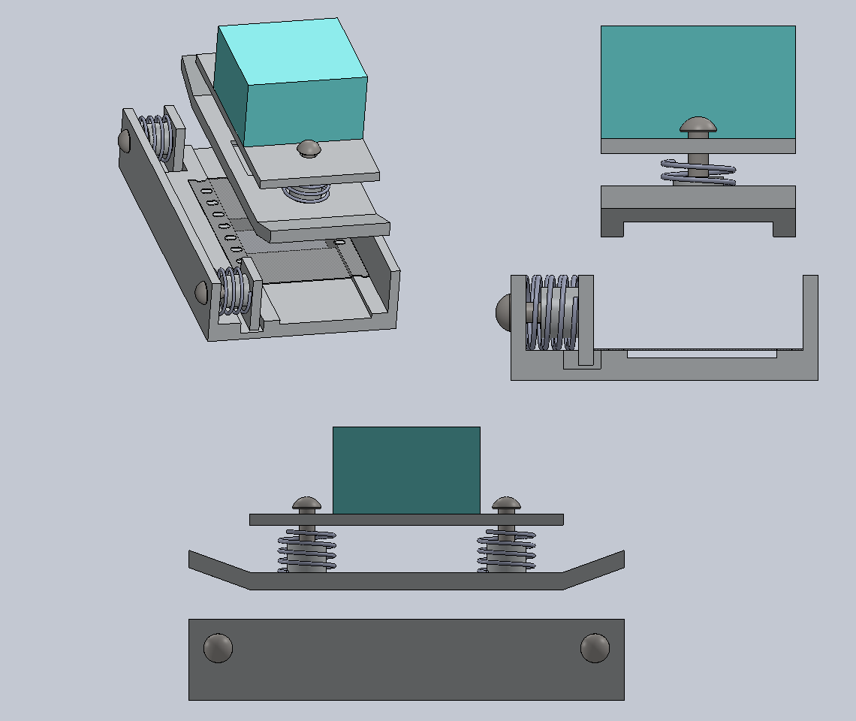
Film Gate – Design #3
Flexible 2 piece side alignment
Slot on the base plate for side plate to overlap
More machine tolerance
Notes:
In the third design attempts were made to fix the issues presented in the second design. The side plate is now split into two for a more flexible and independent alignment. An extra slot is also cut into the base plate for the side plate to overlap, leaving no gaps for the film to catch. This design is the safest in terms of film handling and machine tolerancing.

Slide 15
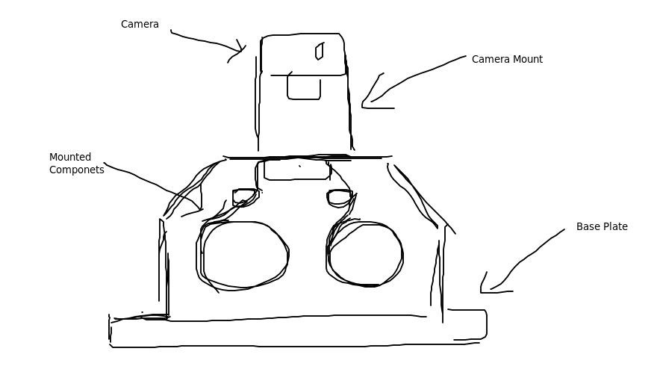
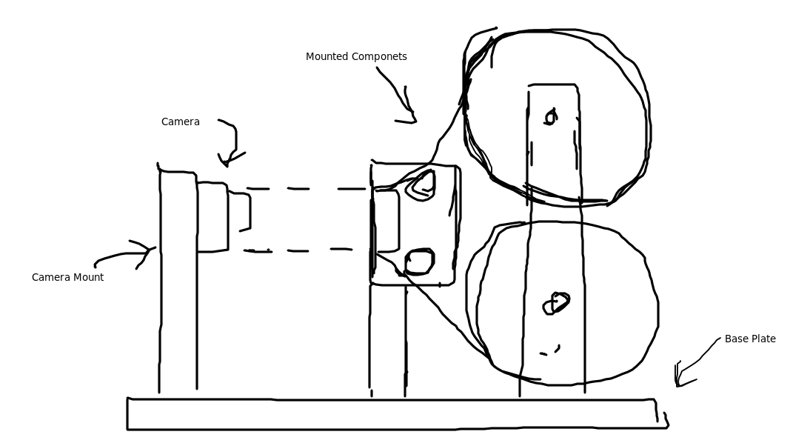
Frame & Component Mounting
Notes:
There are two ways to mount the frame components. The first is the parallel method as shown before with the camera mount on top. Another concept is to mount it upright so the camera can be mounted at the side. The benefits of the upright method is that it gives you better camera adjustments. However this design is very dependent on the components and it is not very flexible for changes. Therefore the parallel mounting is preferred for the first prototype.

Slide 16
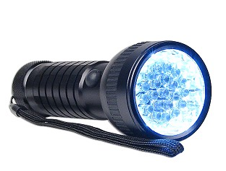
Illumination
LEDs with light filter
Available in flashlights
Long lasting
Low heat output
 | LEDs | CFLs | Incadescents
Lifespan | 50,000 hours | 10,000 hours | 1,200 hours
Cost | $35.95 | $3.95 | $1.25
450 Lumens | 4-5 Watts | 8-12 Watts | 40 Watts
Turns on Instantly | Yes | Slight Delay | Yes
Heat Emitted | 3 btu/hr | 30 btu/hr | 85 btu/hr
Notes:
The preferred type of light source is LEDs because of its longer lifespan and low heat output that will last for the long durations of the film transport. They are easily obtainable from flashlight and all needs is a light filter.

Slide 17
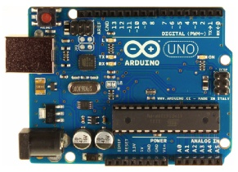
Micro controller
Arduino Uno
Easy to implement
Large supporting library of code
Past experience with the controller
Notes:
The choice of micro controller for the control system is the Arduino Uno due to its ease of implementation, large supporting library and most importantly our past experience with the controller because of the time it would take to get used to a new controller.

Slide 18
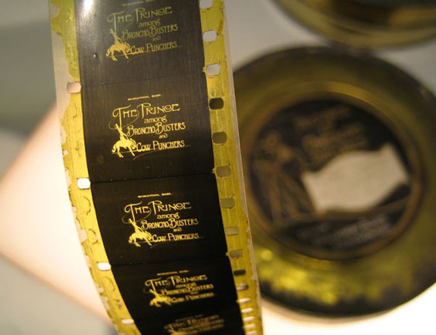
Questions?

