Slide 1

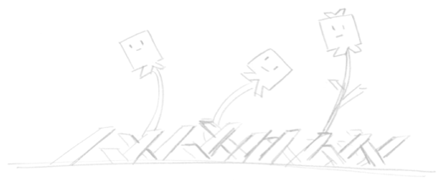
Introduction to CAD
Brought to you by:
Robot Garden
www.robotgarden.org
Notes:
What brought you to this class? Did you have something in mind to make?

Slide 2
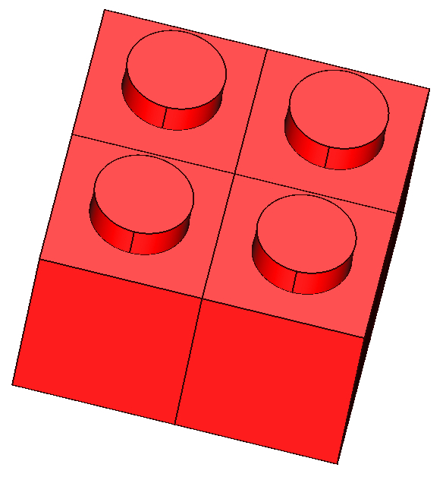
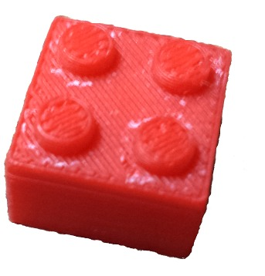


What is CAD?
Computer Aided Design
Pipeline to Computer Aided Manufacturing
2D, 2.5D and 3D
But what can I do with it?
Notes:
* If you’ve ever used paint or a similar program to create or manipulate a picture, you’ve experienced computer aided design! When I was a kid I remember having all sorts of ideas that I never felt like I could bring to life simply because what I could do artistically did not live up to what I envisioned in my mind. CAD has changed that entirely for me!
* Describe the maker movement – power of manufacturing in the hands of the people! CAD is a gateway technology to making things through CAM
* There are many applications for CAD, as I mentioned, even image manipulation is CAD and in fact there are many 2D applications. For example, blueprints, electronics schematics, etc. 2.5D comes in when you’re dealing with a three dimensional object that has only horizontal and vertical surfaces. This doesn’t matter in the modeling phase, but can be greatly important when you want to manufacture the part since 2.5D is a much simpler process than true 3D. And of course full fledged 3d.

Slide 3
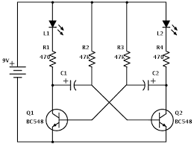
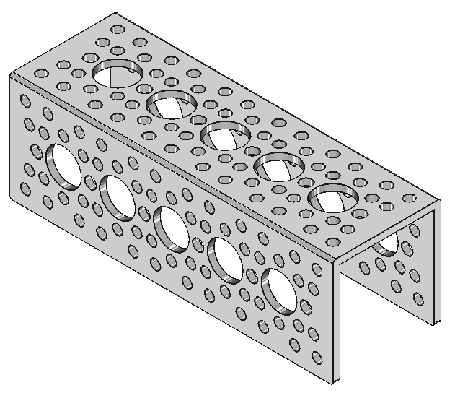
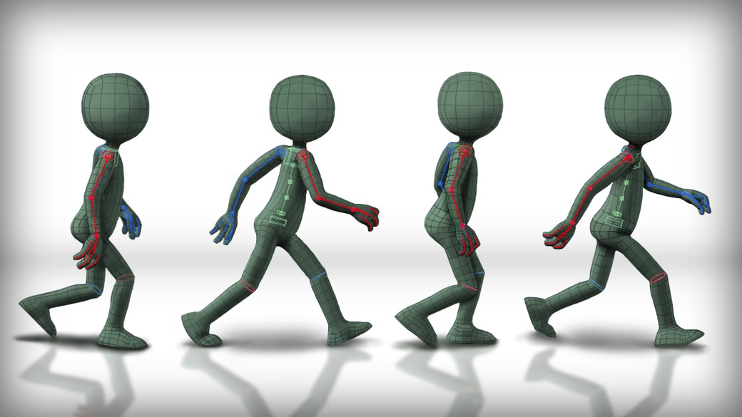

CAD Applications
Part Design
Landscaping Design
Building Architecture
Mechanical Design
Electronics Design
Animation
Can you think of others?
Notes:
As I mentioned, there are many applications that benefit from CAD. Listed on this page are some, but by no means all of them. As you can imagine, this is a very empowering technology used in many technical fields. In fact I’ve spoken with educators who say that students that have had some exposure to CAD have a leg up when they go to college. Listed here are some that I will describe in case you don’t know what I’m referring to.
* Part Design – just as it sounds – you have a part or solid you need to model and create. Think knobs, gears, brackets and the likes
* Landscaping and Building architecture are probably familiar to most people but if not, please just ask.
* Mechanical designing is where parts come together to make working machines – imagine a set of gears coming together and rotating
* Electronics schematics are used anytime you have a piece of electronics and need to design circuits and the likes.
* Yes even Animation is a form of CAD and there are softwares out there to aid in creating tese
* Even more beyond this!

Slide 4



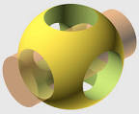










Common CAD Software
Commercial
3d
Fusion 360 from Autodesk
SolidWorks
CorelCAD
2d
Eagle CAD
Adobe Illustrator
Autodesk Maya
Free and Open Source
3d
TinkerCAD
Sketchup
FreeCAD
OpenSCAD
Blender
2d
KiCAD
Inkscape
Notes:
The list here is by no means exhaustive, nor does it cover the spectrum of applications we just went through. If you’re truly interested in CAD, you should spend a little time researching the type of CAD program that would meet your needs best. Let me talk a little bit to each of these programs
* Fusion 360 – best suited for parts and mechanical design – can also do CAM. Free for inventors, but quite pricey if you intend to use it for commercial application
* SolidWorks – best suited for parts and mechanical design. Major competitor to Fusion 360 – takes into account materials and their properties
* CorelCAD – parts and mechanical design, but at a much lower cost than Autodesk or Solidworks softwares
* Eagle CAD is commercial CAD designed specifically for circuit/electronics design
* Adobe Illustrator is a vector graphics software used for 2D manufacturing such as laser cutting and engraving
* Autodesk has an offering in nearly every CAD application and their vector graphics software is called Maya
* TinkerCAD – geared for easy adoption with an intuitive interface. Often used for kids and mostly in the parts design space
* Sketchup is 3D CAD geared more towards room and building designs
* FreeCAD is largely a parts design tool, although it is actively being developed to do more in the future
* OpenSCAD brings a development based UI to parts design. You literally write the code that makes the objects
* Blender is a software for creating Animations
* KiCAD is a competitor to Eagle CAD and is used in electronics/electrical schematics
* InkScape is a free and open source vector graphics software similar to Illustrator

Slide 5

Materials
Plastics
Metals
Wood
PCBs
Landscaping material
Videos
Much More!!
Notes:
Although CAD is strictly part of the design phase, it is still important to keep in mind the materials that are being targeted for what you’re creating since it can impact the process. For example, in 3d printing through a common extrusion style printer where there is a nozzle ejecting melted material in layers to form an object, if you design something with sharply overhanging faces, you might have troubles, so the best orientation of the part may be laying on it’s side or even upside down!
It’s also important to think about the type of manufacturing you will be utilizing. Additive as in the 3d printing example or subtractive where you might be using a CNC Mill, laser cutter or similar technology.
Finally the process of CAM should be a consideration – complexity goes up as more dimensions come into play – 2D is very simple for example on a laser cutter or simple CNC milling. 2.5D greatly simplifies the process of creating a part with a CNC mill over 3D and of course true 3D with curves and the likes is the most complicated CAM process.

Slide 6
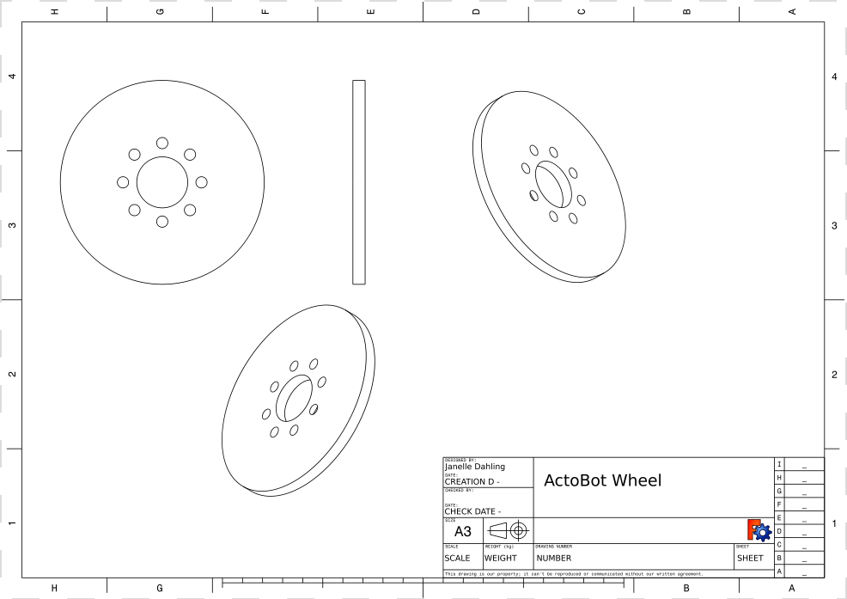
CAD Demo using FreeCAD
Notes:
Now I’m going to shift gears and bring up some videos I’ve made while creating and manipulating objects in FreeCAD to give you a sense of how the tool works and then I’ll give you a chance to ask any questions you have.

Slide 7


Questions?
This presentation is available at:
https://github.com/RobotGarden/cad_intro
Notes:
This slidedeck is in LibreOffice and PDF format and a copy can be obtained at the Robot Garden github site, located here at the url listed on this page. The QR code to the right will take you to the same location: https://github.com/RobotGarden/cad_intro
This material is considered Free and Open Source material. We ask only that you preserve the Robot Garden attributions and would prefer if any derivative work preserve the Apache 2 or similarly open license.
There is an appendix to this document that anyone interested more in this topic might want to reference for additional information including the license under which this material is copyrighted.

Slide 8
Appendix

Slide 9

License/Copyright
The materials for this class are licensed under the Apache license. See the file LICENSE for details.
Copyright 2016 J Dahling
Licensed under the Apache License, Version 2.0 (the "License"); you may not use this file except in compliance with the License. You may obtain a copy of the License at http://www.apache.org/licenses/LICENSE-2.0.
Unless required by applicable law or agreed to in writing, software distributed under the License is distributed on an "AS IS" BASIS, WITHOUT WARRANTIES OR CONDITIONS OF ANY KIND, either express or implied. See the License for the specific language governing permissions and limitations under the License.

Slide 10

Additional References
The Manufacturers
Commercial
Autodesk, Fusion 360 and Maya: http://www.autodesk.com/
Fusion 360 can be obtained for free so long as it is not used in a commercial endeavor
Solidworks: http://www.solidworks.com/
CorelCAD: http://www.coreldraw.com/en/product/corel-cad/
EagleCAD: https://cadsoft.io/
Adobe Illustrator: http://www.adobe.com/products/illustrator.html
Free or Free and Open Source
TinkerCAD - Free but not Open Source: https://www.tinkercad.com/
Sketchup - Free but not Open Source: http://www.sketchup.com/
FreeCAD - Free and Open Source:http://www.freecadweb.org/
OpenSCAD - Free and Open Source: http://www.openscad.org/
Blender - Free and Open Source: https://www.blender.org/
KiCAD - Free and Open Source: http://kicad-pcb.org/
Inkscape - Free and Open Source: https://inkscape.org/
Online Resources
Wikipedia: https://en.wikipedia.org/wiki/Computer-aided_design
Maker Culture/Movement Wiki: https://en.wikipedia.org/wiki/Maker_culture

Slide 11
Attributions
Special thanks to Robot Garden for providing the content and branding of this presentation http://robotgarden.org/
Special thanks to the Free and Open Source platforms upon which much of the original art in this presentation were made:
FreeCAD
GIMP
Kazam Desktop video software
OpenShot video editor
And of course our friends at Canonical for making the Ubuntu distribution this document was authored on

