Slide 1

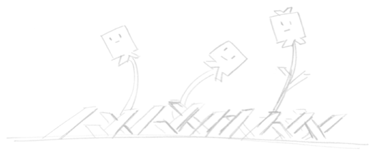
Introduction to 3D Printing
Brought to you by:
Robot Garden
www.robotgarden.org

Slide 2
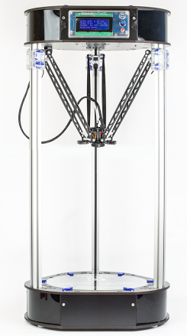
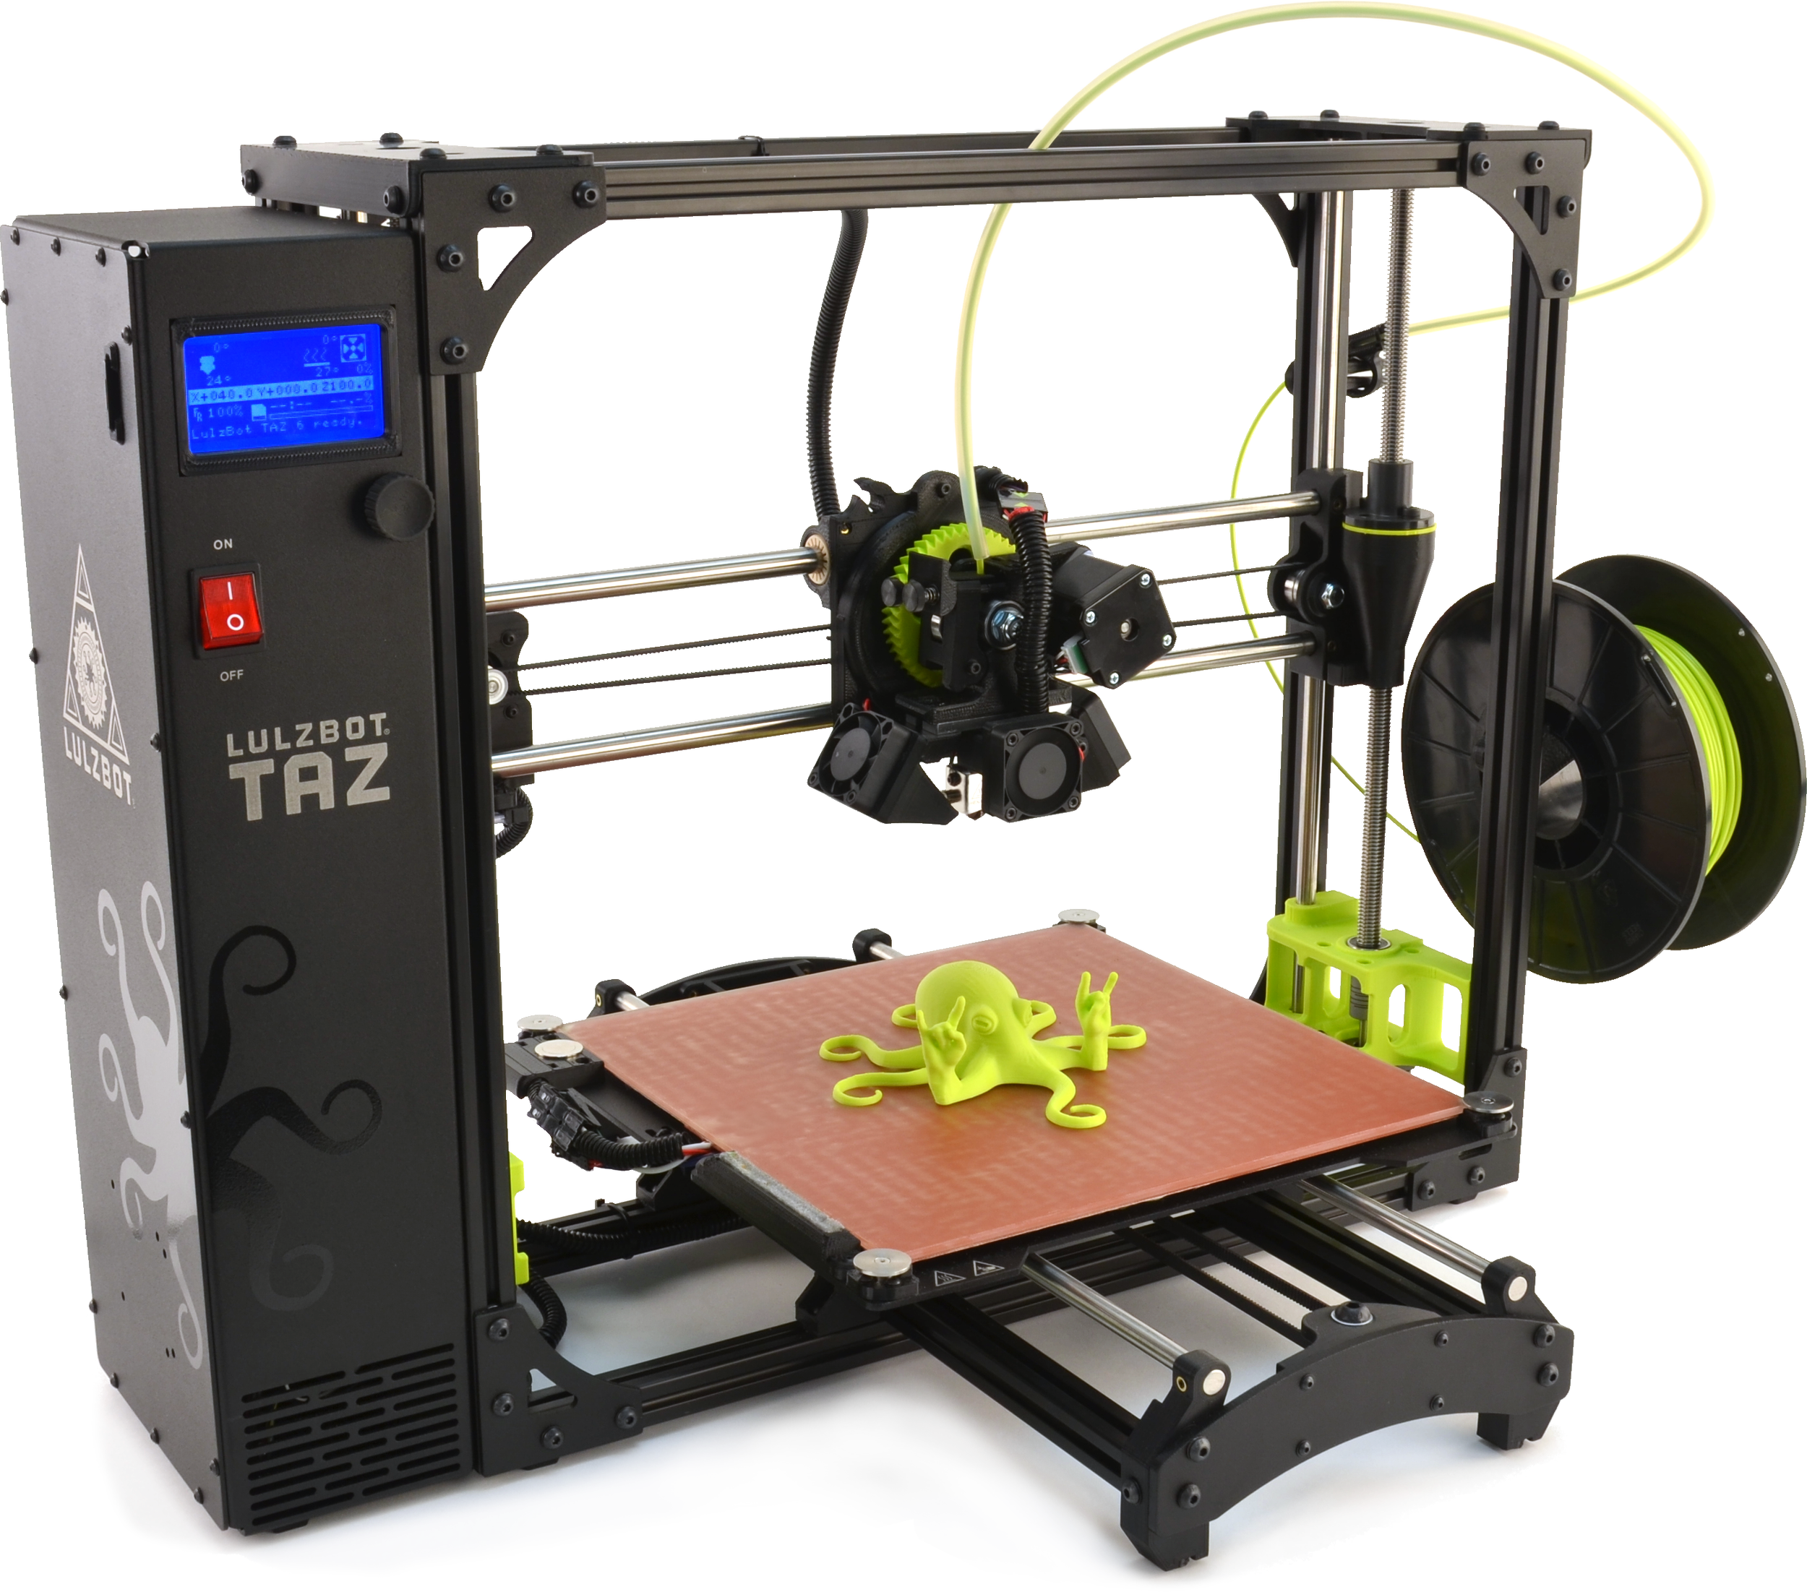

What is 3D Printing?
Additive Manufacturing
Maker Movement
So what?
Notes:
* Additive vs. Subtractive – industry norm is subtractive.
* 3D printers are a big part of the maker movement largely because they’ve become affordable enough for nearly anyone to own one. Star Trek replicator come to life!
* Why should you care about 3D printers? There are a wide variety of applications for 3D printing, including prototyping, replacing broken parts, artistic endeavors and much more!

Slide 3
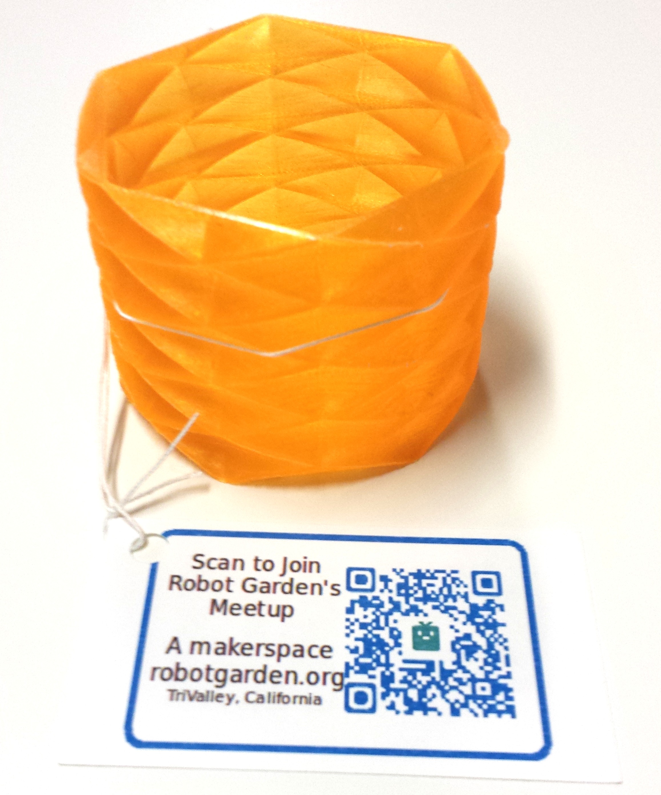
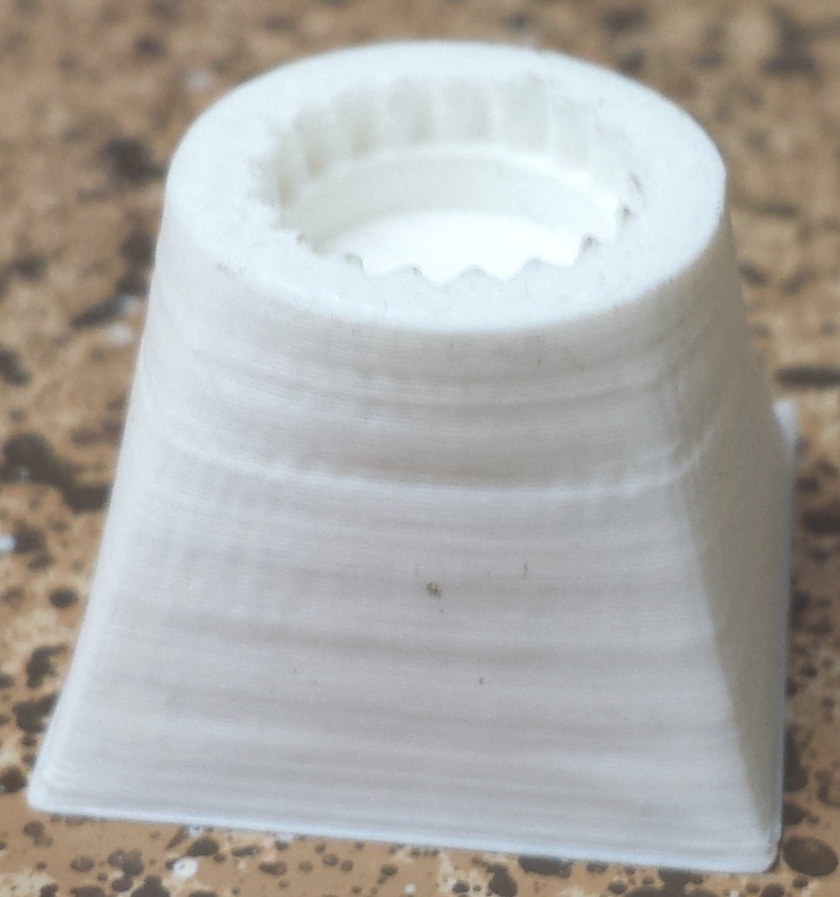

3D Printer Technologies
Extrusion
Light Polymerized
Powder Bed
Powder Fed
Notes:
* Several ways to achieve 3D printing
* Extrusion – Works by using a filament that feeds into a hot nozzle that then pushes out the melted material creating first an x,y plane, then moving up a layer on z. Think of it like your average hot glue gun, where you melt it and push it out, but then it solidifies – now imagine that controlled by a computer
* Light polymerized (Stereo Lithographic) – lasers crystallizing resin – the resin is just like your orthodontist uses, it’s light sensitive so that when the laser hits it, it crystallizes. The resin is in liquid form in a basin that the laser directs into and hardens
* Powder Bed uses a bed of powdered metal and a high powered laser which is focused on that bed – very similar to stereo lithographic except that the material is metal and the laser is much more powerful
* Powder Fed, which is very similar to Powder Bed except that the powder is not in a bed, but rather fed to the focus of the laser beam similar to extrusion printers
* Even more beyond this!

Slide 4
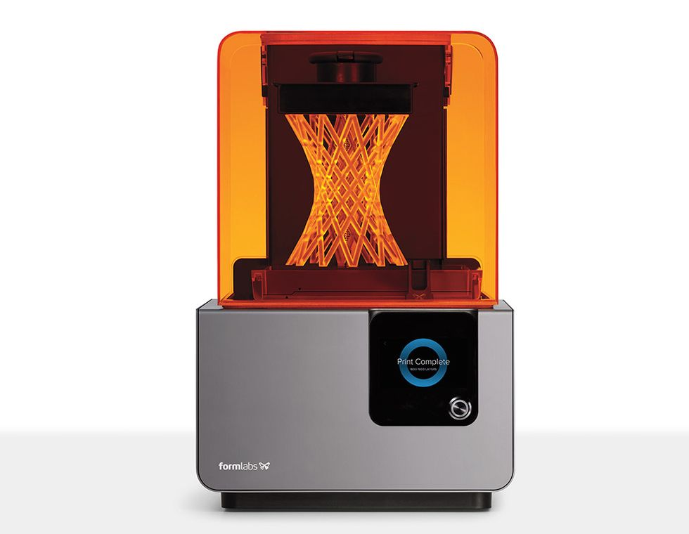
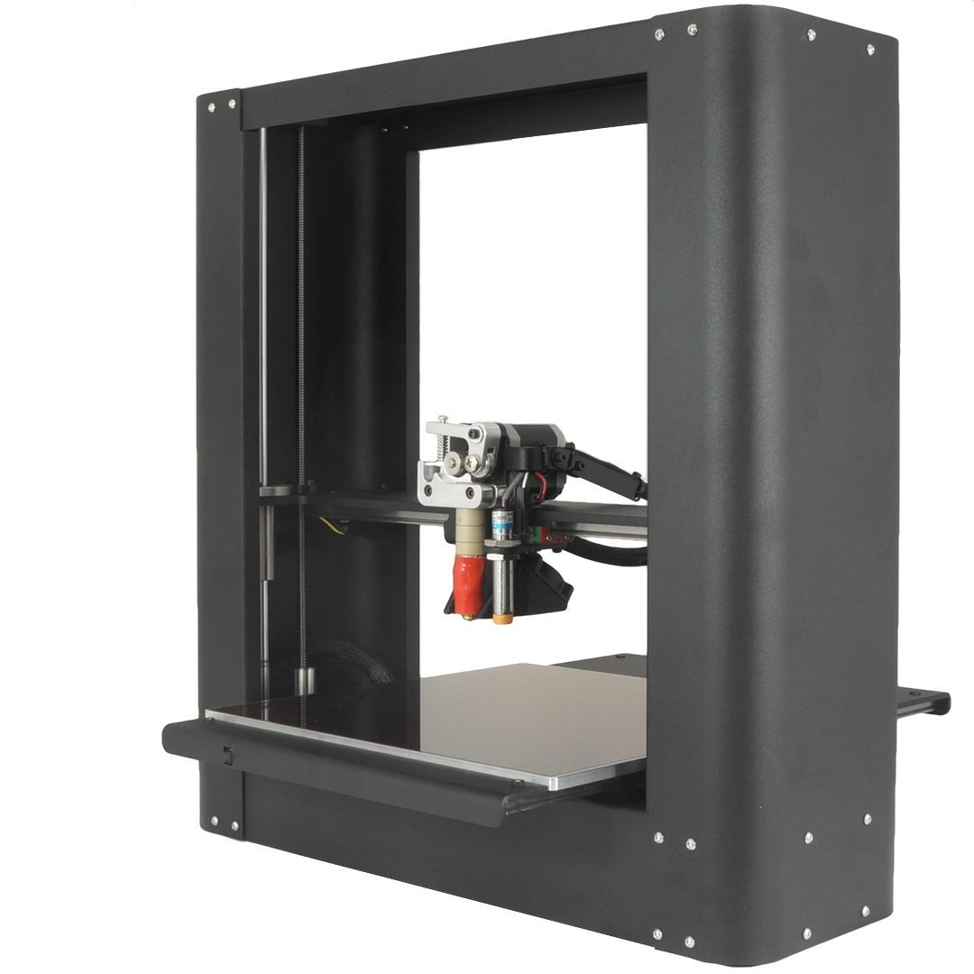


Common 3D Printers
Commercial
FormLabs Form 1+/2
Ultimaker
MakerBot Replicator
RepRap
Seemecnc Rostock Max v3
LulzBot Taz6
Printrbot Plus
Notes:
list here is from the vantage of home or hobby level 3D printers. 3D printers can be much bigger, more detailed in it’s prints, faster, more rugged, extend to greater materials but it all comes at a cost. Also looking at the high end – many cheaper from these and other mfgs and even DIY kits that can come very cheap
* Form 1+/2 - Stereolithographic printer. Cost is just under 2000 for 1+, 3500 for the 2. Great for prototyping, not great for finished parts – only one material, messy with post cleanup required
* Ultimaker 3rd extrusion type printer. Definitely considered a top end home/hobbyist printer selling at 3500 for their base model. Ultimaker 2 is still available on the market at 2500
* Replicator+ - similar to the Ultimaker 2 in capability and similar in price at about $2000
RepRap is humanity’s first general-purpose self-replicating manufacturing machine. You can print the printer! Open-source philosophy – many kits based on RepRap
* Rostock Max v3 – it’s a DIY kit that you have to assemble. Also one of the unique delta arm printers. Kit is $1000
* Taz 6 – nearly fully assembled printer, personal favorite – I own the previous version Taz 4 – but pricier coming in at $2500
* Printrbot sells both kits and fully assembled. Their highest end fully assembled Plus is $1100

Slide 5
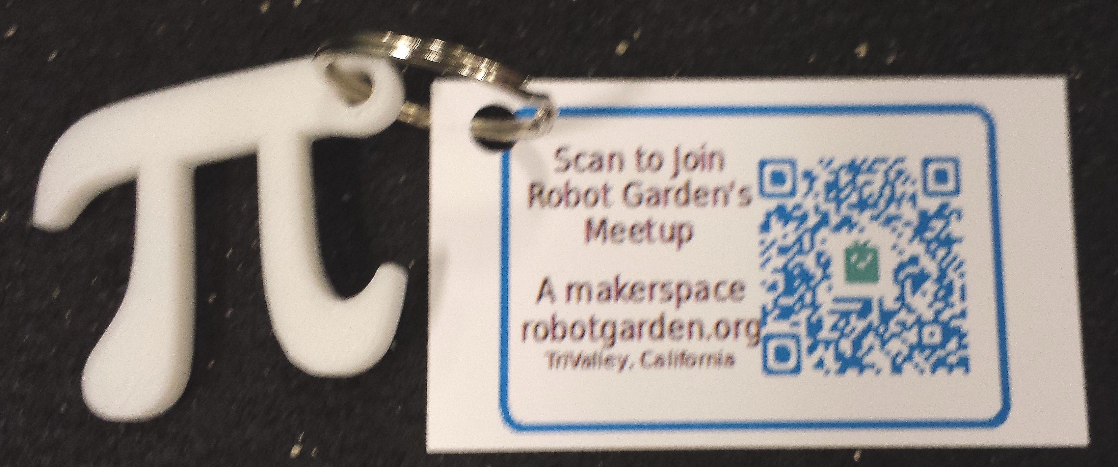
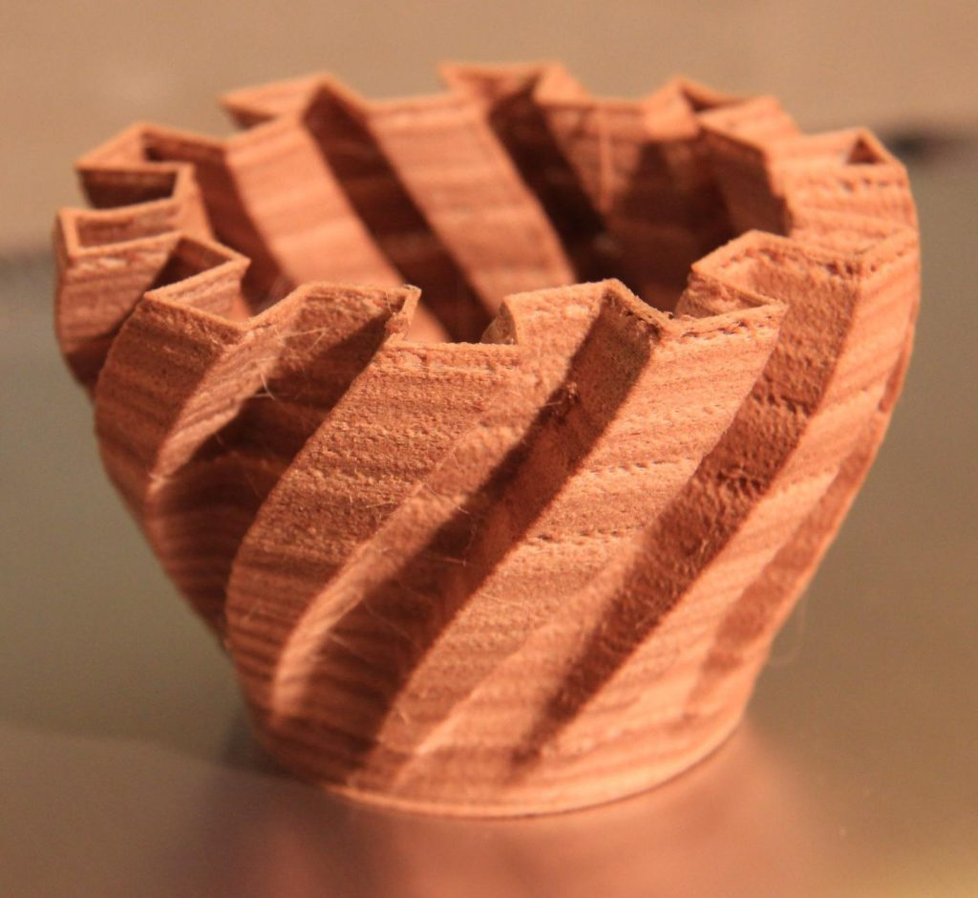
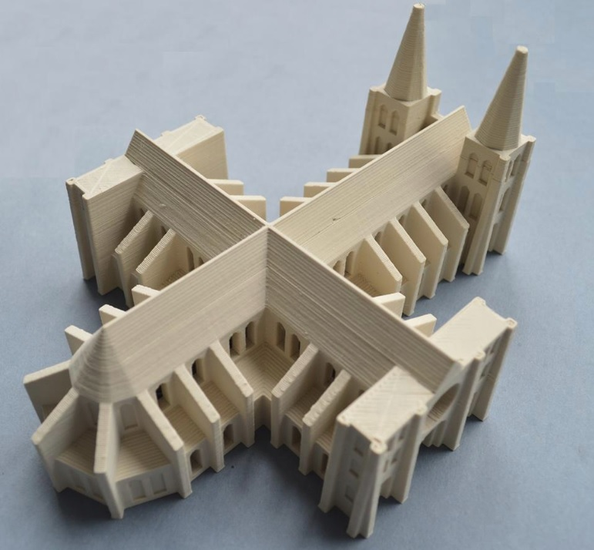
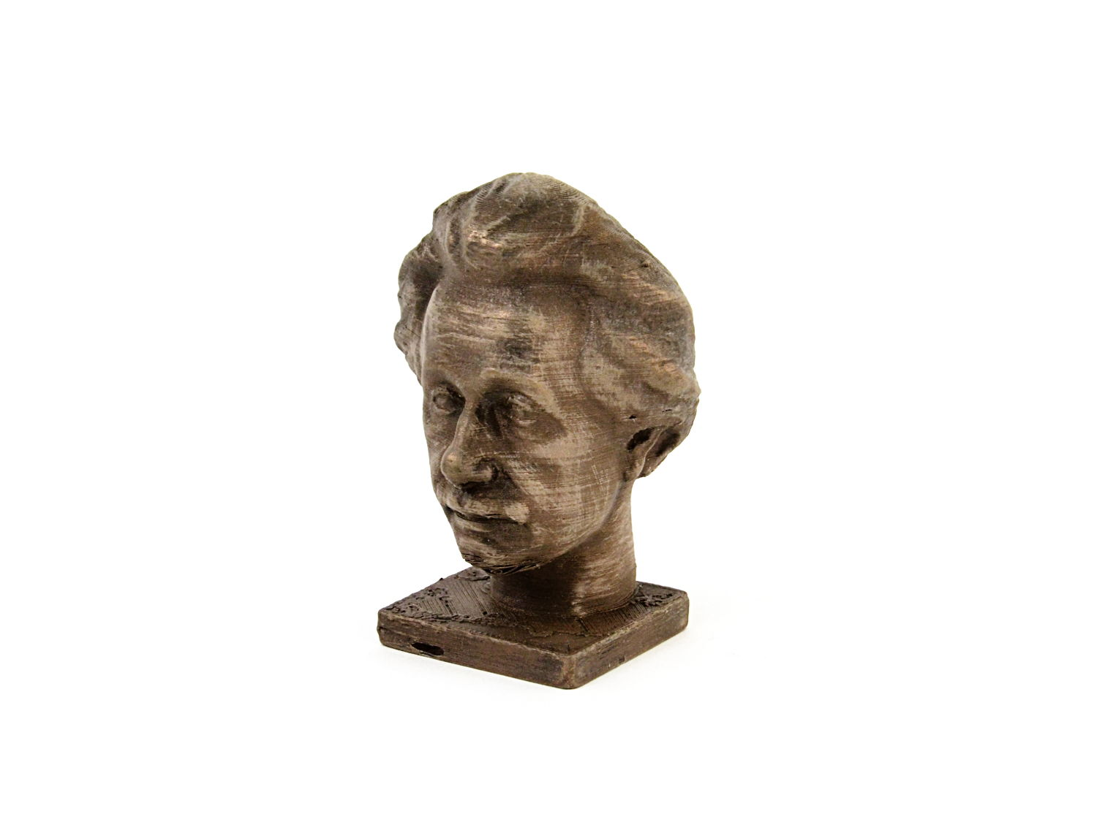
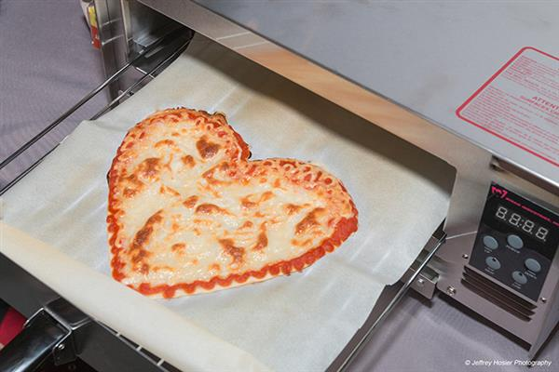

3D Printable Materials
Plastics
Exotics
Metals
Wood
Food
Much More!!
Notes:
* This is the most common material printed. There is a wide range of plastics available, the three most commonly used are PLA, which is essentially a corn-based plastic and ABS which is petroleum based and HIPS another petroleum based plastic. Depending on what you’re printing, you will want to select the right plastic. For example, HIPS and PLA are typically very easy plastics to work with and generally have fewer problems when 3d printing, making them excellent beginner plastics
* There are a lot of exotic materials coming onto the market such as polymerized clay. It is essentially finely milled chalk suspended in a plastic. Soluble plastic is another – talk about support material. Flexible plastics and more
* Metals – copper, bronze, iron all the way up to steel and even magnetic and conductive in some of the higher end hobby level printers such as the Taz 6. It is also powdered metal suspended in a polymer.
* Woods – bamboo or more standard looking woods – also suspended wood fiber in a polymer. Talk about heat variance causing patterns
* Food – yes some people are taking candy to a whole new level making intricate sugar sculptures, frostings on cakes and Nasa even made a 3d printer to print pizza.
* Materials are the future – more and more every year

Slide 6




3D Print Services Available
Online Services
Storefront
Community
Notes:
* Browse 100s of 3d printable models online on thingiverse and yeggi. Or create your own and send it online to a place that will 3d print it for you and ship it back. Show Thingiverse here. Talk about how Microsoft is including 3d print drivers to ship models to them for printing
* Yes there are now storefronts in some places where you can walk in and have someone 3d print something for you. Talk about Montclair store
* Thousands of people are now interacting online around 3d printing – sharing knowledge, models and much more. Reprap.org – Special interest groups are popping up in maker spaces around 3d printing both from a modelling perspective as well as tinkering with the printer itself.

Slide 7
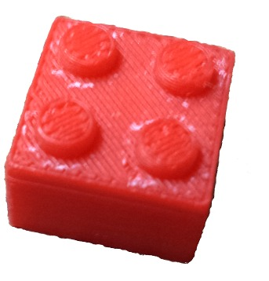

How To: Your First 3D Print
Make or Find a model
Preparing the model for the printer
Preparing the printer
Print
Watch
Finish
Notes:
Important to note that 3D printing does require some time in becoming familiar with some technical concepts. What I will talk to here today is the high level process, but you probably won’t be able to execute a successful 3d print on this information alone, that said, it’s important to understand the steps involved before attempting to learn the rest
* You don’t have to learn Computer Aided Design to make unique items – you can just download a model from thingiverse or yeggi, but if you do want to pursue modelling, it can be very rewarding but will take some learning
* Models aren’t written in a language a 3d printer understands. Talk about the way layers are built in 3d printers here. We have to take the model and “Slice” it into those layers. Many different slicing softwares out there for this part of the job. Slicing is a little tricky, but some slicers help you with “common” configurations
* The printer needs to warm up, just like your laserjet. There are two parts that often need heating prior to printing – the nozzle where the plastic is extruded and the bed to help the part stick to the surface (talk about why sticking matters)
* Watch your part come to life! It is fascinating to watch 3d printing, but at the same time kind of boring.
* Sometimes prints need a little post processing to smooth them or make them shiny or even paint them multiple colors

Slide 8
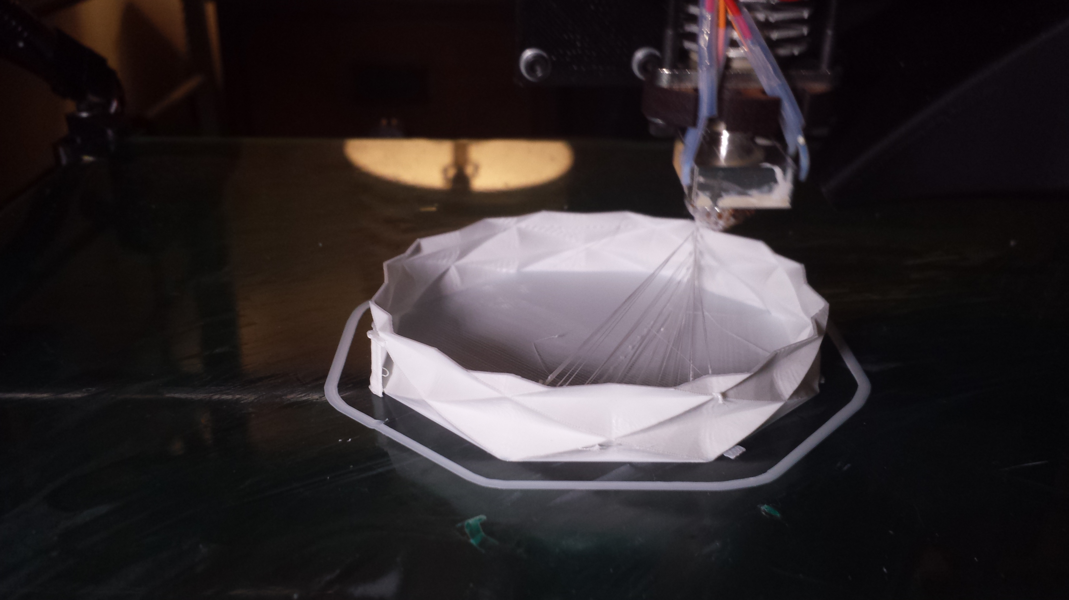

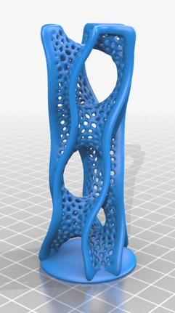

Questions?
This presentation is available at:
https://github.com/RobotGarden/cad_intro
Notes:
This slide deck is in LibreOffice and PDF format and a copy can be obtained at the Robot Garden github site, located here at the url listed on this page. The QR code to the right will take you to the same location: https://github.com/RobotGarden/cad_intro
This material is considered Free and Open Source material. We ask only that you preserve the Robot Garden attributions and would prefer if any derivative work preserve the Apache 2 or similarly open license.
There is an appendix to this document that anyone interested more in this topic might want to reference for additional information including the license under which this material is copyrighted.

Slide 9
Appendix

Slide 10

License/Copyright
The materials for this class are licensed under the Apache license. See the file LICENSE for details.
Copyright 2016 F Douthit
Licensed under the Apache License, Version 2.0 (the "License"); you may not use this file except in compliance with the License. You may obtain a copy of the License at http://www.apache.org/licenses/LICENSE-2.0.
Unless required by applicable law or agreed to in writing, software distributed under the License is distributed on an "AS IS" BASIS, WITHOUT WARRANTIES OR CONDITIONS OF ANY KIND, either express or implied. See the License for the specific language governing permissions and limitations under the License.

Slide 11

Additional References
The Printers/Manufacturers
FormLabs: https://formlabs.com/
Ultimaker: https://ultimaker.com/
MakerBot: https://www.makerbot.com/
Rostock: https://www.seemecnc.com/
LulzBot: https://www.lulzbot.com/
PrintrBot: http://printrbot.com/
Online Resources
Wikipedia: https://en.wikipedia.org/wiki/3D_printing
RepRap: http://www.reprap.org/
Thingiverse: http://www.thingiverse.com/
Yeggi: http://www.yeggi.com/
Maker Culture/Movement Wiki: https://en.wikipedia.org/wiki/Maker_culture
Great blog resource for beginners: http://3dprintingforbeginners.com

Slide 12
Attributions
Special thanks to Robot Garden for providing the content and branding of this presentation http://robotgarden.org/
Thanks to http://3dprintingforbeginners.com for allowing us to use some of their great pictures
Thanks to http://www.3ders.org/ for pictures of the nasa 3d printed pizza
Thanks to Pixabay for having so many great pictures in the free domain: https://pixabay.com

