Slide 1

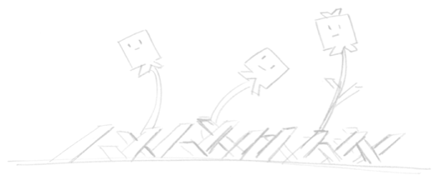
Introduction to Laser Cutting and Engraving
Brought to you by:
Robot Garden
www.robotgarden.org
Notes:
What brought you to this class? Did you have something in mind to make?

Slide 2
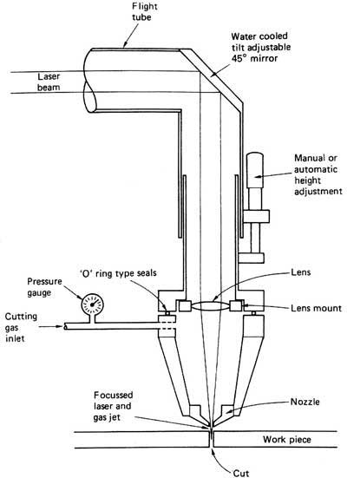
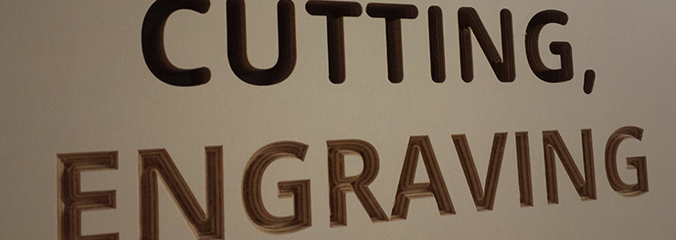

What is Laser Cutting and Engraving?
High power light directed through optics
Subtractive manufacturing
Vector vs. Raster
2D and 2.5D
But what can I do with it?
Notes:
* Laser cutters work by focusing a laser light through lenses and other optics to create a highly focused point that is sufficiently hot that it can burn or cut materials
* Laser cutting and engraving is what is known as subtractive manufacturing, as opposed to something like 3d printing which is additive in nature. Subtractive is the more common form of manufacturing. Those starting out in making often find laser cutters/engravers one of the easiest technologies to learn how to use. I have trained complete novices on a laser cutter in under an hour and seen them able to succeed with it from there.
* When we talk about cutting vs. engraving in laser cutters, we’re talking about Vector graphics vs. Raster graphics. Raster graphics are what you would typically see with a bitmap or jpeg. They are defined in terms of pixels of color. Vector graphics uses geometrical objects such as points, lines, curves and polygons to model the image. This is why it is vector graphics that are generally used for cutting and raster for engraving, because to cut you typically need to follow a path such as a line but in raster that concept doesn’t exist. On the other hand, with Raster, those pixels are just what you want to “burn away” material to engrave.
* Laser cutters/engravers generally only do 2D type cutting and engraving, however newer lasers are coming out that can do 2.5D which is essentially adding a perpendicular Z ability through multiple passes. Think of 2.5D as all horizontal and vertical surfaces.

Slide 3
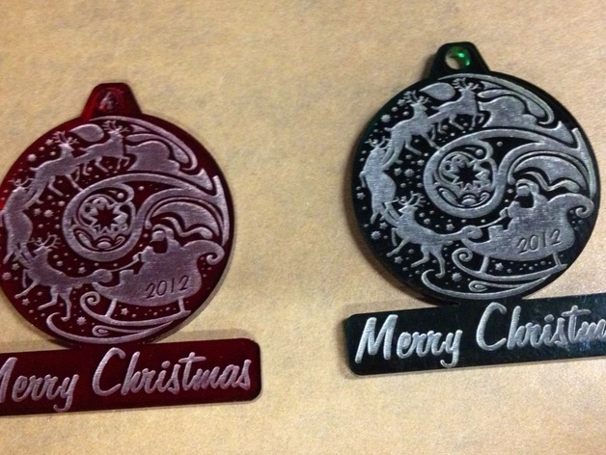
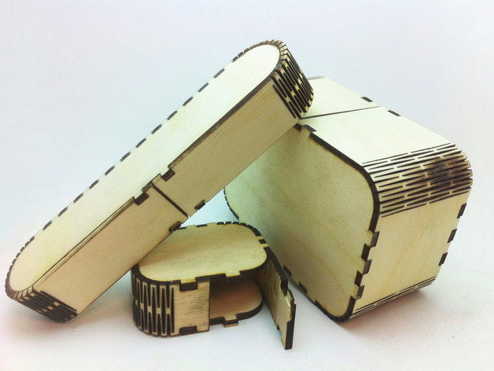
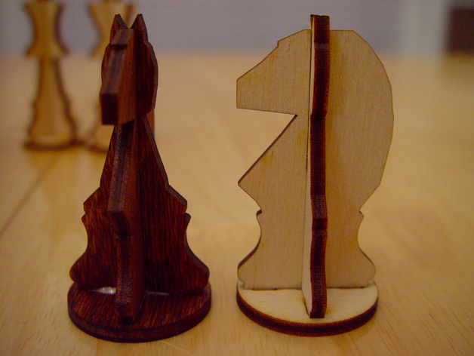

Cutting/Engraving Possibilities
Flat Pack items
Engrave every day items
Fabric cutting for sew-on designs
Iron ons
Wood Boxes
Pop-up Cards
Rubber Stamps
Notes:
There are a surprising range of things you can cut or engrave with a laser cutter.
* People often first feel as though everything has to be flat with a laser cutter, but with flat-pack items, you can cut and then assemble an item.
* Custom engravings on all sorts of things such as laptop covers, leather patches that you can add to clothes, backpacks etc
* One really great way to make custom patches to sew onto clothes is to use the precision of a laser cutter to make those patches
* There is iron on material that is safe to use in a laser cutter to make similar iron-on custom graphics
* There are a few websites listed in the appendix of this presentation where you can put in dimensions and get a design for a lasercutter that will create a box! As you can see in the picture here, some of them even have flexible rounded corners!
* I love making intricate popup cards and they’re a huge hit with people. Paper is extremely fast and easy to cut with a lasercutter
* For all you crafters out there into stamps, talk about the ultimate in custom rubber stamps! You can use any raster silhouette you like to create completely unique rubber stamps!
* Far more beyond the examples I list here – if you simply google or search through pinterest you will probably be inspired by any number of possibilities you find!

Slide 4

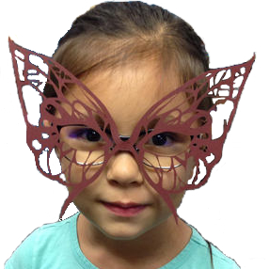
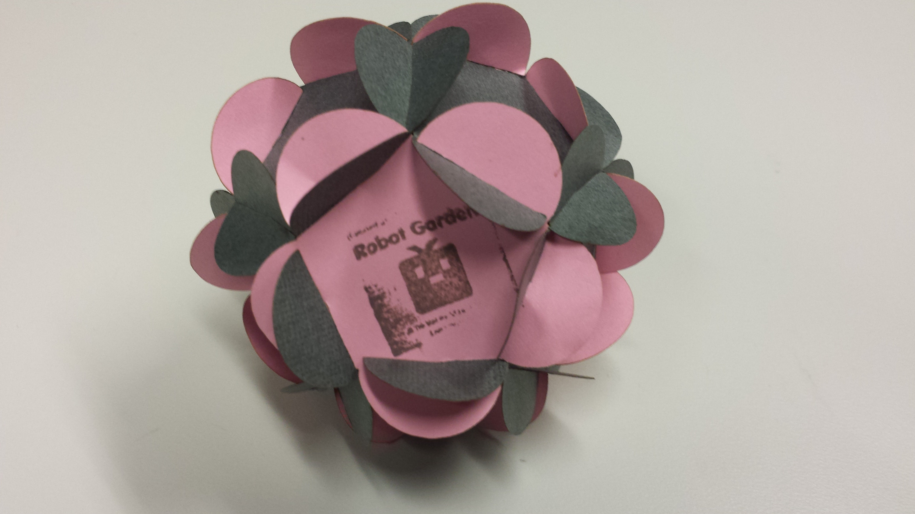

The High Level Process
Safety first!
Design or Search for graphic
Vector – thickness of lines
Make sure your material is laser-safe!
Set speed, intensity and number of passes
GO!
Notes:
The process to getting a successful laser cut is pretty simple, however this presentation isn’t meant to make you fully capable of laser cutting. Obviously without access to a laser cutter, it’d be hard to actually get you going, but nevertheless it’s good to see the basic process
* Anytime you’re dealing with something potentially dangerous, always practice safety first. The laser cutter likely has some requirements – for example, the laser cutter at Robot Garden in Livermore uses a water cooled system, a vent and a safety-enabled lid. Before ever doing anything it’s important to ensure there is enough water to keep the cutter cool, that the vent is operating and that the lid is closed. Also a laser cutter should never be left alone while operating as it’s possible to start a fire or create a toxic environment.
* Maybe you have a custom logo or design you want to bring to life. If so, great! I’ll talk later about some tools you can use to do so, but you don’t have to be a full fledged artist to laser cut. There are tons of graphics in the public domain both as rasters and vectors that you can find online
* With Vector graphics, pay attention to the thickness of your lines – if you have wide lines the laser cutter may pass over a cut line multiple times to get the right width.
* It’s very important not to laser cut the wrong materials. For example, some plastics when burned emit toxic or corrosive gases. Any material containing chlorine such as vinyl should never be laser cut. Some materials you can laser cut, but you should vent, such as plexiglass because it emits a fume that is unpleasant. Finally some things just don’t cut well. For example, ABS plastic tends to just melt rather than cut which is undesirable. There are many references online that will tell you what is safe and what is not – when in doubt, don’t try.
* Laser cutters typically allow you to set a few things. First is whether you’re engraving or cutting, second how fast the head of the cutter should move, third how intense the laser should be typically expressed as a percentage from 0 to 100, and finally number of passes. This last setting is important when trying to obtain some depth.
* Once you’re configured, you just send your job to the laser cutter and watch it go. Watch out though – don’t watch directly for too long without protective eyewear. You can watch for short periods without worry, but you can burn your retina if you watch too long and develop a temporary blind-spot!

Slide 5
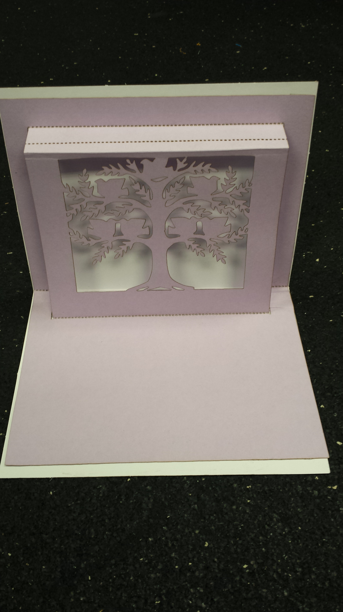


Materials
Plastics
Anodized Metals
Wood
Fabric
Paper
Rubber
Much More!
Notes:
So what can you cut?
* There are a lot of plastics that are safe to lasercut or engrave such as Delrin, Acrylic, Plexiglas, Lucite etc.
* Anodized metals are great for engraving! You can’t really cut the metal, but you can burn away the anodized coating and leave really interesting shiny metal patterns in the coating
* Woods such as plywood and MDF manufactured woods work great, but two things to be aware of: 1. Depending on how powerful your laser cutter, you may not be able to cut very thick wood 2. Plywoods that are “pressed” with glue can be difficult to cut because the glue just melts and you never really cut through that part.
* Fabrics are great to jazz up existing clothes or design something new! Leather is great for cutting and creating engravings that look like burns! Cotton, felt, silk, Linen, Polyester, Fleece and many more are laser safe
* Paper for popup cards, holiday decals to hang in windows or on walls
* As mentioned, rubber is great for making rubber stamps and can both be cut and engraved. Be sure to make sure the rubber you use is natural rubber or explicitly states it is safe for laser cutting
*Many more materials than this!

Slide 6
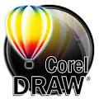





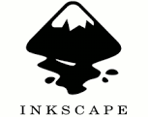

Software to Design
Raster
Commercial:
  Adobe Photoshop
  Leonardo
  Corel PaintShop Pro
Free and Open Source (FOSS):
  Gimp
  GraphicsMagick
  ImageMagick
Vector
Commercial:
  Adobe Illustrator
  Corel DRAW
  Microsoft Visio
Free and Open Source (FOSS):
  Inkscape
  LibreOffice Draw
  Vectr
Notes:
Here are some fairly common Raster and Vector graphics tool. I’ve organized this page with Raster on the left, Vector on the right each with a commercial and free and open source section. I personally am a Free and Open Source advocate and my preferred tools in this space are Gimp and Inkscape.

Slide 7
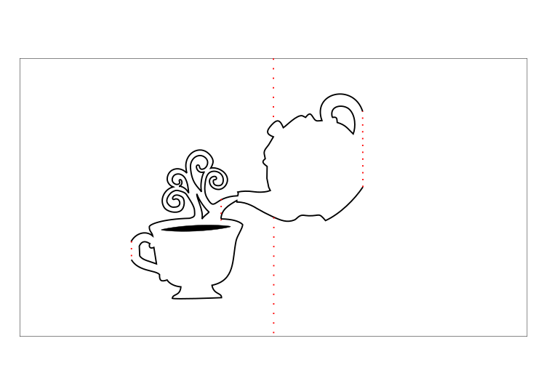
Demo Using Inkscape
Converting a Raster Silhouette into a Vector Graphic for cutting

Slide 8

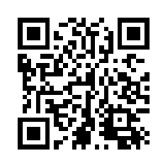
Questions?
This presentation is available at:
https://github.com/RobotGarden/cad_intro
Notes:
This slide deck is in LibreOffice and PDF format and a copy can be obtained at the Robot Garden github site, located here at the url listed on this page. The QR code to the right will take you to the same location: https://github.com/RobotGarden/cad_intro
This material is considered Free and Open Source material. We ask only that you preserve the Robot Garden attributions and would prefer if any derivative work preserve the Apache 2 or similarly open license.
There is an appendix to this document that anyone interested more in this topic might want to reference for additional information including the license under which this material is copyrighted.

Slide 9
Appendix

Slide 10

License/Copyright
The materials for this class are licensed under the Apache license. See the file LICENSE for details.
Copyright 2017 J Dahling
Licensed under the Apache License, Version 2.0 (the "License"); you may not use this file except in compliance with the License. You may obtain a copy of the License at http://www.apache.org/licenses/LICENSE-2.0.
Unless required by applicable law or agreed to in writing, software distributed under the License is distributed on an "AS IS" BASIS, WITHOUT WARRANTIES OR CONDITIONS OF ANY KIND, either express or implied. See the License for the specific language governing permissions and limitations under the License.

Slide 11

Additional References
The Manufacturers
Commercial
Adobe Photoshop and Illustrator: http://www.adobe.com/
Xade Software Leonardo: http://www.getleonardo.com/
Corel PaintShop Pro: http://www.paintshoppro.com/en/products/paintshop-pro/standard
Corel DRAW:
Microsoft Visio: www.microsoft.com/Visio
Free or Free and Open Source
Gimp: https://www.gimp.org
GraphicsMagick: http://www.graphicsmagick.org/
ImageMagick: https://www.imagemagick.org/
Inkscape: https://inkscape.org/
LibreOffice Draw: https://www.libreoffice.org/discover/draw/
Vectr: https://vectr.com/
Online Resources
Wikipedia on Laser Cutting: https://en.wikipedia.org/wiki/Laser_cutting
Thingiverse: http://www.thingiverse.com/
Wikipedia Comparison of Vector Graphics Software: https://en.wikipedia.org/wiki/Comparison_of_vector_graphics_editors
Wikipedia Comparison of Raster Graphics Software: https://en.wikipedia.org/wiki/Comparison_of_raster_graphics_editors
Box Creating Sites:
  makeabox.io
  www.makercase.com
  boxdesigner.connectionlab.org

Slide 12
Attributions
Special thanks to Robot Garden for providing the content and branding of this presentation http://robotgarden.org/
Special thanks to the Free and Open Source platforms upon which much of the original art in this presentation were made:
GIMP
Inkscape
LibreOffice
And of course our friends at Canonical for making the Ubuntu distribution this document was authored on

