Slide 1

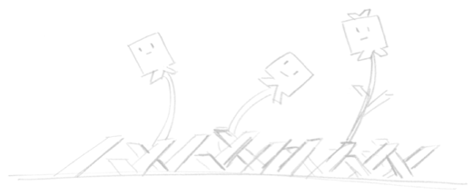
Robot Garden, The Maker Movement and You
Brought to you by:
Robot Garden
www.robotgarden.org

Slide 2

What is Robot Garden?
A community of people who make
A maker space
A place for makers to build and learn. Like a gym membership, members learn about and use the equipment.
a non profit Maker Space started in Livermore, CA

Slide 3
What is Maker Culture?
Maker culture is a technology-based extension of the do it yourself (DIY) movement. Enhancing self-sufficiency with help from technology.
Makers seek to empower themselves and others by learning new skills and sharing with others.
Makers culture supports open-source hardware and software. Individuals and groups across the globe contribute to create software and designs for all of us to freely use and modify.
Maker culture fosters community. We love to share our knowledge with our friends.

Slide 4
What do Makers do?
Makers create new things and adapt existing designs to their needs.
Makers use electronics, software, robotics, drones, 3D printing, laser cutting, CNC machines, as well as metal working, woodworking and arts and crafts.

Slide 5
If you Want to Help create a Maker Space...
Learn about maker movement
Read RG's
  Website
  Blog
  github
Get the word out:
  Put up posters
  Bring a friend to an event
Help plan an event and create content
Call to the ladies: arts and crafts is making too!
Help create a group locally

Slide 6

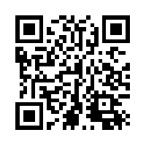
Questions?
This presentation is available at:
https://github.com/RobotGarden/cad_intro
Notes:
This slidedeck is in LibreOffice and PDF format and a copy can be obtained at the Robot Garden github site, located here at the url listed on this page. The QR code to the right will take you to the same location: https://github.com/RobotGarden/cad_intro
This material is considered Free and Open Source material. We ask only that you preserve the Robot Garden attributions and would prefer if any derivative work preserve the Apache 2 or similarly open license.
There is an appendix to this document that anyone interested more in this topic might want to reference for additional information including the license under which this material is copyrighted.

Slide 7
Appendix

Slide 8

License/Copyright
The materials for this class are licensed under the Apache license. See the file LICENSE for details.
Copyright 2016 F Douthit
Licensed under the Apache License, Version 2.0 (the "License"); you may not use this file except in compliance with the License. You may obtain a copy of the License at http://www.apache.org/licenses/LICENSE-2.0.
Unless required by applicable law or agreed to in writing, software distributed under the License is distributed on an "AS IS" BASIS, WITHOUT WARRANTIES OR CONDITIONS OF ANY KIND, either express or implied. See the License for the specific language governing permissions and limitations under the License.

Slide 9

Additional References
Online Resources
Wikipedia: https://en.wikipedia.org/wiki/Hackerspace
Maker Culture/Movement Wiki: https://en.wikipedia.org/wiki/Maker_culture
Robot Garden: http://www.robotgarden.org/

Slide 10
Attributions
Special thanks to Robot Garden for providing the content and branding of this presentation http://robotgarden.org/
Special thanks to the Free and Open Source platforms upon which much of the original art in this presentation were made:
Our friends at Canonical for making the Ubuntu distribution this document was authored upon.

