Slide 1
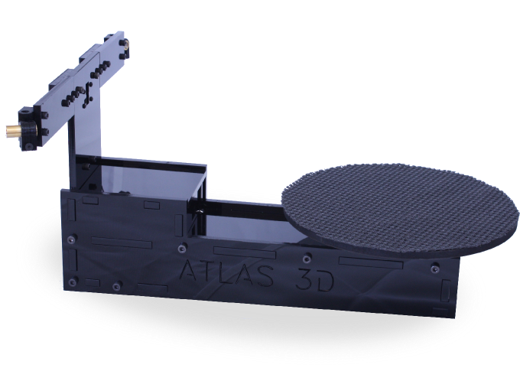

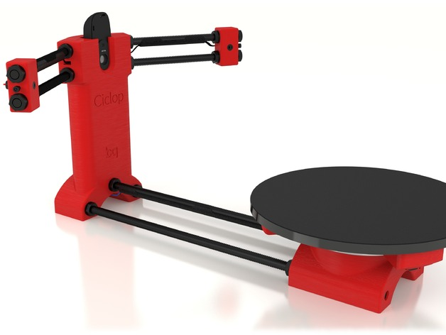

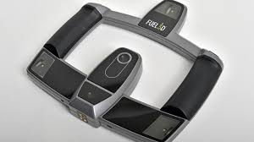
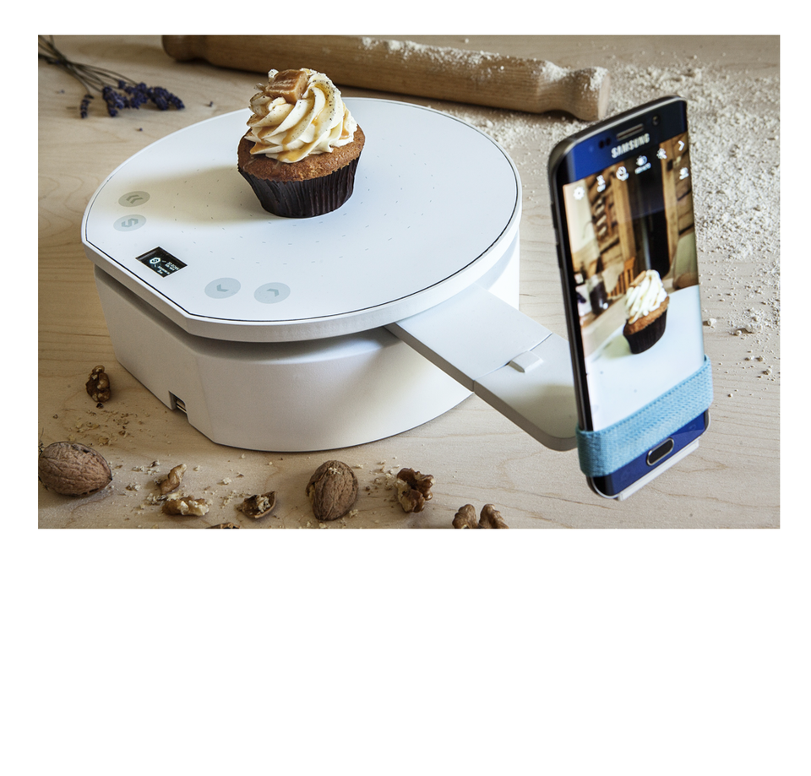
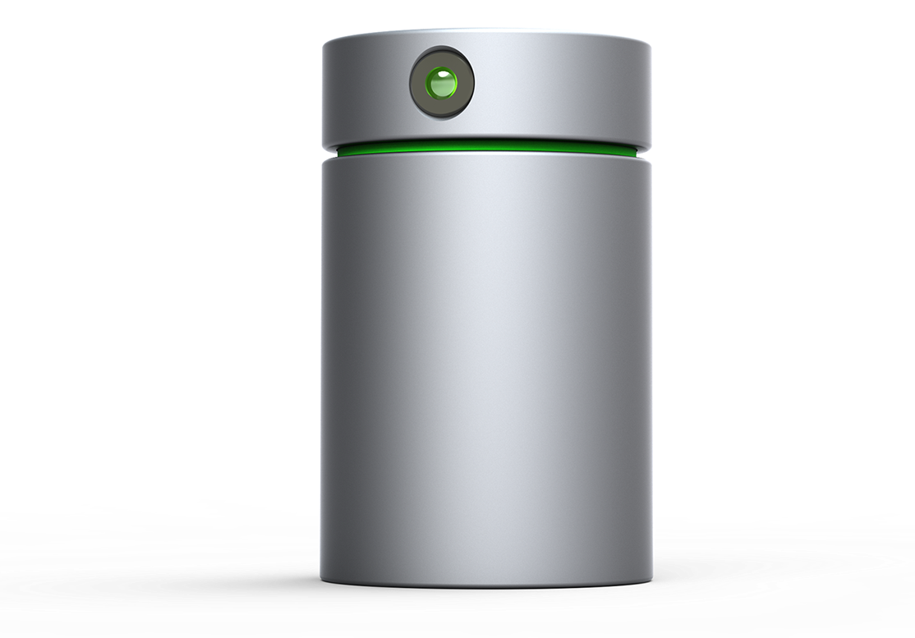
DIY Scanners

Slide 2
What is a 3D Scanner?
From https://en.wikipedia.org/wiki/3D_scanner:
A 3D scanner is a device that analyses a real-world object or environment to collect data on its shape and possibly its appearance (e.g. color). The collected data can then be used to construct digital three-dimensional models.
What would you use it for?
Replicating parts from off the shelf purchases
Reverse engineering parts
Creating complex 3d models from real world objects not easily designed in CAD software (such as faces or organic objects)
Fixing broken parts by scanning them and correcting the model
Preserving objects that may change or degrade over time

Slide 3
Scanify by fuel-3d
The Good
Hand held design allows for unique use cases
Very fast 0.1 seconds to scan
Scans colors
Big scan area 40cm/16” diagonal
Detailed scans down to 350 microns
The Bad
Very Costly at $1,490
Not really DIY, pre-calibrated and ready to work out of the box
Takes scan from only 1 vantage point at a time
Youtube: Scanify at CES 2015

Slide 4
Pixelio by smart3d
The Good
Inexpensive at less than $199
Works with any smart phone or GoPro camera
Can be used to take panorama pictures or 3d images
Is also a wireless charger
The Bad
Also not DIY
Not a complete product – you bring the camera
Vimeo: Indie Go Go Campaign Video

Slide 5
Eora 3D
The Good
Works with any smart phone
Less than 100 micron precision
The Bad
Not out yet, no sense of when it will be
No idea on cost
Very little detail about the product on their site
Not DIY
Youtube: Sample Scan of a cup

Slide 6
Atlas 3D by Murobo
The Good
Open Source/Open Hardware
Kit is reasonable at $229
You can save $20 by providing your own Pi
Can control it through a web browser, no software installs
Parts and an enclosure can be 3d printed
The Bad
Kit doesn't include the plastic parts, you have to print them yourself
Not as high resolution as other options at 0.25mm
Small scan area at 8x6 inches
Youtube: Atlas 3D Kickstarter video

Slide 7
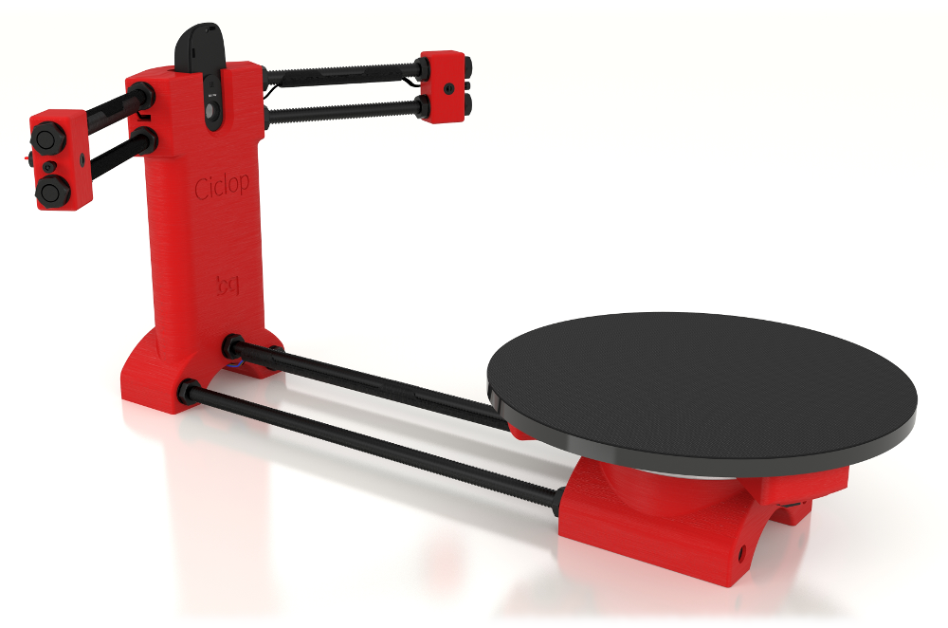
Ciclop by BQ
The Good
Our cheapest contender – kits can be had for $135
Open Source/Open Hardware
As DIY as you want – all information on github, parts on thingiverse
Lulzbot offers the kit as well
The Bad
Has it's own software that isn't ported to all flavors of Linux
Resolution is fairly low between 0.3 and 0.5 mm
Small scan area
Youtube: Ciclop building instructions

Slide 8

So What's next?

