Slide 1
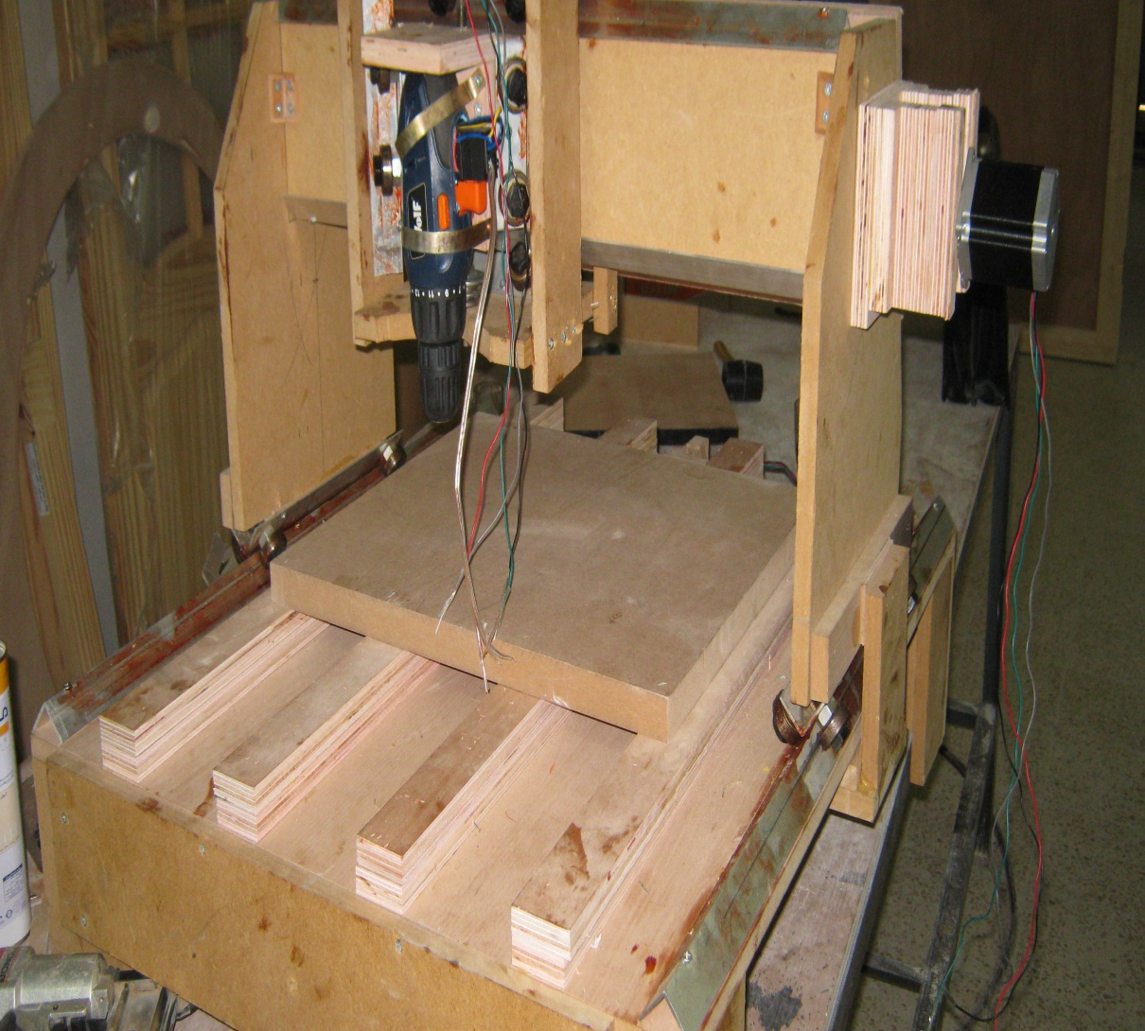
Cnc machine
Prepared By:
Rania hasan
Enas hamadneh

Slide 2

Numerical control is a method of automatically operating a manufacturing machine based on a code of letters, numbers, and special characters.
The numerical data required to produce a part is provided to a machine in the form of a program, called part program or CNC program.
The program is translated into the appropriate electrical signals for input to motors that run the machine.

Slide 3

Increase production throughput
Improve the quality and accuracy of manufactured parts
Stabilize manufacturing costs
Manufacture complex or otherwise impossible jobs -2D and 3D contours

Slide 4

Flexibility of operation is improved, as is the ability to
produce complex shapes with good dimensional accuracy,
repeatability, reduced scrap loss, and high production rates,
Tooling costs are reduced, since templates and other fixtures are not required.
Machine adjustments are easy to make with microcomputers
More operations can be performed with each setup, and less
lead time for setup and machining is required compared to
conventional methods. Design changes are facilitated, and
inventory is reduced.

Slide 5

Programs can be prepared rapidly and can be recalled at
any time utilizing microprocessors. Less paperwork is involved.
Faster prototype production is possible.
Required operator skill is less than that for a qualified
machinist, and the operator has more time to attend to other tasks in the work area

Slide 6

Our machine understand G-code language which is commonly used in CNC’s World.
Advantages:
benefit by existent smart algorithms that generate G-code for any complex computer shapes .

Slide 7

Wood body
Pic 18 controller.
Stepper motors and electrical movable arm
Driver circuit for steppers H-bridges, and other components.
Serial communication interface.

Slide 8

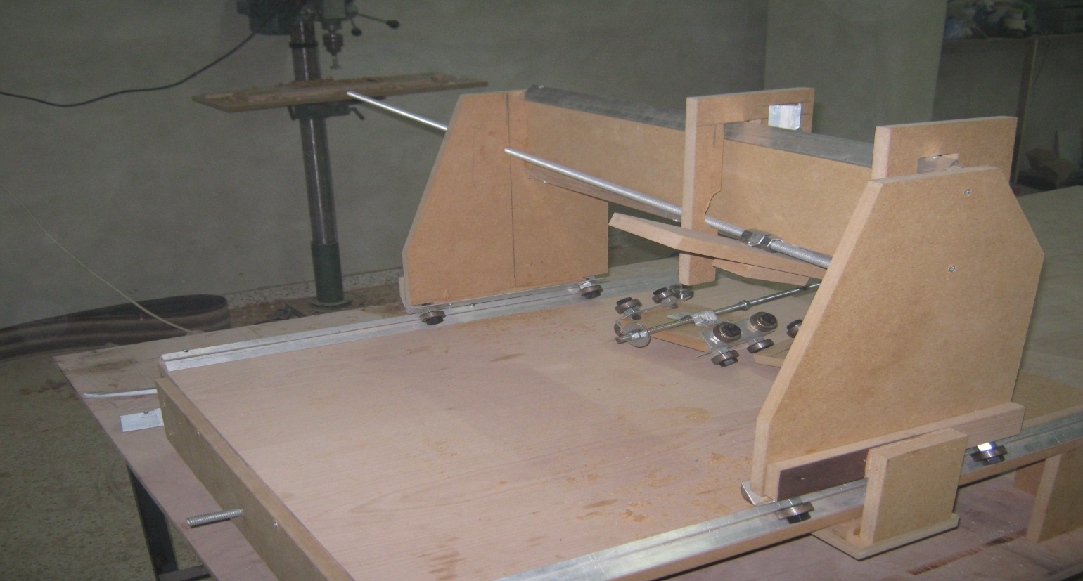
wooden layout: We used wood in building our body since its lighter than iron

Slide 9
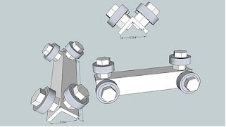
We used linear-motion bearing which is a bearing designed to provide free motion in one dimension The bearing will slide on an aluminum or steel angle keeping the bearing in place. These bearings will also walk on aluminum corners.

Slide 10

CNC Axis (x, y, and z): The z-axis is one of three axes for the CNC The z-axis allows the router to move in the up and down direction. The CNC Z axis is very important to the CNC machines. Without this axis, depth cannot be created.
The function of the y-axis serves as a motor mount to move the z-axis in addition to the slide mechanism.

Slide 11
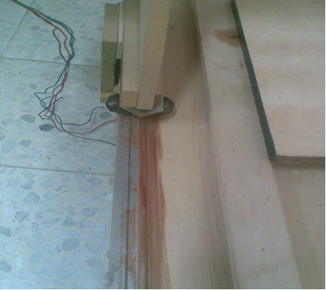
X-axis :use 2 pieces One for the front and one for the back. these two pieces serve also as height stands

Slide 12

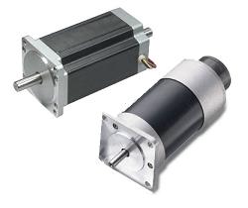
Stepper Motors
The motors are the heart of any CNC machine. The size and type of motor can define a CNC routers precision, speed, and accuracy. There are two primary classes of motors used on CNC machines, stepper motors and servo motors. Within these two classes there are several types.

Slide 13

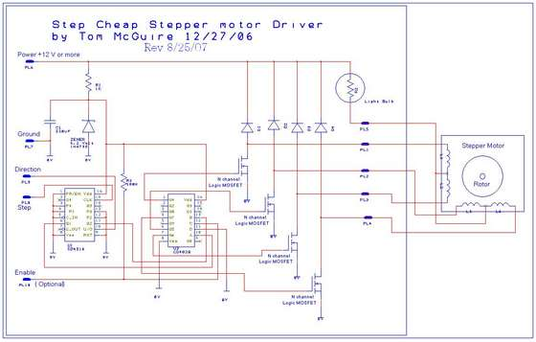

Slide 14

This Step motor controller uses the L297 and L298N driver combination; it can be used as standalone or controlled by microcontroller. It is designed to accept step pulses at up to 25,000 per second. Previous schematic is just to control one motor so for the milling machine you need 3 of these circuits and 3 motors.

Slide 15

G Code
The "instructions" read by CNC machines are usually a human readable format called G-Code. The machine is set up with a base unit, like Inch or mm, and a command of G01 X500 Y200 Z100 on a metric mm setup tells the machine it needs to move
500 units on the X axis and 200 units on the Y axis and 100 on z axis.

Slide 16

C# application with simple and easy to use interface.
Main idea in C# application is to read a text file which contain the G-Code and parse the values of pixel of the image to the PIC, then the microcontroller get the values and move the motors according to the signed values received.

Slide 17

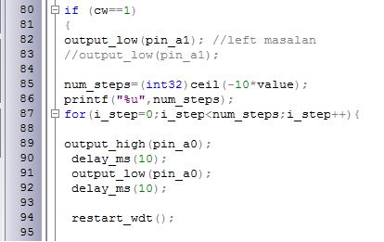
The picc code give the values of pixel to the stepper motor through pic ports

Slide 18

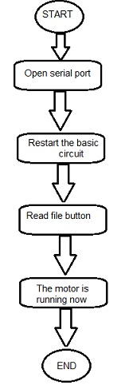
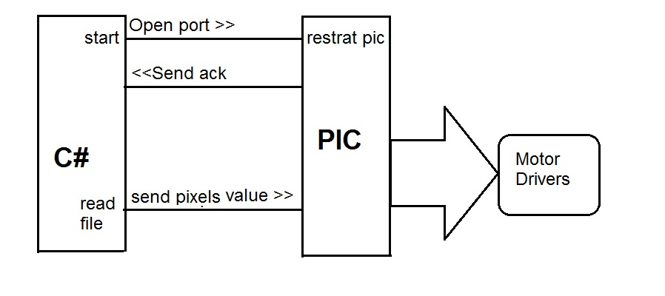

Slide 19

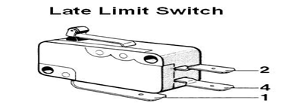
We used a limit switches in our body to ensure that the machine will stop directly in case the motor try to rotate a distance more that the length of the axis.

Slide 20

Cnc mean computer numerical control machine it’s a form of programmable automation drill drawings on wood use g coding consist of 3 motors and their drivers and pic with its basic circuit and body made of wood hold on motors and drill and the wood we want to draw on it
We tried to make cheap fast safety cnc machine that drill on wood piece according to any drawing we draw to it.

