Slide 1


Slide 2
Objectives
After this presentation, you should be able to:
Understand the way Git works as a VCS. Describe its features and explain how it Works.
Describe the most used and important Git operations

Slide 3
History
Features
Core Concepts
Operations
History

Slide 4
History
Created by Linus Torvals, creator of the Linux kernel
3th of April – 18th of April, 2005. Git is started, announced, self-hosted and finished (low-level)
26th of July, 2005. Junio Hamano assumes the maintenance of the Project
2002, Linux Started using the “community”
version of BitKeeper
1st of April, 2005 Community versión discontinued
18th of June, 2005 Linux 2.6.12 release is managed by Git
2007. Git has an “easy to use” interface
(command-line)

Slide 5
Design goals
To be the anti-CVS (by extension, SVN)
Support distributed workflows similar to those enabled by Bitkeeper
Offer high performance
Offer safeguards against content corruption
Simple design

Slide 6
History
Features
Core Concepts
Operations
Features

Slide 7
Distribution
Centralized CVS
CVS & SVN
Network is required to perform most operations
The central server is a single point of failure
Commit permissions & stable status
Computer A
Central VCS Server
Checkout
Version Database
File
Version 3
Version 2
Computer B
Checkout
Version 1
File

Slide 8
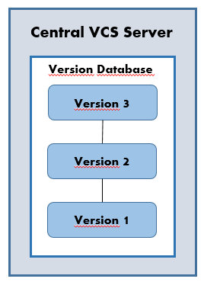
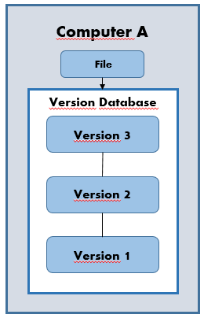
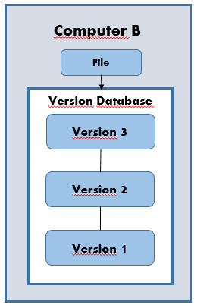
Distribution
Distributed VCS
BitKeeper, Git, Mercurial & Bazaar
There is no central server and all nodes are at the same level
Every single node has a versión of the entire repository
Every operation is local (fast) except synchronizing with other nodes
There is no single point of failure

Slide 9
Performance
Performing most operations in local instead of through network is key
Not just “doing things faster”. Allows workflows otherwise imposible
Fast even with very large repositories
Designed to manage projects like the Linux kernel (15 M LOC, 400k commits, 9 years of history, 533 MB current source code, 1.1GB the whole repository)

Slide 10
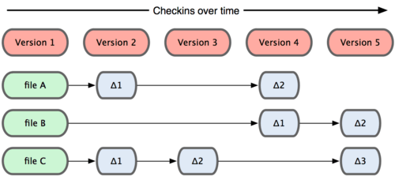
Snapshots vs Deltas
Delta-based
CVS & SVN
Each specific version of a project contains only the changes regarding the previous version
To checkout a version other versions are needed to apply the modifications

Slide 11
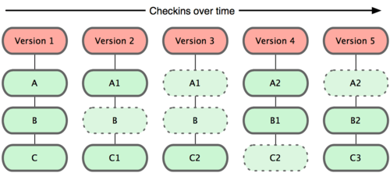
Snapshots vs Deltas
Snapshot-based
Each specific version of a project contains all the files that compose it
To checkout a version we only need its identifier, not other versions
If a file has not changed the same reference is used (it’s not stored multiple times)

Slide 12
Data integrity
Data integrity based on the security of the SHA I hash algorithm
File contents, commits, etc. are referenced using their SHA I
With the reference to a version you are certain that its contents and its entire history hasn’t changed

Slide 13
History
Features
Core Concepts
Operations
Core Concepts

Slide 14
Core Concepts
Present in SVN
Repository
Revision / Commit*
Checkout*
Working directory
Branch
Tag*
Merge
Diff
Status
Log
Blame
Patch
Cherry-pick*

Slide 15
Core Concepts
New concepts:
Stage / Index
Stash
Remote
History “rewriting”
Rebase
Squash
Reflog

Slide 16
Repository
Directed acyclic graph (DAG)
Each node is a commit (identified by its SHA I – immutable) containing “the whole thing”
Branches and tags* are just references to commits (name → SHA I)
feature-y
head
E
F
G
A
B
C
D
J
K
v 1.0.1
H
I
master
feature-x

Slide 17
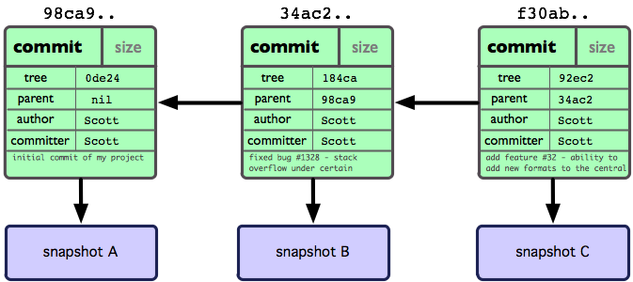
Commit
A node containing
A pointer to the parent commit/s
An autor and a commiter
A commit message
The snapshot

Slide 18
Branch
A branch in git is just a movable pointer to a commit
.git/{…}/my-branch
This pointer start at some point (a commit) and moves as we do commits on it
By default, Git creates a (regular) branch called master
32897eb818bea9aa51ced56feb4381b5b7e22b89

Slide 19
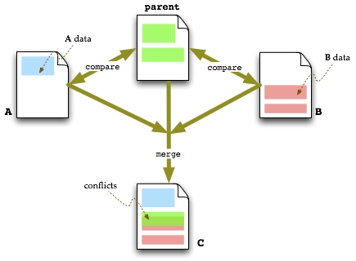
Merge
Merging is combining the changes in two branches
Git usually uses a 3-way merge strategy (except fast-forward)
The current branch is updated to point to commit resulting of applying changes in both branches

Slide 20
Tags
Static pointers
2 types
Lightweight: just named pointers (like branches, but static)
Annotated: more information
Author
Message
[Signature]

Slide 21
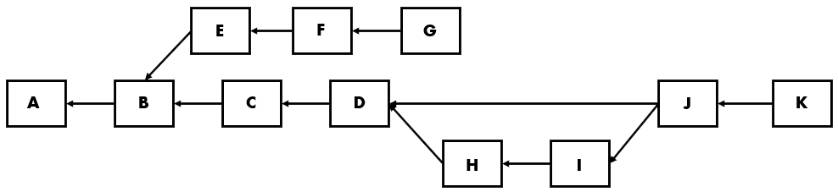
Working directory
my-repository
.git
dir1
dir2
file1
file2
.git
Refs:
master → G
my-feature → K
git checkout master
git checkout my-feature

Slide 22
Stage / index
The stage (also called index) can be seen as a draft of a commit (mandatory)
Like a commit, contains a full snapshot of the project (not only changes)
Allows commiting partial changes of a file
The “commit” operation is a “copy” of this draft
Local Operations
working
directory
staging
area
git directory
(repository)
Checkout the project
Stage files
commit

Slide 23
Stash
Recording changes in the working directory and in the index to a stack
Useful to switch to another branch with unfinished work → no need to commit
These changes can be popped out whenever in any branch
working
directory
index
stash
git stash save
git stash pop/apply

Slide 24
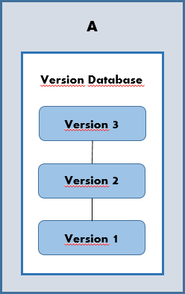
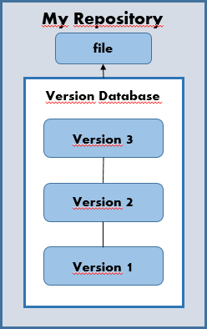
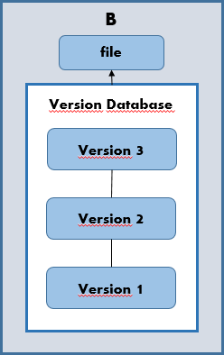
Remotes
Remotes are [regular] repositories where a repository can push or pull changes to or from
Can be in local or in a network location
Usually without working directory (bare repository)
Synchronization is made by merging branches

Slide 25
History
Features
Core Concepts
Operations
Operations

Slide 26
Repository creation
Create a new repository with no history. Can be created in an existing non-empty directory
Clone a repository from a remote. Copies the database and checks out the active branch
My Repository
file
Origin
Version Database
Version Database
Version 3
Version 3
Version 2
Version 2
Version 1
Version 1
git init
git clone <base-repository>

Slide 27
WC and index management
Compare the working directory and the stage with the current branch
Add and remove files to the index
Discard changes in a file or all the changes
Do a commit with the contents of the index
Switch to another branch, tag or commit
commit -a
add / rm
commit
working
directory
index
Local repository
checkout
reset
checkout HEAD
diff HEAD
diff
diff --cached

Slide 28
History review
foo
bar
Inspect changes in the repository traversing the history graph
Log history
Information about a commit
Differences between whole commits or single files
Origin of each line in a file
F
G
H
C´
D´
E´
A
B
C
I
J
K
baz
git log
git log –graph –decorate –oneline
git show <ref>
git diff <ref1> <ref2> [-- <files>]
git blame file [<ref>]

Slide 29
Change reversion*
Safe operation:
Revert some commits creating new commits
Unsafe* operation:
Modify the last commit
Restore the status of the current branch to a certain commit
A
B
C
D
BD-1
A
B
C
D
HEAD (before)
D´
HEAD (after)
A
B
C
D
HEAD (before)
HEAD (after)
git revert <commits>
git commit –amend
git reset <commit> [--hard]

Slide 30
B&M: Merge
git checkout –b my-branch
git commit –m “Commit D”
git checkout master
git pull*
git merge my-branch
git branch –d my-branch
A
B
master
C
my-branch
master
E
D
my-branch
master
F

Slide 31
B&M: Merge conflict resolution
Can occur both merging and rebasing (only not fast-forward)
When it happens, the merged snapshot is left at the index
Conflict resolution consists of:
Editing files
Adding them to the index
Make a commit
Repository at “merging/rebasing” status until solved or aborted
A
B
master
D
C
my-branch
E
git merge my-branch
# Solve conflict
git add conflicting-file/s
git commit

Slide 32
B&M: Fast-forward merge
git checkout –b my-branch
git commit –m “Commit D”
git checkout master
git merge my-branch
git branch –d my-branch
A
B
master
C
my-branch
master
D
my-branch

Slide 33
B&M: Forcing no-ff
git checkout –b my-branch
git commit –m “Commit D”
git checkout master
git merge my-branch –no-ff
git branch –d my-branch
A
B
master
C
my-branch
D
my-branch
master
E

Slide 34
B&M: Rebasing
git checkout –b my-branch
git commit –m “Commit D”
git checkout master
git pull*
git checkout my-branch
git rebase master
A
B
master
C
my-branch
master
E
D
my-branch

Slide 35
Remote configuration
All remote repos have a name. When cloning, “origin” by default
Special branches tracking remote branches
My Repository
file
Origin
Version Database
Version Database
Version 3
Version 3
Version 2
Version 2
Version 1
origin/master
origin/other-remote-branch
Version 1
git remote add <remote-name> <path>

Slide 36
Remote synchronization
“Fetch” updates “remote/*” branches
Update local branches merging with remote ones (usually fast- forward)
“Push” to update remote branches with local ones
History must not be “rewritten” when pushing to a repository
Local repository
Remote repository
fetch
merge
pull
push
Local branch
Mirror branch
Local branch
git fetch & git merge origin/branch
git pull
git push

Slide 37
Remote synchronization
A
A
A
A
A
B
B
B
B
B
E
C
C´
master
C
C
Local #2
F
master
master
D
D
X Push
Remote
Local #1
E
G
X Push
master
master
Local #3
Local #4
V Push
V Push

Slide 38
Summary
Git is very fast because most operations are performed locally using efficient data structures
A Git repository is simply a directed acyclic graph
Commits are full snapshots of a project at some time, identified by a hash that guarentees nothing has changed in it
Synchronization with remote repositories is made by merging local and remote branches
Git has lots of operations (that can also be done with a GUI client), but we must know what they are doing to our repository and others

Slide 39
Resources
Pro Git by Scott Chacon: http://git-scm.com/book
Command reference: http://git-scm.com/docs

Slide 40

PRACTICE

Slide 41
B
My Repository
A
file
file
Origin
Version Database
Version Database
Version Database
Version Database
Version 3
Version 3
Version 3
Version 3
Version 2
Version 2
Version 2
Version 2
Version 1
Version 1
Version 1
Version 1

Slide 42
foo
bar
F
G
H
C´
D´
E´
A
B
C
I
J
K
baz
A
B
C
D
BD-1
A
B
C
D
HEAD (before)
D´
HEAD (after)
A
B
C
D
HEAD (before)
HEAD (after)

Slide 43
A
A
B
B
master
D
C
my-branch
master
C
my-branch
E
master
E
D
my-branch
A
master
F
B
master
C
my-branch
master
D
my-branch

Slide 44
A
A
B
B
master
C
my-branch
C
master
my-branch
D
master
E
my-branch
D
my-branch
master
E

Slide 45
A
A
A
A
B
B
A
B
B
C
C´
B
E
C
C
master
master
master
F
Local #1
Local #2
D
master
Remote
G
master
Local #4

