Slide 1
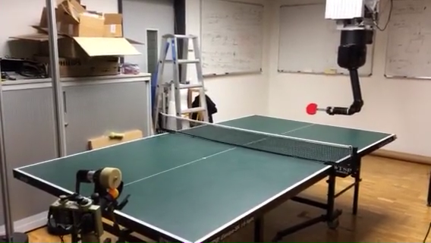
Optimizing Robot Striking Movement Primitives with Iterative Learning Control
Okan Koç, Jan Peters
Max Planck Institute for Intelligent Systems, Tübingen, Germany
Guilherme Maeda, Gerhard Neumann
TU Darmstadt, Germany
Digest must be prepared and submitted in MS PowerPoint (no other file format accepted)
Use Arial 28pt font in bold face for the title
Use Arial 24pt font for the authors and Arial 20pt font their brief affiliations
3 or 4 bullet points (limit each to less than 15 words in Arial 20pt font)
Please do not change the template. Please also note that the digest will be printed in black and white.
7 DOF Barrett WAM playing table tennis

