Slide 1
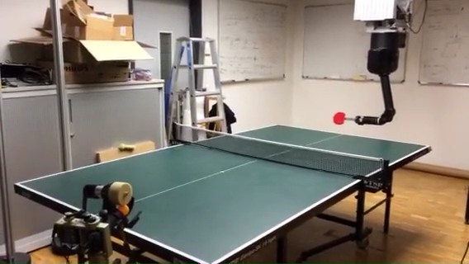
Optimizing Robot Striking Movement Primitives with Iterative Learning Control
Okan Koç, Jan Peters
Max Planck Institute for Intelligent Systems, Tübingen, Germany
Guilherme Maeda, Gerhard Neumann TU Darmstadt, Germany
Tracking errors of movement primitives captured from demonstrations can be compensated with ILC.
Model-based ILC is very efficient and fast, however it is not robust when tracking striking movement primitives.
We propose goal-based ILC as an alternative.
We evaluate our algorithm in our table tennis platform and show that it outperforms conventional ILC.
7 DOF Barrett WAM playing table tennis

