Slide 1
ROBOTML PLATFORM: DESIGN, SIMULATE AND DEPLOY ROBOTIC APPLICATIONS
Saadia DHOUIB
CEA LIST
CEA | 10 AVRIL 2012
| PAGE <number>

Slide 2

WHY DSMLS FOR ROBOTIC SYSTEMS
Robotic systems are becoming more and more complex
  Software intensive systems
  Heterogenous components (software, hardware, computation, communication, coordination, etc)
Need for a modeling language that
  eases modeling, simulation and deployment of such complex systems
  gives common modeling language to specify overall robotic systems architecture
  fasten the design process of robotic systems
Provide a whole toolchain to automate as much as possible the lower-level task of robotic application developer
| PAGE <number>

Slide 3
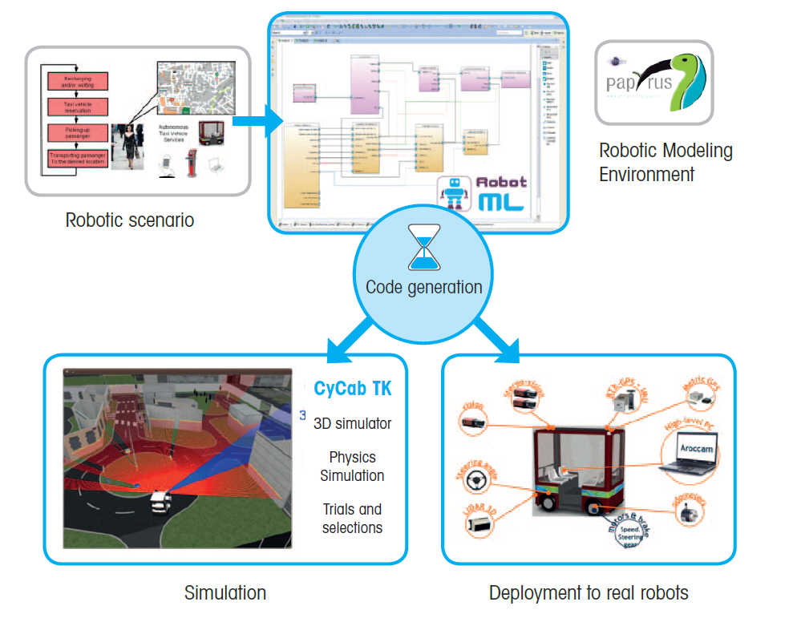
ROBOTML PLATFORM
| PAGE <number>

Slide 4





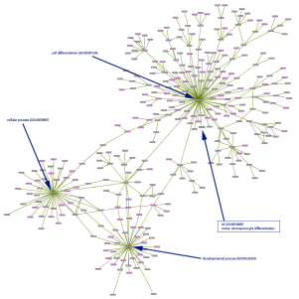


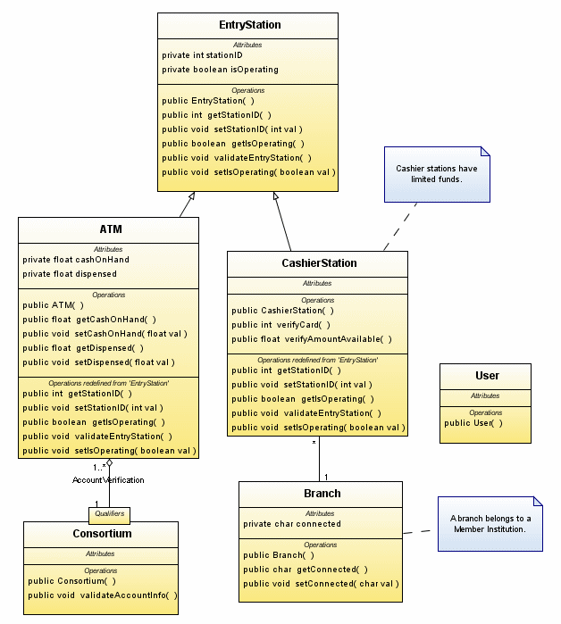




ROBOTML DESIGN PROCESS
State of the art on middlewares , simulators and DSLs for robotics systems
1. DSL Requirements
Verification
2. Domain Model
Robotic
Ontology
3. DSL Implementation
4. Modeling Tools development
| PAGE <number>

Slide 5
ONTOLOGY / DSL COMPARISON (1/3)
Ontology
  A specification of a conceptualization (Gruber, 1992)
  An ontology is a description of the concepts and relationships that can exist for a community of agents
    A set of concept definitions
    A syntactic layer added to data and is claimed to be a semantic enrichment
| PAGE <number>
Notes:
In the context of knowledge sharing, I use the term ontology to mean a specification of a conceptualization. That is, an ontology is a description (like a formal specification of a program) of the concepts and relationships that can exist for an agent or a community of agents. This definition is consistent with the usage of ontology as set-of-concept-definitions, but more general. And it is certainly a different sense of the word than its use in philosophy.
What is important is what an ontology is for. My colleagues and I have been designing ontologies for the purpose of enabling knowledge sharing and reuse. In that context, an ontology is a specification used for making ontological commitments. The formal definition of ontological commitment is given below. For pragmetic reasons, we choose to write an ontology as a set of definitions of formal vocabulary. Although this isn't the only way to specify a conceptualization, it has some nice properties for knowledge sharing among AI software (e.g., semantics independent of reader and context). Practically, an ontological commitment is an agreement to use a vocabulary (i.e., ask queries and make assertions) in a way that is consistent (but not complete) with respect to the theory specified by an ontology. We build agents that commit to ontologies. We design ontologies so we can share knowledge with and among these agents.
A Domain Specific Language is a formal language, and then a grammar, tailored to a specific application domain. It is then a metamodel at a notation level said M2. A DSL (or its graphical representation, the DSML - Domain Specific Modelling Language -) is a textual representation of a domain and enables the specification of a model in accordance with a defined metamodel. . It adds symbols, represents the concepts of a metamodel and enables to handle them. A model is an abstraction of the reality (as a Data-Base) and therefore is only a specific viewpoint on the reality.
The semantics of the Models is not straightforwardly available.

Slide 6
ONTOLOGY / DSL COMPARISON (2/3)
DSL
  A formal language tailored to a specific application domain
  DSML
  A model is an abstraction of the reality and therefore is only a specific viewpoint on the reality
c2
metametamodel MMM
Conforms to
c2
metamodel MM
c2
System S
representation of
Model M
repOf
[Bézivin, 2010]
| PAGE <number>

Slide 7
ONTOLOGY / DSL COMPARISON (3/3)
Criteria | Ontology | DSL
Design Domain | Knowledge Engineering | Engineering (Computer science, Electronics - RT embedded systems, robotics, avionics-)
Building / Development Methodology | Ontology Building User need and requirements capture Reuse possibilities Domain knowledge and structuring relations Evaluation | DSL development User need and requirements capture Reuse possibilities Domain knowledge and structuring relations Implementation of executable DSL tools (i.e. a compiler or translator, …) Evaluation
Application Domains | Classification, Automatic Annotation, Web-Services Orchestration, Knowledge Base, Dictionaries, Natural Language Generation, … | Systems modelling, Code Generation, Functional and non-functional verification, Simulations, …
Technologies and Tools | Ontology GUI, inference engine, ontology editor, reasoning engines, … | DSL development framework (Eclipse GMT, MetaCase…), DSL development graphical environment (DSL Toolkit Microsoft, Papyrus,…), Code generator, transformation languages (ATL,…),…
Format | RDF, OWL, Topic Maps,… | MOF, EMF, EMOF, CMOF,
| PAGE <number>
Notes:
Engineering in general (Computer science engineering, System engineering, Electronics - real time embedded systems, robotic systems, avionics systems-)

Slide 8
FROM ONTOLOGY TO DSL
Mapping from the ontology to the DSL domain model
Ontology (OWL) | Domain model (UML class diagram)
Concept | Class
subClassOf | Generalization
Property | Association
Property:IsA | Inheritance
Property:HasA | Composition
Cardinality | Multiplicity
| PAGE <number>

Slide 9
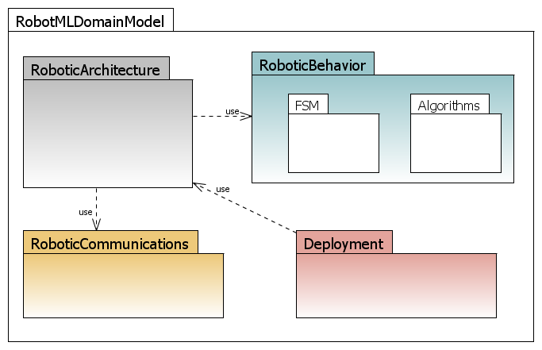
ROBOTML DOMAIN MODEL
  specific components that constitute robotic architectures (sensors, actuators, control)
define the behavior of robotic components
  communication mechanisms between components (sending/receiving data, provided/required services)
Allocation of a robotic system to a target robotic execution
platform (a middleware or a simulator)
| PAGE <number>

Slide 10
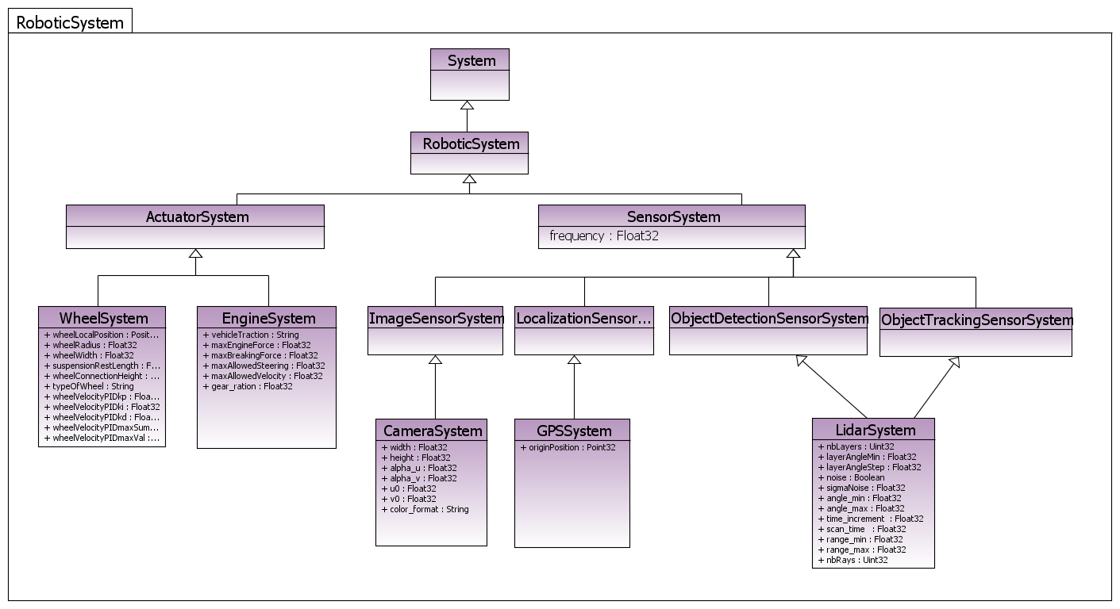
ROBOTML DOMAIN MODEL :: ROBOTIC ARCHITECTURE :: ROBOTIC SYSTEM
CEA | 6 Décembre 2012
| PAGE <number>

Slide 11
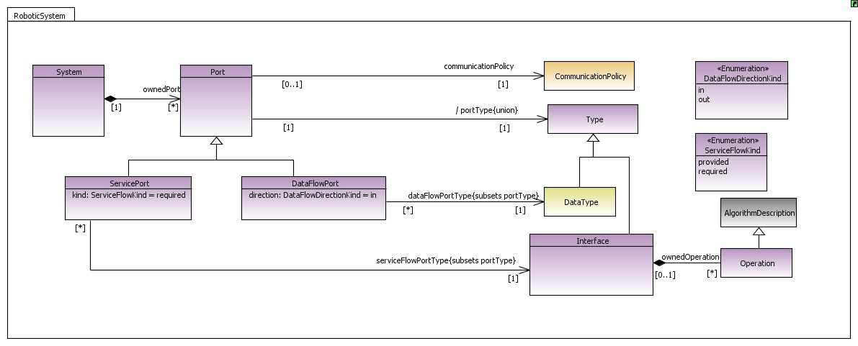
ROBOTML DOMAIN MODEL :: ROBOTIC COMMUNICATION
CEA | 6 Décembre 2012
| PAGE <number>

Slide 12
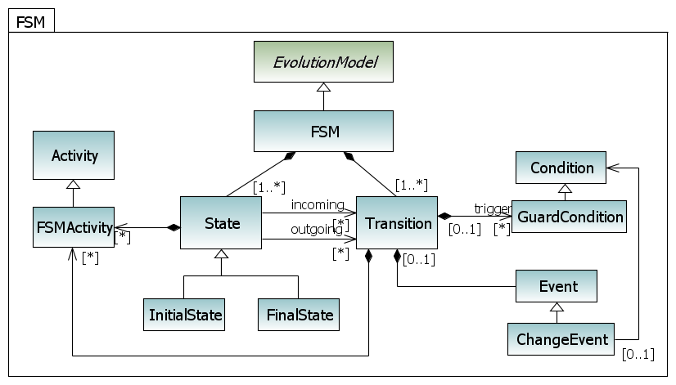
ROBOTML DOMAIN MODEL :: ROBOTIC BEHAVIOR :: FSM
CEA | 6 Décembre 2012
| PAGE <number>

Slide 13
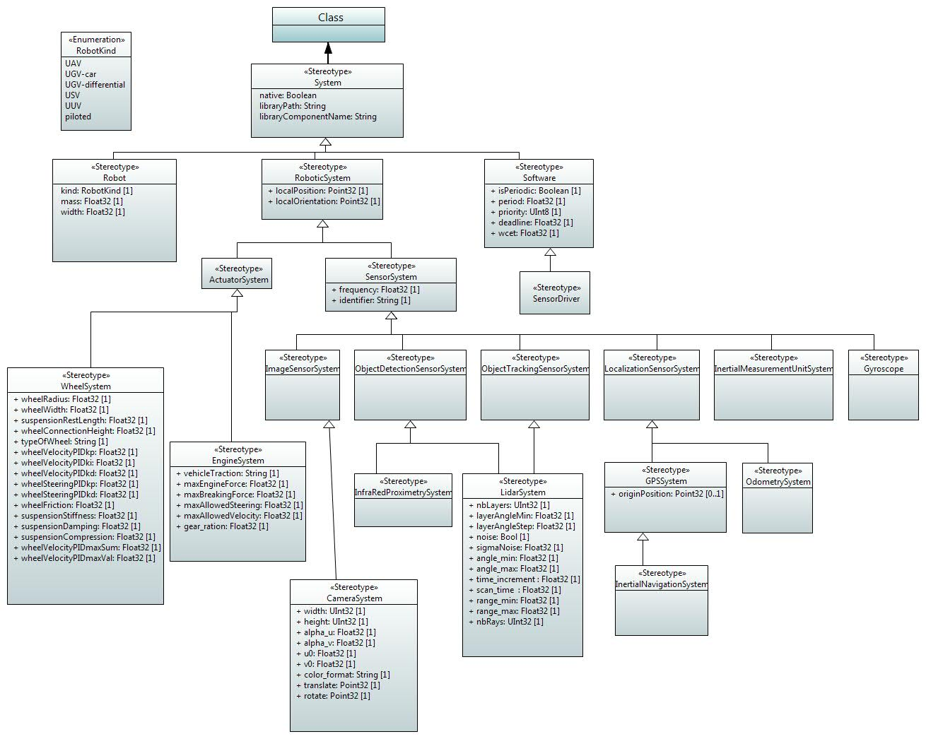

ROBOTML IMPLEMENTATION
UML Profile
  Domain specific extension
  of the UML metamodel
Papyrus
  Eclipse based UML modeling platform
  includes all the facilities for defining and applying UML profiles
  provides powerful domain specific tool customization capabilities
| PAGE <number>

Slide 14
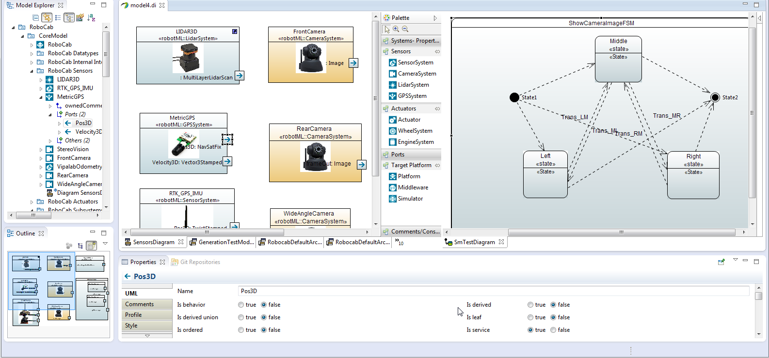
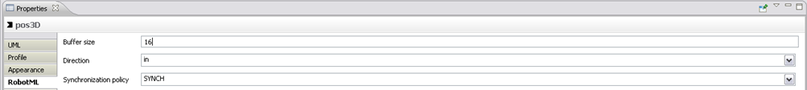
ROBOTML MODELLING ENVIRONMENT
Model
Explorer
Components
Definition Diagram
Finite State Machine
Diagram
Properties View
CEA | 05/11/2013
| PAGE <number>

Slide 15
ONGOING WORK AND FUTURE DIRECTIONS
  Work done in the frame of the French national project PROTEUS (partners: DASSAV, Thales TRT, LIP6, ONERA, GREYC, LASMEA, Effidence, INRIA, Gostai, ECA, PRISME)
  RobotML SDK is available with open-source license
  Standardization:
    Plan to standardize the RobotML language
    Ongoing work to standardize the PROTEUS ontology within IEEE ORA working group
  Participation to euRobotics topic group “Software and Systems Engineering for robotics”
  ROMEO2: French national project started in December 2012, Safety analysis for humanoid robots
  ¹extra feature of papyrus http://www.eclipse.org/papyrus/
CEA | 6 Décembre 2012
| PAGE <number>

