Slide 1



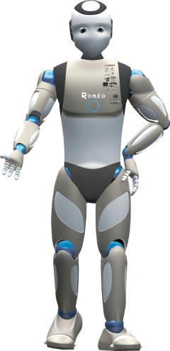

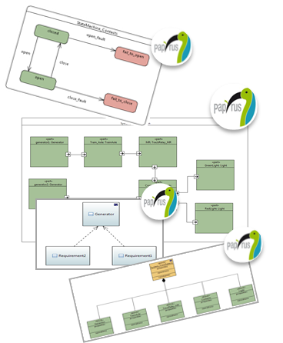
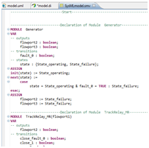


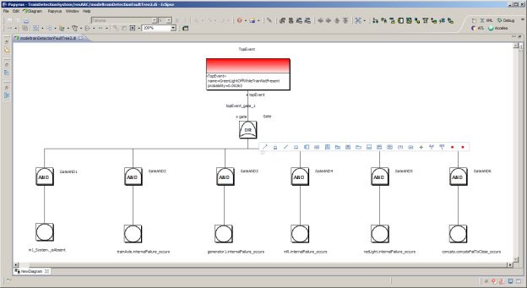
Model-Driven Safety Assessment for robotic systems
Aldebaran Robotics Copyrignt ©

Slide 2
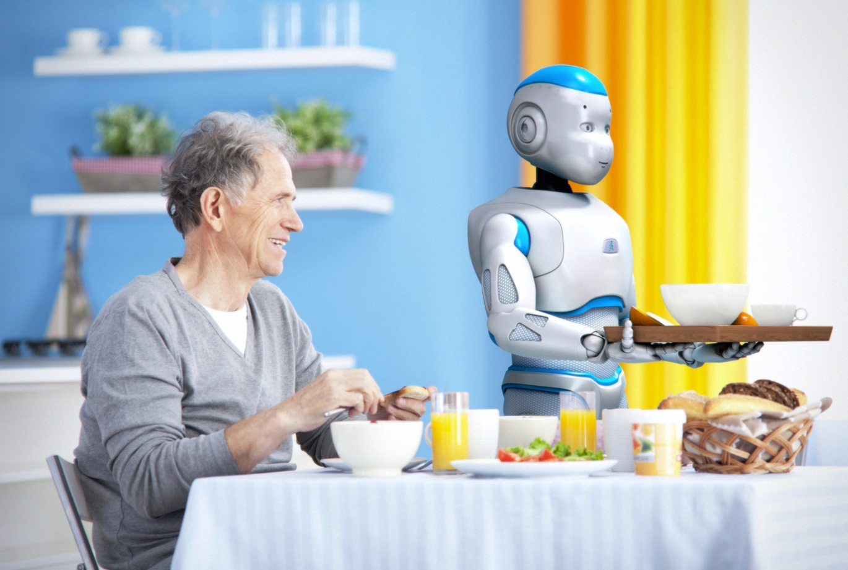
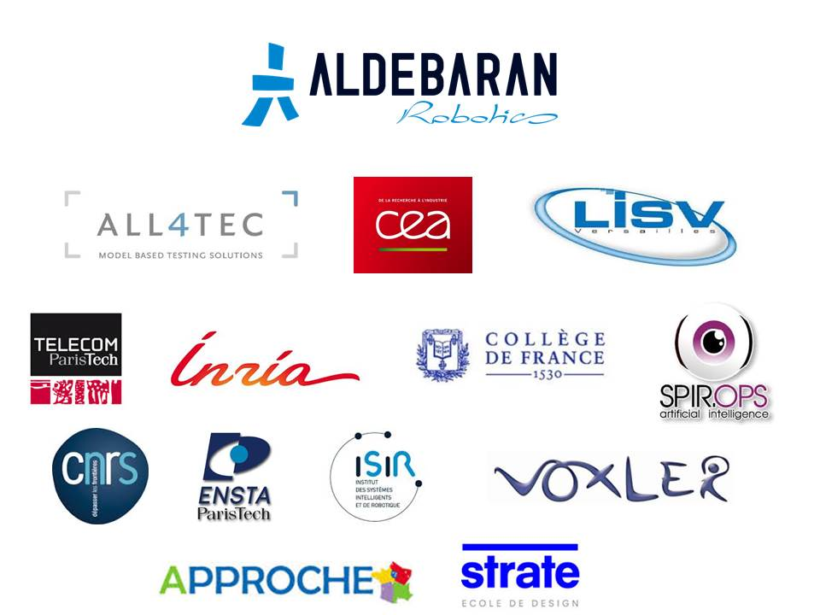
Romeo2 Project
Romeo2 research platform is now being used to validate the possible service uses for a larger robot than Nao and to test new technologies for possible integration in future Aldebaran products.
The innovations tested on Romeo include human-robot interaction, moving eyes and the vestibular system, force control, etc.
Romeo is a humanoid robot from Aldebaran Robotics which is intended to be a personal assistant and companion

Slide 3
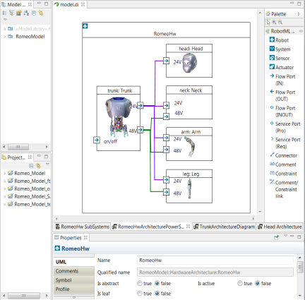
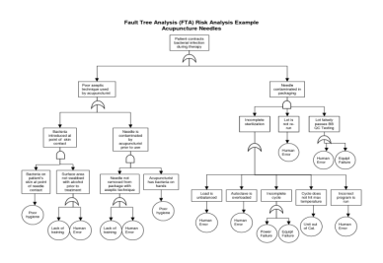
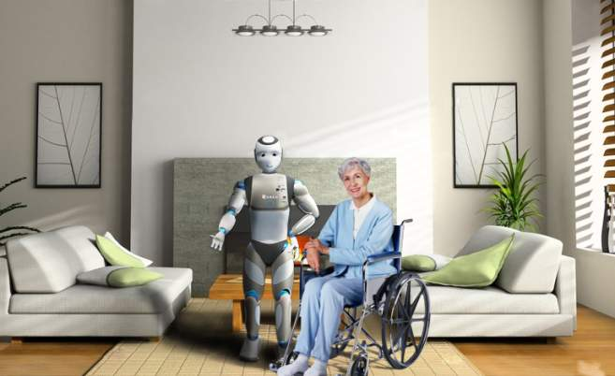



Contexte
Model-driven engineering
of robotic systems
Classical safety analysis methods
No standard modeling tools
Modeling language RobotML is based on the UML/SysML standards
Code generation for simulators, middleware/OS and deployment to real robots
Robotic safety standards(ISO13482, ISO10218 ) list risks specific to robotic applications and recommend FMEA and FTA methods for safety analysis
FMEA and FTA are often performed manually => time consuming, costly, high probability of errors
Design Engineer
Need for safety analysis assistance
Safety Engineer

Slide 4
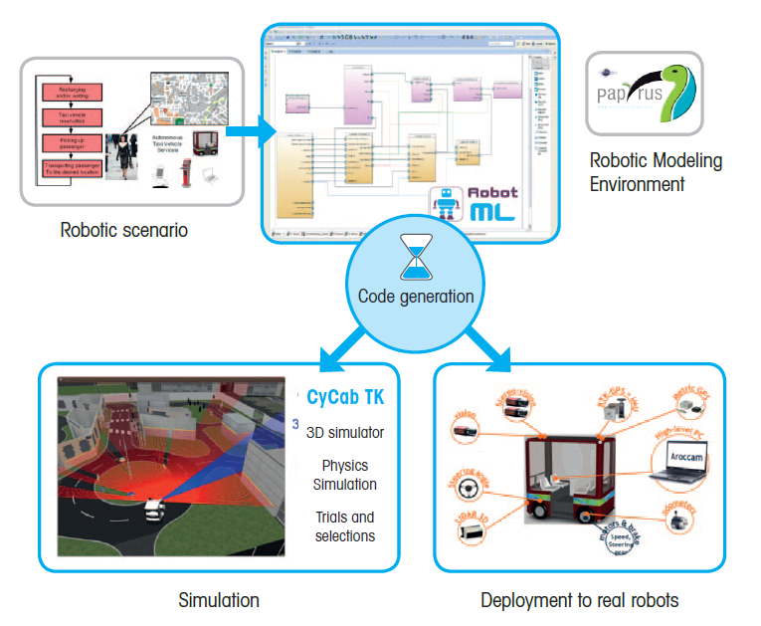

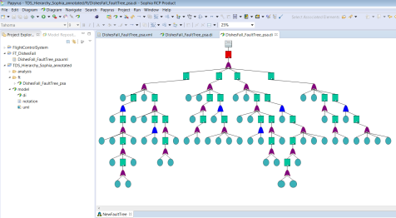
Model-Driven Safety analysis
Safety Analysis Environment
UML profile for safety analysis
Own dedicated models
Strong links between system engineering and safety analysis
Copyright CEA ©
Uniform environment for modeling and safety analysis of robotic applications
Notes:
MBSE is a convenient way to develop safety-critical systems. This approach relies upon system level models that enable to simulate the overall performance and behavior of complex systems as well as to integrate SA techniques into the engineering process. MBSE environments offer convenient frameworks to integrate different dedicated analysis views within a global design environment.
We propose a modeling framework, called Sophia, for model-based safety analysis. Sophia uses the Papyrus editing tool to leverage features of SysML modeling language and includes facilities to perform different types of safety analysis.

Slide 5

Safety Life-Cycle
Safety Assessment with Sophia
System Development
IEC 61508 generic standard on functional safety
SOPHIA-PHA
SOPHIA-SHA
SOPHIA-Requirements
Concept & Requirements
Acceptance & Maintenance
Functional Hazard Analysis
Validation
ISO/DIS 13482 safety standard for personal care robots
SOPHIA-FTA
Preliminary System Safety Assessment
SOPHIA-FMEA
Design & Optimization
Validation
Integration & Test
SOPHIA-ModelChecking
System Safety Assessment
Implementation
Sophia targets early phases of system life-cycle
Copyright CEA ©

Slide 6
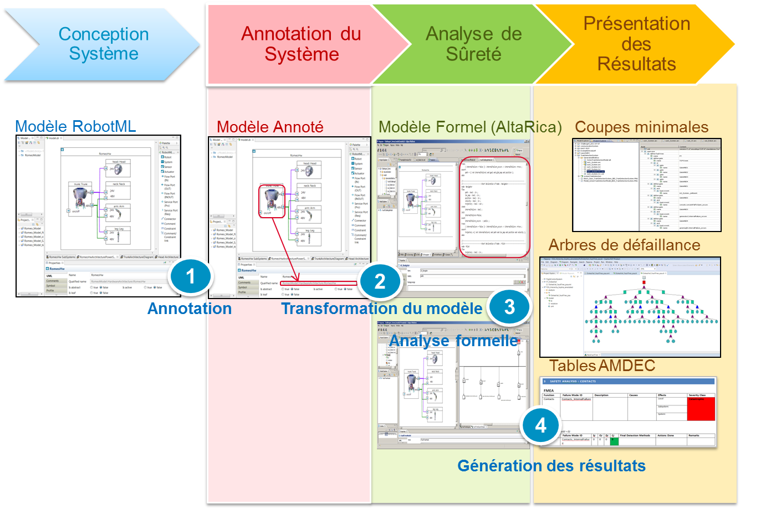


Sophia Methodology*
Copyright CEA ©
* N. Yakymets, S. Dhouib, H. Jaber, A. Lanusse, “Model-Driven Safety Assessment of Robotic Systems,” 2013 IEEE/RSJ International Conference on Intelligent Robots and Systems, IROS’2013, November 3-7, Tokyo, Japan, 2013.

Slide 7

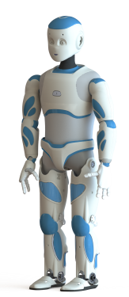
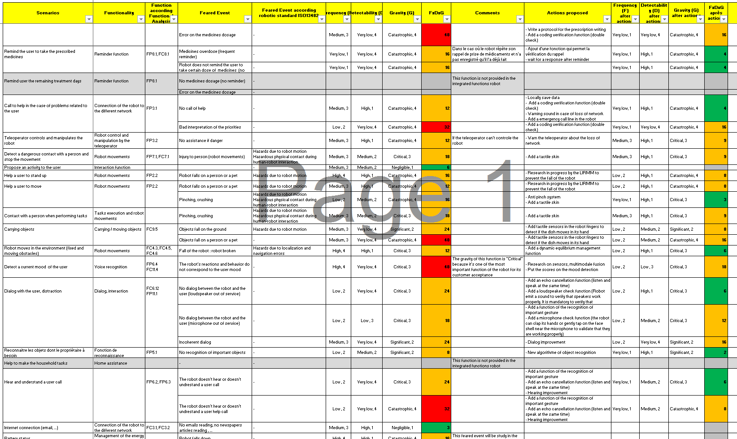


Romeo2: obtained results
Objectives
Modeling of Romeo2 software and hardware architecture with RobotML
Safety analysis of Romeo2 based on RobotML model
Romeo2 Architecture
Results
RobotML model of HW &SW architecture of the Romeo2 robot
Development a methodology specifying the process of safety analysis of robotic applications related to ISO13482
Safety analysis of Romeo2 using FME(C)A and FTA techniques recommended by ISO13482
Automatic report generation
FMEA Tables
Fault Trees
Copyright CEA ©

Slide 8
Direction DRT Département DILS Laboratoire LISE
Thank you!
Commissariat à l’énergie atomique et aux énergies alternatives
Institut Carnot CEA LIST
Centre de Saclay | 91191 Gif-sur-Yvette Cedex
T. +33 (0)1 69 08 32 93
Etablissement public à caractère industriel et commercial | RCS Paris B 775 685 019

Slide 9
Conclusion
RobotML
Extends UML for robotic domain
Extra feature of papyrus http://www.eclipse.org/papyrus/
RobotML SDK is available with open-source license
Standardization: Plan to standardize the RobotML language Ongoing work to standardize the PROTEUS ontology within IEEE ORA working group
ROMEO2: French national project started in December 2012, Safety analysis for humanoid robots
Sophia
Integration of safety techniques within a model-driven engineering process
Support of generic standard on functional safety design IEC61508 and ISO 13482 safety standard (non-industrial personal care robots)
Modelling of architecture, behaviour and failure logic (SysML and RobotML)
Automatic document generation
Perspectives
Take into account propagation of failure behavior while allocating SW to HW
Tackle a complexity of robotic systems by architecture partitioning and controlling the depth of safety analysis
Copyright CEA ©

