Slide 1


Semantic Technology: A Basic Introduction
Dr. Lowell Vizenor
Ontology and Semantic Technology Practice Lead
Alion Science and Technology

Slide 2
Overview
The underlying idea of the Semantic Web and Linked Data
Semantic Web standards: RDF/S, SPARQL 1.1, and OWL 2
Basic tools and methods (including TopBraid and Protégé, Reasoners)
An example: Universal Core Semantic Layer (UCore SL)

Slide 3
Web 2.0 and Beyond
Web 2.0
O'Reilly Media Web 2.0 Conference (2004)
Characteristics
Web as platform
Democratizing the Web
Distributed data
Examples: Social-networking sites (Facebook, LinkedIn), blogs (Blogger), wikis (Wikipedia), video-sharing sites (YouTube), hosted services, web applications, mashups and folksonomies (Digg)
… and Beyond
Web 3.0 = Semantic Web?
Tim Berners-Lee, James Hendler and Ora Lassila. The Semantic Web : A new form of Web content that is meaningful to computers will unleash a revolution of new possibilities, Scientific American, May 17, 2001
Key idea: Metadata added to Web pages can make the existing World Wide Web machine readable (or the Web as a distributed database).

Slide 4
Semantic Web - Example
Dinner and a Movie
Assume that you and your date want to have dinner at an Italian restaurant and then go and see a movie that your friends have recommended on a social networking site, that is within walking distance of the restaurant, and starts two hours after your dinner reservation.
Current approach: Search multiple sites and manually cross-reference the information and make a decision.
Semantic Web vision:
a computerized agent performs search based on user inputs and metadata
recommends best options, and
makes reservations, purchases movie tickets for you, and sends out calendar invite.

Slide 5
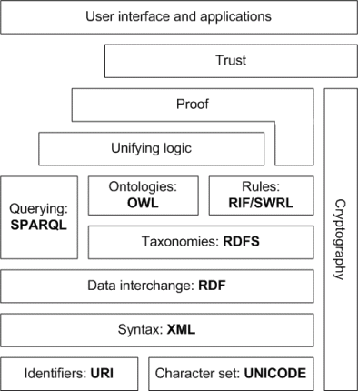
Applying Semantic Web Architecture to the Enterprise
Semantic Web Stack

Slide 6

Resource Description Framework (RDF)

Slide 7
RDF Data Model
An RDF graph is a set of RDF triples
Subject/Predicate/Object
Triples are statements (i.e. they are true or false)
The smallest graph is a single triple
 | Subject | Predicate | Object
Statement 1 | p1 | type | Person
Statement 2 | p1 | name | John Smith
Statement 3 | p1 | mbox | jsmith@acme.com

Slide 8
RDF Graph Data Model
foaf:Person
rdf:type
ex:p1
foaf:name
“John Smith”
foaf:mbox
“jsmith@acme.com”
 | Subject | Predicate | Object
Statement 1 | p1 | type | Person
Statement 2 | p1 | name | John Smith
Statement 3 | p1 | mbox | jsmith@acme.com

Slide 9
Anatomy of a URI
Uniform Resource Identifier (URI)
Definition
A Uniform Resource Identifier (URI) is a compact sequence of characters that identifies an abstract or physical resource.
Example URI
<http://xmlns.com/foaf/0.1/Person>
Every URI has a namespace
<http://xmlns.com/foaf/0.1/Person>
Every URI has a local name
<http://xmlns.com/foaf/0.1/Person>
Qname or alias
foaf:Person
@prefix foaf: <http://xmlns.com/foaf/0.1/>

Slide 10
Anatomy of a URI
“Cool URIs don’t change”
– Tim Berners-Lee
@prefix foaf: <http://xmlns.com/foaf/0.1/>
@prefix ex: <http://www.example.com/example#>
foaf:Person
rdf:type
ex:p1
foaf:name
“John Smith”
foaf:mbox
“jsmith@acme.com”
Notes:
“Cool URIs don’t change” – Tim Berners-Lee <http://www.w3.org/Provider/Style/URI.html>

Slide 11
URI Resources and Labels
myth:Mercury
skos:altLabel
skos:prefLabel
“Hermes”
“Mercury”
skos:prefLabel
elem:Mercury

Slide 12
Merging Graphs
Dataset 1
foaf:Person
rdf:type
ex:p1
foaf:name
“John Smith”^^xsd:string
foaf:mbox
<mailto:jsmith@acme.com>
rdf:type
foaf:Person
Dataset 2
ex:p1
foaf:gender
“male”^^xsd:string
foaf:age
“45”^^xsd:int

Slide 13
Merging Graphs
foaf:Person
rdf:type
“John Smith”^^xsd:string
rdf:type
foaf:name
<mailto:jsmith@acme.com>
foaf:mbox
ex:p1
ex:p1
foaf:gender
“male”^^xsd:string
foaf:age
“45”^^xsd:int

Slide 14
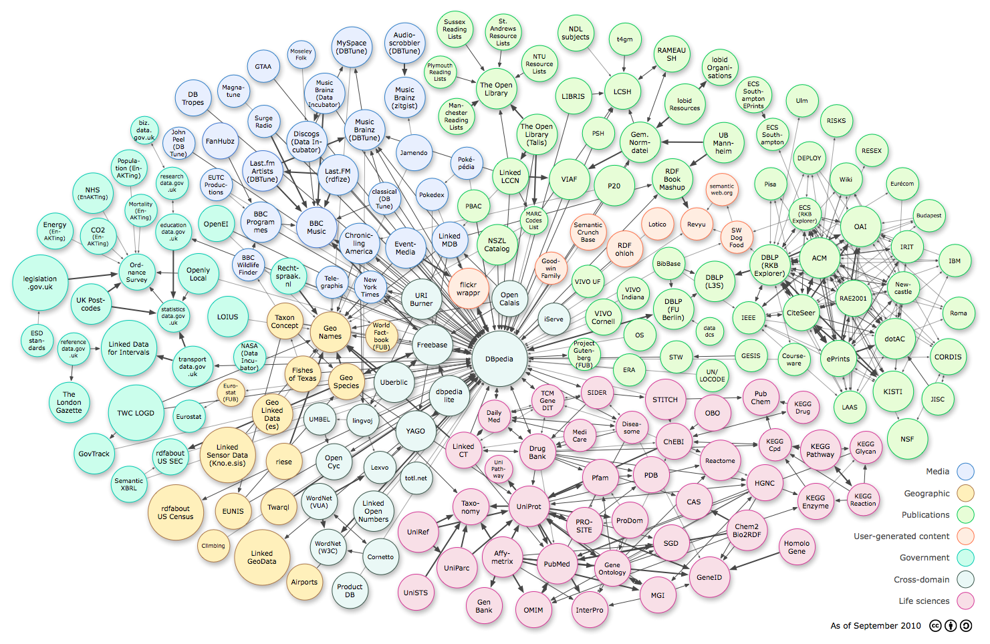
Linked Open Data

Slide 15
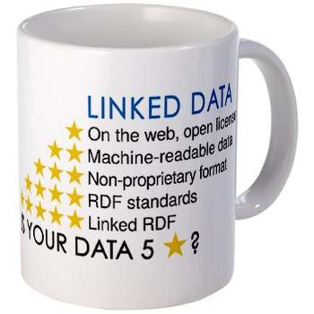
Linked Data Principles
Use URIs as names for things
Use HTTP URIs so that people can look up those names.
When someone looks up a URI, provide useful information, using the standards (RDF, SPARQL)
Include links to other URIs. so that they can discover more things.
Tim Berners-Lee
http://www.w3.org/DesignIssues/LinkedData.html

Slide 16
SPARQL 1.1
SPARQL Query Language for RDF

Slide 17
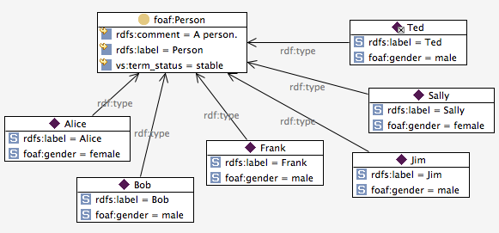
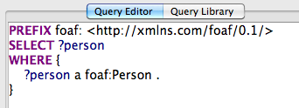
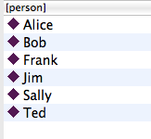
Select all the persons

Slide 18
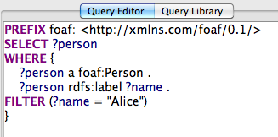
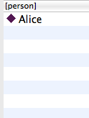
Select every one named “Alice”

Slide 19
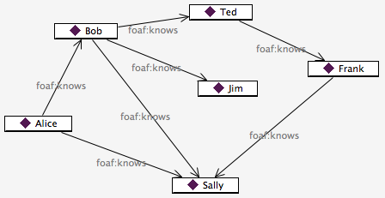
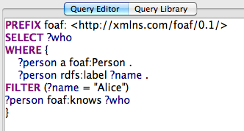
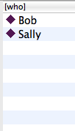
Who does Alice know?

Slide 20
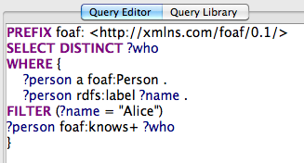
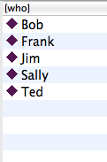
Who is Alice connected to via foaf:knows?

Slide 21
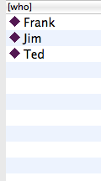
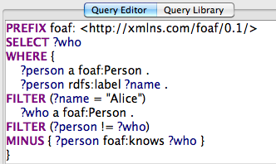
Who does Alice not know?

Slide 22
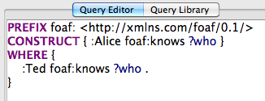
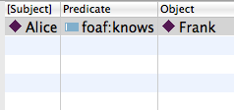
Alice knows everyone who Ted knows

Slide 23
SPARQL Federation demo

