Slide 1




Platform for RObotic modeling and
Transformations for End-Users
and Scientific communities
Presentation ANR
Avancement à 18 mois
La plate forme
Agence Nationale de la Recherche
Dassault Aviation, Saint Cloud
5th of May, 2011
http://www.anr-proteus.fr

Slide 2
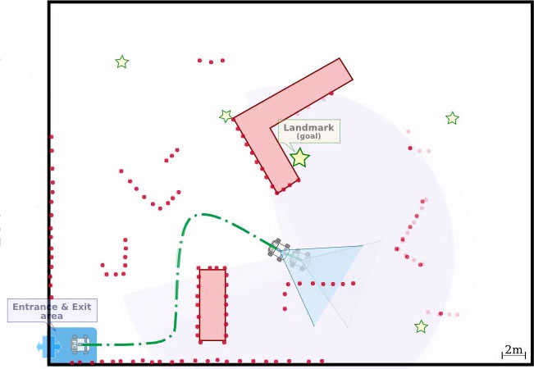
The problem – find and go
Problem
providers

Slide 3
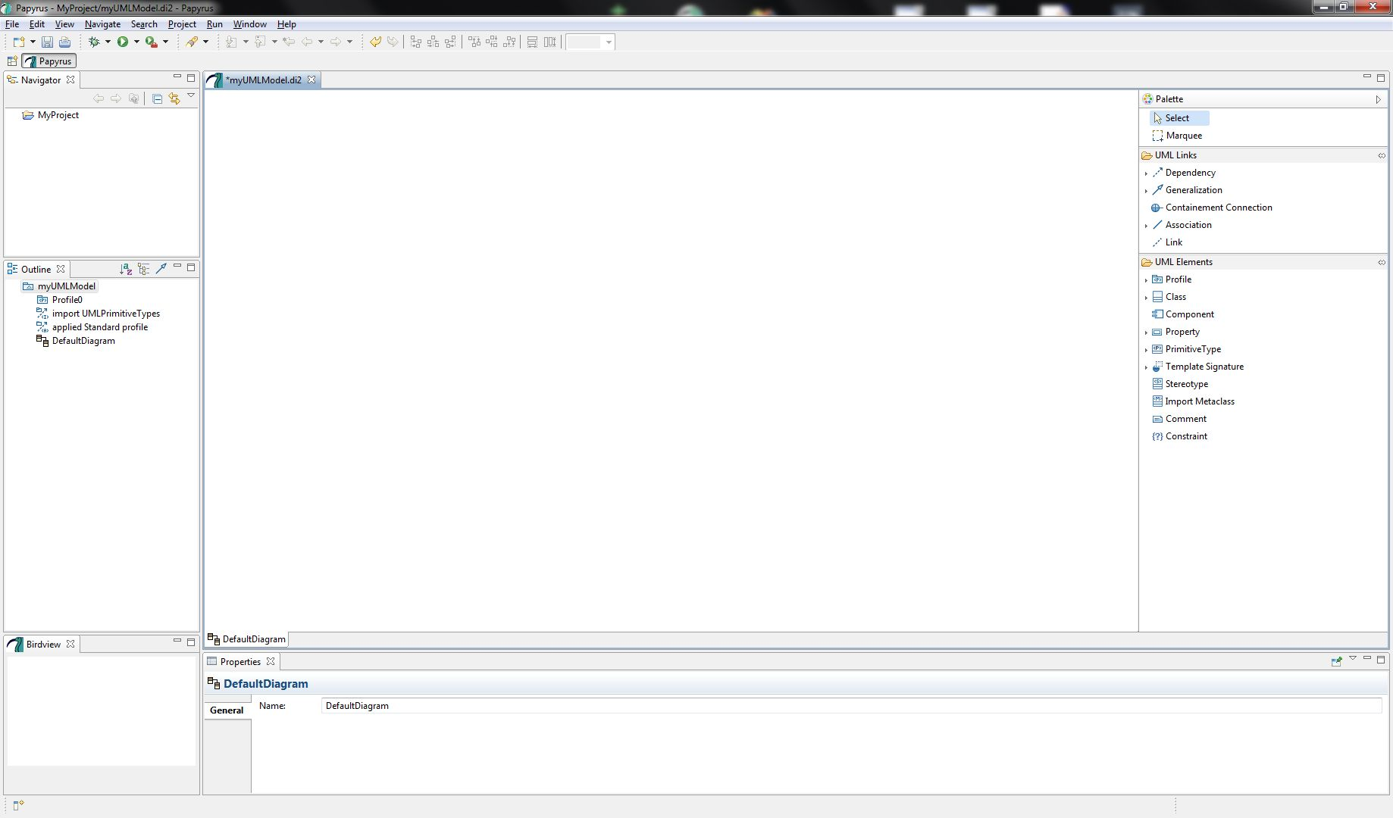
The problem – Modelling with DSL
Problem
providers
Control &
Communication DSL
Archi DSL
algo QuickSortInPlace
(inout list:Integer[0...*])
{
If (low < high)
L = low;
Etc...
Algo DSL
G

Slide 4
The problem – Mapping with DSL
Problem
providers
Playing field
For solution
algo QuickSortInPlace
(inout list:Integer[0...*])
{
If (low < high)
L = low;
Etc...
G
Robot System
Environment

Slide 5
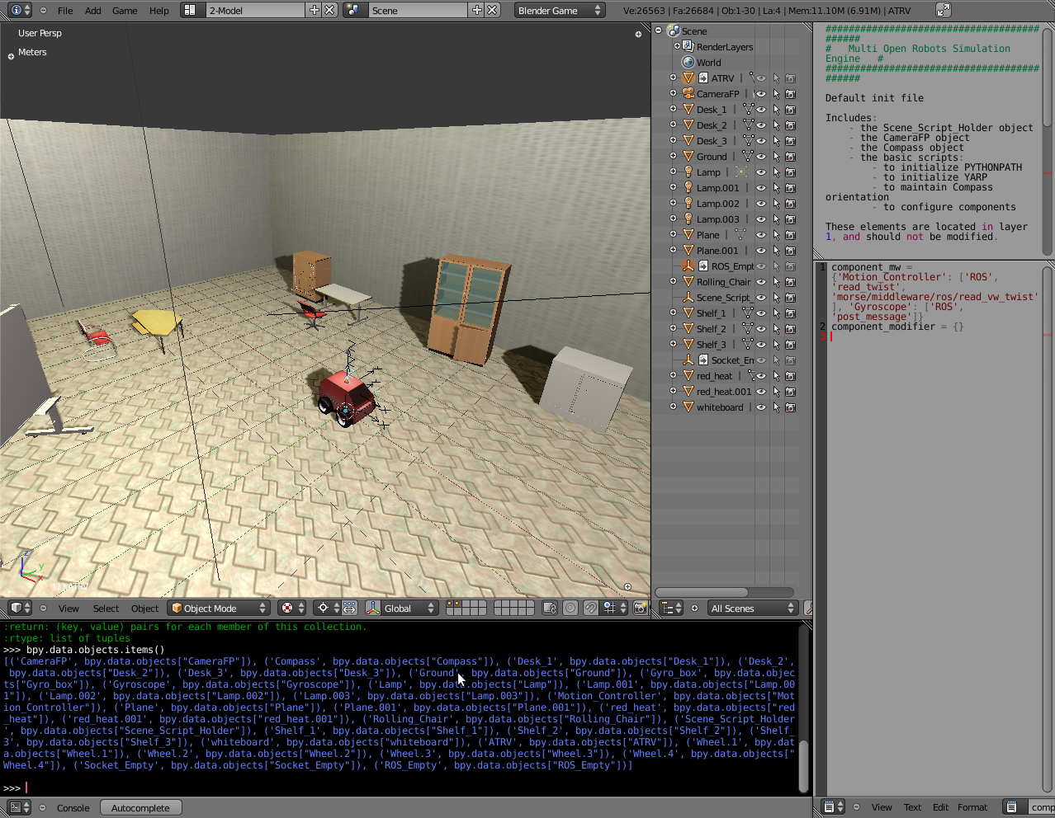
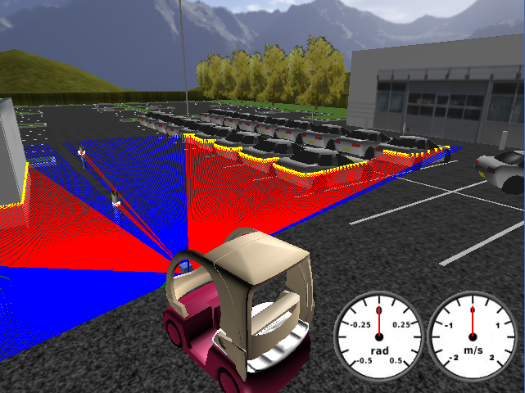
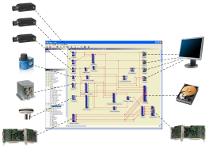
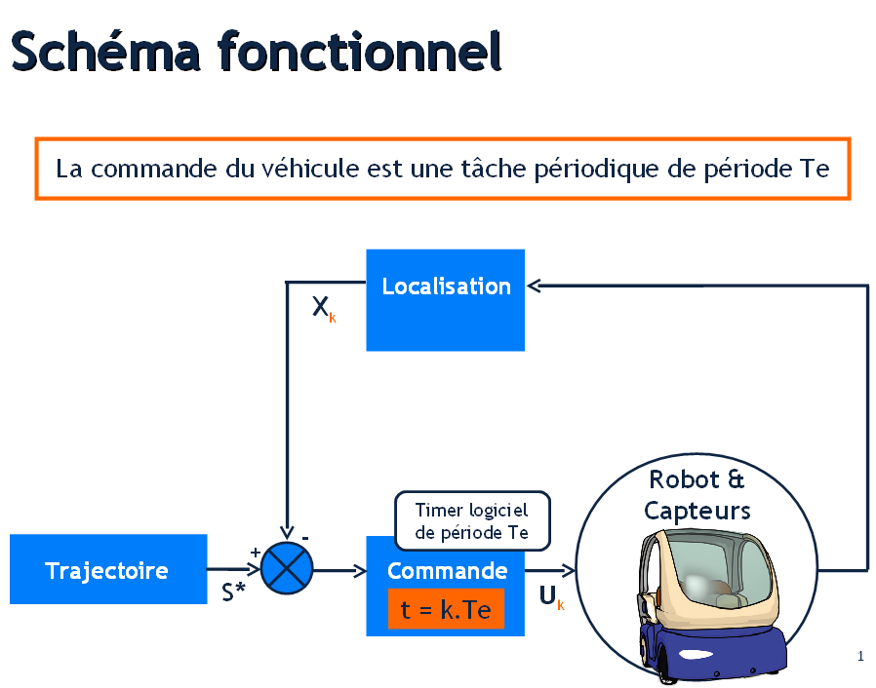
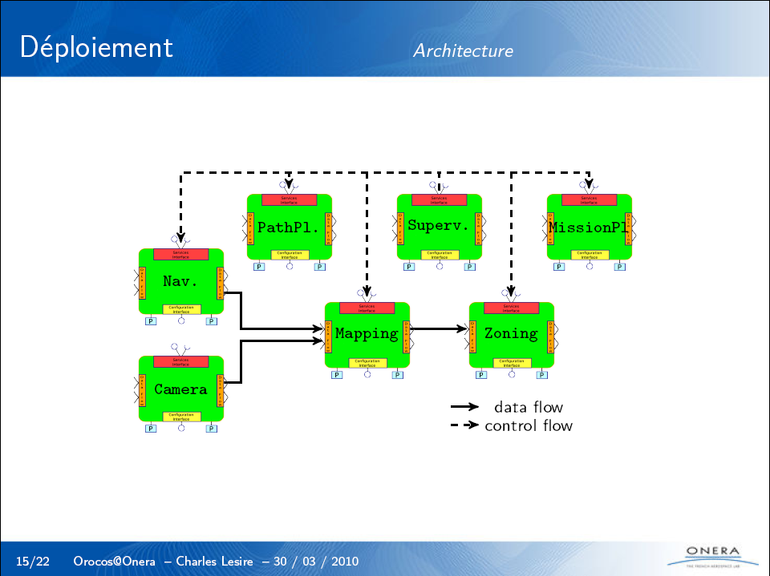


The problem – Generation
Problem
providers
Playing field
For solution
algo QuickSortInPlace
(inout list:Integer[0...*])
{
If (low < high)
L = low;
Etc...
G
Robot System
Environment
MAGIC BUTTON !!
MORSE
Cycab-TK
RT-MAPS
ARROCAM
OROCOS
OTHERS
OTHERS

Slide 6
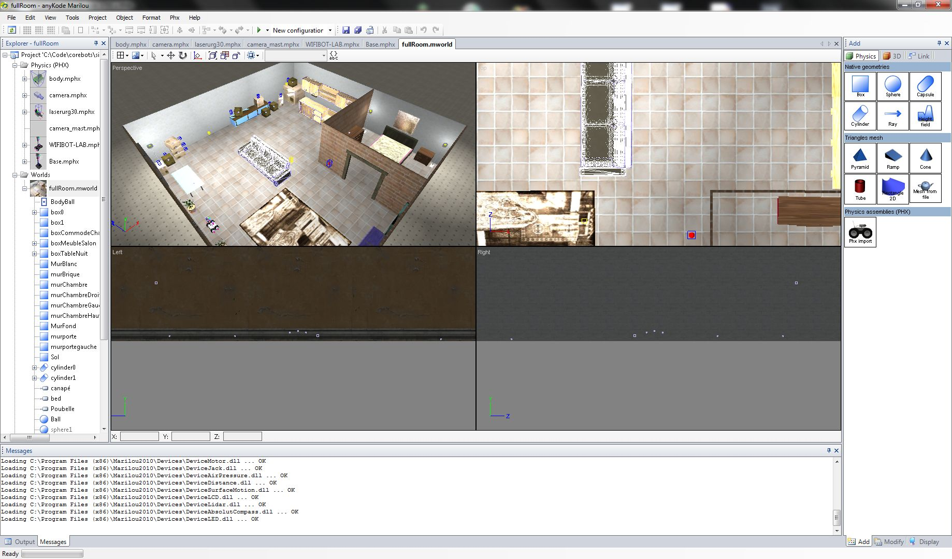
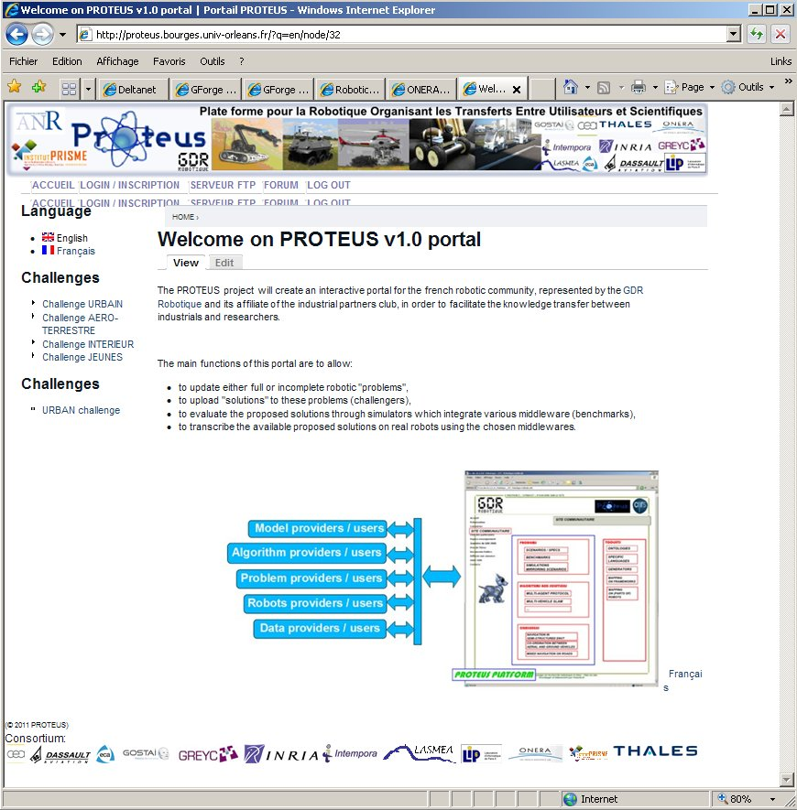
The problem – provided
Algorithm
Algorithm
providers
providers
Problem
Problem
users
users
PROTEUS PORTAL

Slide 7
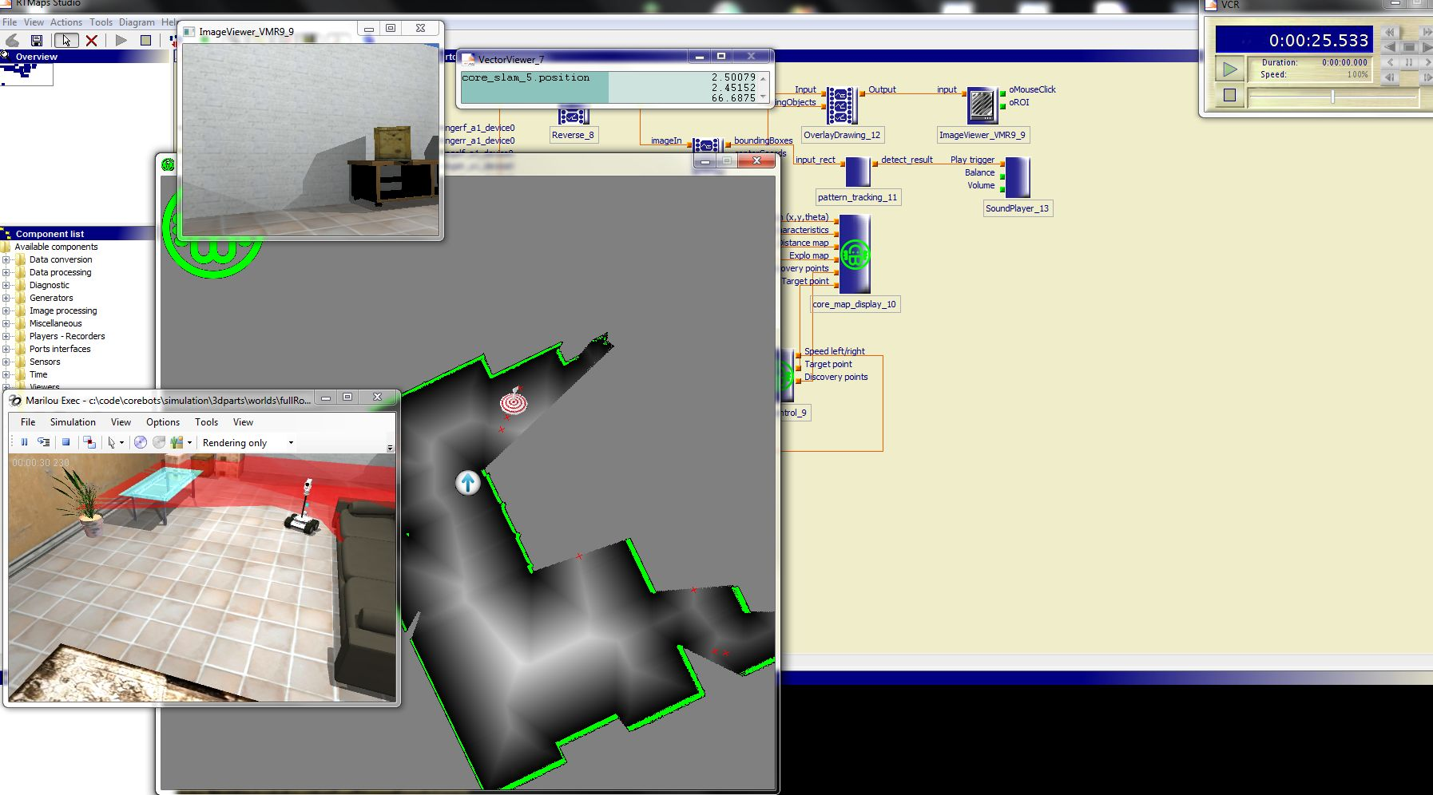
The solution – Algorithm inside playing field
Algorithm
users
Problem
providers
PROTEUS PORTAL

Slide 8
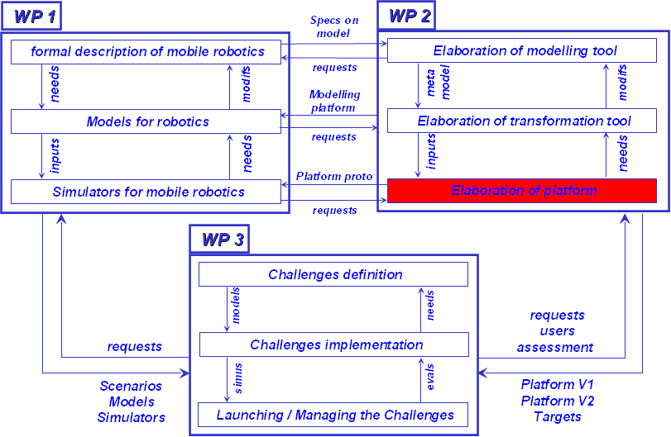
The platform and target architectures
PORTAL interfaces
Eclipse
Simulator
consolidate
Solution
Problem preparation
SW robot modelling
Solution development
Assess and Compare
Problem
Meta-model instanciation
Transformation
Generation
HW robot modelling
Managing external algorithmic modules
Environment modelling
Profil/Meta-model
PROTEUS
Papyrus
Generic services
(moteur physique, séquenceurs, logs, …)
SYSML/MARTE
UML
EMF
GMF
Wrappers
To portal
(potentially) External Algorithmic Modules

Slide 9
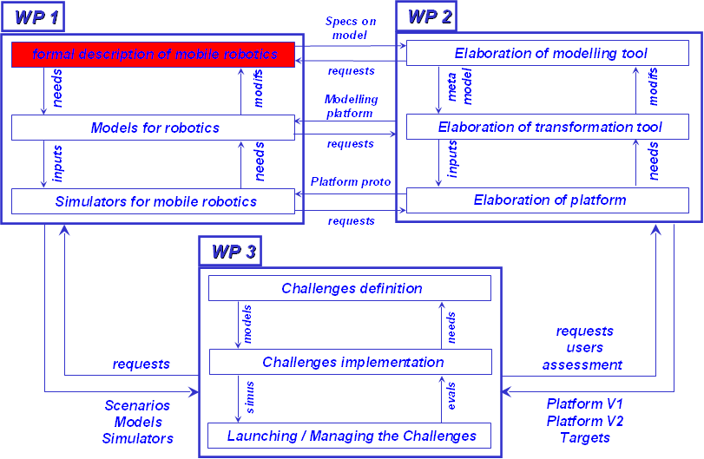
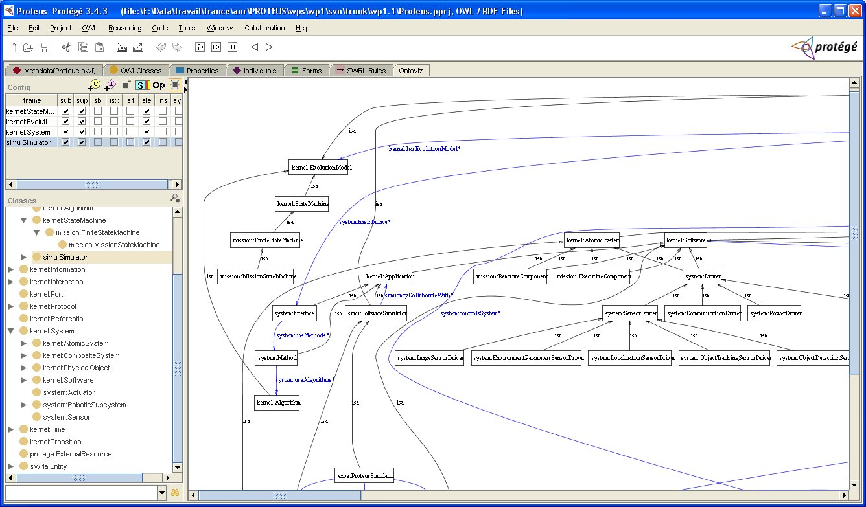


Ontology and Tool used
Ontology - formal representation of :
  a set of concepts within a domain
  the relationships between those concepts
Usage :
  describe the domain
  reason about the properties of that domain
Built through :
  Defininition of a taxonomy
  Structuring it in classes categorising a subject and its dependencies
  Specifying its different components such as Relations, Restrictions and Attributes

Slide 10
Ontology modules stack – a snapshot
EXPERIMENT
It describes the PROTEUS process
… Problem, Solution, Assessment, ...
DEVS
It describes DEVS theory of modelling and simulation
… IO, Lambda, Q, ...
ROBOT
It describes robots
… Atmosphere, LandSurface, Building, Floor, ...
SIMULATION
It describes how system can live inside software, hardware, etc
… Simulation, Probe, providesLifeTo, ...
MISSION
It describes a mission that can be used by the components performing it or for performance assessment
… MissionObjective,MissionType,, ...
SYSTEM
what are the possible systems of a robot
… DeviceSystem,ActuatorSystem, SensorSystem,PowerSystem,, ...
ENVIRONMENT
It describes were the robots evolve and defines
the interactions propagation
… Atmosphere, LandSurface, Building, Floor, ...
INFORMATION
It describe data pieces that can be used in different parts / differents modules
… algorithms, software modules, ...
KERNEL
Generic concepts necessary to describe a scenario:
« A robot moves in and interact with an environment where
physical objects evolve »
… PhysicalObject, Interaction, System, EvolutionModel, ...

Slide 11
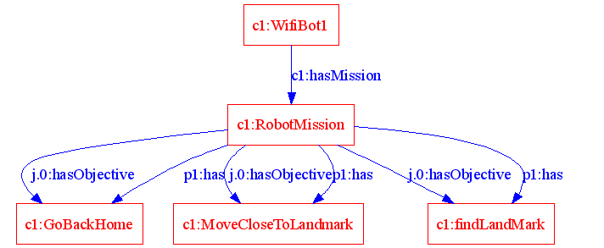
An example of use – the Youth Challenge

Slide 12
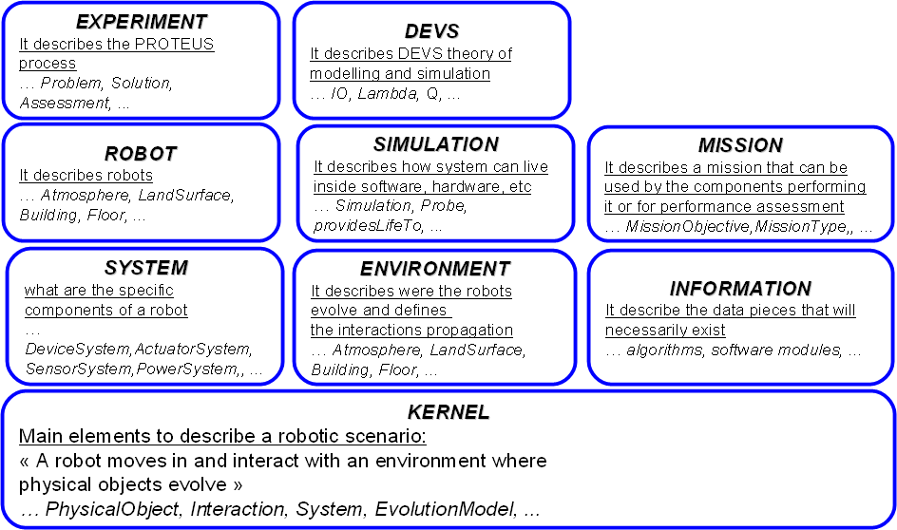
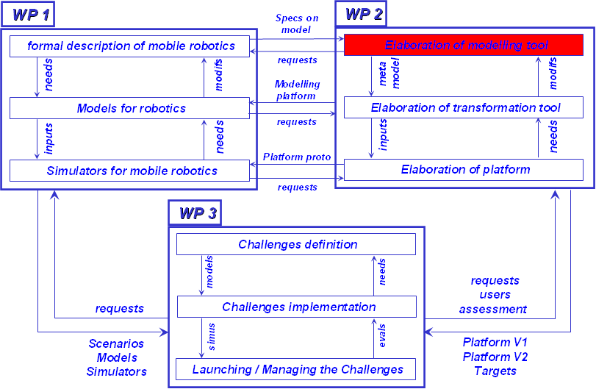
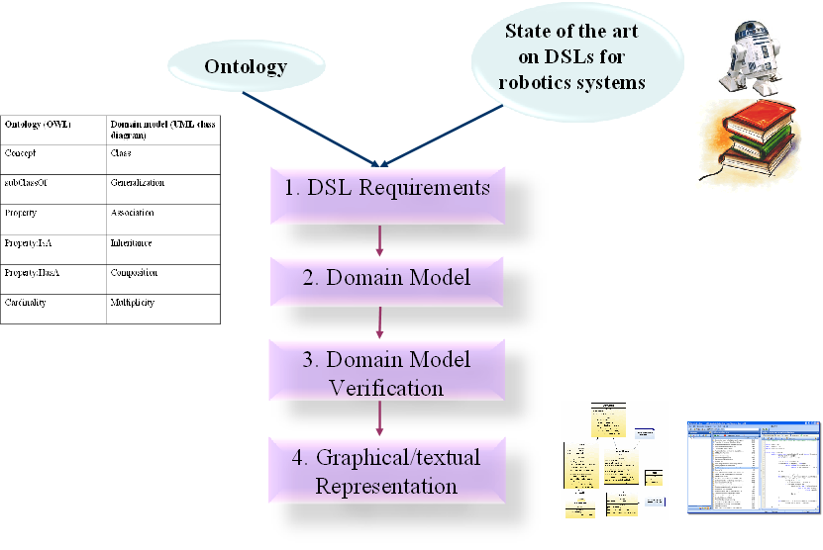
From PROTEUS ontology to PROTEUS DSLs
Notes:
Requirements:
Design of modern robotics systems depends more and more on effective interplay of multiple
disciplines, such as mechanical, control, electronics, and soft-ware engineering. These systems are
compositions of different inter-related parts (also called components), some of which may have
already been designed while others need to be designed. Given their heterogeneous nature, the
parts are typically designed by different design teams, possessing different expertise, and using
different languages and tools. This is often done through vertical design chains such as, for
example, in the avionics and automotive industries. A complete development chain typically
involves a multitude of tools and data that are today still poorly integrated. In particular, the lack
of a common modelling language to specify the overall system architecture hampers reasoning
about solution trade-offs during early development phases. This results in high development costs
due to long feedback cycles for issues uncovered during the integration phase.
Given the importance that sharing knowledge has in system development, we subscribe to the
view that both system design and integration will be reduced significantly by the use of a common
modelling formalism. Defining such common modelling language for the robotics domain is the
purpose of the PROTEUS project.
The domain model is a metamodel of the DSML that contains:
Fundamental language constructs (domain concepts).
Relationships between domain concepts
Constraints that govern how the domain concepts can become valid models.
Concrete syntax of the DSML.
Semantics of the language

Slide 13
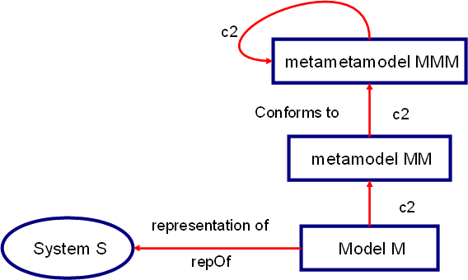

DSL - Domain Specific Language
DSL: Formal language tailored to a specific application domain
Model:
  abstraction of the reality
  only a specific viewpoint on the reality
Semantics not straightforwardly available
[Bézivin, 2010]

Slide 14

The PROTEUS DSLs
Architecture DSL
  specific robotic architectures (reactive, deliberative, hybrid)
  specific components that form those architectures (sensors, actuators, planners)
Control / Communication DSL
  control the robotic components
  ease the definition of communication mechanisms between components (sending/receiving of data, provided/required services)
Algorithms DSL
  algorithms triggered with the “Control & Communication DSL”
  for implementing behaviours in the different components of an architecture described with the “Architecture DSL”

Slide 15
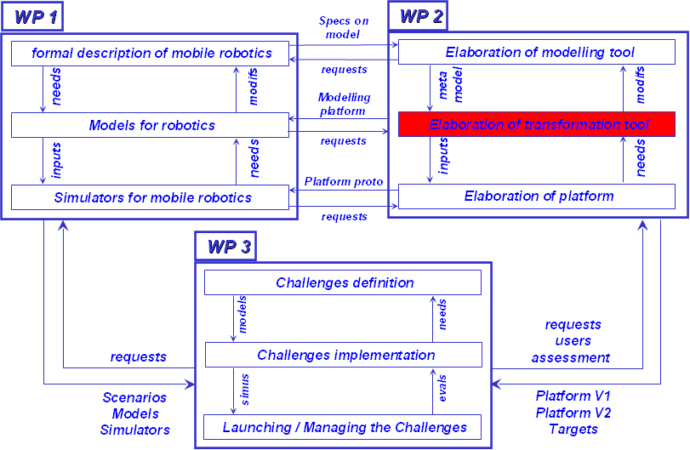


From DSL to Target Architecture (1 / 5)
Objective: to generate executable code from the PROTEUS DSL
Approach
  Mapping between PROTEUS DSL concepts and platform concepts
  Implement code generation as Model-To-Text transformation
Problems and challenges, define agile transformations that resist to :
  Target platform evolution
  DSL evolution
  TOM as a Model Transformation Language

Slide 16
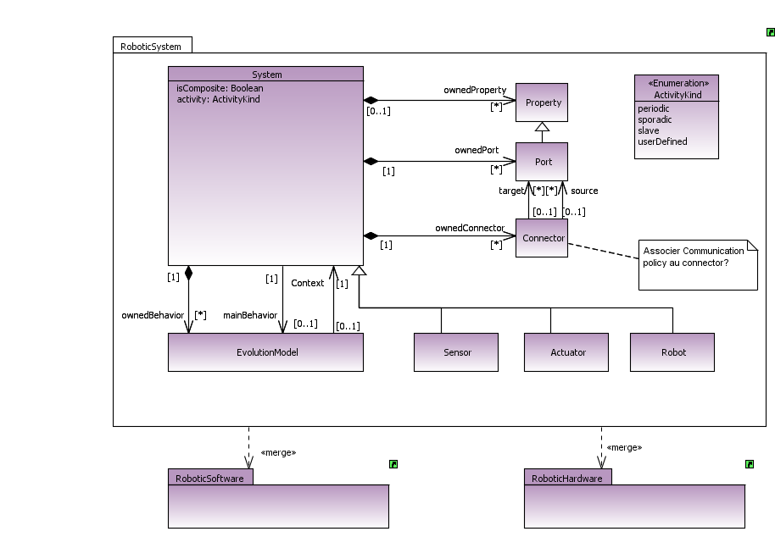
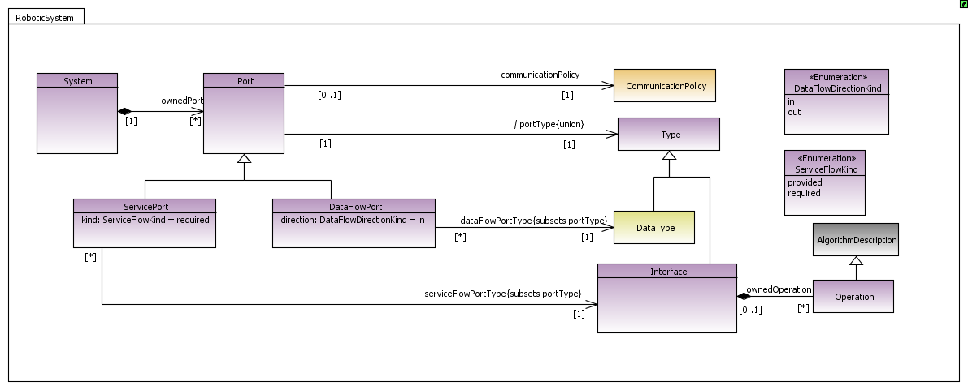
From DSL to Target Architecture (2 / 5)
DSL PROTEUS Concept | Orocos Code
Component | class MyC : public TaskContext {..}
DataFlowPort | // Input port InputPort<double> inPort; // Output ports OuputPort<double> outPort public: // ... MyC(std::string name): TaskContext(name) { .. this->ports()->addPort( "inPort", inPort ).doc( "Idoc." ); this->ports()->addPort( "outPort", outPort ).doc( "doc." ); ... }
..... | .....

Slide 17
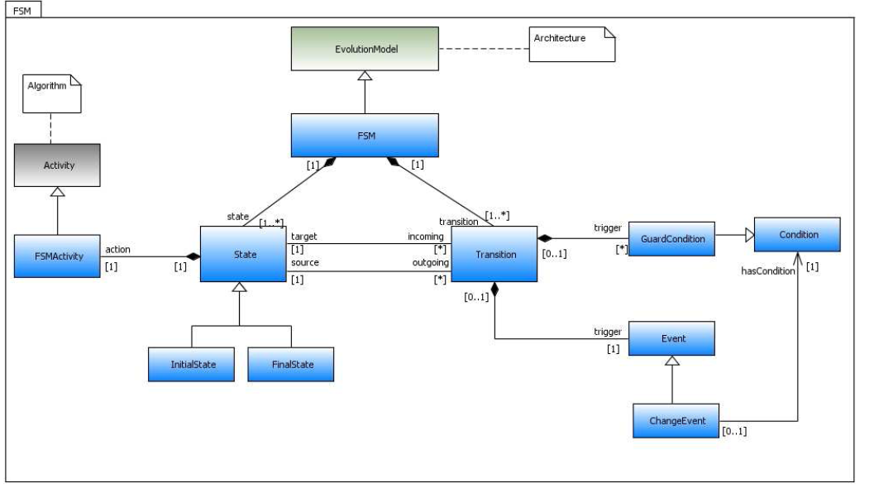
From DSL to Target Architecture (3 / 5)
DSL Proteus Concept | Orocos Code
FSM | StateMachine MyStateMachineDefinition { initial state myInit { // all these programs are optional and can be left out: entry { // entry program } run { // run program } handle { // handle program } exit { // exit program } // Ordered event based and conditional select statements transition ... { /* transition program */ } select ... transition ... } final state myExit { entry { // put everything in a safe state. } // leave out empty programs... transition ... } state Waiting { // ... } // ... repeat }

Slide 18
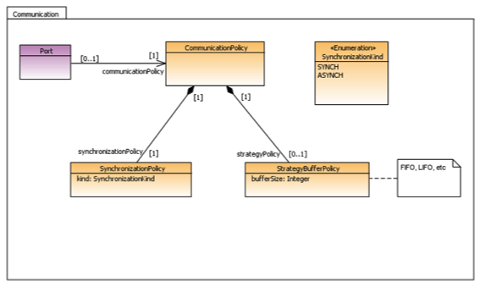
From DSL to Target Architecture (4 / 5)
DSL Proteus Concept | Orocos Code
CommunicationPolicy | // Create a connection with a buffer: ConnPolicy policy = RTT::ConnPolicy::buffer(10); a_port.connectTo( &b_port, policy ); // Create an unbuffered 'shared data' connection: policy = RTT::ConnPolicy::data(); a_port.connectTo( &b_port, policy ); b_port.connectTo( &a_port, policy ); // ok... c_port.connectTo( &a_port, policy ); // fine too.

Slide 19
From DSL to Target Architecture (5 / 5)
public class CompilatorOrocos{
%include{DSLProteus.tom}
%include { sl.tom }
%include{dom_1_5.tom}
%include { string.tom }
%strategy generateOrocosCode() extends Fail() {
visit Component {
Component(name, provided , required, hasPort)-> {
//Apply the mapping rule : Component
%match (hasPort){
PortEList(_*,port,_*)->{
//Apply the mapping rule : Port=
%match(provided){
InterfaceEList(_*,Interface(_,operations),_*)->{
//Apply the mapping rule : Interface
}
}
visit Fsm{
Fsm(name,state, transition)->{
//Apply the mapping rule : Finite state machines
}
}
}
Fragment of TOM code

Slide 20
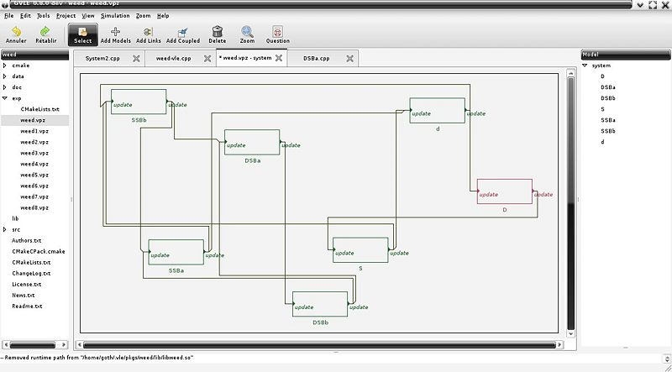
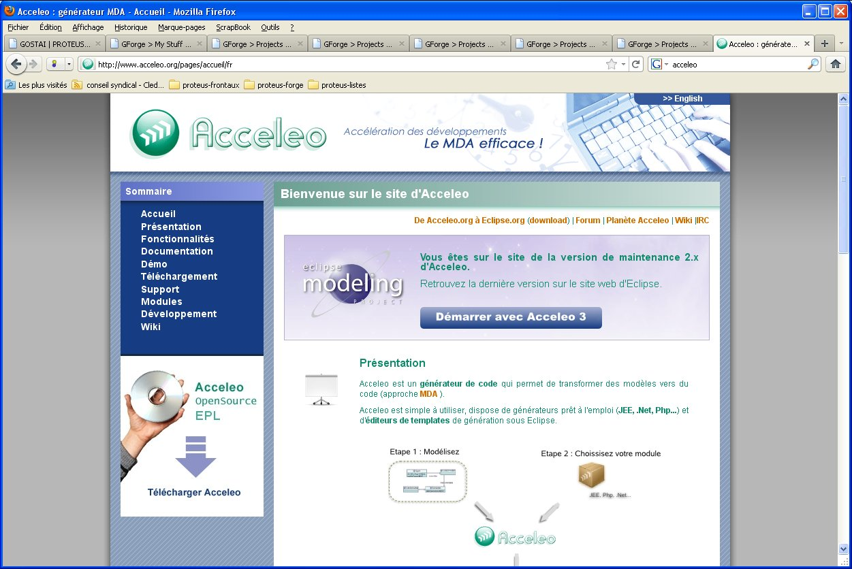
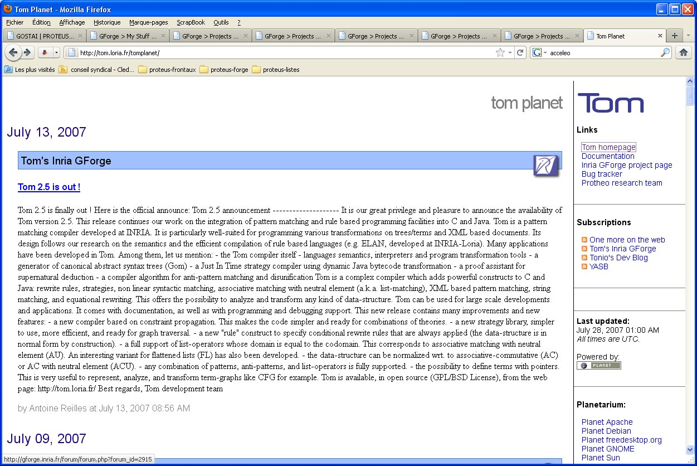
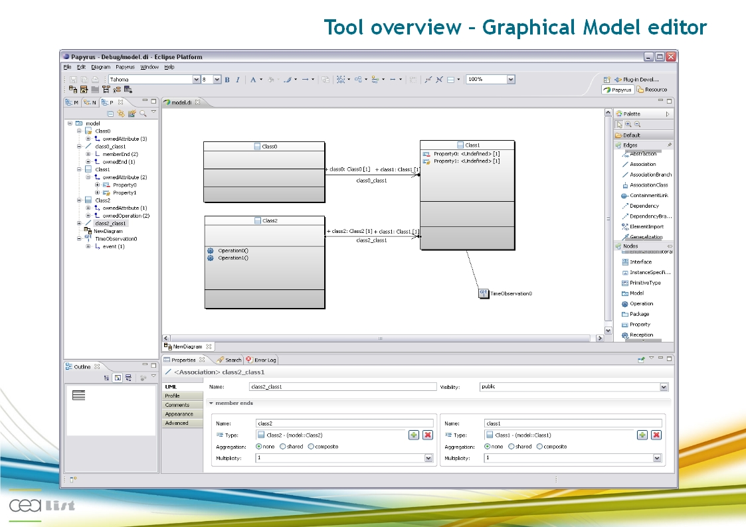
PROTEUS Platform
Eclipse
consolidate
Virtual Laboratory Environment
Problem preparation
Solution development
Assess and Compare
Meta-model instanciation
Transformation
Generation
Acceleo
TOM
Profil/Meta-model
PROTEUS
Managing external algorithmic modules
Papyrus
SYSML/MARTE
UML
EMF
GMF

Slide 21
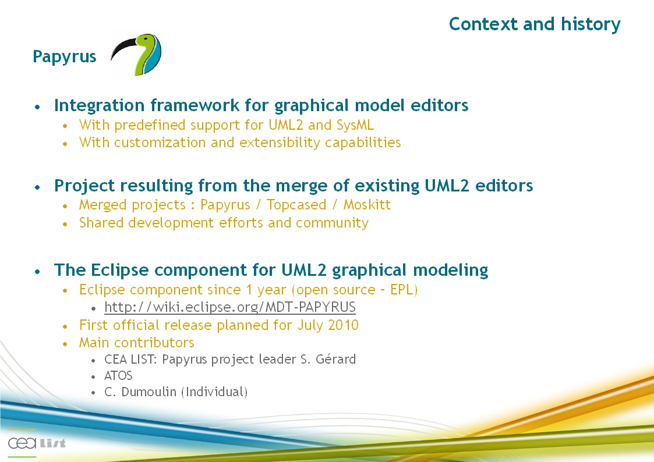
PROTEUS Platform – Papyrus foundation

Slide 22
Target architecture
Behaviours
Simulation engine
Simulation structure
ALF external algorithms modules
(wrapped in ROS components)
One Robot for example
Robotic middlewares
Arocam/Orocos/RTMaps/Urbi/ROS
ROS communication bus
One component and its dynamic
Internal algorithms
External algorithms modules (C/C++/MATLAB)
Coupling between component&behaviour
General services
(physical engine, scheduling, logs, …)

Slide 23
Targeted Simulators (PROTEUS project)
MORSE
  Standard open-source simulation engine of PROTEUS
  Main dev: LAAS (France) + other contributors
  Based on Blender 2.57, physical game engine (Bullet)
  Python scripting, API for MORSE/Blender objects
  Integration with ROS middleware (middleware agnostic)
  Sensors/actuators already built in MORSE: 8 types of actuators&10 classes of sensors
  Website: http://morse.openrobots.org/
  Example:morse video
Cycab-TK
  Alternate open-source simulation engine of PROTEUS
  Main dev: INRIA (France)
  Used mgengine (INRIA) based on Bullet physical engine
  Scripting in LUA, Blender data imports
  ROS integration (Work in progress)
  Website: cycabtk.gforge.inria.fr

Slide 24
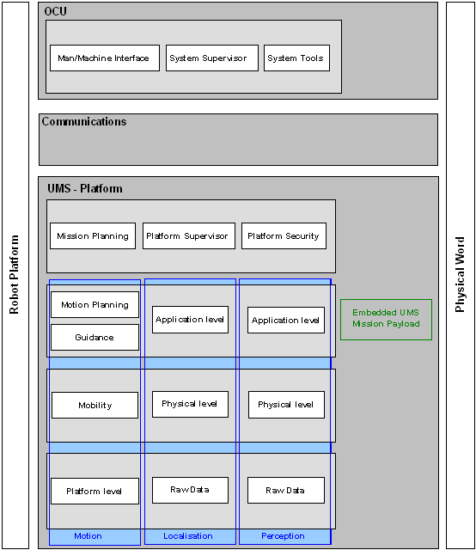
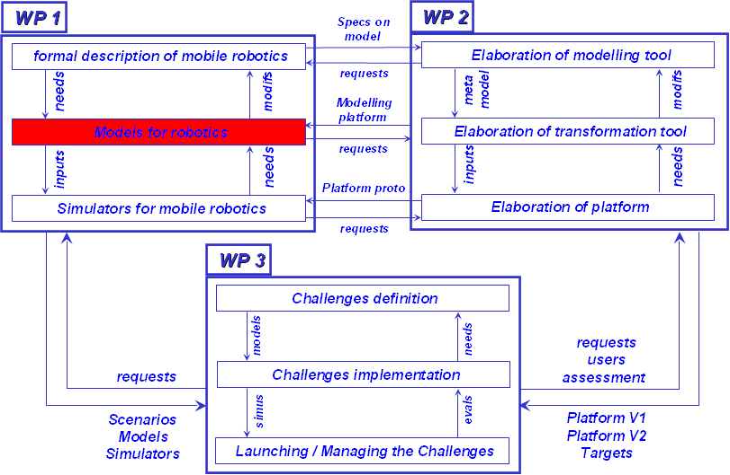
Functional Models

Slide 25
Conclusions
Many products are available or almost in preliminary versions
  Ontologies
  Meta-model
  Platform definition
  …
Many things remains to be done
  Meta-model consolidation
  Complete life cycle instanciated
  ...
PROTEUS – WORK IN PROGRESS

Slide 26
Discussions
QUESTIONS / REQUESTS
  Things to add ?
  Review of ontologies – available by summer – help requested
  Review of DSLs – available end of the year – help will be requested
  Interactions with other projects
  ...
PROTEUS – ONLY A FIRST STEP

Slide 27
Platform for RObotic modeling and
Transformations for End-Users
and Scientific communities
Presentation to the Advisory Board
-
Year 1
Supplementary slides
Advisory Board
Ecole des Mines, Paris
20th of April, 2011
http://www.anr-proteus.fr

Slide 28
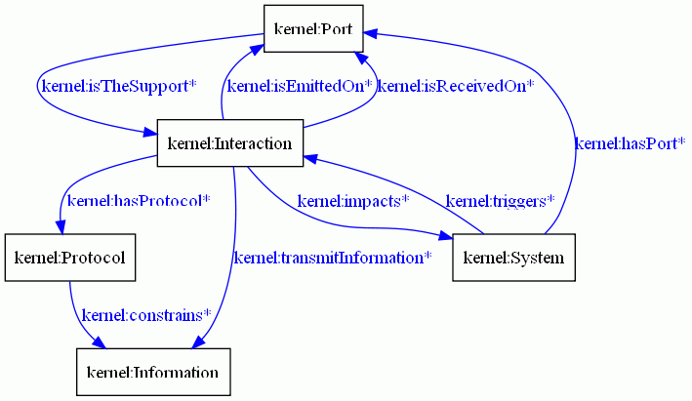
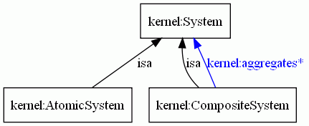
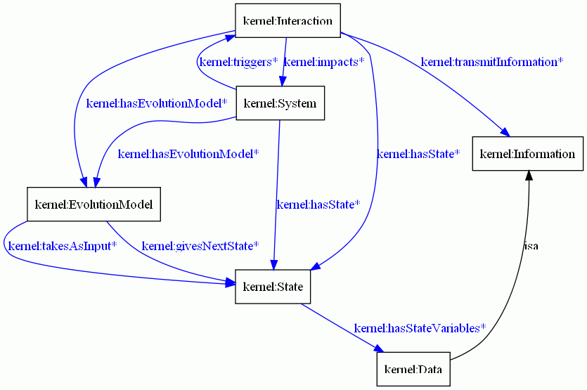
KERNEL – some key concepts
System boudaries
Capability to get / send info
Composition
Capability to build imbricated blocs
System evolution
Capability to live

Slide 29
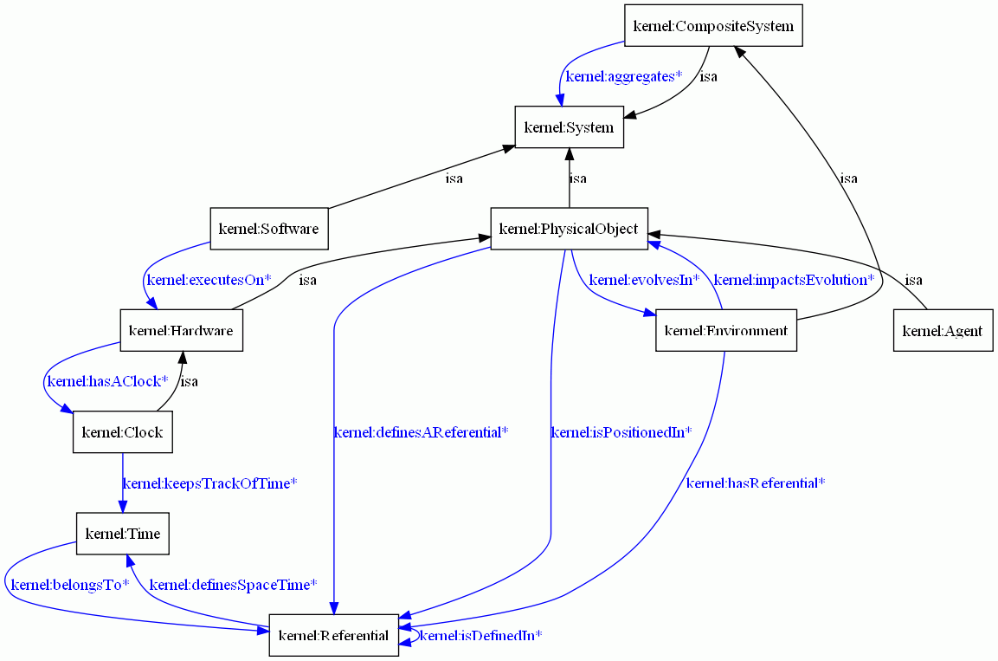
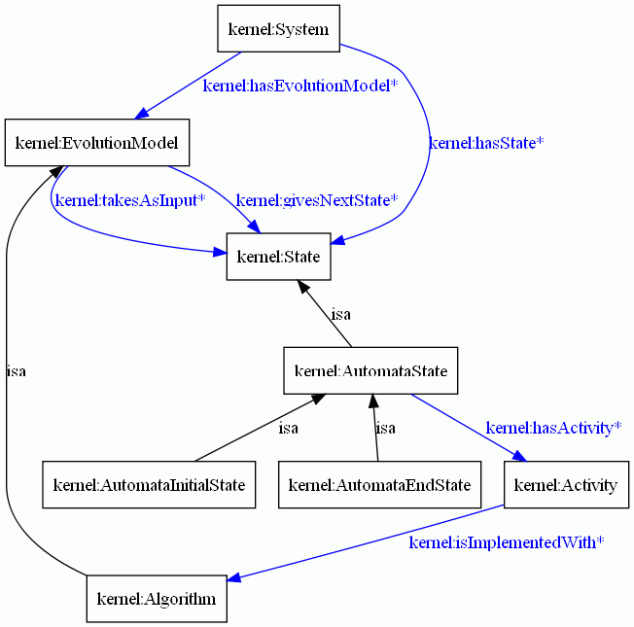
KERNEL – some key concepts
Object of the world
First set of living objects
Generic evolution model
The finite state machine

Slide 30
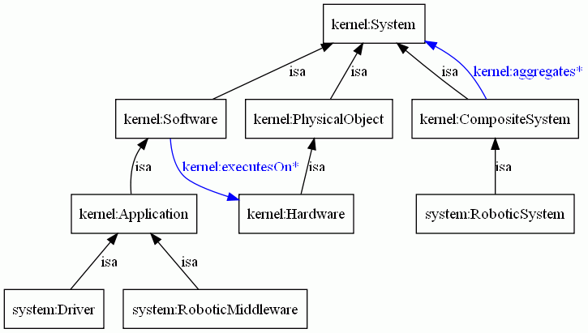
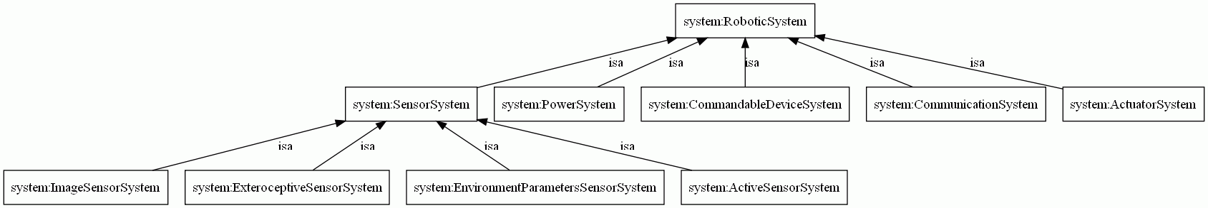
SYSTEM – some key concepts
Robot system main cocepts
Most important mechanisms
Robot system first list
zoology

Slide 31
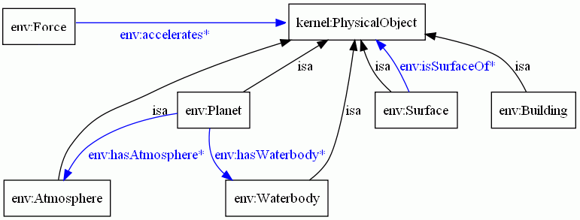
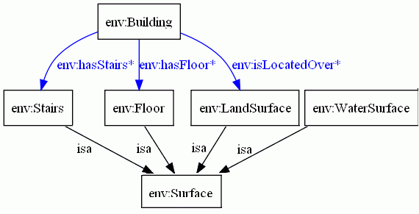
ENVIRONMENT – some key concepts
Environment description concepts
Surface concept description

Slide 32
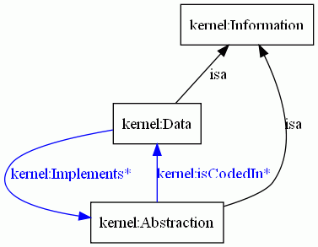
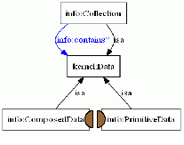
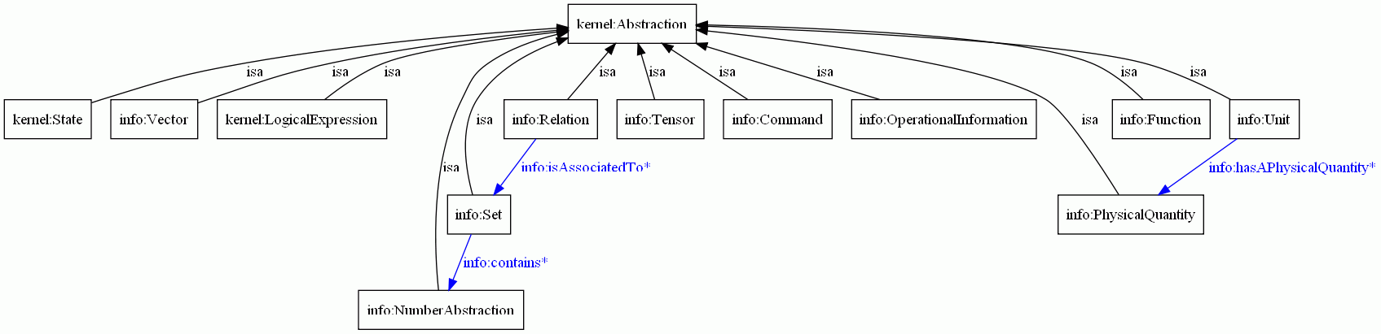
INFORMATION – some key concepts
Information and data for exchanges and descriptions of properties
Includes a zoology
Relationship abstraction and implemented information
Decomposition of data
Decomposition of abstract information concept

Slide 33
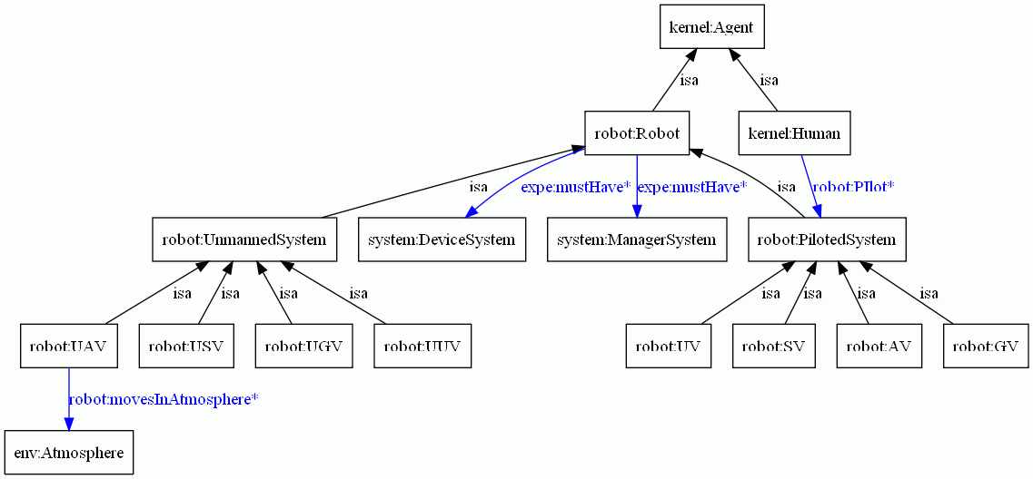
ROBOT – some key concepts
Robot categorisation
Most common classes and some properties

Slide 34
SIMULATION – some key concepts

Slide 35
MISSION – some key concepts

Slide 36
EXPERIMENT – some key concepts

Slide 37
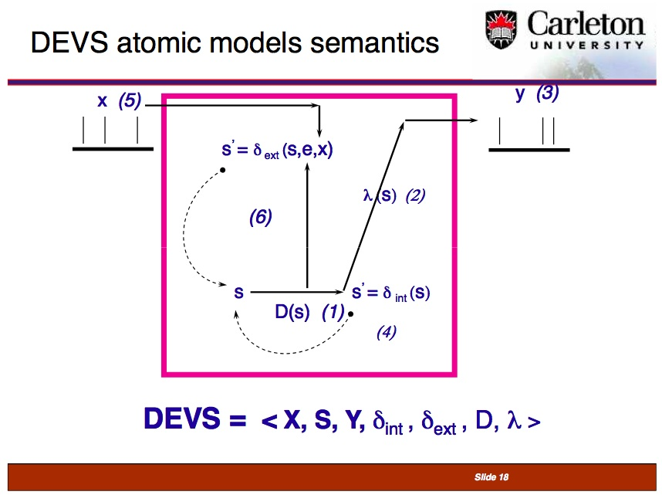
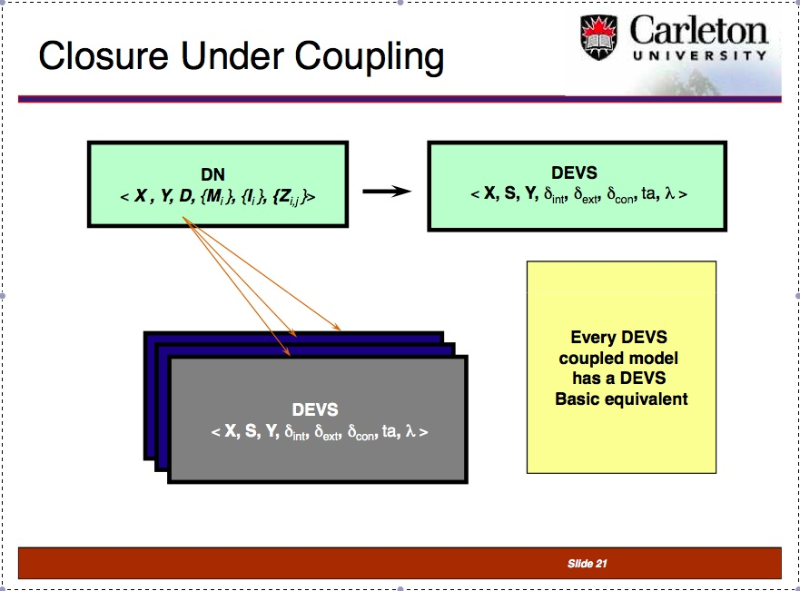
DEVS – some key concepts

Slide 38
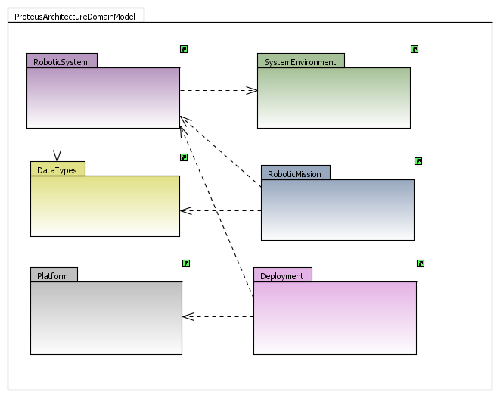
The PROTEUS Architecture DSL (1 / 3)

Slide 39
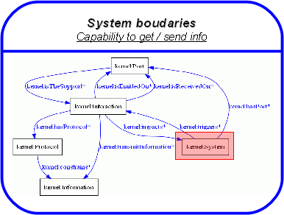
The PROTEUS Architecture DSL (2 / 3)

Slide 40
The PROTEUS Architecture DSL (3 / 3)

Slide 41
The PROTEUS Control DSL (1 / 3)
Finite State Machine to specify behaviour of System

Slide 42
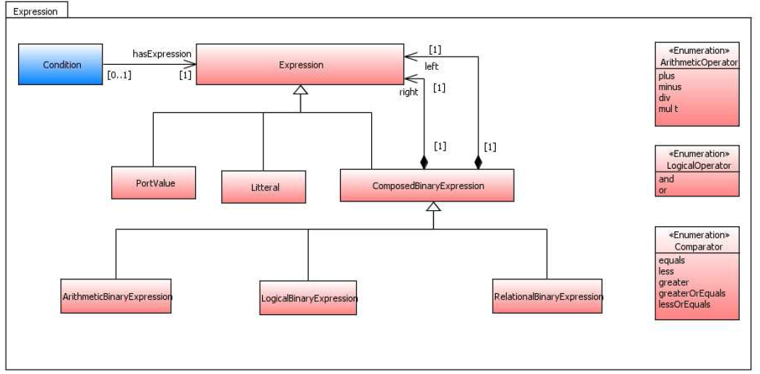
The PROTEUS Control DSL (2 / 3)
Expression to specify conditions on FSM transitions
Finite State Machine to specify behaviour of System

Slide 43
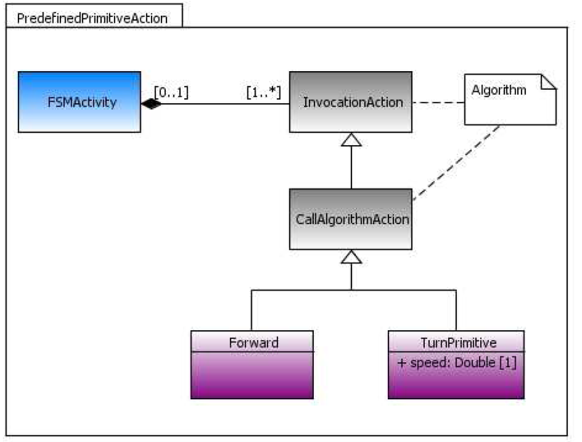
The PROTEUS Control DSL (3 / 3)
FSM triggers actions defined using DSL Algo

Slide 44
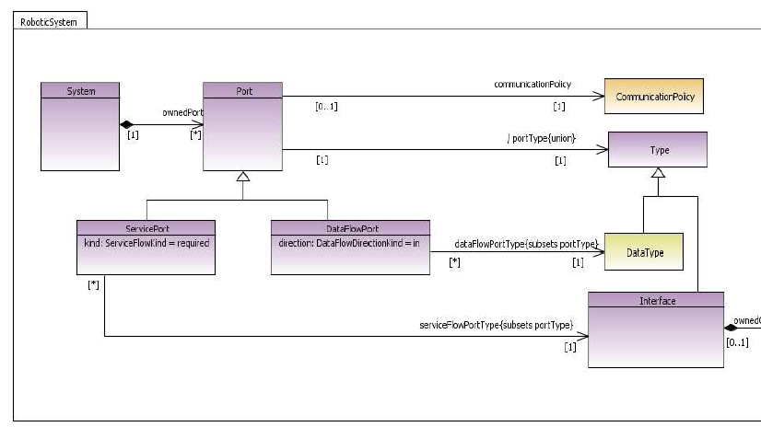
The PROTEUS Communication DSL
DataFlowPort and ServiceFlowPort to specify communications.

