Slide 1
Reverse Engineering
Mostly with Ghidra

Slide 2
Reverse Engineering Tools
IDA Pro
Gold standard for 20 years
Expensive – requires licenses for each CPU you want to decompile
Ghidra
Free and on-par with IDA Pro
BinaryNinja
Built by CTF players
Highly scriptable with Python

Slide 3
Reverse Engineering Tools (cont’d)
Radare2
Open-source community loves this tool
Painful for large projects
Hopper Disassembler
OSX is the main platform
Good with ObjectiveC programs
Objdump and other static disassemblers

Slide 4
Disassembling vs Decompiling
Disassembling = Machine code to assembly
Decompiling = Machine code to C code
Much harder task
Usually, the tool lifts the native code to an intermediate language and decompiles from there
Many different intermediate languages – every tool seems to use it’s own IL

Slide 5
Dynamic Analysis
Linux
GDB
Windows
Windbg – Native Microsoft
OllyDbg
Last release 8 years ago
https://www.ollydbg.de/
x64dbg
Actively maintained
https://x64dbg.com/
Unicorn emulator – scriptable Python CPU emulator

Slide 6
RE Objectives
Add enough context to understand the code
Information is lost during compilation to native code
Compiler does not leave the data types of code
Compiler can re-use register variables as temporaries
Compiler can optimize and inline code

Slide 7
Main actions
Follow the data
Identify data types and structure usage/layout
Labeling
Provide a name to functions
Provide a name to function arguments
Provide a name to variables (stack, globals, heap)
Add comments
Use search and cross-references effectively
Augment with dynamic analysis

Slide 8
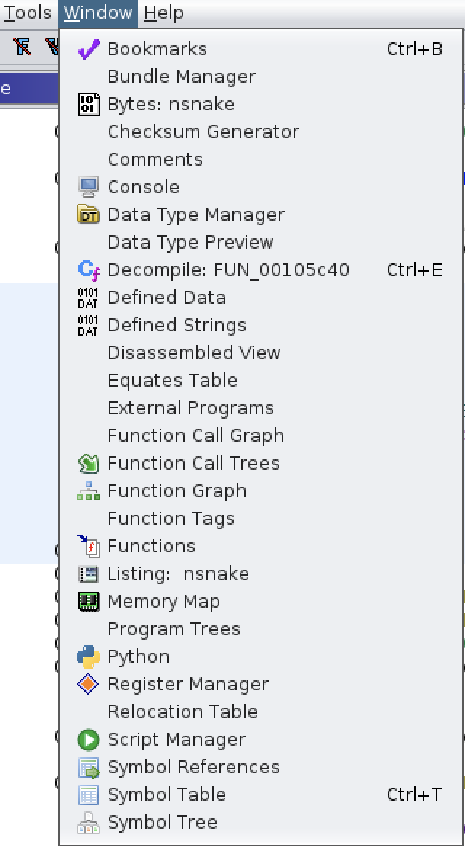
Ghidra Windows
Listing – aka Disassembly or dead listing
Function Graph
Decompiler
Useful:
Defined Strings
Function Call Trees

Slide 9
Ghidra Window Rearrangement
Drag the bar with the window title
You can make split windows
You can also make tabbed windows

Slide 10
Ghidra Debugger
This is a separate tool
You can connect to local or remote debugger
Console can be weird on Linux when the program you are debugging wants user input

Slide 11

Next Steps
Start reverse engineering CTF binaries
Get the Ghidra book
Go through the built-in Ghidra training
In the Ghidra zip file: docs/GhidraClass
3 Classes in there

