Slide 1
Intro to x86 Part 2: Writing, Compiling and Analyzing x86
Updated slides 2021/2022
Slides derived from content made by Xeno Kovah – 2009/2010
xkovah at gmail

Slide 2
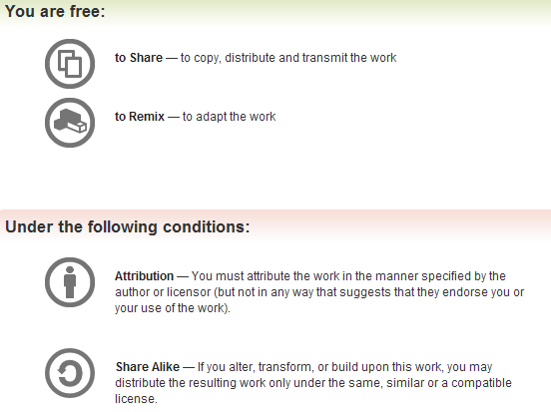
All materials is licensed under a Creative Commons “Share Alike” license.
http://creativecommons.org/licenses/by-sa/3.0/

Slide 3
Intel vs. AT&T Syntax
Intel: Destination <- Source(s)
  Windows. Think algebra or C: y = 2x + 1;
  mov ebp, esp
  add esp, 0x14 ; (esp = esp + 0x14)
AT&T: Source(s) -> Destination
  *nix/GNU. Think elementary school: 1 + 2 = 3
  mov %esp, %ebp
  add $0x14,%esp
  So registers get a % prefix and immediates get a $
By default gdb displays in ATT syntax, however most gdb tools for RE/VR display in Intel syntax, as well as many writeups.
It’s important to be versed in both, so you're prepared to encounter either format.

Slide 4
Intel vs AT&T Syntax 2
In my opinion the hardest-to-read difference is for r/m32 values
For intel it’s expressed as
  [base + index*scale + disp]
For AT&T it’s expressed as
  disp(base, index, scale)
Examples:
  call DWORD PTR [ebx+esi*4-0xe8]
  call *-0xe8(%ebx,%esi,4)
  mov eax, DWORD PTR [ebp+0x8]
  mov 0x8(%ebp), %eax
  lea eax, [ebx-0xe8]
  lea -0xe8(%ebx), %eax
Notes:
And some versions of the gnu tools, instead of using like “mov -0x4(%ebp)” will show it as “mov 0xFFFFFFFC(%ebp)”
Some more links talking about the differences
http://www.w00w00.org/files/articles/att-vs-intel.txt <- haxors ;)
http://en.wikipedia.org/wiki/X86_assembly_language
http://sig9.com/articles/att-syntax

Slide 5
Intel vs AT&T Syntax 3
For instructions which can operate on different sizes, the mnemonic will have an indicator of the size.
  movb - operates on bytes
  mov/movw - operates on word (2 bytes)
  movl - operates on “long” (dword) (4 bytes)
Intel does indicate size with things like “mov dword ptr [eax], but it’s just not in the actual mnemonic of the instruction

Slide 6
Syscalls- x86
Syscalls offer a method to invoke and use functionality in the operating system.
Place syscall number in eax
Parameter # | Register
Parameter 1 | EBX
Parameter 2 | ECX
Parameter 3 | EDX
Parameter 4 | ESI
Parameter 5 | EDI
Parameter 6 | EBP
Load parameters in registers
Invoke with “INT 0x80”
2 pretty important syscalls for us in exploit world- system() and execve()!
NOTE: The calling convention for syscalls are different on other architectures, this would even include x64 which uses the SYSCALL instruction instead of INT 0x80.
Resource: https://securityboulevard.com/2021/05/linux-x86-assembly-how-to-build-a-hello-world-program-in-nasm/

Slide 7
How to Find Information on Syscalls?
We need to load a syscall number into EAX for the syscall we want to invoke, but how do we know which numbers relate to what syscall? There are several ways to obtain this information. Here are a few methods:
Linux Kernel Headers
  The most absolute source of truth, but also not the easiest method to get what you’re looking for
Web resources
  https://syscalls.w3challs.com/ is an amazing resource for this
  Has a table view of syscalls, the parameters it expects, and the register configuration
  They have several architectures and OSes covered here
  https://syscalls.w3challs.com/?arch=x86 is the one to look at for Linux 32-bit x86 syscalls.
Resource: https://securityboulevard.com/2021/05/linux-x86-assembly-how-to-build-a-hello-world-program-in-nasm/

Slide 8
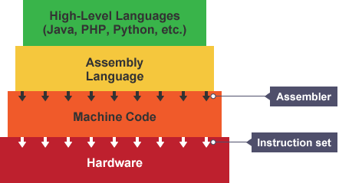
Assembling
Assemblers
  Used to compile assembly language into machine code, aka object files
  Nasm- Our main focus cus I like Intel ☺
    “.asm” extension
    Intel syntax
  As/GCC
    “.s” extension
    Usually in AT&T syntax, so not used as often
    Can make it use Intel syntax like so:
      gcc -S -masm=intel test.c
Resources:
https://cs.lmu.edu/~ray/notes/x86assembly/, https://www.bbc.co.uk/bitesize/guides/zgmpr82/revision/2

Slide 9
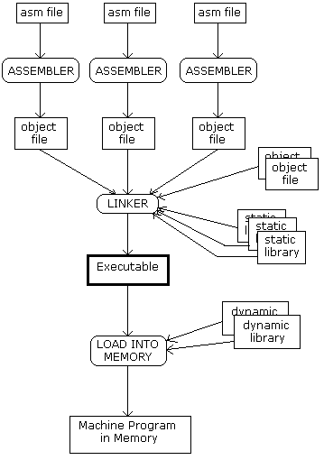
Linking
Linkers
  Used to link together all the object files created from the assembly stage to form an executable
  There are 2 types of linking
    Dynamic linking- Shareable libraries are simply referenced at compile time to be loaded later.
      Requires less space for the executable and multiple programs can share one reference to the required library code
    Static linking- All object files required during execution, including shareable libraries, are included during compile time
      Makes the binary larger but more portable. Since all libraries are included with the executable, this avoids errors/failures related to bad library references between machines.
  Ld is the tool we will be using to link our objects
https://www.geeksforgeeks.org/linker/

Slide 10
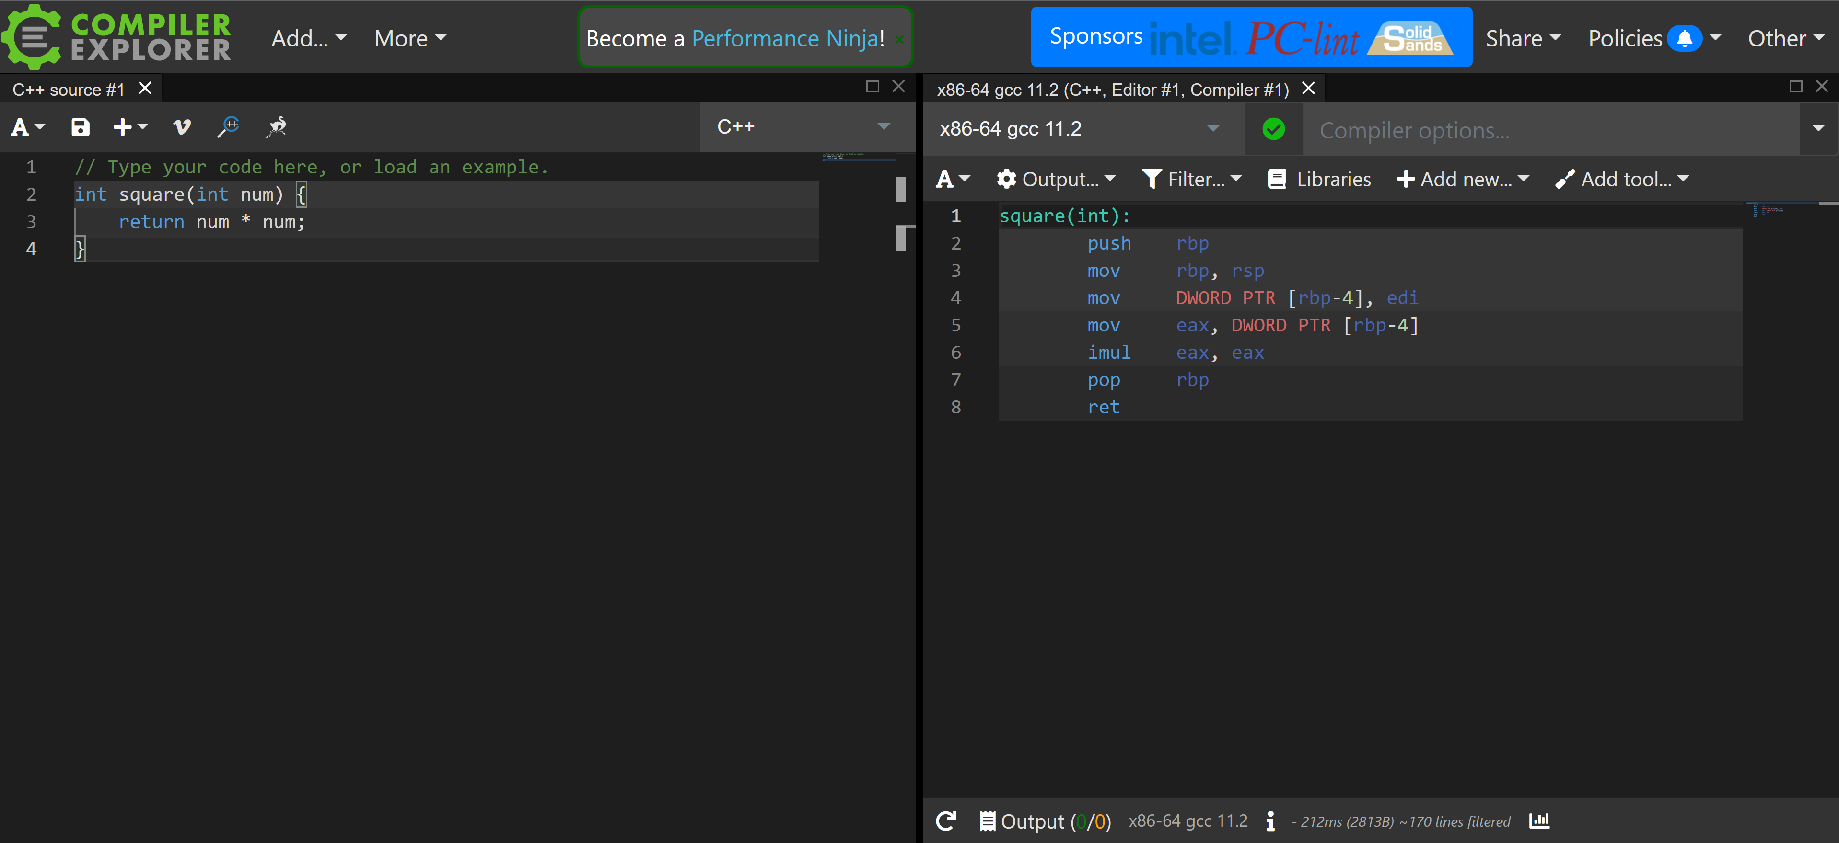
Godbolt
If you are interested in trying out other ways to compile assembly or other archtiectures you can visit godbolt.org!
You can provide it a C/C++ program and it will output the assembly for that code
This is a helpful tool for learning other architectures!

Slide 11
x86 Program Layout
global _start ; this tells the linker where to go when our program starts
section .data ; this is where we would put strings and other variables
<variables>
section .text ; this is the section where we put our instructions
_start: ; _start label indicating what instructions we begin executing at
<instructions> ; where we put assembly we want to run from start
You can declare strings in the .data section using the following format
  <string_label>: db “string contents”
  Refer to strings by their label when you need to reference them in your assembly
  db = data in bytes, 8 bits
    Other data types (dd- double word, 32 bits, dw- word, 16 bits)
You can use semicolons to write comments next to your lines of assembly!

Slide 12
Build x86 using nasm
After we write a .asm file how do we get it to execute?
Commands for building with nasm
  nasm -f elfX32 exit_nasm.asm
    You can see other architectures nasm will compile for by passing the “–hf” option
  ld -m elf32_x86_64 exit_nasm.o -o exit_nasm
  Check your work!
    objdump -d -M intel exit_nasm
      Option “-d” tells objdump you want to see the disassembly
      the “-M” option allows you to specify the syntax you would like to see your dissassembly in. Since we are writing our assembly in intel, this would be our preferred output syntax for comparison!

Slide 13
Example exit(0)
Let’s write some assembly in a .asm file that will only do the exit syscall!
global _start
section .data ; this is where we would put strings etc.
exit_code: db 0 ; change this value to change the exit code
section .text ; this is the section where we put our instructions
_start: ; the starting point for our code to begin executing
mov al, 1 ; move syscall number into eax
mov ebx, [exit_code] ; load error code as param 1
int 0x80 ; interrupt/trap to call the syscall
Open a file with a .asm extension and copy the code above
Compile using nasm commands
After linking your executable, run it!
You can check the exit code by typing “$?” and hitting enter in the terminal
Now change the value of exit_code loaded into ebx and check your exit code again! Did it change?

Slide 14
Strace/Ltrace
Ltrace traces function calls to methods defined in other libraries imported to your binary
  Ltrace gives you the order in which library functions are executing, so that can be helpful to see the flow of the program
  Sometimes you can use this tool to get a list of functions and their addresses for which you might like to overwrite for your exploit
    there are some security mitigations that might limit this approach
Strace traces system calls and signals that are executing/occurring in your binary
  You can use strace to do some reversing on binaries doing things with networking and file paths to get a big picture of what the binary is trying to do when it interacts with the outside world
    I’ve used this to troubleshoot if my exploit was invoking a shell with system()/execve()

Slide 15
File- command to see information stored file header
Different file types have associated magic bytes at the front
  Past CTFs have used this to obfuscate the actual contents of files
Use this command to get an idea of what you're up against
  What architecture is the program written in?
    ARM? X86?
    32 bit or 64 bit?
  Is the file stripped? AKA does it contain debugging symbols?
    Why is this important? Makes it easier to reverse a binary if you can get an idea of what the functions are doing because of their names
    Symbols make it easier to reverse and make the file larger- symbols can be removed with the tool “strip”
  Is the file statically/dynamically linked?
    Sometimes static linking can make reversing a little more difficult if symbols are stripped
      if dynamically linked you can at least get an idea of what dynamic functions a binary is calling, you can use tool “ldd” to see the libraries imported
      IDA Flirt keeps can help you identify these functions though

Slide 16
objdump - display information from object files
Where ”object file” can be an intermediate file created during compilation but before linking, or a fully linked executable
  For our purposes means any ELF file - the executable format standard for Linux
The main thing we care about is -d to disassemble a file.
Can override the output syntax with “-M intel”
  Good for getting an alternative perspective on what an instruction is doing, while learning AT&T syntax
Notes:
More details in the manpage, available by typing “man objdump” on a *nix system
Aside: the equivalent on Mac OS X is otool.

Slide 17
hexdump & xxd
Sometimes useful to look at a hexdump to see opcodes/operands or raw file format info
hexdump, hd - ASCII, decimal, hexadecimal, octal dump
  hexdump -C for “canonical” hex & ASCII view
  Use for a quick peek at the hex
    Even quicker peek, say you just want to look at the header of the file for “magic bytes”, pipe output to “less”
      Hexdump exit_nasm | less
xxd - make a hexdump or do the reverse
  Use as a quick and dirty hex editor
  xxd exit_nasm > exit.dump
  Edit hello.dump
  xxd -r exit.dump > exit_nasm
Notes:
More details in the manpage, available by typing “man hexdump” and “man xxd” on a *nix system

Slide 18
Homework 1: Lab0
Go into lab0 and run the following commands on the binary file exit_nasm:
  file
  strace
  objdump
  hexdump (pipe to less)
  xxd
    Create a hexdump then reverse it back to a binary

Slide 19
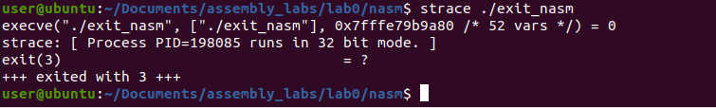
Strace
trace system calls and signals
Strace traces system calls and signals that are executing/occurring in your binary
Run the command strace with your binary to see what syscalls your program is calling Command “strace ./exit_nasm”
  What do you see?

Slide 20
objdump -d exit_nasm
exit_nasm: file format elf32-i386
Disassembly of section .text:
08049000 <_start>:
8049000: b0 01 mov $0x1,%al
8049002: 8b 1d 00 a0 04 08 mov 0x804a000,%ebx
8049008: cd 80 int $0x80

Slide 21
objdump -d -M intel exit_nasm
exit_nasm: file format elf32-i386
Disassembly of section .text:
08049000 <_start>:
8049000: b0 01 mov al,0x1
8049002: 8b 1d 00 a0 04 08 mov ebx,DWORD PTR ds:0x804a000
8049008: cd 80 int 0x80

Slide 22
Quick GDB Overview
We are using pwndbg as a gdb plugin!
  Pwndbg- “GDB plug-in that makes debugging with GDB suck less, with a focus on features needed by low-level software developers, hardware hackers, reverse-engineers and exploit developers.”
  Find out more information about pwndbg here:
    https://github.com/pwndbg/pwndbg
    https://blog.xpnsec.com/pwndbg/
Run the command “gdb ./exit_nasm” in a terminal in your dev machine. The pwndbg plugin will automatically be loaded!
Run the program to the first instruction and break by running the command “starti”.
  This will stop the program on your first instruction under the _start label

Slide 23
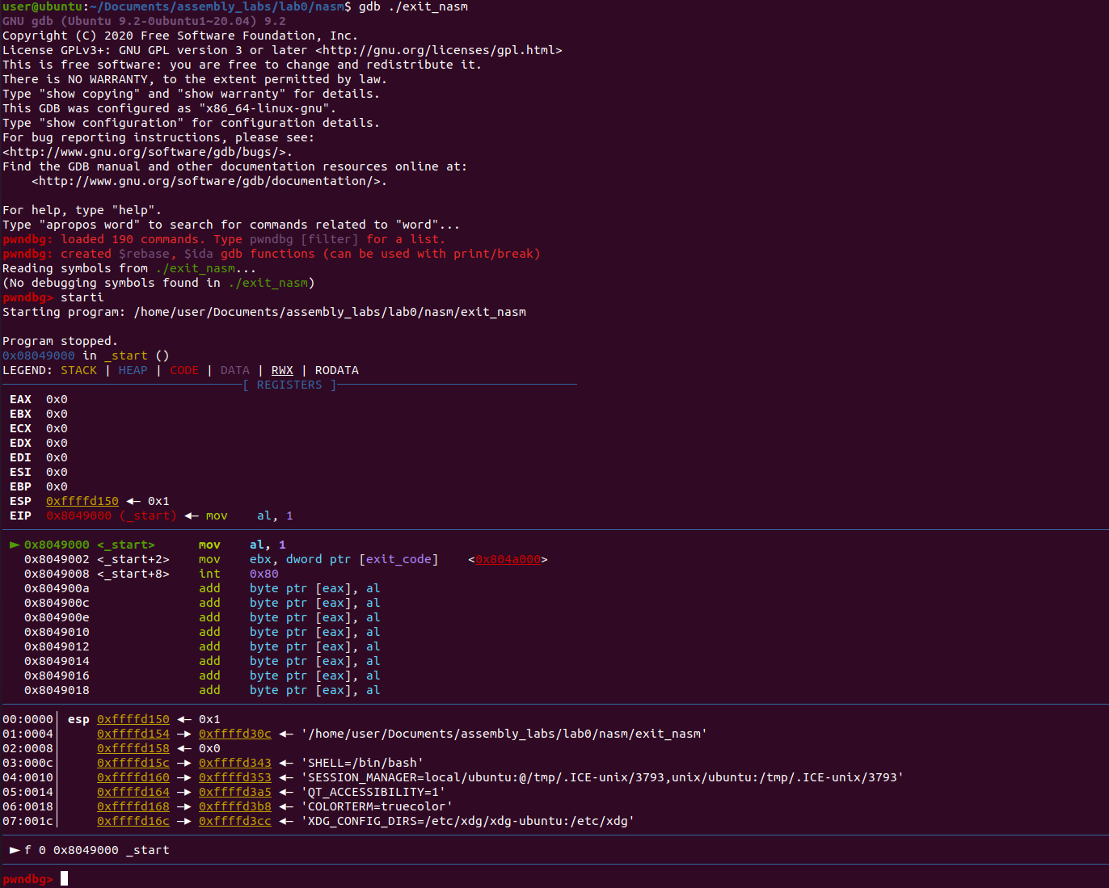
Quick GDB Overview
“Starti” command breaks on the first mov instruction for our exit() syscall instructions
Register contents
Current instruction and instructions to follow
Visualization ofthe stack

Slide 24
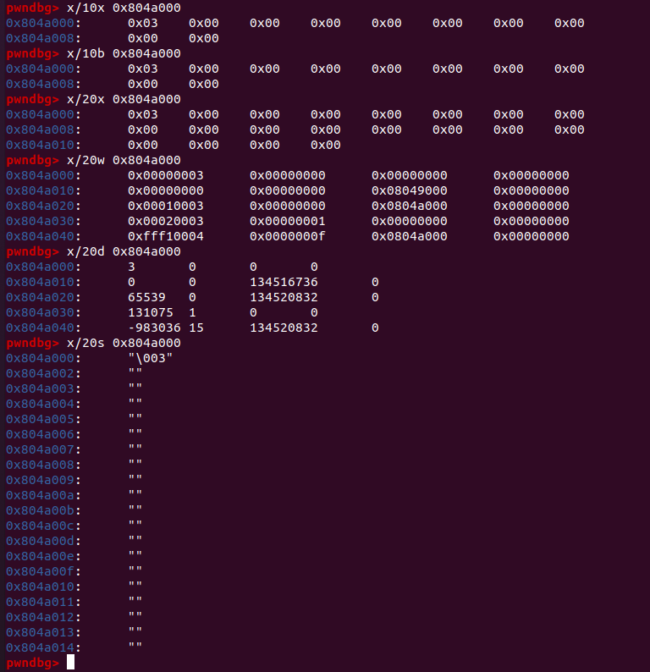

GDB
We can examine memory at the exit code variable in our text section at address 0x804a000
You can examine memory in bytes, words, in hex, as strings. You can also decide how many of each type you would like to print.
Format: x/<quantity><type> <location>
  Type you can have:
    s- string
    x- hex
    d- dword
    w- word
    i- instructions
      It will try to disassemble at the address you provide
    You can find other types here: https://sourceware.org/gdb/onlinedocs/gdb/Memory.html
  Location can be an address or a register

Slide 25
Quick GDB Overview
Useful gdb commands
  h[elp]- internal navigation of available commands
  s- step over (don’t go inside function calls, go t the next instruction following the return of the function)
  si- step into (step inside a function call)
  c[ontinue]- run until the next breakpoint or until the program ends
  disass[embly] <location>- print the disassembly for a given location (you can provide an address or function name)
  i[nfo] b- print breakpoints
  B[reak] <location>- set a breakpoint on a location ( to break on an address the address needs to be proceeded by a “*”
    Example- b *0x8049000
  Backtrace- see the call stack, what functions were called to get to the instruction you are on currently
Run some exploratory commands
  vmmap- virtual and physical memory analysis tool for processes
  checksec- see security features of the binary (we will learn about these features later in the course!)
  Any others?

Slide 26
GDB Other
Other gdb settings
  “set disassembly-flavor <syntax>” - use intel syntax rather than AT&T or vice versa
    Intel is usually the default for RE/VR specific gdb plugins
Other gdb plugins
  PEDA- https://github.com/longld/peda
  GEF- https://github.com/hugsy/gef
  To allow switching to different assembly plugins
    https://infosecwriteups.com/pwndbg-gef-peda-one-for-all-and-all-for-one-714d71bf36b8

Slide 27
HW: Let’s Write a Hello World
Try building an assembly program to print Hello World to your screen!
  Hint: use write syscall for printing!
Can you figure out a way to get the write syscall to print us a newline in our assembly?
Resources if you need hints!
  https://jameshfisher.com/2018/03/10/linux-assembly-hello-world/
  https://securityboulevard.com/2021/05/linux-x86-assembly-how-to-build-a-hello-world-program-in-nasm/
int main(){
int size_hello = 12;
char* hello = “Hello World!”;
write(1, goodbye, size_goodbye);
exit(0);
}
Notes:
1 min

Slide 28
HW: Try Hello World Variations
Take the C code in the last slide and compile with GCC (32 bit) then compare your assembly program with your C program
  Run strace on both. Any differences in syscalls?
  Run objdump on both. What differences do you see?
  Run file on both. Any differences?
Lab1: Write a helloworld with no jumps or calls. Make sure to execute the exit() syscall!
Lab3: Try modifying your helloworld to create a call to exit using the call instruction!
Notes:
1 min

