Slide 1
Intro x86 Part 3:
More Instructions
Updated slides 2021/2022
Slides derived from content made by Xeno Kovah – 2009/2010
xkovah at gmail

Slide 2
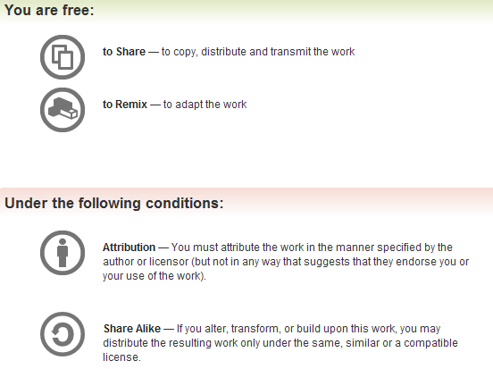
All materials is licensed under a Creative Commons “Share Alike” license.
http://creativecommons.org/licenses/by-sa/3.0/

Slide 3
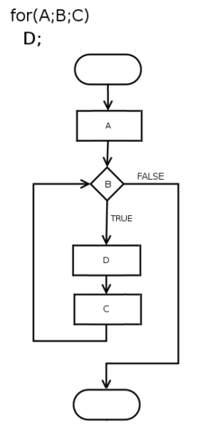
Control Flow
Two forms of control flow
  Conditional - go somewhere if a condition is met. Think “if”s, switches, loops
  Unconditional - go somewhere no matter what. Procedure calls, goto, exceptions, interrupts.
We’ve already seen procedure calls manifest themselves as push/call/ret, let’s see how goto manifests itself in asm.
Resources: https://en.m.wikipedia.org/wiki/Control_flow

Slide 4
Example2.999repeating.c:
//Goto example
#include <stdio.h>
int main(){
goto mylabel;
printf("skipped\n");
mylabel:
printf("goto ftw!\n");
return 0xf00d;
}
00401010 push ebp
00401011 mov ebp,esp
00401013 jmp 00401023
00401015 push 405000h
0040101A call dword ptr ds:[00406230h]
00401020 add esp,4
mylabel:
00401023 push 40500Ch
00401028 call dword ptr ds:[00406230h]
0040102E add esp,4
00401031 mov eax,0F00Dh
00401036 pop ebp
00401037 ret

Slide 5
JMP - Jump
10
Change eip to the given address
Main forms of the address
  Short relative (1 byte displacement from end of the instruction)
    “jmp 00401023” doesn’t have the number 00401023 anywhere in it, it’s really “jmp 0x0E bytes forward”
    Some disassemblers will indicate this with a mnemonic by writing it as “jmp short”
  Near relative (4 byte displacement from current eip)
  Absolute (hardcoded address in instruction)
  Absolute Indirect (address calculated with r/m32)
jmp -2 == infinite loop for short relative jmp :)

Slide 6
Example3.c
(Remain calm)
main:
00401010 push ebp
00401011 mov ebp,esp
00401013 sub esp,8
00401016 mov dword ptr [ebp-4],1
0040101D mov dword ptr [ebp-8],2
00401024 mov eax,dword ptr [ebp-4]
00401027 cmp eax,dword ptr [ebp-8]
0040102A jne 00401033
0040102C mov eax,1
00401031 jmp 00401056
00401033 mov ecx,dword ptr [ebp-4]
00401036 cmp ecx,dword ptr [ebp-8]
00401039 jle 00401042
0040103B mov eax,2
00401040 jmp 00401056
00401042 mov edx,dword ptr [ebp-4]
00401045 cmp edx,dword ptr [ebp-8]
00401048 jge 00401051
0040104A mov eax,3
0040104F jmp 00401056
00401051 mov eax,0DEFEA7h
00401056 mov esp,ebp
00401058 pop ebp
00401059 ret
int main(){
int a=1, b=2;
if(a == b){
return 1;
}
if(a > b){
return 2;
}
if(a < b){
return 3;
}
return 0xdefea7;
}
Jcc

Slide 7
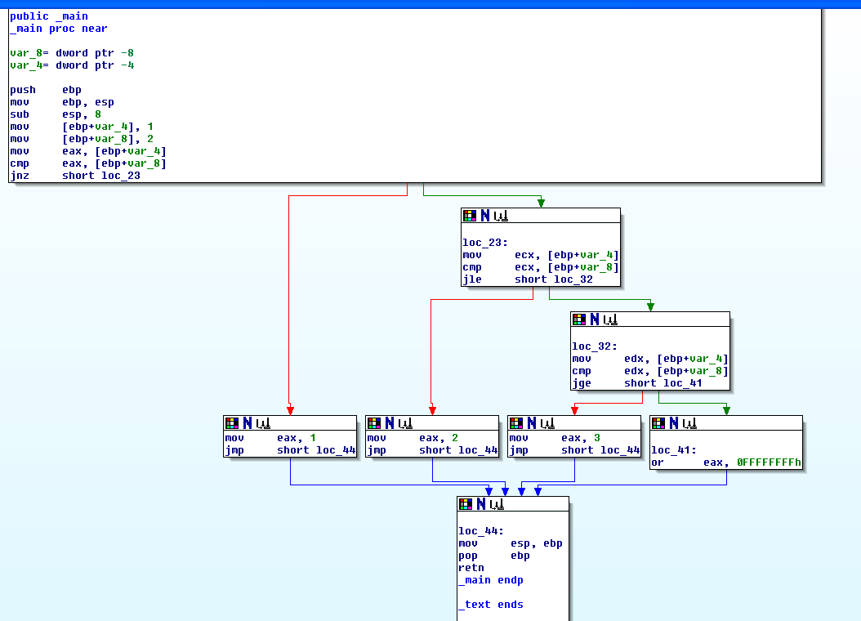
Ghost of Xmas Future:
Tools you won’t get to use today
generate a Control Flow Graph (CFG)
which looks much nicer.

Slide 8
Jcc - Jump If Condition Is Met
11
There are more than 4 pages of conditional jump types! Luckily a bunch of them are synonyms for each other.
JNE == JNZ (Jump if not equal, Jump if not zero, both check if the Zero Flag (ZF) == 0)

Slide 9
Some Notable Jcc Instructions
JZ/JE: if ZF == 1
JNZ/JNE: if ZF == 0
JLE/JNG : if ZF == 1 or SF != OF
JGE/JNL : if SF == OF
JBE: if CF == 1 OR ZF == 1
JB: if CF == 1
Note: Don’t get hung up on memorizing which flags are set for what. More often than not, you will be running code in a debugger, not just reading it. In the debugger you can just look at eflags and/or watch whether it takes a jump.
Note 2: Don’t listen to that guy ^ for what were gonna be doing

Slide 10
Flag setting
Before you can do a conditional jump, you need something to set the condition flags for you.
Typically done with CMP, TEST, or whatever instructions are already inline and happen to have flag-setting side-effects

Slide 11
CMP - Compare Two Operands
12
“The comparison is performed by subtracting the second operand from the first operand and then setting the status flags in the same manner as the SUB instruction.”
What’s the difference from just doing SUB? Difference is that with SUB the result has to be stored somewhere. With CMP the result is computed, the flags are set, but the result is discarded. Thus this only sets flags and doesn’t mess up any of your registers.
Modifies CF, OF, SF, ZF, AF, and PF
(implies that SUB modifies all those too)

Slide 12
TEST - Logical Compare
13
“Computes the bit-wise logical AND of first operand (source 1 operand) and the second operand (source 2 operand) and sets the SF, ZF, and PF status flags according to the result.”
Like CMP - sets flags, and throws away the result

Slide 13
Example4.c
main:
00401010 push ebp
00401011 mov ebp,esp
00401013 push ecx
00401014 mov dword ptr [ebp-4],1301h
0040101B mov eax,dword ptr [ebp-4]
0040101E and eax,100h
00401023 je 0040102E
00401025 mov eax,1
0040102A jmp 00401033
0040102C jmp 00401033
0040102E mov eax,2
00401033 mov esp,ebp
00401035 pop ebp
00401036 ret
#define MASK 0x100
int a=0x1301;
if(a & MASK){
return 1;
}
else{
return 2;
}
}
int main(){
jcc
I actually expected a TEST, because the result isn't stored
Eventually found out why there are 2 jmps!
(no optimization, so simple compiler rules)

Slide 14
Refresher - Boolean (”bitwise”) logic
AND “&”
OR “|”
XOR “^”
0 | 0 | 0
0 | 1 | 0
1 | 0 | 0
1 | 1 | 1
0 | 0 | 0
0 | 1 | 1
1 | 0 | 1
1 | 1 | 1
0 | 0 | 0
0 | 1 | 1
1 | 0 | 1
1 | 1 | 0
Operands
Result
NOT “~”
0 | 1
1 | 0

Slide 15
AND - Logical AND
14
Destination operand can be r/m32 or register
Source operand can be r/m32 or register or immediate (No source and destination as r/m32s)
and al, bl
and al, 0x42
 | 00110011b (al - 0x33)
AND | 01010101b (bl - 0x55)
result | 00010001b (al - 0x11)
 | 00110011b (al - 0x33)
AND | 01000010b (imm - 0x42)
result | 00000010b (al - 0x02)

Slide 16
OR - Logical Inclusive OR
15
Destination operand can be r/m32 or register
Source operand can be r/m32 or register or immediate (No source and destination as r/m32s)
or al, bl
or al, 0x42
 | 00110011b (al - 0x33)
OR | 01010101b (bl - 0x55)
result | 01110111b (al - 0x77)
 | 00110011b (al - 0x33)
OR | 01000010b (imm - 0x42)
result | 01110011b (al - 0x73)

Slide 17
XOR - Logical Exclusive OR
16
Destination operand can be r/m32 or register
Source operand can be r/m32 or register or immediate (No source and destination as r/m32s)
xor al, al
xor al, 0x42
 | 00110011b (al - 0x33)
XOR | 00110011b (al - 0x33)
result | 00000000b (al - 0x00)
 | 00110011b (al - 0x33)
OR | 01000010b (imm - 0x42)
result | 01110001b (al - 0x71)
XOR is commonly used to zero a
register, by XORing it with itself,
because it’s faster than a MOV

Slide 18
NOT - One's Complement Negation
17
Single source/destination operand can be r/m32
not al
not [al+bl]
NOT | 00110011b (al - 0x33)
result | 11001100b (al - 0xCC)
al | 0x10000000
bl | 0x00001234
al+bl | 0x10001234
[al+bl] | 0 (assumed memory at 0x10001234)
NOT | 00000000b
result | 11111111b
Xeno trying to be clever on a boring example, and failing…

Slide 19
Instructions we now know(17)
NOP
PUSH/POP
CALL/RET
MOV/LEA
ADD/SUB
JMP/Jcc
CMP/TEST
AND/OR/XOR/NOT

Slide 20
Example6.c
//Multiply and divide transformations
//New instructions:
//shl - Shift Left, shr - Shift Right
int main(){
unsigned int a, b, c;
a = 0x40;
b = a * 8;
c = b / 16;
return c;
}
main:
push ebp
mov ebp,esp
sub esp,0Ch
mov dword ptr [ebp-4],40h
mov eax,dword ptr [ebp-4]
shl eax,3
mov dword ptr [ebp-8],eax
mov ecx,dword ptr [ebp-8]
shr ecx,4
mov dword ptr [ebp-0Ch],ecx
mov eax,dword ptr [ebp-0Ch]
mov esp,ebp
pop ebp
ret

Slide 21
SHL - Shift Logical Left
18
Book p. 224
Can be explicitly used with the C “<<” operator
First operand (source and destination) operand is an r/m32
Second operand is either cl (lowest byte of ecx), or a 1 byte immediate. The 2nd operand is the number of places to shift.
It multiplies the register by 2 for each place the value is shifted. More efficient than a multiply instruction.
Bits shifted off the left hand side are “shifted into” (set) the carry flag (CF)
For purposes of determining if the CF is set at the end, think of it as n independent 1 bit shifts.
shl cl, 2
shl cl, 3
 | 00110011b (cl - 0x33)
result | 11001100b (cl - 0xCC) CF = 0
 | 00110011b (cl - 0x33)
result | 10011000b (cl - 0x98) CF = 1

Slide 22
SHR - Shift Logical Right
19
Book p. 225
Can be explicitly used with the C “>>” operator
First operand (source and destination) operand is an r/m32
Second operand is either cl (lowest byte of ecx), or a 1 byte immediate. The 2nd operand is the number of places to shift.
It divides the register by 2 for each place the value is shifted. More efficient than a multiply instruction.
Bits shifted off the right hand side are “shifted into” (set) the carry flag (CF)
For purposes of determining if the CF is set at the end, think of it as n independent 1 bit shifts.
shr cl, 2
shr cl, 3
 | 00110011b (cl - 0x33)
result | 00001100b (cl - 0x0C) CF = 1
 | 00110011b (cl - 0x33)
result | 00000110b (cl - 0x06) CF = 0

Slide 23
Example7.c
//Multiply and divide operations
//when the operand is not a
//power of two
//New instructions: imul, div
int main(){
unsigned int a = 1;
a = a * 6;
a = a / 3;
return 0x2bad;
}
main:
push ebp
mov ebp,esp
push ecx
mov dword ptr [ebp-4],1
mov eax,dword ptr [ebp-4]
imul eax,eax,6
mov dword ptr [ebp-4],eax
mov eax,dword ptr [ebp-4]
xor edx,edx
mov ecx,3
div eax,ecx
mov dword ptr [ebp-4],eax
mov eax,2BADh
mov esp,ebp
pop ebp
ret
Notes:
We already saw that when a C operand is a power of 2, it uses shifts instead of multiplies/divides, but this shows that in other cases, it uses multiply or divide instructions.

Slide 24
IMUL - Signed Multiply
20
Book p. 218
Wait…what? Weren’t the operands unsigned?
  Visual Studio seems to have a predilection for imul over mul (unsigned multiply). I haven’t been able to get it to generate the latter for simple examples.
Three forms. One, two, or three operands
  imul r/m32 edx:eax = eax * r/m32
  imul reg, r/m32 reg = reg * r/m32
  imul reg, r/m32, immediate reg = r/m32 * immediate
Three operands? Only one of it’s kind?(see link in notes)
edx | eax | r/m32(ecx)
0x0 | 0x44000000 | 0x4
eax | r/m32(ecx)
0x20 | 0x4
eax | r/m32(ecx)
0x20 | 0x4
initial
operation
imul ecx
imul eax, ecx
imul eax, ecx, 0x6
edx | eax | r/m32(ecx)
0x1 | 0x10000000 | 0x4
eax | r/m32(ecx)
0x80 | 0x4
eax | r/m32(ecx)
0x18 | 0x4
result
Notes:
http://www.microsoft.com/msj/0698/hood0698.aspx - “There's even a form of the IMUL instruction that takes three operands. To my knowledge, this is the only instruction in the Intel opcode set with this distinction.”
I found that quote while trying to find a way to make visual studio naturally emit a MUL instruction. Also, while things containing an r/m32 can encode a mnemonic which looks like is has more operands, the information is still contained in a the normal combo of one or two bytes

Slide 25
DIV - Unsigned Divide
21
Book p. 221
Two forms
  Unsigned divide ax by r/m8, al = quotient, ah = remainder
  Unsigned divide edx:eax by r/m32, eax = quotient, edx = remainder
If dividend is 32bits, edx will just be set to 0 before the instruction (as occurred in the Example7.c code)
If the divisor is 0, a divide by zero exception is raised.
initial
ax | r/m8(cx)
0x8 | 0x3
edx | eax | r/m32(ecx)
0x0 | 0x8 | 0x3
operation
div ax, cx
div eax, ecx
ah | al
0x2 | 0x2
edx | eax | r/m32(ecx)
0x1 | 0x2 | 0x3
result
Notes:
Note that there’s no form which takes an immediate.

Slide 26
LEAVE - High Level Procedure Exit
24
1026EE94 mov eax,dword ptr [ebp+8]
1026EE97 pop esi
1026EE98 pop edi
1026EE99 leave
1026EE9A ret
“Set ESP to EBP, then pop EBP”
That’s all :)
Then why haven’t we seen it elsewhere already?
Depends on compiler and options

Slide 27
XCHG
24
Temporary = Destination; Destination = Source;
Source = Temporary;
Exchanges the contents of the destination (first) and source (second) operands
Both operands need to be a register in format
  XCHG reg, reg
  XCHG reg, mem
  XCHG mem, reg
xchg does not accept immediates, otherwise same rules apply as for mov instruction
  NO mem to mem
XCHG eax, eax same as a nop!
Examples
  XCHG ax, bx
  XCHG

Slide 28

Instructions we now know!
NOP
PUSH/POP
CALL/RET
MOV/LEA
ADD/SUB
JMP/Jcc
CMP/TEST
AND/OR/XOR/NOT
SHR/SHL
IMUL/DIV
LEAVE
XCHG
instructions
Cool website to learn more about x86_64!! (There’s also a paperback copy too)
https://www.xorpd.net/pages/xchg_rax/snip_00.html

Slide 29
HW: Let’s Modify our Hello World
Lab2: Try modifying your helloworld to create a jump to the exit syscall using the jmp instruction!
Notes:
1 min

Slide 30
Homework Cont: Lab 4
Modify your assembly from past homeworks to implement the following C program in x86 and compile.
Change the value in test to see if you can get it to print out “Goodbye World” instead
Use GDB to troubleshoot any problems you’re having!
int main(){
int test = 1;
int size_hello = 12;
int size_goodbye = 15;
char* hello = “Hello World!”;
char* goodbye = “Goodbye World!”;
if(test){
write(1, hello, size_hello);
}else{
write(1, goodbye, size_goodbye);
}
exit(0);
}

Slide 31
Homework Cont: Lab 5
Edit your assembly from the previous homework to implement the following C program
Try to use a mix of call and jump instructions!
Remember you can save register values that are important to you on the stack!
int main(){
int loop_count = 5;
int size_hello = 12;
int size_goodbye = 15;
char* hello = “Hello World!”;
char* goodbye = “Goodbye World!”;
while(loop_count){
write(1, hello, size_hello);
loop_count--;
}
write(1, goodbye, size_goodbye);
exit(0);
}

Slide 32
Homework Cont: Lab 6
Write the following C program in x86 and compile.
int main(){
int loop_count = 5;
int size_hello = 12;
int size_goodbye = 15;
char* hello = “Hello World!”;
char* goodbye = “Goodbye World!”;
int i = 0;
do{
write(1, hello, size_hello);
i++;
}while(i != loop_count);
write(1, goodbye, size_goodbye);
exit(0);
}

Slide 33
Homework Cont: Lab 7
Write the following C program in x86 and compile.
int main(){
int loop_count = 5;
int size_hello = 12;
int size_goodbye = 15;
char* hello = “Hello World!”;
char* goodbye = “Goodbye World!”;
for(int i = 0; i != loop_count; i++){
write(1, hello, size_hello);
}
write(1, goodbye, size_goodbye);
exit(0);
}
An Interesting resource which indicates the difference between different loop types and their disassembly/decompiled versions: https://en.wikibooks.org/wiki/X86_Disassembly/Loops
Check out that link for why for loops and do-while loops are sometimes indistinguishable!

Slide 34
Homework BONUS
Find an interesting instruction we haven’t covered yet, and report the instruction the next time we meet!

