Slide 1
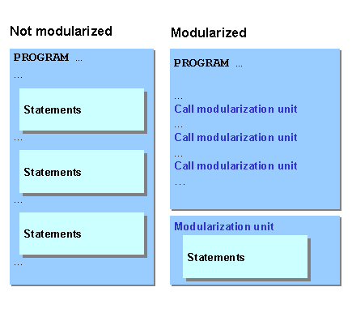


Slide 2

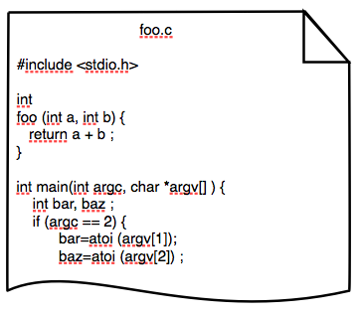

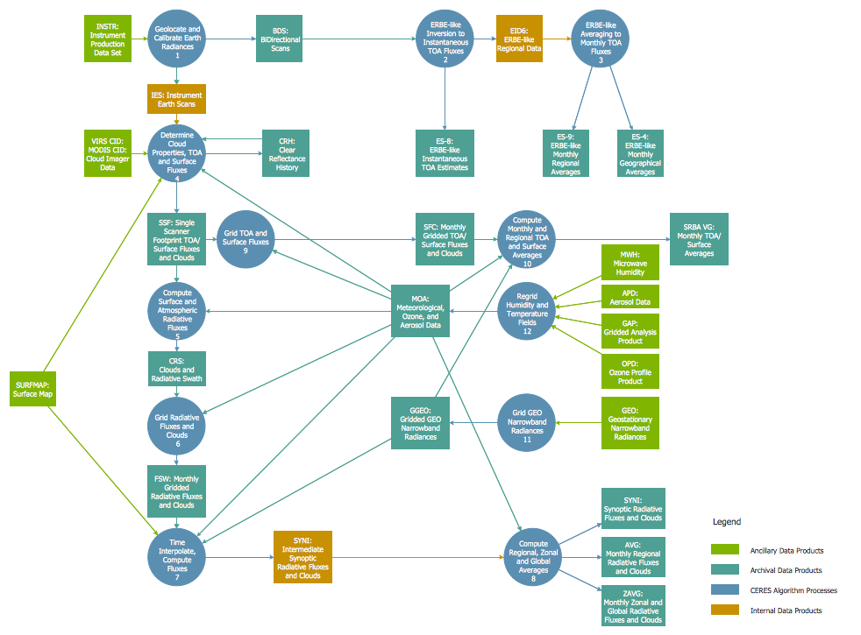


Slide 3

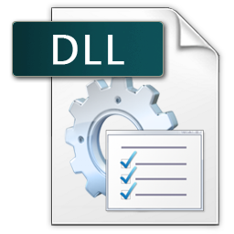


基于抽象图模型的
高层软件设计与实现
动态库封装功能模块
自由嵌入高层图模型

Slide 4
High-Level Abstract Software
Viewer
Sensor
Processor
Logger
Low-Level Functional Modules
Shared Library
Shared Library
Shared Library
Camera
LiDAR
Encoder/IMU
High Pass Filter
Denoise
Dead-Reckoning
Image Viewer
Range Viewer
Trajectory Viewer
Recorder
Range Logger
Trajectory Logger

Slide 5
Kernel Development
Application Development
Graph
Model
High-level
Application
RobotSDK
Generate a Shell
Automatically
Interface
Protocol
Explicitly
Link
Shell
Shell Interfaces
Algorithms
Compile
Packed Algorithm
to Shared Library
Algorithm I/O & Call
Shared Library Development

Slide 6
Image Viewer
抽象对象实例化编程
Camera
RGB2Gray
Recorder
Beam Viewer
Viewer
LiDAR
Denoise
Sensor
Processor
Logger
Logger
抽象图模型
Traj. Viewer
Encoder/IMU
Odometry
Loc. Saver

Slide 7
Image Viewer
泛化
抽象软件架构
Camera
RGB2Gray
Recorder
Beam Viewer
Viewer
LiDAR
Denoise
Sensor
Processor
Logger
Logger
抽象图模型
Traj. Viewer
Encoder/IMU
Odometry
Loc. Saver

