Slide 1

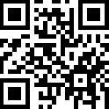


nod
shakeNo
spinLeft
spinRight

Slide 2
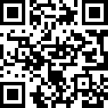
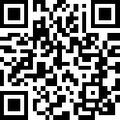
leftHockiePokie
rightHokiePokie

