Slide 1
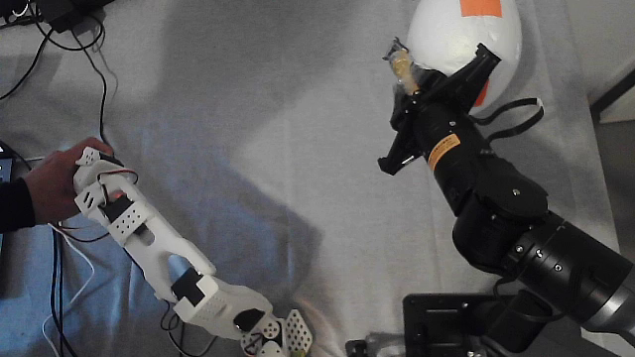
A Quadratic Programming Based Teleoperation Scheme and Its Applications for Robotic Haircutting
The slave follows the operator's pose within its joint limits, without joint correspondence
SO101 master arm (left) and Piper slave arm (right)
Notes:
This talk presents a quadratic programming based teleoperation scheme and its applications for robotic haircutting. The operator gives a desired pose, and the slave manipulator follows it within its joint-angle and joint-velocity limits, so the master and the slave do not need the same joints. We show two applications: a heterogeneous SO101 master arm with a Piper slave arm, and a smartphone that replaces the master arm.

Slide 2
Outline
01
Background and Motivation
04
Convergence Analysis
Why teleoperation for robotic haircutting
Optimality, linear rate, joint limits
02
Problem Formulation
05
Haircutting Experiments
Pose tracking as a QP with joint limits
Master-arm mode and smartphone mode
03
Projection Neural Network
06
Conclusion
Discrete-time solver, one step per instant
Summary and future work
Notes:
The talk has six parts: the motivation, the problem formulation as a quadratic program, the discrete-time projection neural network that solves it, the convergence analysis, the two haircutting experiments, and the conclusion.

Slide 3
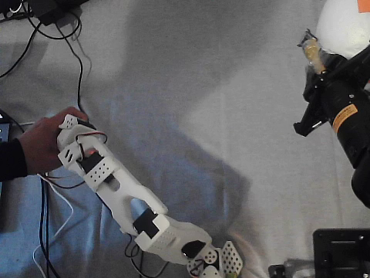
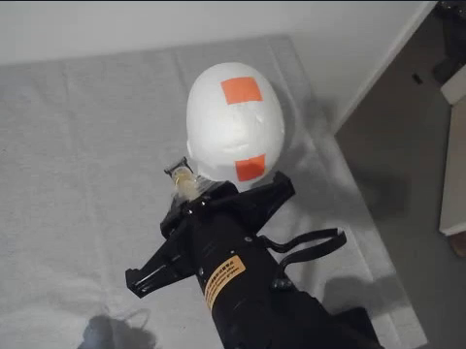


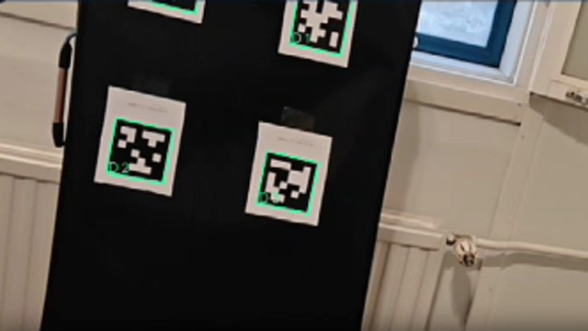
Motivation
Teleoperation keeps a human in the loop for haircutting, but joint-space mapping needs matching arms and a dedicated master.
Joint-space teleoperation
Joint-by-joint mapping
Different joint arrangements?
Slave joint limits?
Dedicated master arm?
master arm
slave arm + mannequin head
Ours
No joint correspondence
Desired pose →
QP + projection neural network
Joint limits at every instant
Smartphone as input
master arm or smartphone
Notes:
Fully autonomous haircutting is still difficult because hair modeling, perception and personalized styling are open problems, so teleoperation that keeps a human in the loop is a practical way forward. In a typical master-slave system the command is mapped joint by joint. This needs the two arms to have matching joints, it does not by itself respect the joint limits of the slave, and it needs a dedicated master arm. In our scheme the operator only gives a desired pose. A quadratic program, solved online by a projection neural network, turns this pose into joint commands of the slave within its limits. So the master can be a different arm, or even a smartphone.

Slide 4
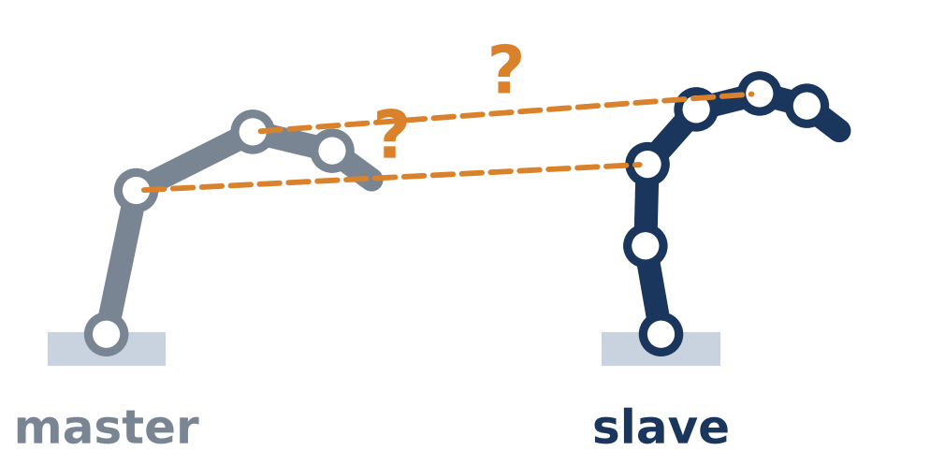
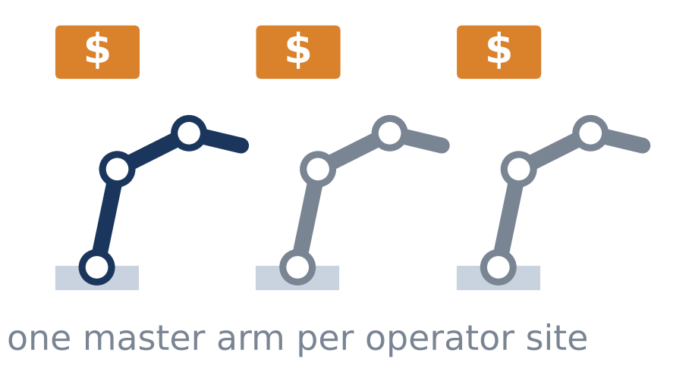
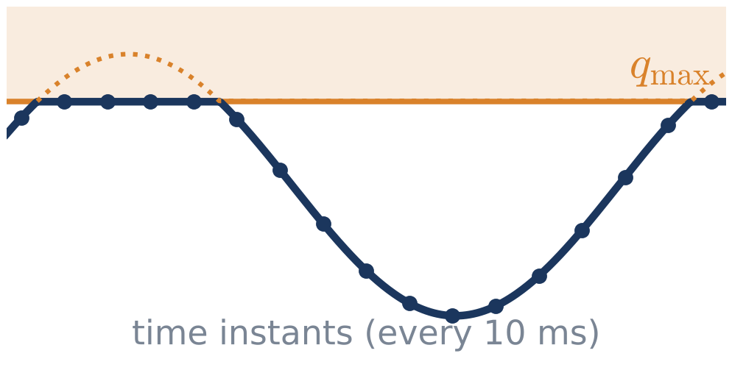
Why Teleoperation for Haircutting Is Hard
The command must be realized by a different arm, near the head, within every sampling interval.
1
Heterogeneous arms
2
Dedicated input device
3
Joint limits in real time
SO101 ≠ Piper
1 arm / site
10 ms
different joint arrangements and workspaces
a dedicated master arm at each operator site
per time instant at 100 Hz
The operator's command cannot be mapped joint by joint.
The equipment cost limits access to remote haircutting.
Every joint command has to stay within the angle and velocity limits.
What we need: a pose-level command that the slave realizes within its own joint limits, computed online, from any pose source.
Notes:
There are three difficulties. First, the master and the slave are heterogeneous: an SO101 arm and a Piper arm have different joint arrangements and workspaces, so the command cannot be copied joint by joint. Second, a dedicated master arm at each operator site increases the equipment cost and limits access. Third, the tool moves near the head, so every joint command must respect the joint-angle and joint-velocity limits, and it must be computed within the sampling interval of ten milliseconds. So we need a pose-level command that the slave realizes within its own limits, computed online, and independent of the device that supplies the pose.

Slide 5
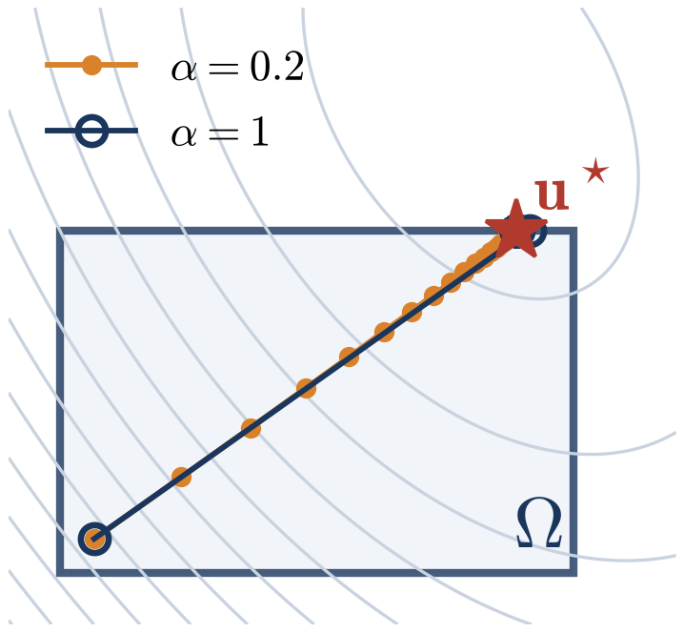
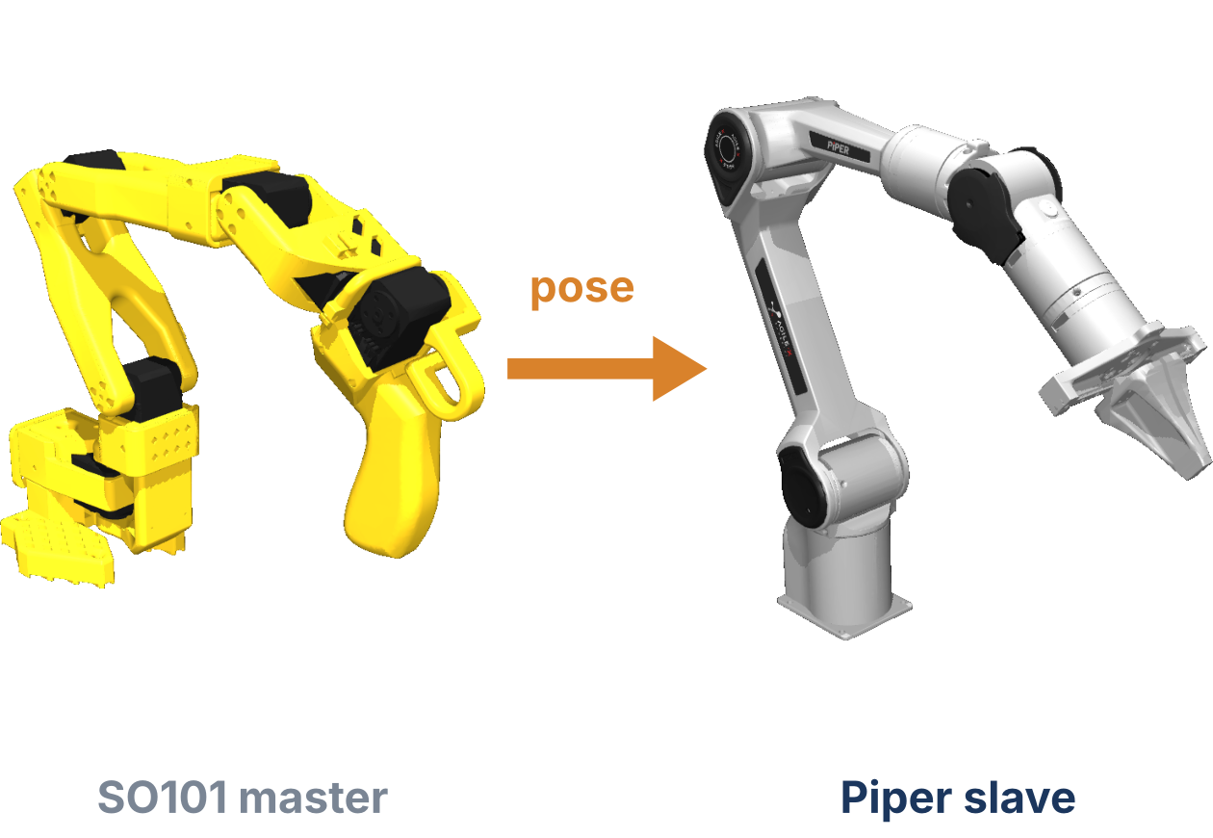
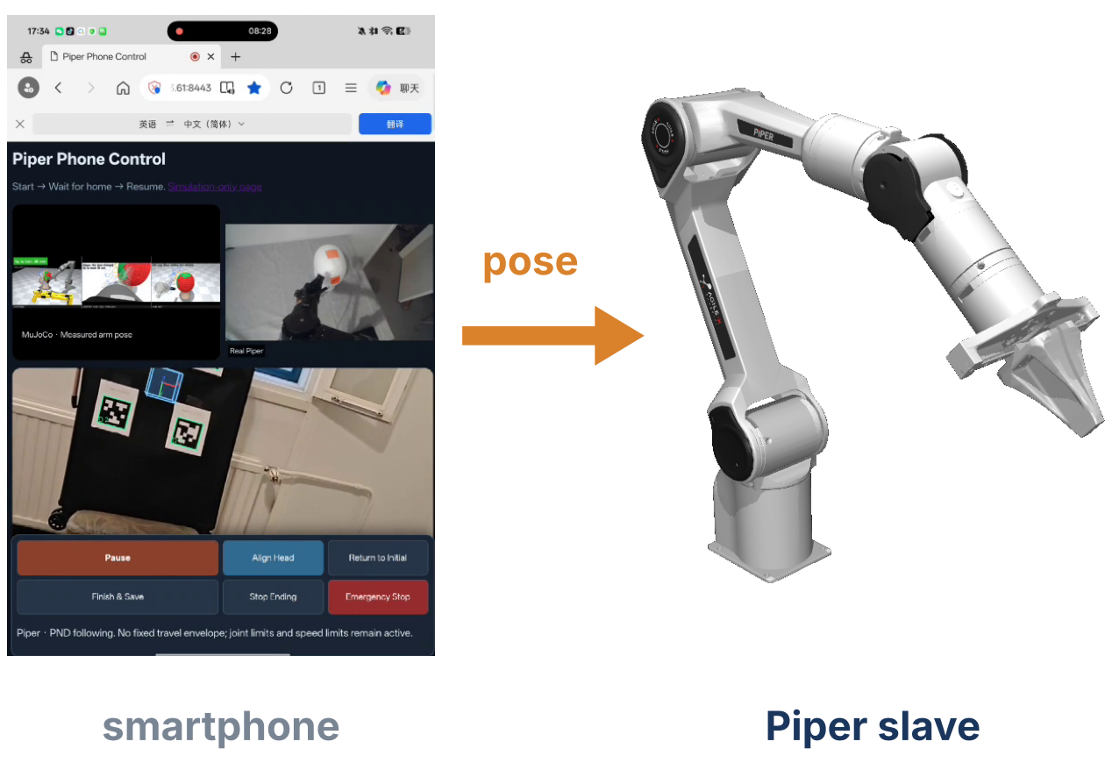
Our Contributions
To our knowledge, the first QP-based teleoperation scheme for robotic haircutting.
1
QP-based scheme
2
Heterogeneous arms
3
Smartphone mode
Pose tracking within joint limits, solved online by a discrete-time projection neural network.
An SO101 master teleoperates a Piper slave without joint correspondence.
A smartphone observing AprilTags replaces the master arm at low cost.
Notes:
This paper makes three contributions. First, a QP-based teleoperation scheme for robotic haircutting, which is the first of its kind as far as we know; its QP problem is solved online by a discrete-time projection neural network. Second, the scheme realizes teleoperation with heterogeneous master and slave manipulators, an SO101 master and a Piper slave, without joint correspondence. Third, it realizes a smartphone-based operation mode via a visual tag, which replaces the dedicated master arm and gives a low-cost solution.

Slide 6
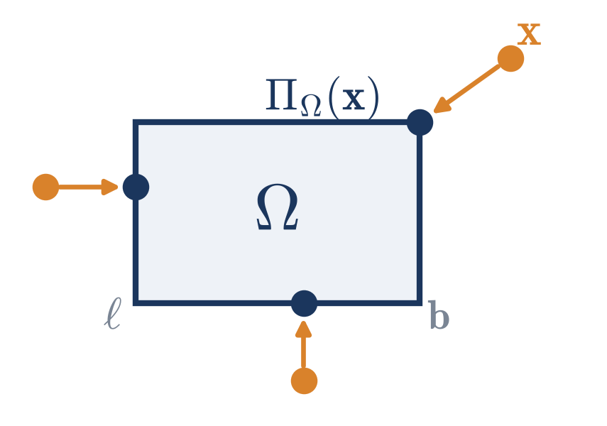
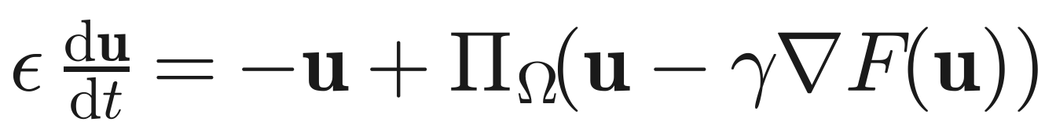
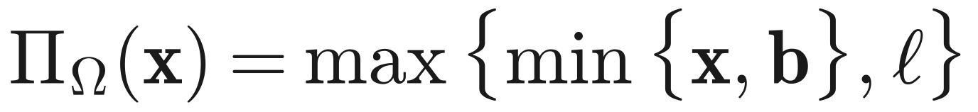
Preliminaries: Projection Neural Network
A projection neural network solves a convex problem over a box; the projection simply clips each element.
Projection neural network [Xia et al., 2002]
Projection onto the box Ω = {u | ℓ ≤ u ≤ b}
F: convex objective; ε > 0: time constant; γ > 0: scaling parameter
The state is stable at the optimal solution of min F(u) over Ω
Elementwise clipping: cheap enough for every control cycle
Points outside Ω are moved to the nearest point of the box
Notes:
We start from the projection neural network of Xia and coauthors. For a convex objective F over a box set Omega, the network moves the state toward the projection of a gradient step. Its state is stable at the optimal solution. For a box, the projection is just elementwise clipping between the lower bound l and the upper bound b, as the figure shows, so it is very cheap to compute.

Slide 7
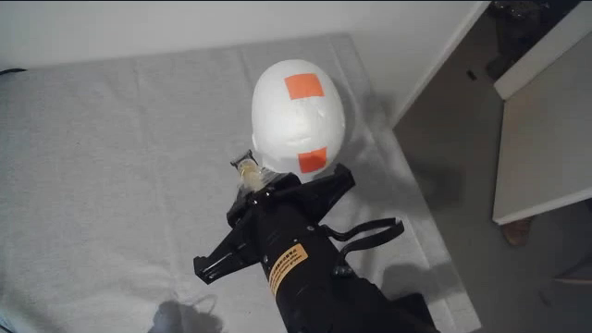
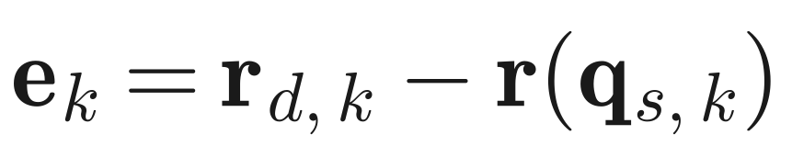
Problem: Pose Tracking within Joint Limits
At each time instant, the joint velocity trades tracking accuracy against smooth motion, inside the joint limits.
Setting
1
Tracking error of the slave
2
Optimization problem for the joint velocity
tracking term + smoothness term; a larger λ gives smoother motion and a larger error
Piper slave (6 joints) with a tool and a mannequin head
3
Bounds from joint-angle and joint-velocity limits
Desired pose: 6-D, from the master arm or the smartphone
No redundancy: 6 joints for a 6-D pose, so accuracy and small joint velocities conflict
Notes:
The tracking error is the desired pose minus the forward kinematics of the slave. Here the desired pose has six dimensions and the Piper slave has six joints, so it has no redundancy: accurate tracking and small joint velocities conflict, especially near singularities and joint limits. So the joint velocity is computed from this problem. The first term drives the end-effector velocity toward k_e times the error, and the second term penalizes large joint velocities; lambda sets the trade-off. The bounds combine the joint-velocity limit with the distance to the joint-angle limits divided by the sampling interval, so a feasible velocity never pushes a joint past its limit within one step. Dropping constants, this is a QP with Hessian J transpose W squared J plus lambda I.

Slide 8
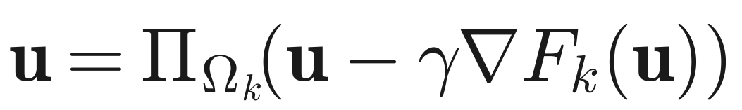
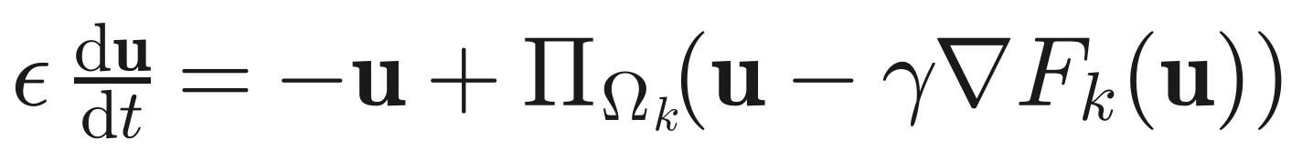
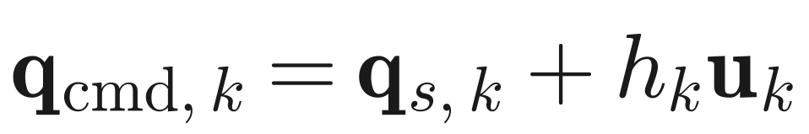
Discrete-Time Projection Neural Network
Three steps turn the QP into a network that runs one step at each time instant.
Step 1 Optimality condition
Step 2 Continuous-time model
Step 3 Euler forward, α = τ/ε
Discretize the model with time step τ, one step per control cycle (digital controller)
Network at the k-th time instant
joint command
Compute e_{k}, J_{k}, H_{k}, f_{k} and the bounds
Project u_{k−1} onto Ω_{k}
One network step → u_{k}
Send q_{cmd,k} to the slave
Smaller α: the command changes more smoothly (low-pass filter with inertia 1 − α), but approaches the optimum more slowly.
Notes:
The network is designed in three steps. Step one: a vector solves the QP if and only if it is a fixed point of the projected gradient map. Step two: as in the projection neural network, this gives a continuous-time model whose equilibrium is the optimal solution. Step three: since the slave is controlled digitally, we discretize it by the Euler forward method, with alpha equal to tau over epsilon, and execute only one step per time instant. The result is this update. The gradient term reduces the tracking error, and the projection enforces the joint limits. The joint command is the measured angle plus the sampling interval times u_k. Algorithm 1 is just these four operations. Alpha acts as a low-pass filter: a smaller alpha gives a smoother command, at the cost of slower approach to the optimum.

Slide 9


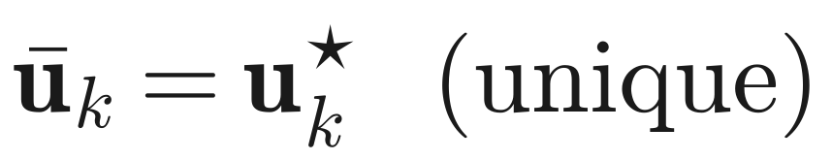
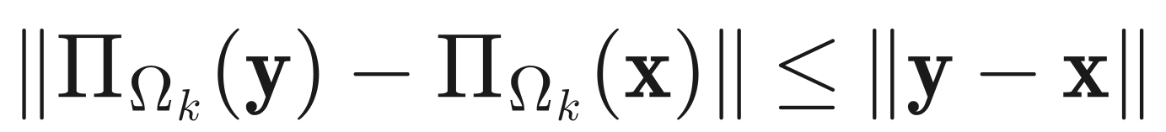
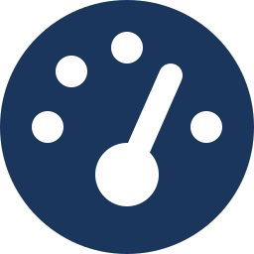

Convergence Analysis
The equilibrium is optimal, the error contracts linearly, and the joint limits hold at every instant.
Theorem 1 Optimal equilibrium
Lemma 1 Non-expansive projection
H_{k} is positive definite, so the QP has one optimum, and it is the equilibrium of the network.
Projection onto the box never increases distances.
Theorem 2 Linear convergence
Theorem 3 Joint limits at every instant
If 0 < α ≤ 1 and 0 < γ < 2/σ̄_{k}, then ρ_{k} < 1; for a fixed QP, convergence is global and linear.
Holds whether or not u_{k} has reached the optimum, i.e., even with one iteration.
Accuracy bound: Theorem 3 also bounds the distance to the optimum by a residual that can be computed online at every time instant.
Notes:
The analysis has four results. Theorem 1: because the Hessian is positive definite, the QP has a unique optimal solution, and it is exactly the equilibrium of the network. Lemma 1 is the non-expansiveness of the projection. Theorem 2: with alpha in zero to one and gamma below two over the largest eigenvalue, the distance to the optimum shrinks by a factor rho_k smaller than one at each step, and if the QP stays fixed, the network converges globally at a linear rate. Theorem 3 is the one that matters most for haircutting: at every time instant, whether or not the network has converged, the joint velocity and the joint command stay within their limits, even with one iteration. It also gives a residual-based bound on the distance to the optimum.

Slide 10
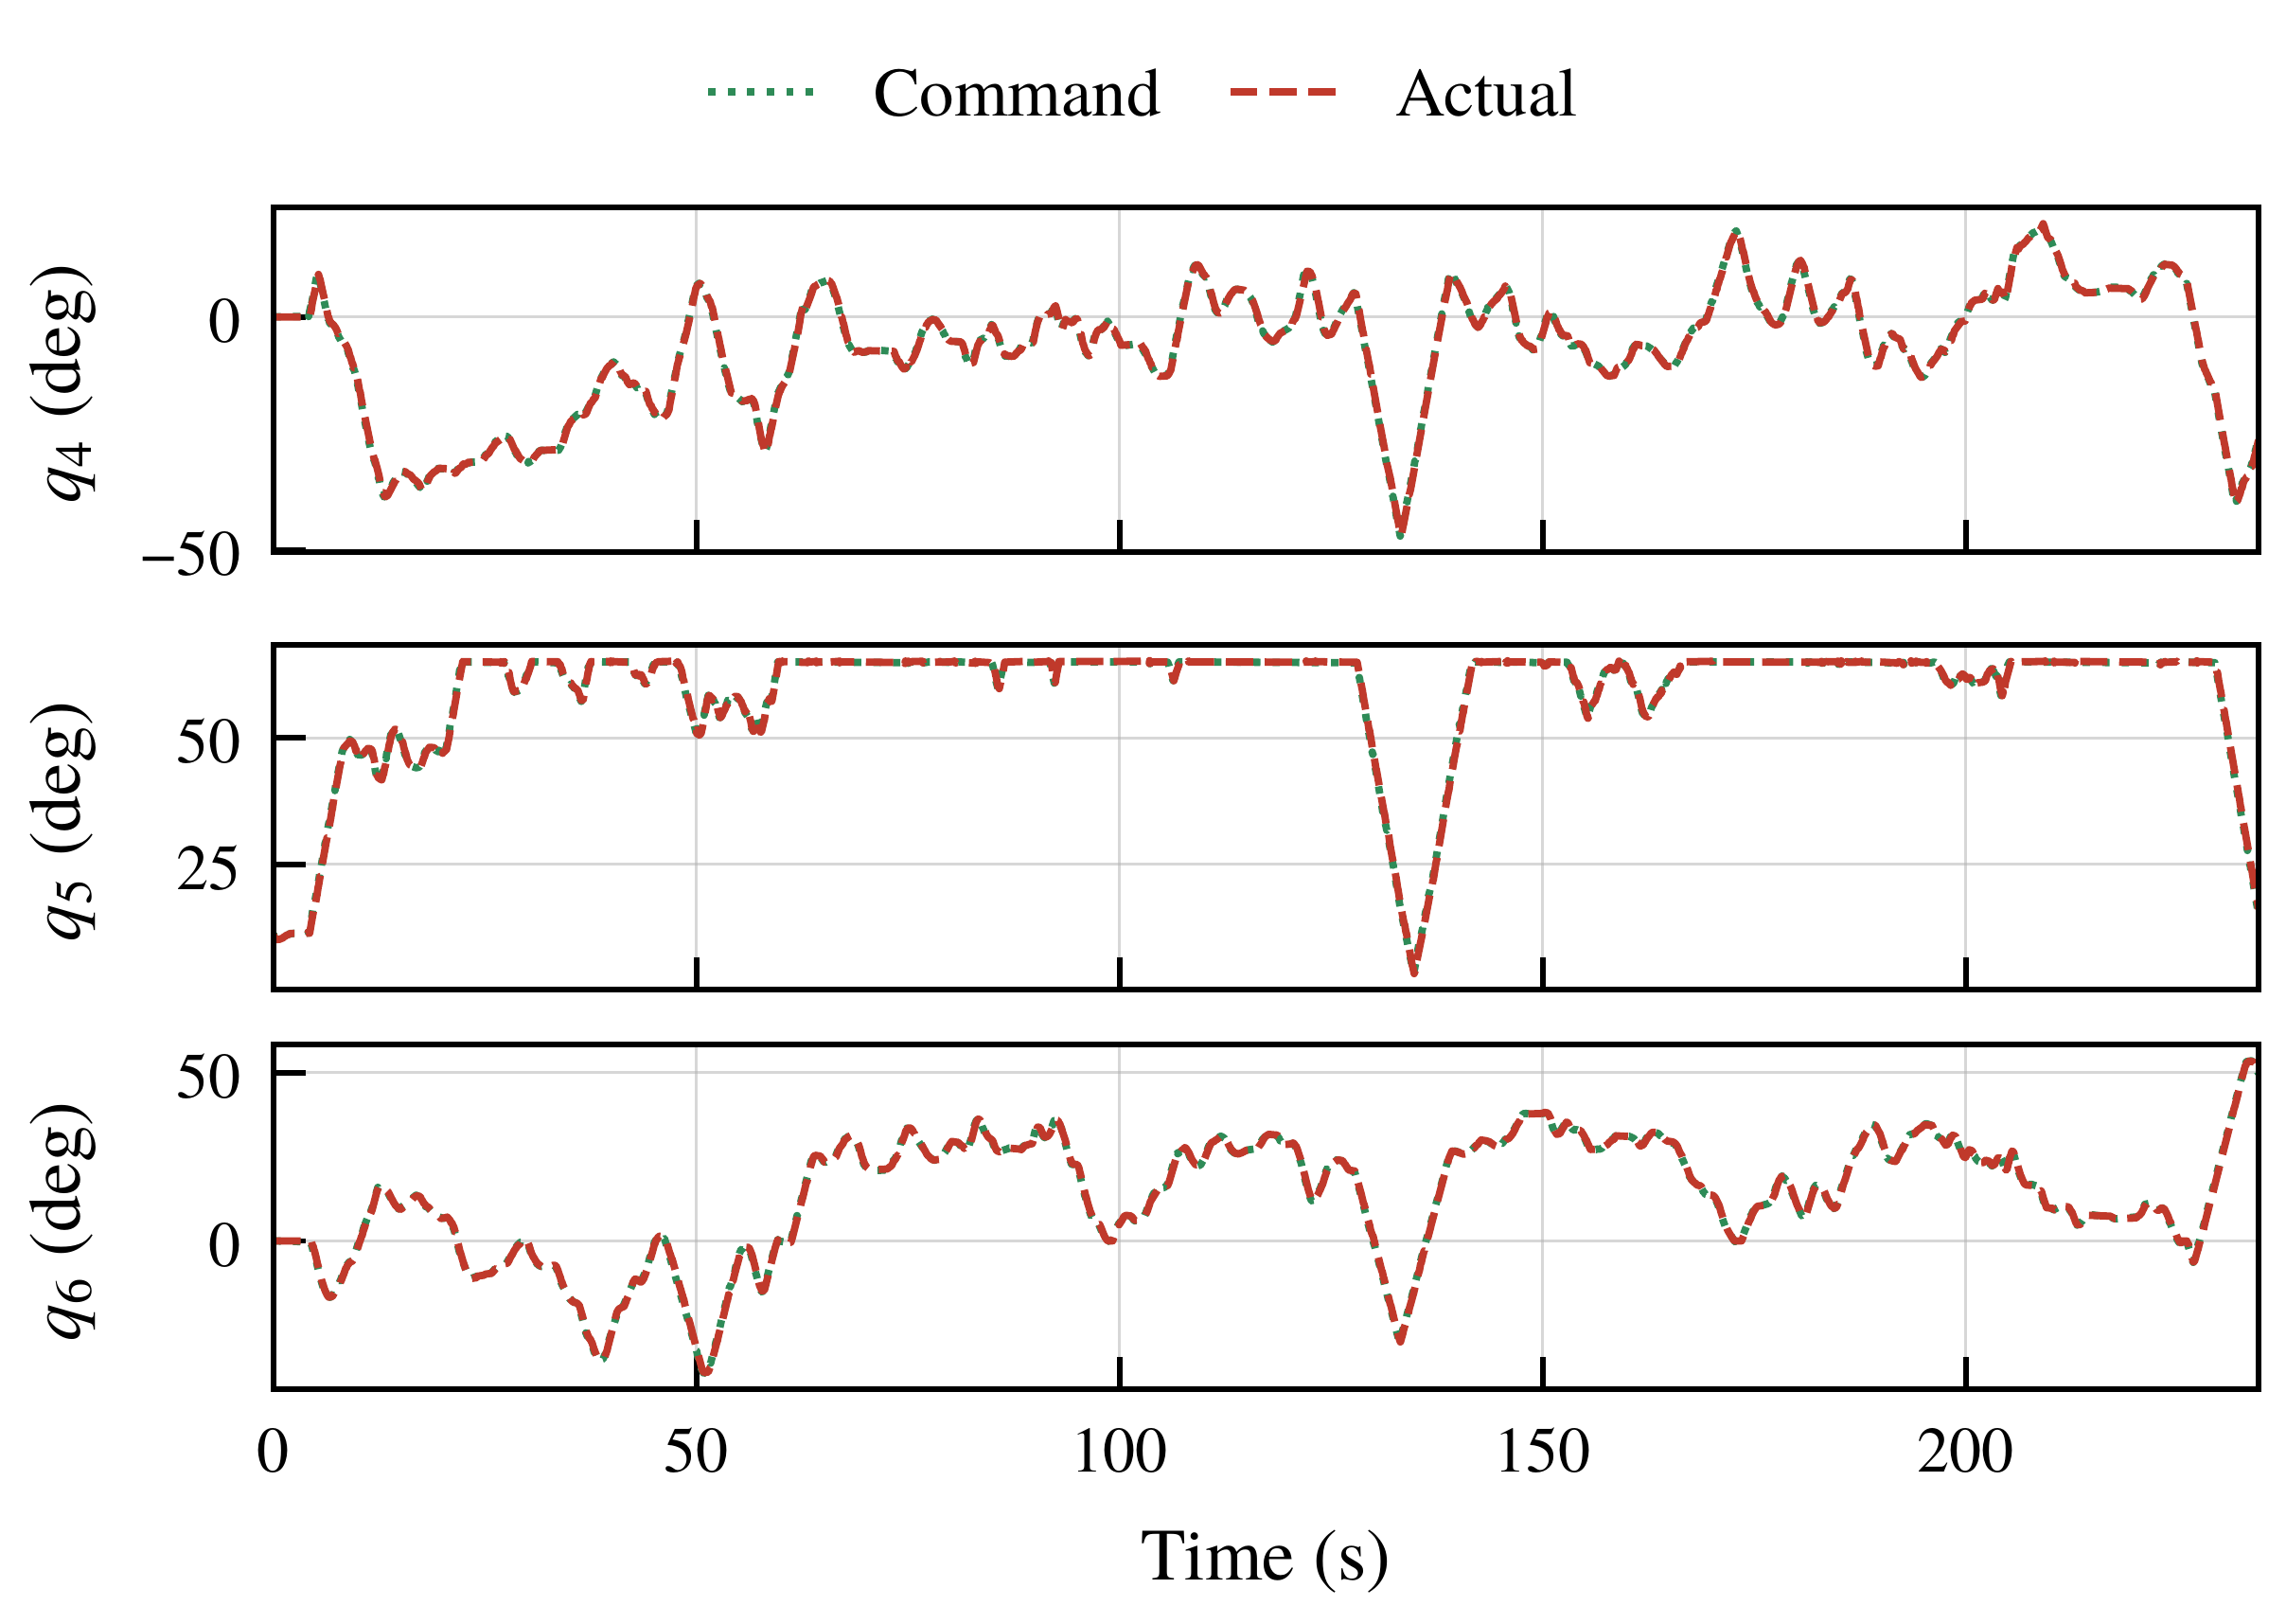
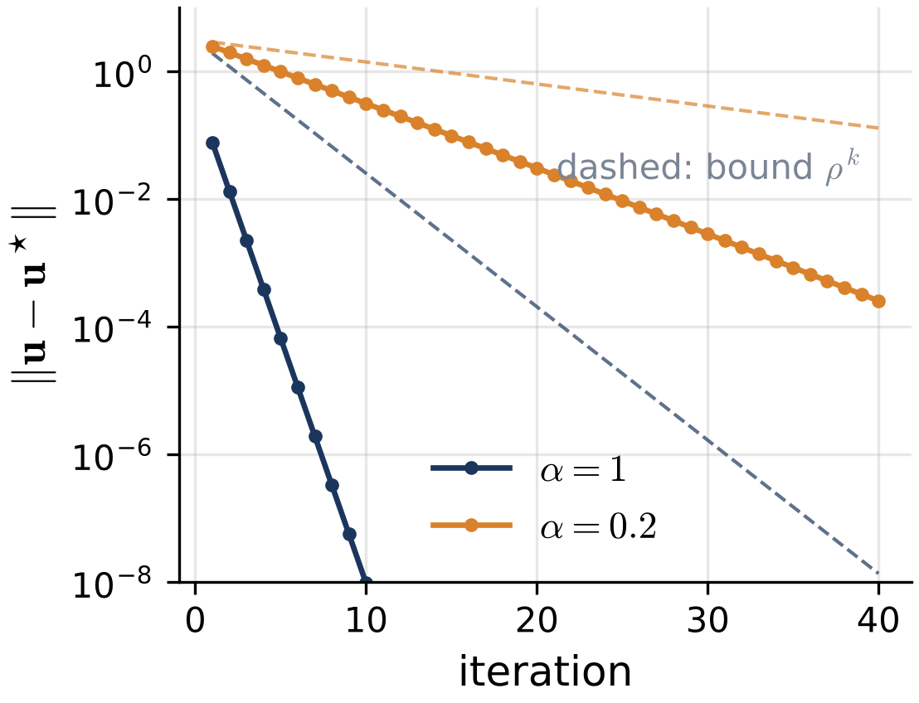
What the Theory Means in Practice
The error shrinks linearly, and the joint limits hold even before convergence.
Commanded and measured angles of joints 4–6, master-arm mode, α = 1 (paper figure)
Illustration on a fixed 2-D QP (not from the paper): the distance to the optimum decays linearly on a log scale, below the bound ρᵏ; α = 0.2 is slower but smoother
65°
0
upper limit of joint 5, where it often rests
commanded angles outside the limits in both master-arm trials (Theorem 3)
Notes:
Here is what the theory means in practice. On the left is an illustration on a small two-dimensional QP, drawn for this talk: on a log scale, the distance to the optimum decreases along a straight line, below the bound rho to the power k from Theorem 2; with alpha equal to 0.2 it is slower, which is the price of a smoother command. On the right is the paper's figure of joints 4 to 6 in the master-arm trial with alpha equal to one. Joint 5 often reaches its upper limit of 65 degrees and stays there, and all commanded joint angles remain within the limits in both trials, which verifies Theorem 3.

Slide 11
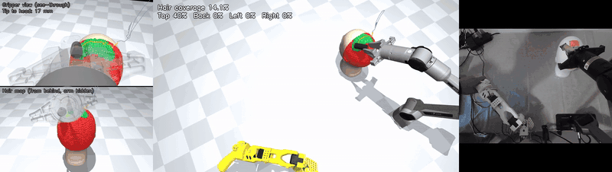
Application 1: Heterogeneous Master–Slave Teleoperation
An SO101 master arm teleoperates a Piper slave arm; the master's end-effector pose is the desired pose.
2x
Simulation views with model-based coverage (left, center) and camera view of the real arms (right)
Arms
Control
Parameters
Trials
SO101 master, Piper slave (6 joints)
100 Hz, joint velocity ≤ 90°/s
w_{p} = 1, w_{r} = 0.1, k_{e} = 30, λ = 0.001, γ = 1/σ̄_{k}
α = 1 (234.6 s) and α = 0.2 (290.8 s)
Notes:
In the first application, an SO101 arm is the master and a six-joint Piper arm is the slave, with a tool guided around a mannequin head. The two arms have different joints, and the end-effector pose of the master is the desired pose of the slave. The clip, at twice the real speed, shows the simulation views with the model-based coverage and the camera view of the real arms. The controller runs at 100 hertz with a joint-velocity limit of 90 degrees per second. We ran two trials, with alpha equal to one and 0.2.

Slide 12
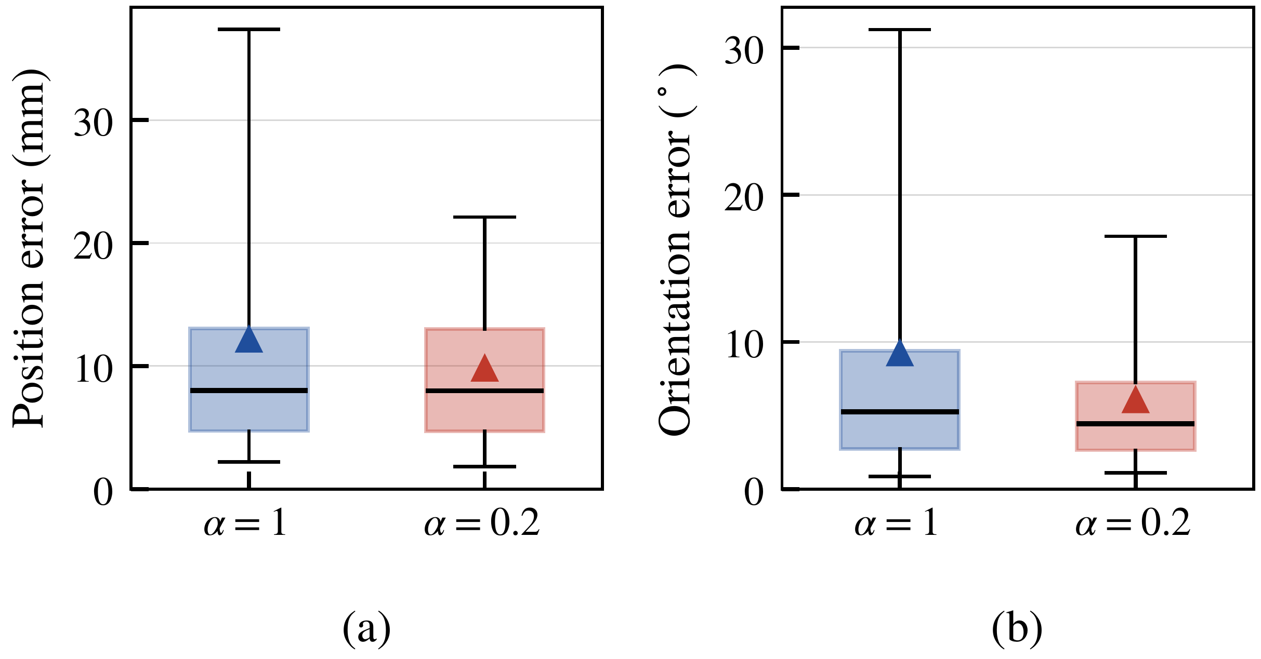
Application 1: Tracking Errors
α = 0.2 lowers the mean and peak errors, while the median position error is almost unchanged.
12.12 → 9.76 mm
mean position error, α = 1 → α = 0.2
9.20° → 6.01°
mean orientation error, α = 1 → α = 0.2
183.82 → 69.21 mm
Feedback tracking errors: boxes are quartiles, lines medians, whiskers 5th–95th percentiles, triangles means
maximum position error, α = 1 → α = 0.2
Where the large errors come from (α = 1): a wrist singularity from 129 s to 141 s, and the last 5 s, when the desired pose leaves the reachable region.
Notes:
Since the operator moves the master freely, the two trials are compared by statistics. With alpha equal to 0.2, the mean position error drops from 12.12 to 9.76 millimeters, and the mean orientation error from 9.20 to 6.01 degrees, while the median position error is almost the same, about 8 millimeters. The peak error is much smaller. The larger errors for alpha equal to one come mainly from two segments: near a wrist singularity between 129 and 141 seconds, and in the last five seconds, when the operator lifts the master out of the reachable region of the slave.

Slide 13
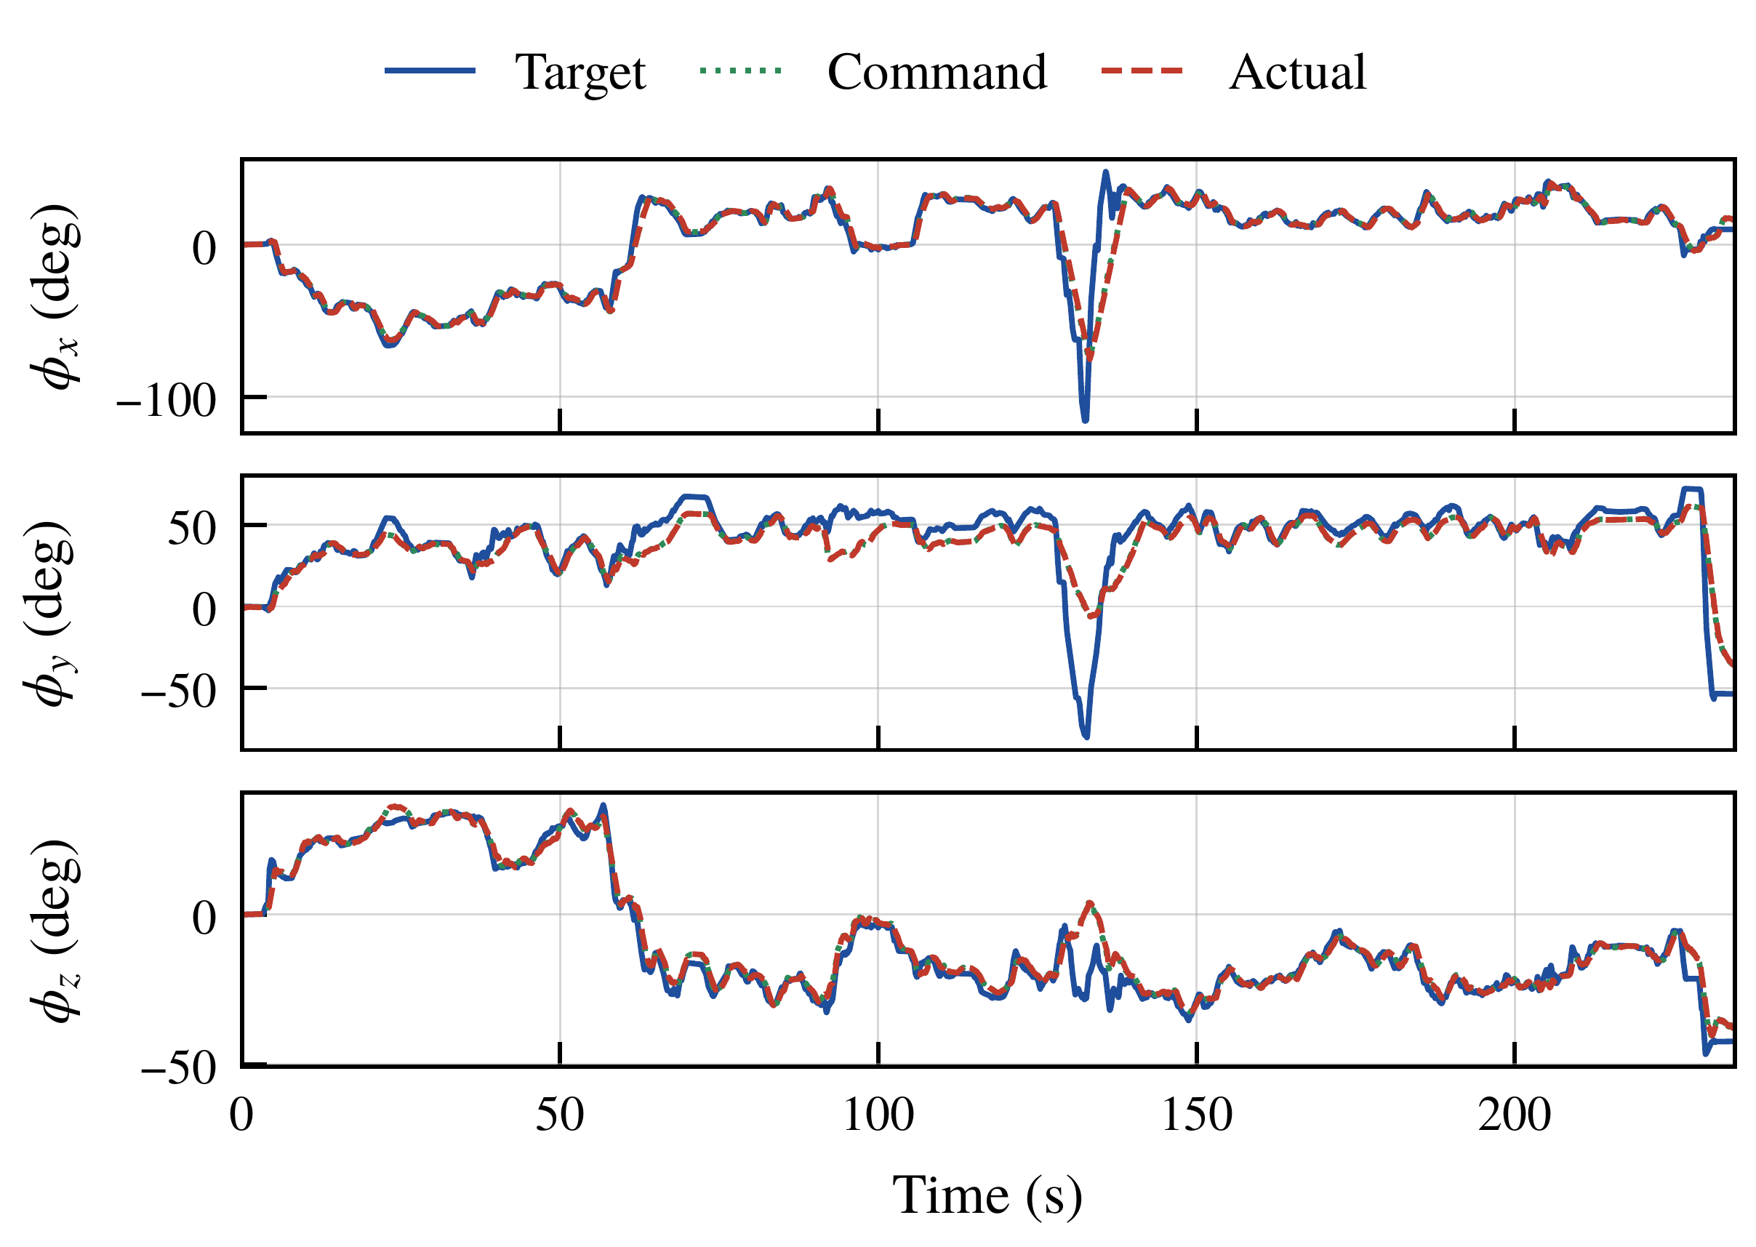
Application 1: Effect of Joint Limits
When joint 5 sits at its limit, the orientation yields while the position is still tracked.
Mode | Group | Samples | Pos. (mm) | Ori. (°)
Master, α = 1 | Away | 8260 | 17.70 | 12.45
 | Near | 14095 | 8.86 | 7.29
Master, α = 0.2 | Away | 19197 | 9.95 | 5.61
 | Near | 8515 | 9.34 | 6.91
Mean errors grouped by limit proximity (near: a commanded angle within 0.5° of its limit)
6.06° vs 3.41°
median orientation error with joint 5 at its upper limit vs otherwise (α = 1)
Orientation tracking, α = 1: the error mainly occurs in φ_{y} (65–125 s)
Orientation weight w_{r} = 0.1 < position weight w_{p} = 1, so the position is kept when both cannot be met.
Notes:
This slide shows what happens at a joint limit. With alpha equal to one, the actual phi_y stays below the desired one from 65 to 125 seconds, when joint 5 stays at its upper limit. If the desired orientation needs joint 5 to pass its limit, the orientation cannot be fully achieved, but the position is still tracked, because the orientation weight is smaller than the position weight. The median orientation error is 6.06 degrees at the limit and 3.41 otherwise. In the table, for alpha equal to 0.2, the position errors near and away from the limits are close, while the orientation error is larger near the limits. For alpha equal to one, the errors away from the limits are larger, because the singular segment and the last seconds are away from the limits.

Slide 14
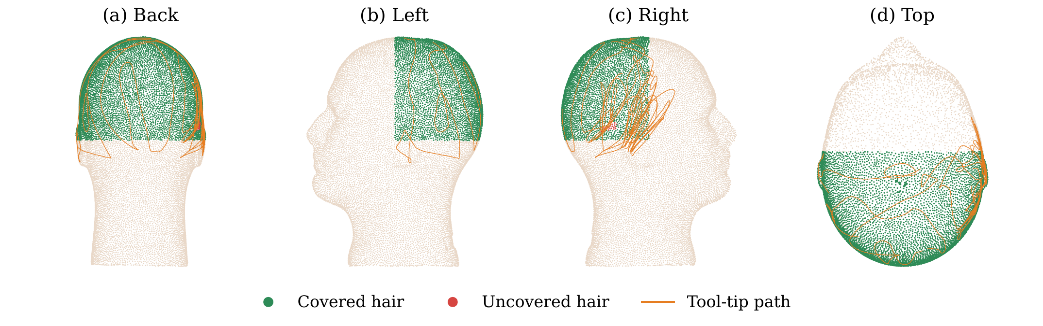
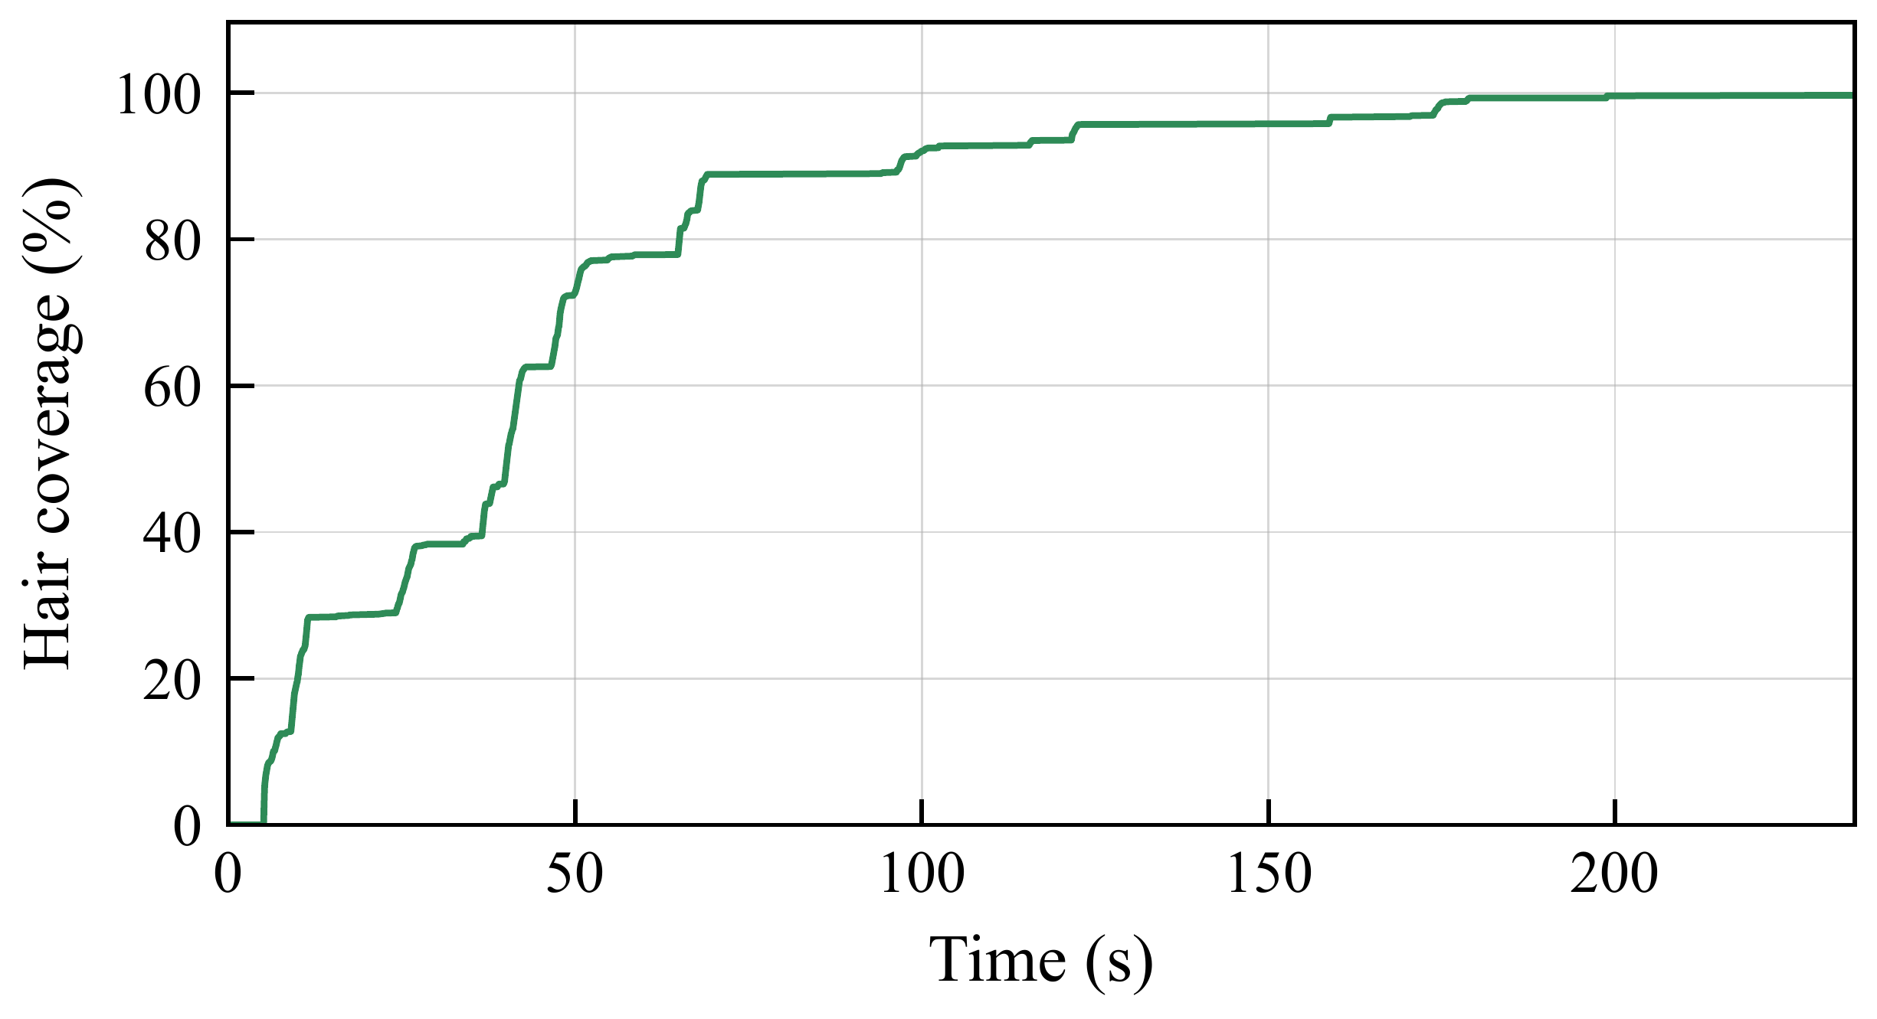
Application 1: Coverage and Computation Time
The tool covers almost the whole modeled hair region, and one step takes well under the sampling interval.
Tool-tip path projected onto the head from four views (green: covered, red: uncovered), α = 1
Cumulative coverage, α = 1
99.7%
0.72 ms
10 ms
final geometric coverage, α = 1 (99.5% for α = 0.2)
mean computation time per instant, both trials
sampling interval at 100 Hz
Notes:
Coverage is measured on the head model: a region counts as covered when it comes within 30 millimeters of the tool tip. The final geometric coverage reaches 99.7 percent for alpha equal to one and 99.5 percent for alpha equal to 0.2. The mean computation time is about 0.7 milliseconds in both trials, much shorter than the sampling interval of 10 milliseconds. So the scheme teleoperates robotic haircutting with heterogeneous arms, and alpha equal to 0.2, with its smoother command and smaller peak errors, is more suitable near the head.

Slide 15
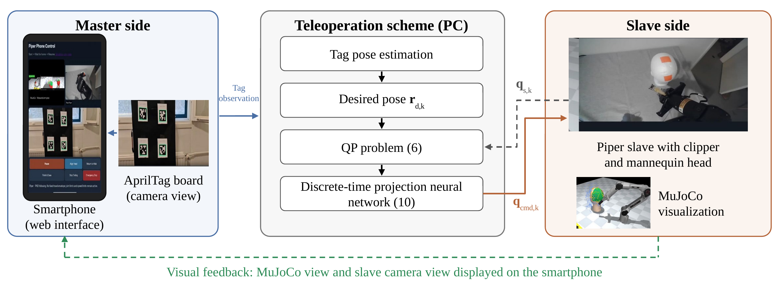
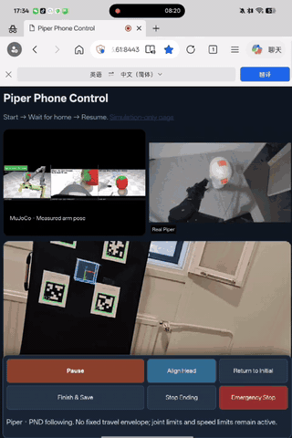
Application 2: Smartphone-Based Teleoperation via Tag
The smartphone camera observes a board with four AprilTags; the estimated pose is the desired pose of the slave.
Schematic of the smartphone mode (paper figure)
829.2 s trial · median sampling interval 24 ms · iterated to convergence at each instant
2x
Smartphone screen: MuJoCo view and camera view of the slave
Notes:
In the second application the master arm is replaced by a smartphone. Its camera observes a board with four AprilTags, and the estimated pose is used as the desired pose of the slave. The same QP and network compute the joint commands. The smartphone also shows the MuJoCo view and the camera view of the slave as visual feedback. In this experiment the network is repeated until convergence at each time instant. The trial lasts 829 seconds with a median sampling interval of 24 milliseconds. The clip of the smartphone screen plays at twice the real speed.

Slide 16
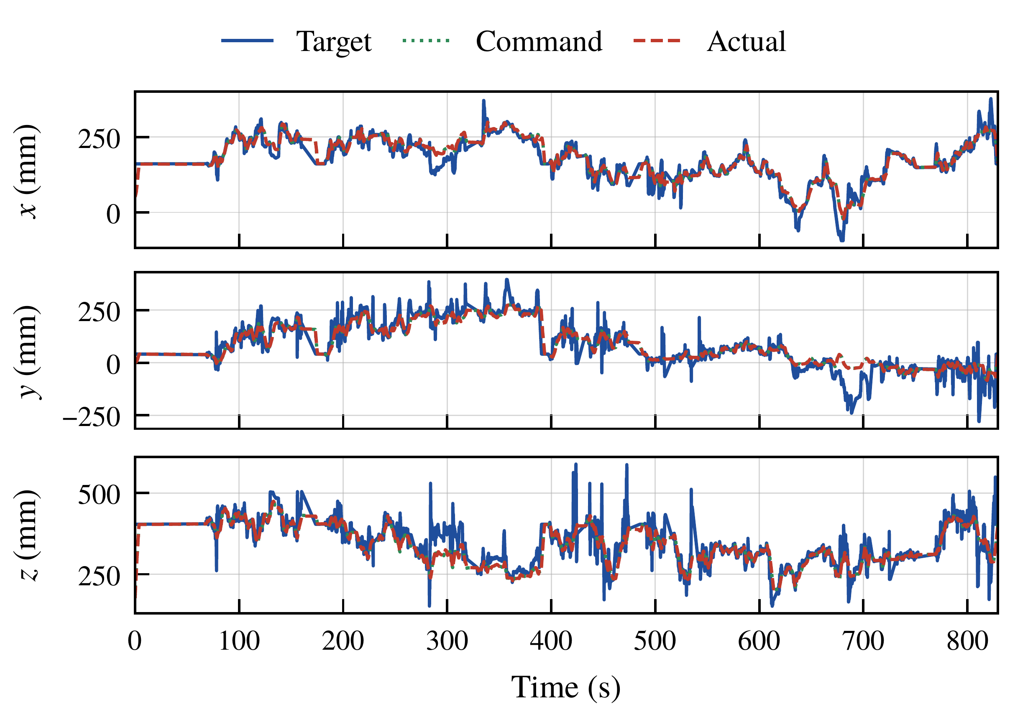
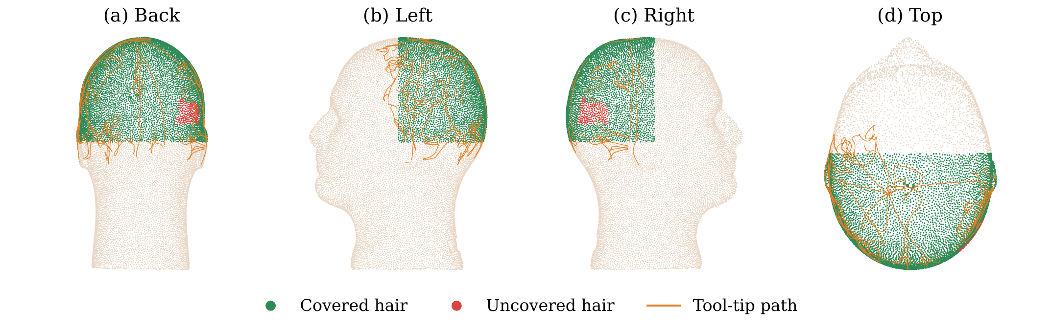
Application 2: Results
Both modes complete the task; the hand-held smartphone gives a noisier desired position.
Quantity | Master arm | Smartphone
Mean position error (mm) | 12.12 | 49.67
Mean orientation error (°) | 9.20 | 4.47
Mean computation time (ms) | 0.72 | 1.88
Geometric coverage (%) | 99.7 | 96.96
Smartphone mode: desired (Target), command-derived and actual positions
Joint-velocity limits smooth the rapid hand motion, which causes short peaks of the position error.
Smartphone mode: tool-tip path on the head (green: covered, red: uncovered)
Notes:
The desired position from the hand-held smartphone contains rapid variations. The slave follows a smoother trajectory because of the joint-velocity limits, which causes short peaks of the position error, so the mean position error is larger than in the master-arm mode. Both modes complete the haircutting task: the smartphone mode reaches 96.96 percent coverage with a mean computation time of 1.88 milliseconds. Joint 5 again often reaches its upper limit; its commanded angle exceeds the limit by at most 0.11 degrees, and only when the measured angle has already overshot it. Hence a low-cost smartphone can take the place of the dedicated master arm.

Slide 17
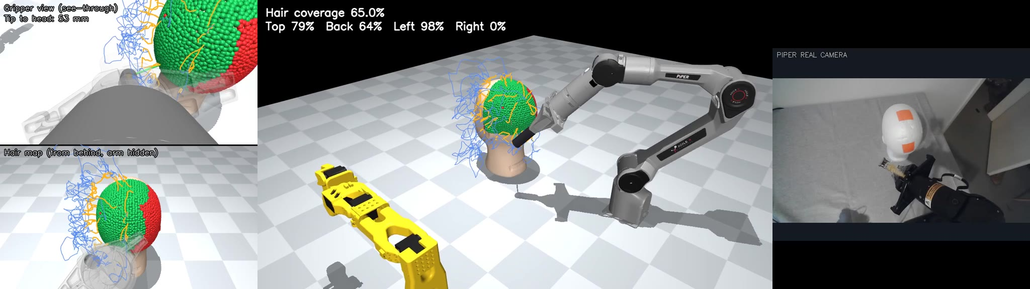
Conclusion
QP-Based Heterogeneous Teleoperation for Robotic Haircutting
an SO101 master with a Piper slave, and a smartphone as a low-cost master
Master-arm mode
Smartphone mode
Thank you
Notes:
The main message: a QP-based scheme realizes heterogeneous teleoperation for robotic haircutting. The slave follows the operator's pose within its joint-angle and joint-velocity limits, with no joint correspondence, and a discrete-time projection neural network solves the QP online. We proved that it converges globally and linearly, and that its output satisfies the joint limits at every time instant even with one iteration. It works with a heterogeneous SO101 and Piper pair and with a low-cost smartphone. Future work includes filtering the pose from the smartphone, evaluation under remote communication, reducing the error caused by joint limits, and evaluating physical haircutting outcomes. Thank you.

