Slide 1
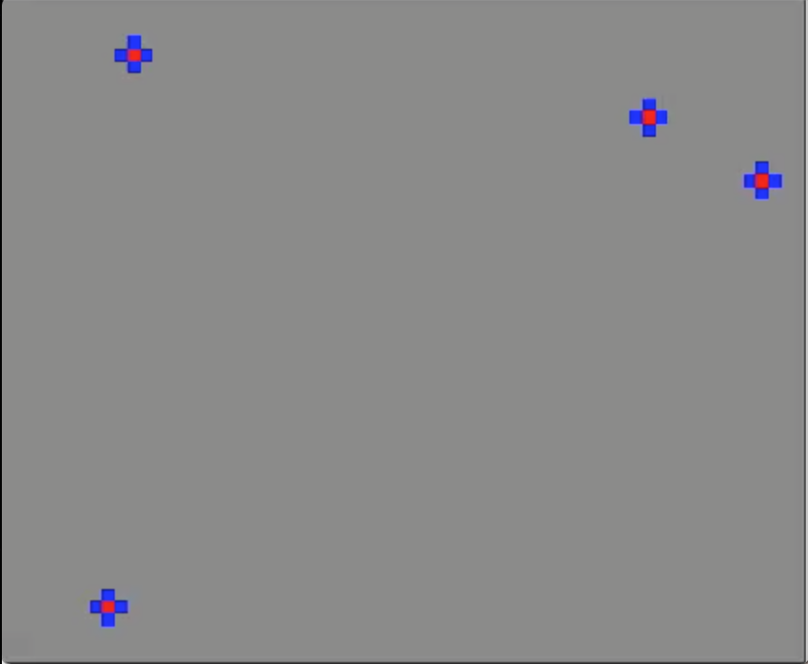
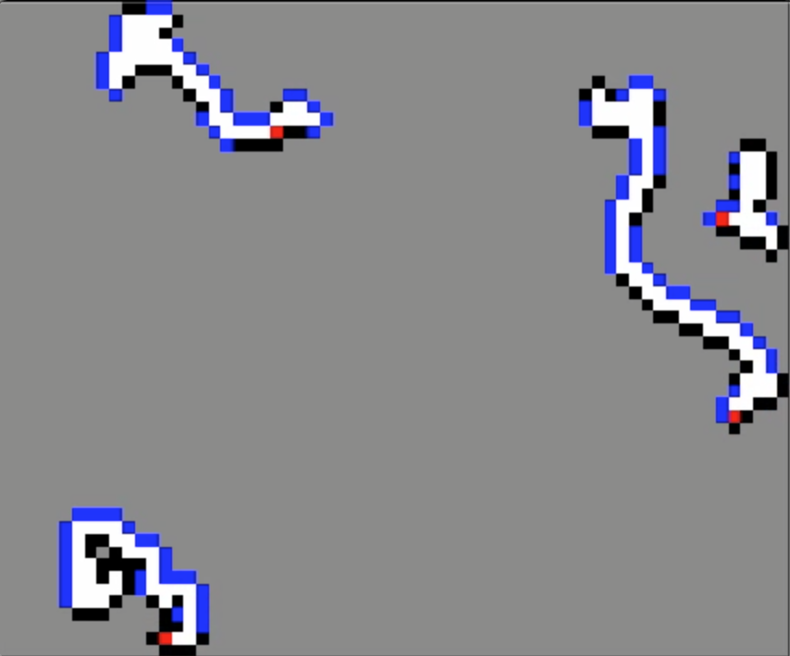
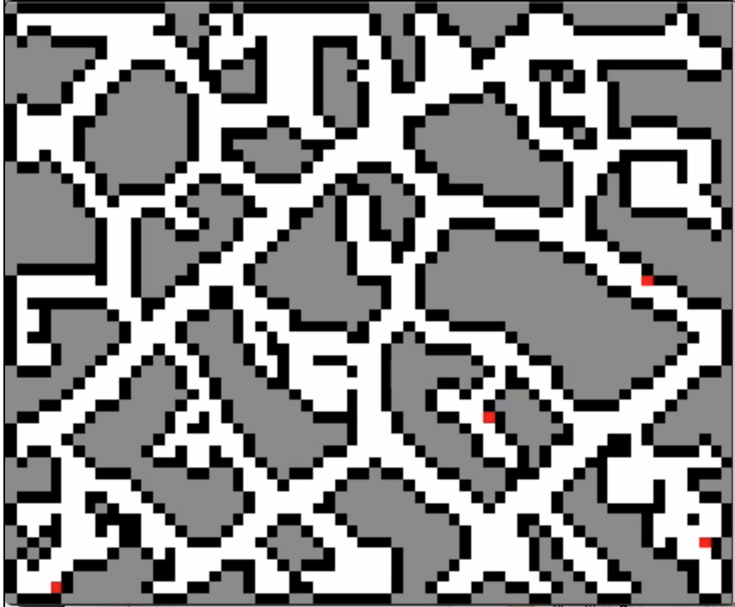
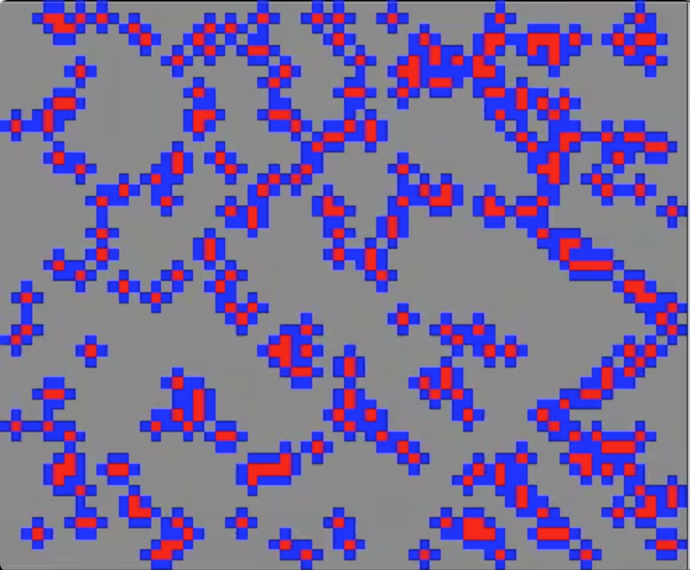
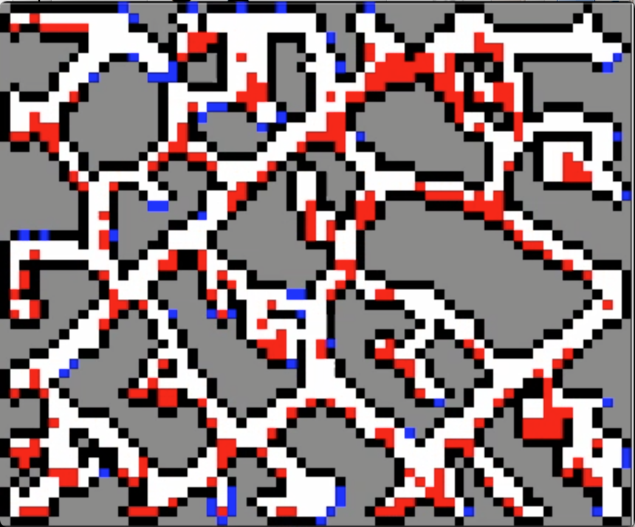
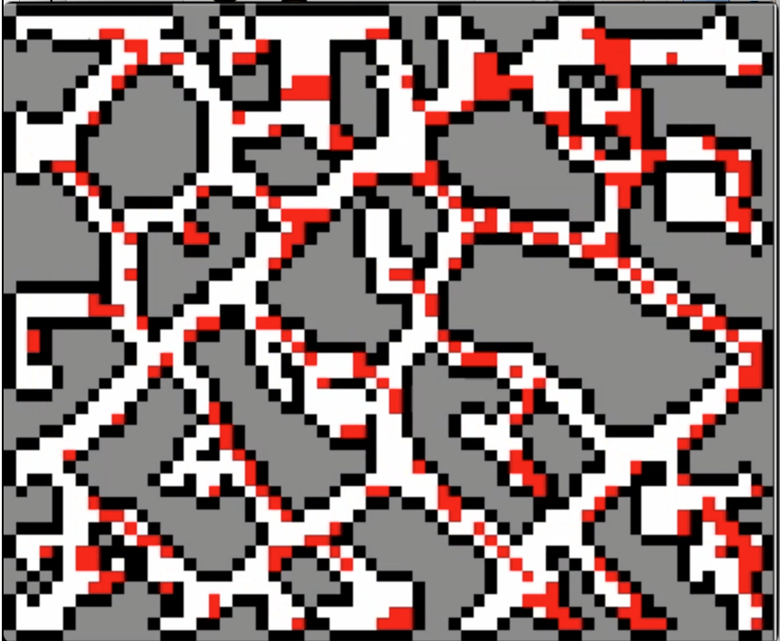
Frontier (blue)
Particle (red)
Free space (White)
Unknown (Grey)
Obstacle (black)
move 0, n=4
move 50, n=4
move 2394, n=4
move 0, n=300
move 50, n=300
move 82, n=300

